Slide 1
Computer Science:
Concepts & Explorations
2nd edition
David Reed, Creighton University
Software Models

Slide 2
Software Models
when studying complex systems (e.g., weather, stock markets, voting), software models provide a fast & cost-effective tool for gaining insights
  computer simulations can be much faster than real-world counterparts
    e.g., can simulate centuries of climate change in seconds
  can be much cheaper to simulate than to study the real-world system
    e.g., can try different investment strategies without risking real money
  can control for parameters that are difficult to obtain reliably in real-world
    e.g., can speculate on how changes in demographics would affect an election
we will consider 2 examples of modeling real-world systems
disease spread
volleyball game
software models always make simplifying assumptions
  must always be careful to examine the model and make sure that the simplifications do not invalidate conclusions drawn from the simulations

Slide 3
Disease Spread
when there is a disease outbreak (e.g., COVID-19), the CDC and other health organizations build software models to
  better understand and warn the public about the disease
  study potential interventions (e.g., social distancing, vaccines)
these models can be very complex, taking into account:
  transmission method, patient incubation period, population density, …
a very simple model uses the basic reproduction number, R₀: the number of people that a patient will infect over the course of their infection
  if R₀ < 1, then each patient infects fewer than 1 other (on average), so the disease will eventually die out
  if R₀ = 1, then each patient infects exactly 1 other (on average), so the disease spreads steadily (known as an endemic)
  if R₀ > 1, then each patient infects more than 1 other (on average), so the disease spreads exponentially (known as an epidemic or pandemic)

Slide 4
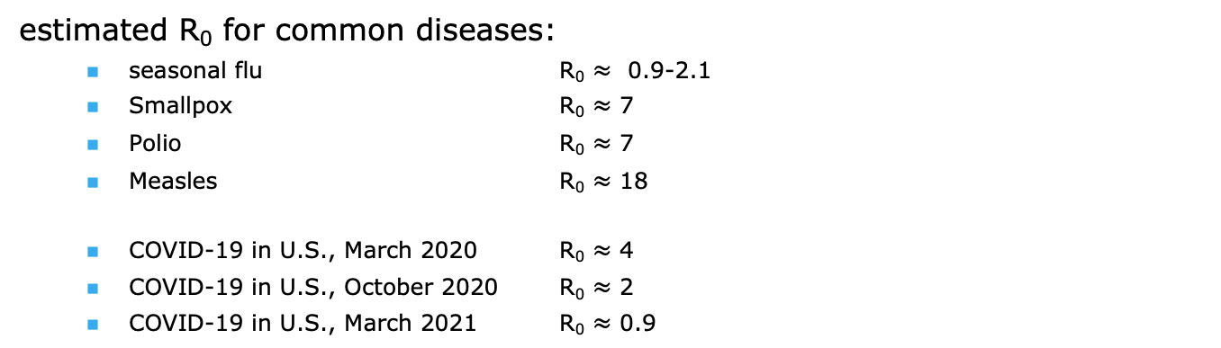
R₀ Example
suppose a disease has R₀ = 2, 100 people infected:
  in 1st wave, those 100 patients infect 200 (2 per person on average)
  in 2nd wave, the 200 patients from wave 1 infect 400
  in 3rd wave, the 400 patients from wave 2 infect 800
  . . .
  in 10th wave, the 51,200 patients from wave 9 infect 102,400
estimated R₀ for common diseases:
  seasonal flu R₀ $≈$ 0.9-2.1
  Smallpox R₀ $≈$ 7
  Polio R₀ $≈$ 7
  Measles R₀ $≈$ 18
  COVID-19 in U.S., March 2020 R₀ $≈$ 4
  COVID-19 in U.S., October 2020 R₀ $≈$ 2
  COVID-19 in U.S., March 2021 R₀ $≈$ 0.9
fortunately, vaccines have been developed for many highly contagious diseases
note: R₀ is not fixed – medical treatments and behavior changes can affect it

Slide 5
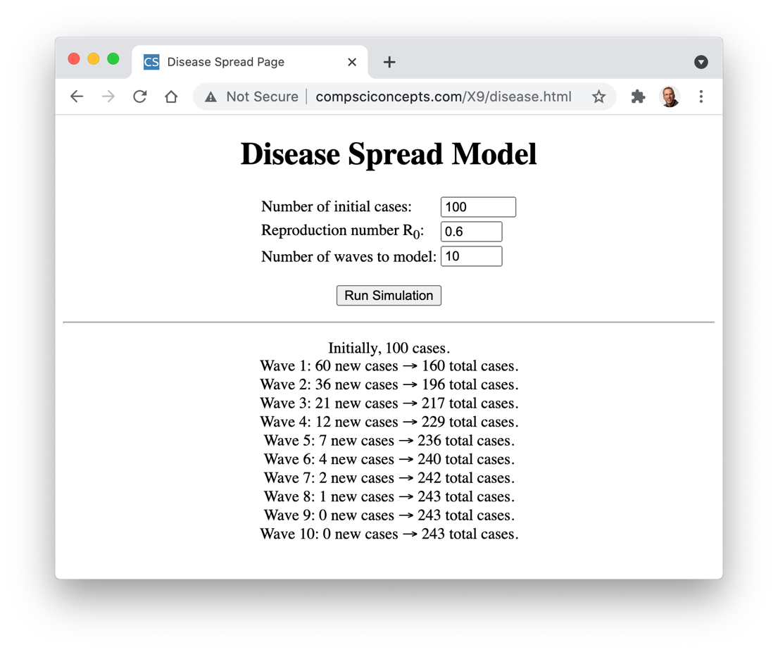
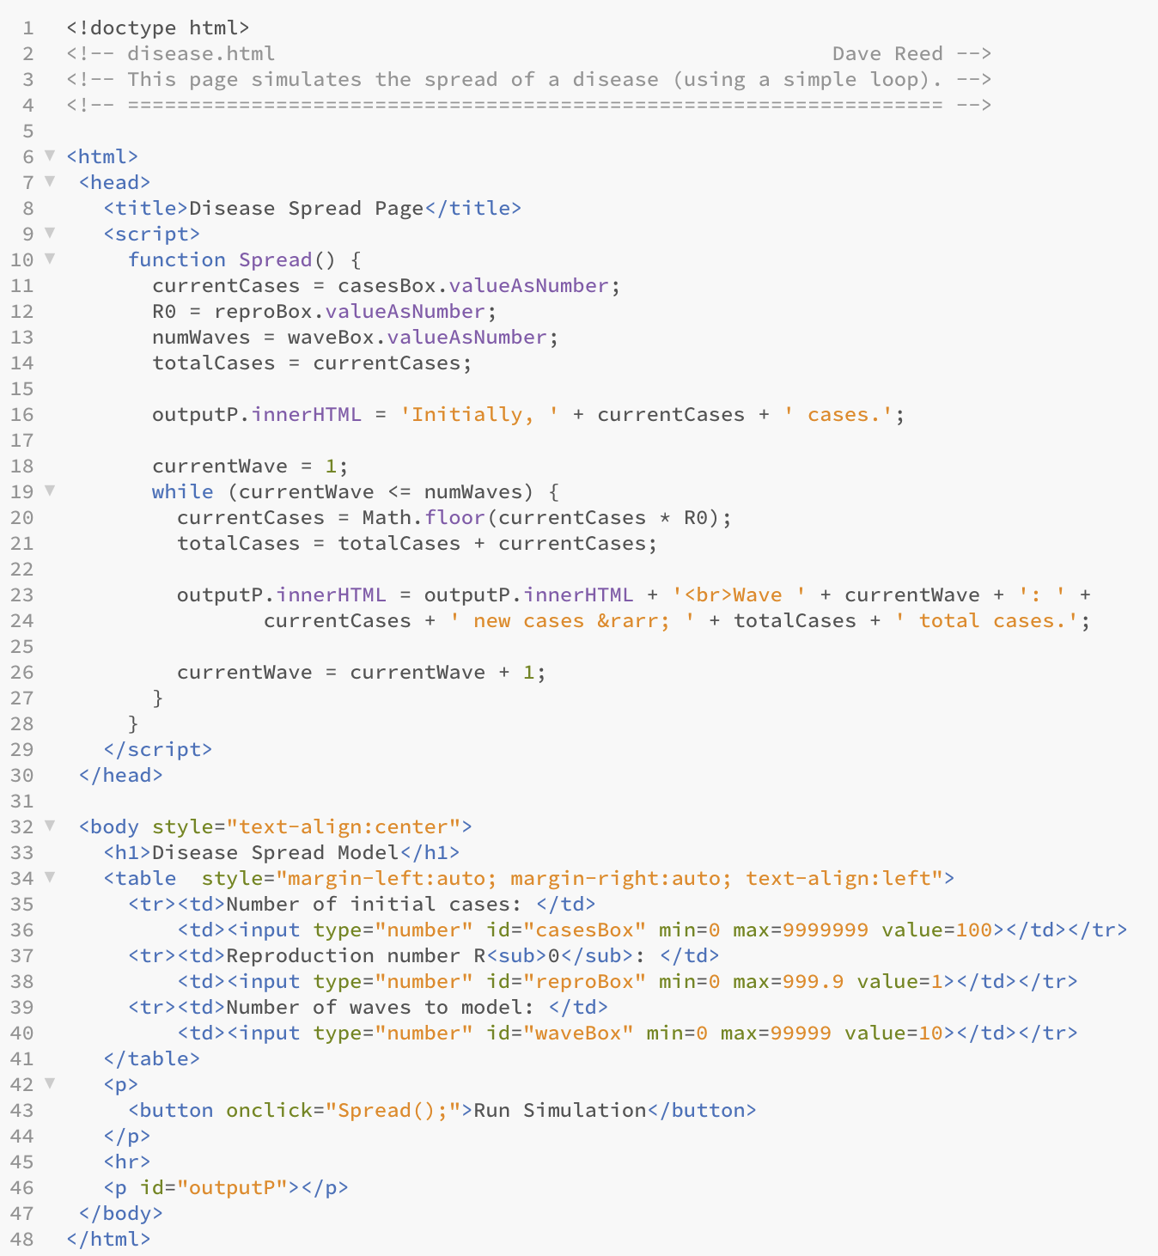
Disease Spread Example
similar to Hailstone & compound interest examples from Ch. X8
currentWave counter controls the loop
currentCases calculates the new cases each wave
totalCases sum keeps track of the total number of cases

Slide 6
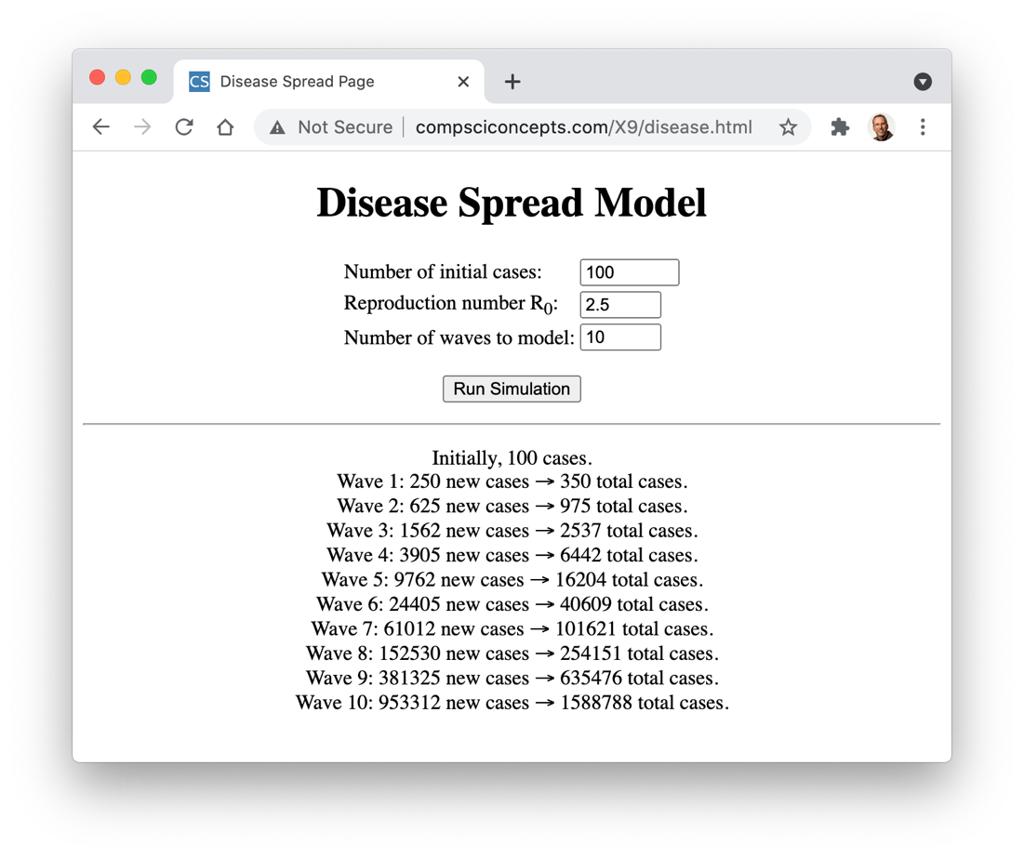


Model Results

Slide 7
Modeling Tradeoffs
advantages:
  CONVENIENCE: software models can be executed anywhere sufficient computer power is available
  SAFETY: since software models run on a computer, they pose no risk to patients or researchers
  SPEED: the speed at which software models can be executed is only limited by the complexity of the model and the processing power of the computer
  CUSTOMIZABILITY: software models are typically built with parameters that can be adjusted to test different conditions
  REPRODUCIBILITY: as they are fast and customizable, software models can be repeated to confirm results and compare outcomes under different conditions
disadvantages:
  OVERSIMPLIFICATION: by their very definition, software models simplify the systems they are modeling, potentially ignoring factors that may be important
  INCORRECTNESS: as with any software system, software models can contain errors that impact the results
  OVERCONFIDENCE: due to flaws in design or implementation, model can produce results that look reasonable but are incorrect or misleading

Slide 8
Nondeterministic Models
the R₀ model of disease spread is deterministic
  it follows rules that unambiguously determine the output
  i.e., same inputs will always produce the same output
many real-world systems are too complex to model deterministically
  instead, they utilize probabilities to capture unpredictable features
  i.e., same input should produce similar but not necessarily identical results
consider a nondeterministic model of disease spread
  each day, an infectious patient has a certain probability of infecting those with whom they come in contact
  allows us to introduce more complex variables: locality & contagious period
  e.g., once infected, a patient will be contagious for 4 days & have 20% probability of infecting those with whom they come in contact

Slide 9
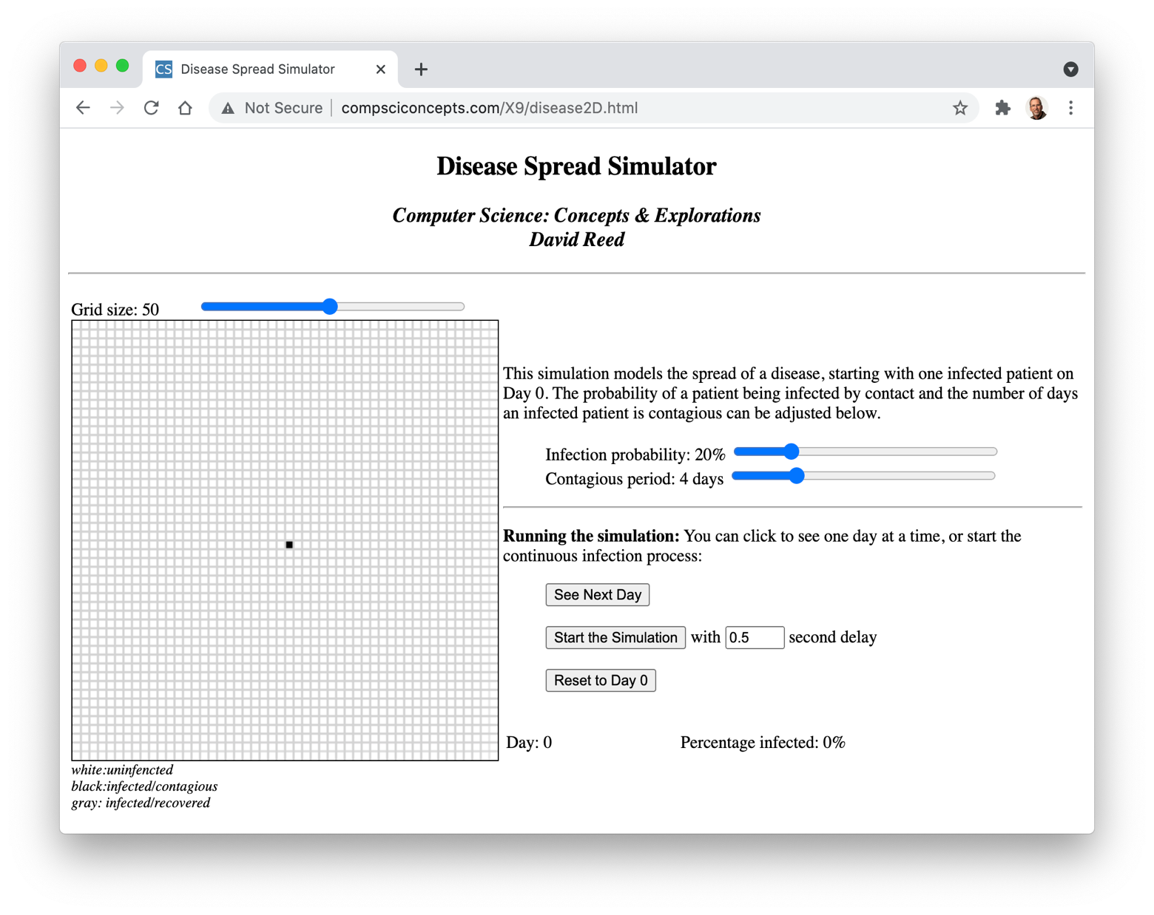
2-D Disease Spread
the user can control
the size of the grid
infection probability
contagious period
initially, there is a single infected person at the center of the grid
can click a button to see:
a single day
a series of days (with delays in between)

Slide 10
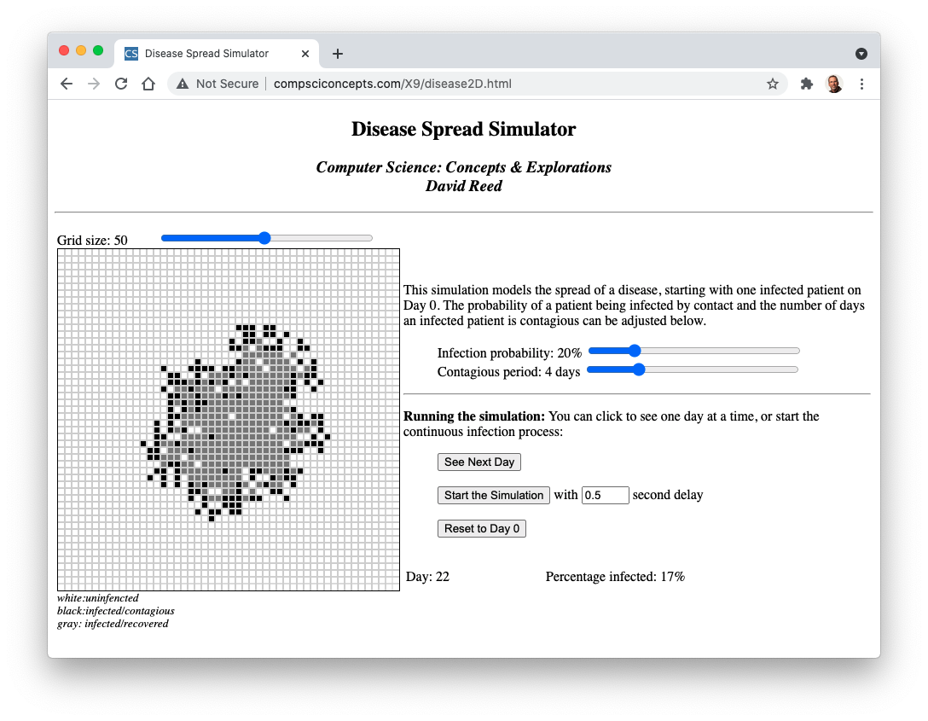
2-D Disease Spread
white square: uninfected person
black square: infect & contagious person
gray square: infected but no longer contagious
the simulation is highly sensitive to changes in the infection rate & contagious period

Slide 11
Volleyball Simulations
in 1998, FIVB switched the scoring system for international volleyball
  old system: sideout scoring – only serving team can win a point
  new system: rally scoring – a point is awarded on every rally
  the goal was to make games more exciting and more consistent in length
in conjunction, they extended games from 15 points to 25 points
  the new game length was intended to maintain competitive balance
  HOW DID THEY DETERMINE THE NEW GAME LENGTH?
for our model:
  assume each team has a ranking (1-100) that quantifies their strength
  by comparing team strengths, can determine the likelihood of winning a rally
    e.g., if team1 is 80 and team2 is 40, team1 twice as likely to win a given rally
  to simulate a game, repeatedly simulate points and keep score
    the game is over when a team reaches 25 points (must win by 2)

Slide 12
Simulation Details
the following is a general layout of the simulation
score1 = 0;
score2 = 0;
while (GAME_NOT_OVER) {
DETERMINE_WINNER_OF_RALLY
if (TEAM1_WON_RALLY) {
score1 = score1 + 1;
}
else {
score2 = score2 + 1;
}
DISPLAY_SCORE
}
need to figure out the loop condition
also need to figure out how to simulate a rally

Slide 13
Simulation Details
if we ignore the win-by-2 rule, the loop test is straightforward
while (score1 < 25 && score2 < 25) {
be careful with loop tests
  they are not stopping conditions, they are continuing conditions
  the game continues as long as both teams are under 25 points
the win-by-2 condition adds another possibility of continuing
  continue if both teams are under 25 points OR within 1 point of each other
while ((score1 < 25 && score2 < 25) ||
(Math.abs(score1-score2) < 2)) {

Slide 14
Simulation Details
to simulate a single rally, we need to pick the winner probabilistically
  if team1 is X% better, they should be X% more likely to win any given rally
  we can simulate this using RandomInt (from the random.js library)
    generate a random integer in the range 1 to (strength1+strength2)
    if that random integer <= strength1, then team1 wins the rally
    otherwise, team2 wins the rally
  e.g., suppose team1 has strength 50 and team2 has strength 50
    if pick a random number in 1…100, it is equally likely to be 1..50 as 51..100
  e.g., suppose team1 has strength 80 and team2 has strength 40
    if pick a random number in 1…120, it is twice as likely to be 1..80 as 81-120

Slide 15
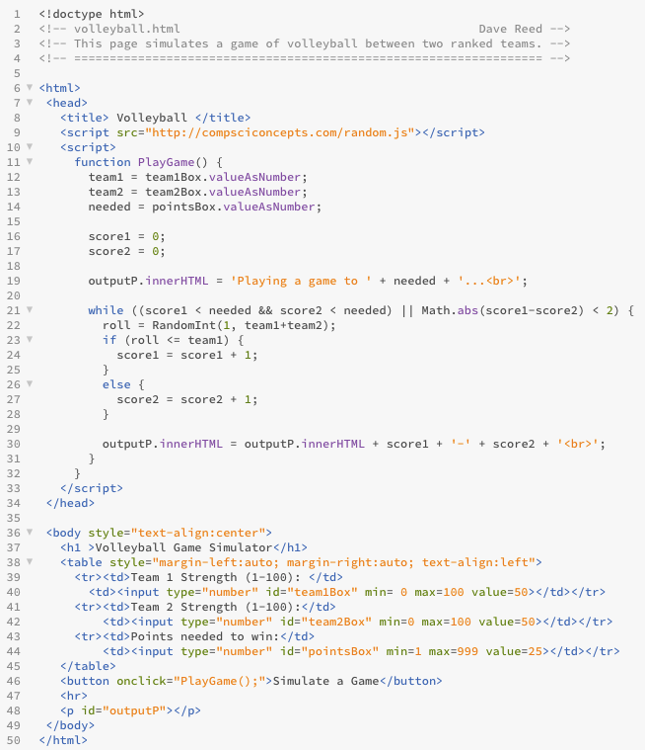
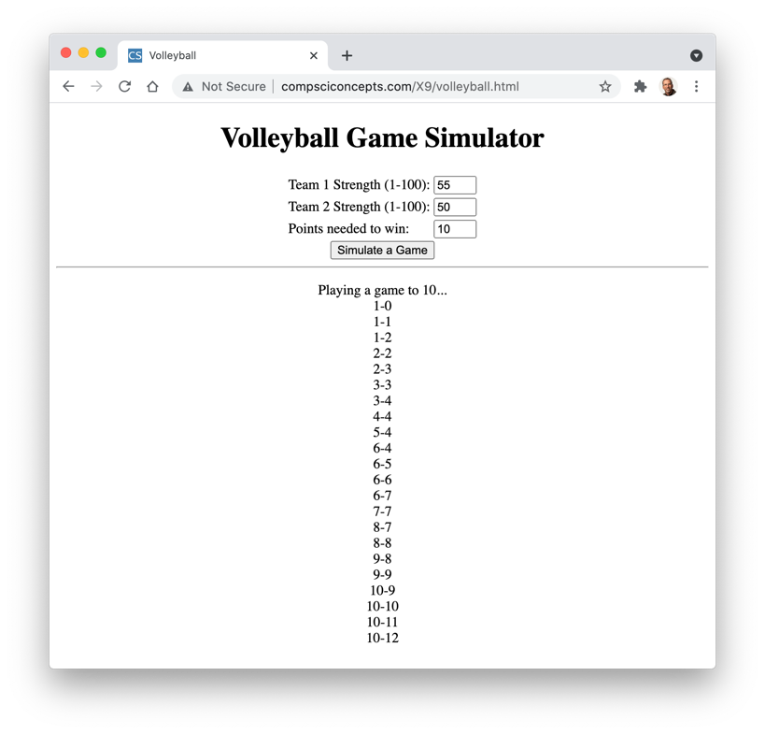
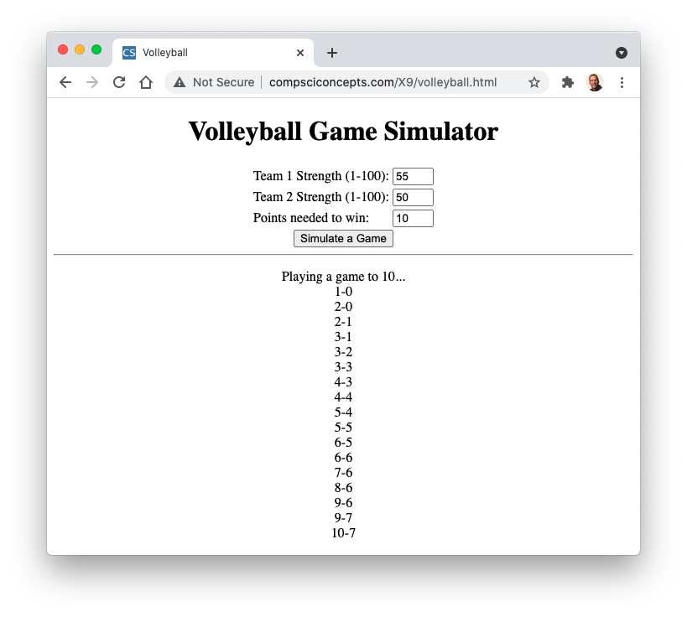
Volleyball

Slide 16
Simulating Many Games
with any nondeterministic model, need to perform a large number of simulations to obtain statistically meaningful results
  with only a small number, lucky/unlucky streaks can greatly skew the results
  e.g., 7 HEADS out of 10 coin flips would not shock you, 700 out of 1,000 should
if we want to simulate thousands of games, we don't need to see point-by-point scores
  similar to roll stats example from Ch. X8, simply keep a counter of wins/losses and display the final result when done
  remove the statements from PlayGame that display the score
  instead, add an if statement at the end of the function that determines the winner and returns either 'team1' or 'team2'
  define a function that simulates a specified number of games (by calling PlayGame inside a loop) and keeps count of wins by team1

Slide 17
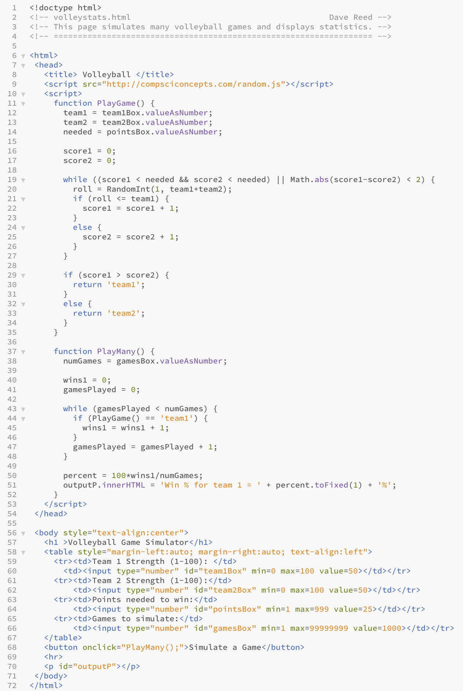
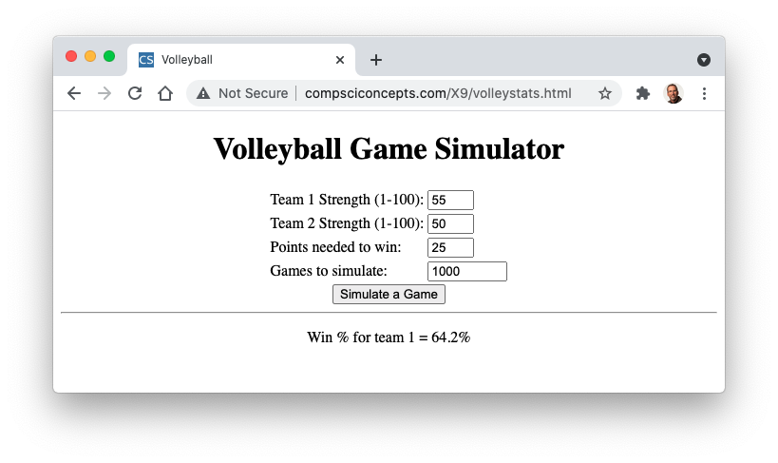

Volleyball

