Slide 1
Computer Science: Concepts & Explorations 2nd edition David Reed, Creighton University
Conditional Repetition

Slide 2
Conditional Repetition
an if statement is known as a control statement
it is used to control the execution of other JavaScript statements
provides for conditional execution
is useful for solving problems that involve choices
either do this or don't, based on some condition (if)
either do this or do that, based on some condition (if-else)
closely related to the concept of conditional execution is conditional repetition
many problems involve repeating some task over and over until a specific condition is met
e.g., rolling dice a set number of times and generating statistics
e.g., calculating compound interest on an investment over years
e.g., simulating successive waves in the spread of a disease
in JavaScript, while loops provide for conditional repetition

Slide 3
While Loops
a while loop resembles an if statement in that its behavior is dependent on a Boolean condition
however, the statements inside a while loop’s curly braces (a.k.a. the loop body) are executed repeatedly as long as the condition remains true
general form:
while (BOOLEAN_TEST) {
STATEMENTS_EXECUTED_AS_LONG_AS_TRUE
}
when the browser encounters a while loop, it first evaluates the Boolean test
if the test succeeds, then the statements inside the loop are executed in order, just like an if statement
once all the statements have been executed, program control returns to the beginning of the loop
the loop test is evaluated again, and if it succeeds, the loop body statements are executed again
this process repeats until the Boolean test fails

Slide 4
While Loop Example
example: suppose we want to display a countdown (from 10 down to 1)
count = 10;
while (count > 0) {
alert(count);
count = count – 1;
}
alert('BLASTOFF!');
before the loop begins:
count = 10
try the test: since 10 > 0, the statements are executed:
alert window displays 10; count = 10 – 1 = 9
repeat the test: since 9 > 0, the statements are again executed:
alert window displays 9; count = 9 – 1 = 8
repeat the test: since 8 > 0, the statements are again executed:
alert window displays 8; count = 8 – 1 = 7
. . .
repeat the test: since 1 > 0, the statements are again executed:
alert window displays 1; count = 1 – 1 = 0
repeat the test: since 0 ≯ 0, the loop terminates:
alert window displays BLASTOFF!
Notes:
1<br>

Slide 5
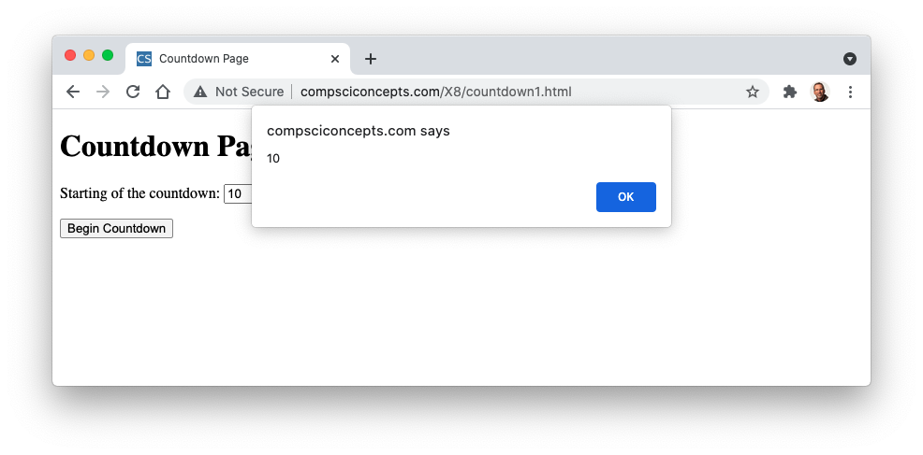
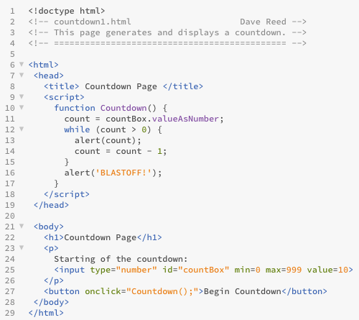

Countdown (v. 1)
this works, but tedious since the user must close each alert window

Slide 6
Another Example
similarly, suppose we want to repeatedly flip a coin until get HEADS
can simulate a flip by calling the RandomOneOf function from random.js
flip = RandomOneOf(['HEADS', 'TAILS']);
while (flip != 'HEADS') {
alert(flip);
flip = RandomOneOf(['HEADS', 'TAILS']);
}
alert(flip);
why is the final alert statement there?
without it, the last flip will not be displayed
suppose the first flip is HEADS
then while test fails and the code inside the loop is never executed
without the final alert statement, nothing would be displayed

Slide 7
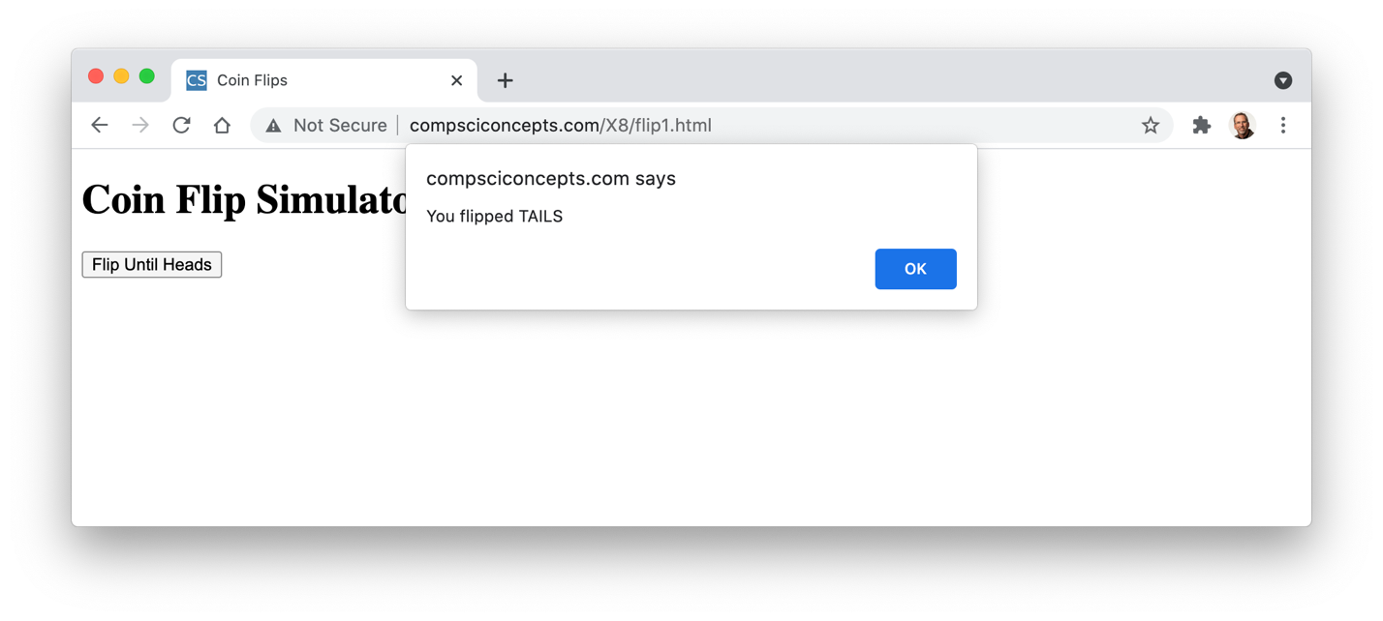
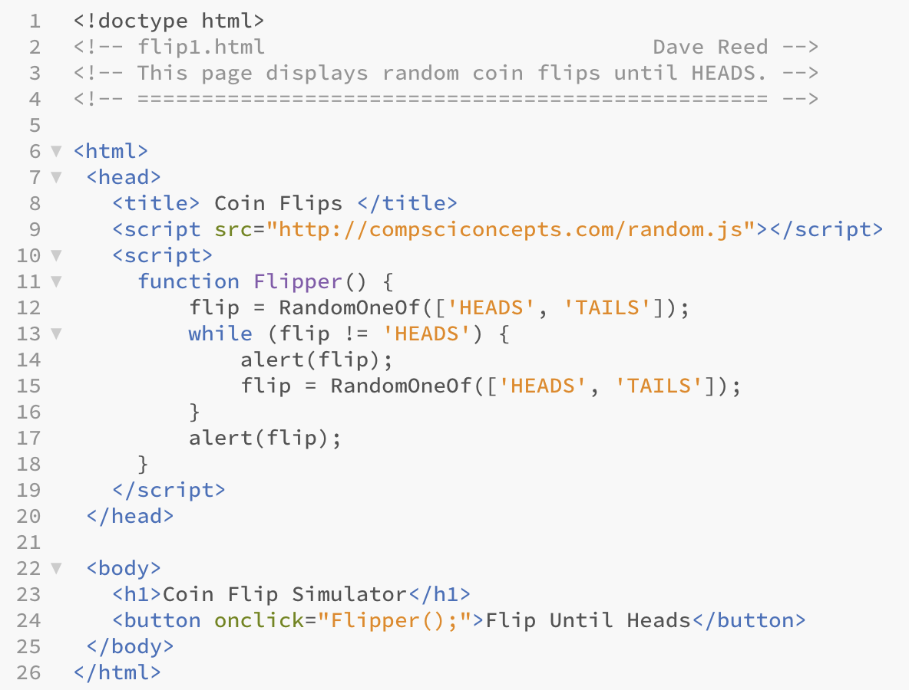
Flips (v. 1)
again, tedious since the user must close each alert window

Slide 8
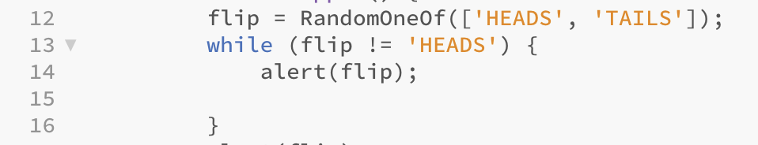
Infinite Loops
the browser will repeatedly execute statements in the body of a while loop
as long as the loop test succeeds (evaluates to true)
it is possible that the test will always succeed and the loop will run forever
e.g., suppose the line that updates the flip is accidentally removed
a loop that runs forever is known as an infinite loop
to guard against infinite loops, make sure that some part of the loop test changes inside the loop
in the above example, flip is not updated in the loop so there is no chance of terminating once the loop starts
an infinite loop may freeze up the browser
sometimes, clicking the Stop button will suffice to interrupt the browser
other times, you may need to restart the browser

Slide 9
Variables as Counters
Chapter X6 introduced the concept of a counter
there, the contents of a span element were used to keep count of some event (e.g., dice roll)
variables can also serve as counters
variable counters are common with while loops
want to keep track of how often something occurs, but not see the results until the end
e.g., flips page
what is the point of displaying the flips?
could just simulate them all and display the number needed to get HEADS
use a variable to keep the count
flip = RandomOneOf(['HEADS', 'TAILS']);
numFlips = 1;
while (flip != 'HEADS') {
flip = RandomOneOf(['HEADS', 'TAILS']);
numFlips = numFlips + 1;
}
when loop terminates, numFlips will be the number of flips made

Slide 10
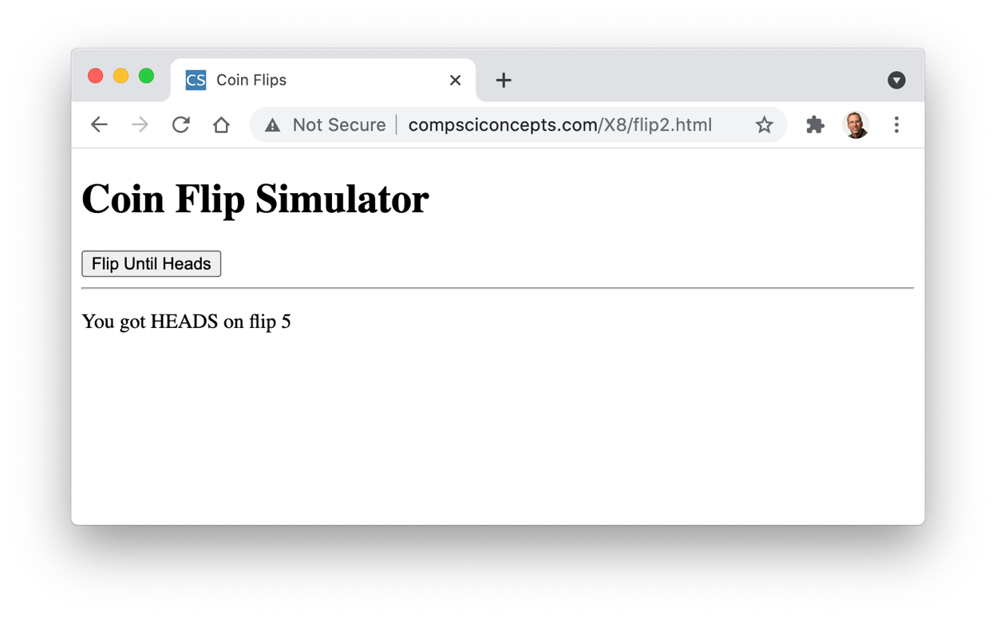
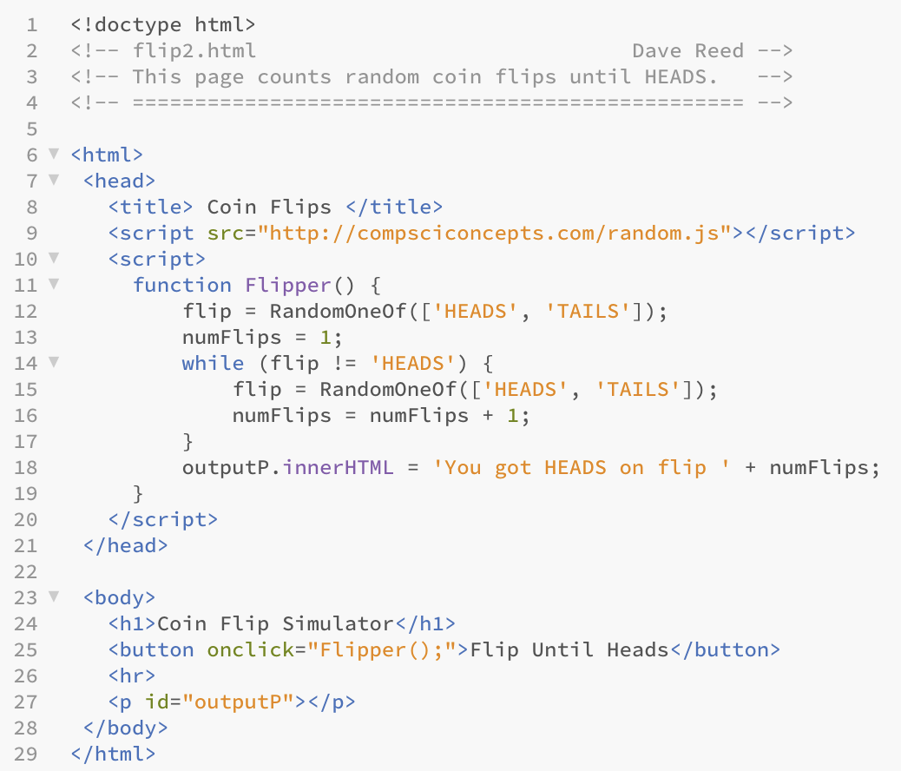
Flips (v. 2)
this is a more convenient way of showing the flip results
if got HEADS on flip 5, then know the first 4 were TAILS

Slide 11
Another Example
Chapter X7 had several pages for simulating dice rolls and keeping stats
each roll required the user to click a button
if we wanted to simulate hundreds or thousands of rolls, that would be tedious!
a while loop can automate as many rolls as we want, very quickly
we don't want to see the dice or the counts change on each roll – too slow
instead, can use variables to keep track of counts, only display results at the end
numRolls = 0
while (numRolls < desiredRolls) {
roll1 = RandomInt(1, 6);
roll2 = RandomInt(1, 6);
numRolls = numRolls + 1;
CODE_FOR_KEEPING_STATS
}
CODE_FOR_DISPLAYING_STATS

Slide 12
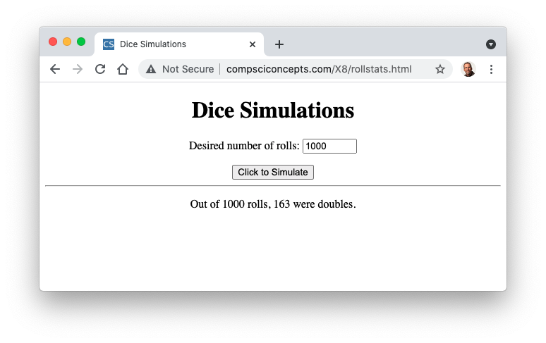
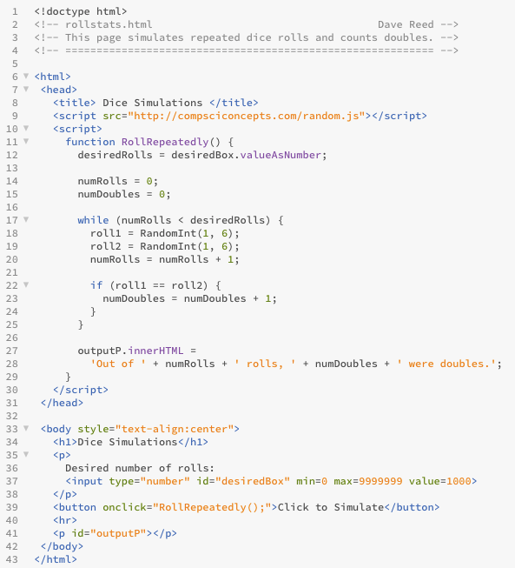
Rollstats
loop until the number of rolls reaches the desired number
each time through the loop:
simulate a roll
add to the numRolls
if rolled doubles, then add to the numDoubles

Slide 13
Cumulative Output
sometimes, we would like to loop and repeatedly add text to a page
e.g., for countdown, display each descending number in a paragraph
count = 10;
while (count > 0) {
outputP.innerHTML = count; // DOES NOT WORK!
count = count – 1;
}
outputP.innerHTML = 'BLASTOFF!';
problem: each assignment to the paragraph overwrites the previous contents
instead, need to concatenate the new contents to the old (with <br> tag to break lines)
count = 10;
while (count > 0) {
outputP.innerHTML = outputP.innerHTML + '<br>' + count; // WORKS!
count = count – 1;
}
outputP.innerHTML = 'BLASTOFF!';

Slide 14
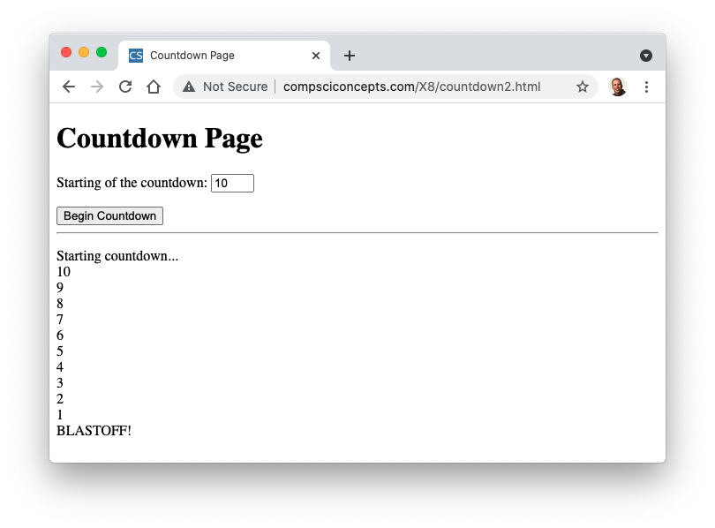
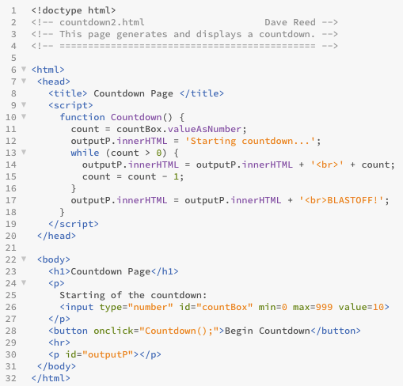
Countdown (v. 2)
outputP.innerHTML is assigned:
'Starting countdown…'
'Starting countdown…<br>10'
'Starting countdown…<br>10<br>9'
.
.
.
'Starting_countdown…<br>10<br>9<br>8<br>7<br>6<br>5<br>4<br>3<br>2<br>1<br>BLASTOFF!'

Slide 15
Hailstone Sequence
an interesting unsolved problem in mathematics concerns what is called the Hailstone Sequence
Start with any positive integer.
If that number is odd, then multiply it by 3 and add 1; otherwise, divide it by 2.
Repeat as many times as desired.
e.g., Hailstone sequence starting at 5:
5 → 16 → 8 → 4 → 2 → 1 → 4 → 2 → 1 → …
e.g., Hailstone sequence starting at 35:
35 → 106 → 53 → 160 → 80 → 40 → 20 → 10 → 5 → 16 → 8 → 4 → 2 → 1 → …
it is conjectured that no matter what number you start with, the sequence will always end up in the 4 → 2 → 1 loop
it has been proven to hold for all starting values up to 87 x 10⁶⁰
but still not proven to hold for all numbers

Slide 16
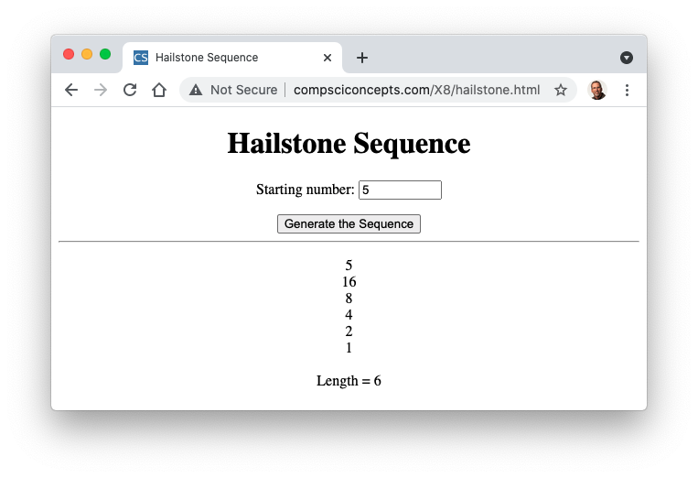
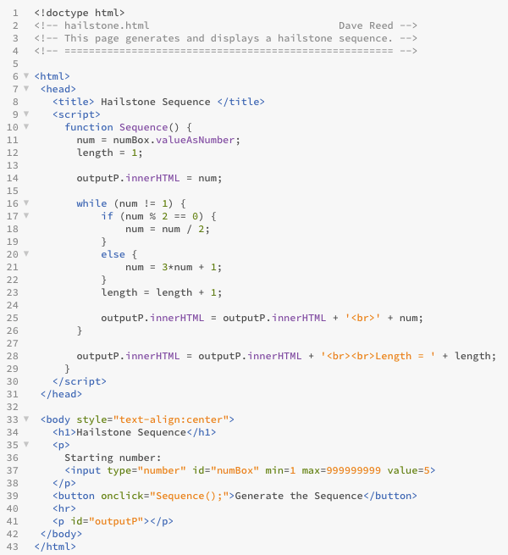
Hailstone
num is initialized to the number entered in the box
loops until num becomes 1
updates the value of num depending on odd or even
note: % is the remainder operator
keeps a counter to determine the length of the sequence

Slide 17
Variables as Sums
Chapter X5 included an example that calculated compound interest based on a closed formula:
total = amount * (1 + rate/100)^{years}
alternatively, we could use a loop to calculate and display the amount earned after each year
total = 100;
while (total < 200) {
interest = total*(4/100);
total = total + interest;
outputP.innerHTML = outputP.innerHTML + '<br>' + total;
}
here, the variable total maintains the sum of the money earned each year
a sum is similar to a counter in that both are initialized and added to repeatedly
the difference is that a counter goes up by 1, while a sum can change by any amount

Slide 18
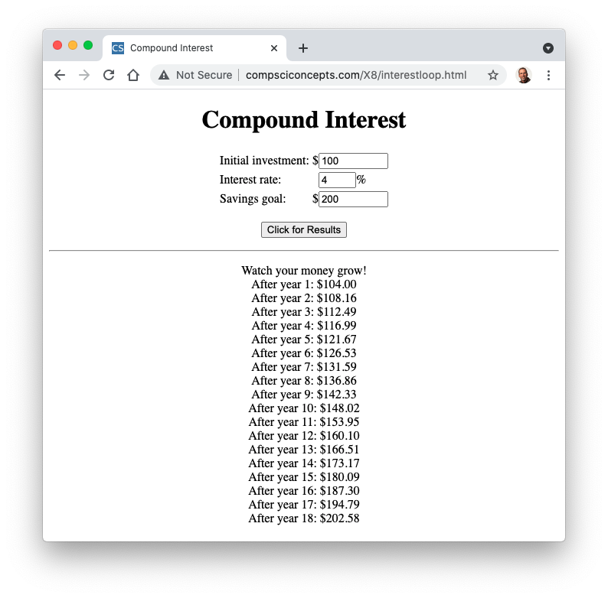
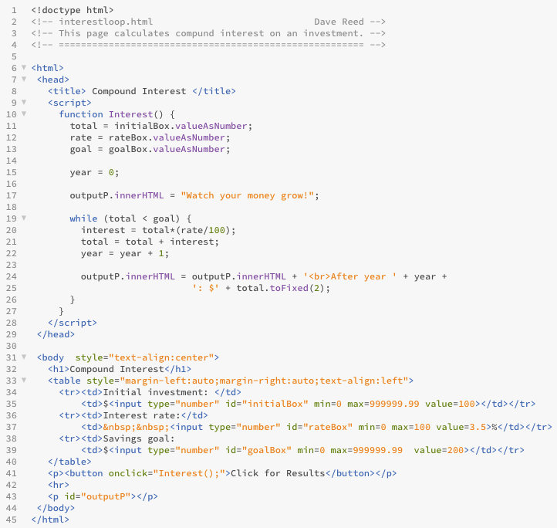
Compound Interest Example
year is a counter that controls the loop
total is a sum that keeps track of the money earned

