Slide 1
Computer Science: Concepts & Explorations 2nd edition David Reed, Creighton University
Conditional Execution

Slide 2
Conditional Execution
so far, all of the code you have written has been unconditionally executed
the browser carried out statements in the same set order
in contrast, many programming tasks require code that reacts differently under varying circumstances or conditions
e.g., a student's course grade depends upon his/her average
e.g., an ESP test requires recognizing when a subject guessed right
e.g., the outcome of a game depends upon die rolls or player moves
conditional execution refers to a program’s ability to execute a statement or sequence of statements only if some condition holds true

Slide 3
If Statements
in JavaScript, the simplest form of conditional statement is the if statement
one action is taken if some condition is true, but a different action is taken if the condition is not true (called the else case)
the else case is optional
general form of the if statement:
if (BOOLEAN_TEST) {
STATEMENTS_EXECUTED_IF_TRUE
}
else {
STATEMENTS_EXECUTED_IF_FALSE
}
note: indentation is not required, but it is STRONGLY RECOMMENDED to make an if statement readable

Slide 4
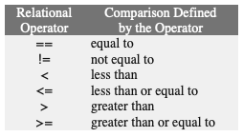
Boolean Tests
the test that controls an if statement can be any Boolean expression (i.e., an expression that evaluates to either true or false)
Boolean tests are formed using relational operators because they test the relationships between values
NOTE:
== is for comparisons
= is for assignments
the Boolean test in an if statement determines the code that will be executed
if the test succeeds (evaluate to true), then the code inside the subsequent curly braces will execute
if the test fails (evaluates to false), then the code inside the curly braces following the else will execute
note that if the test fails and there is no else case, the program moves on to the statement directly after the if

Slide 5
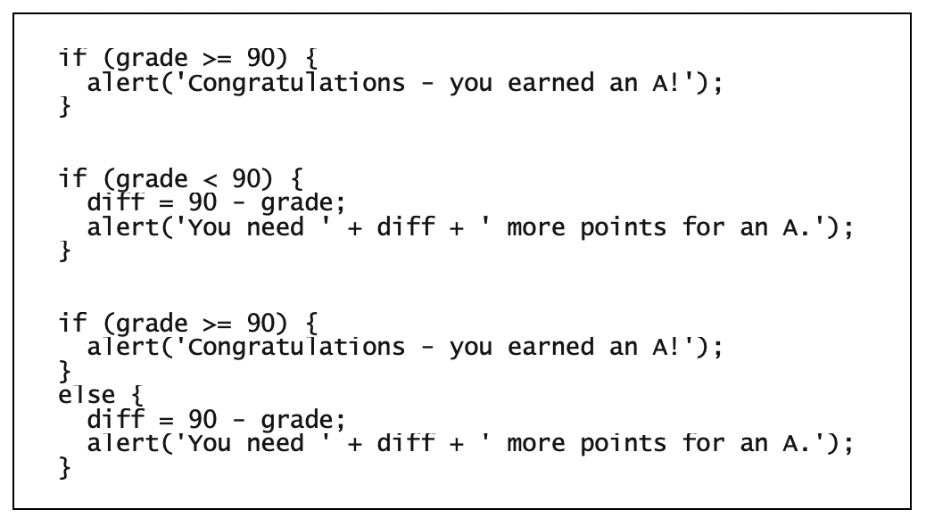
If Statement Examples
an if statement is known as a control statement, since its purpose is to control the execution of other statements

Slide 6
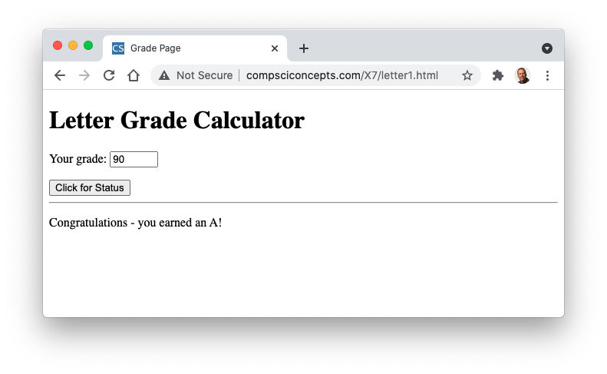
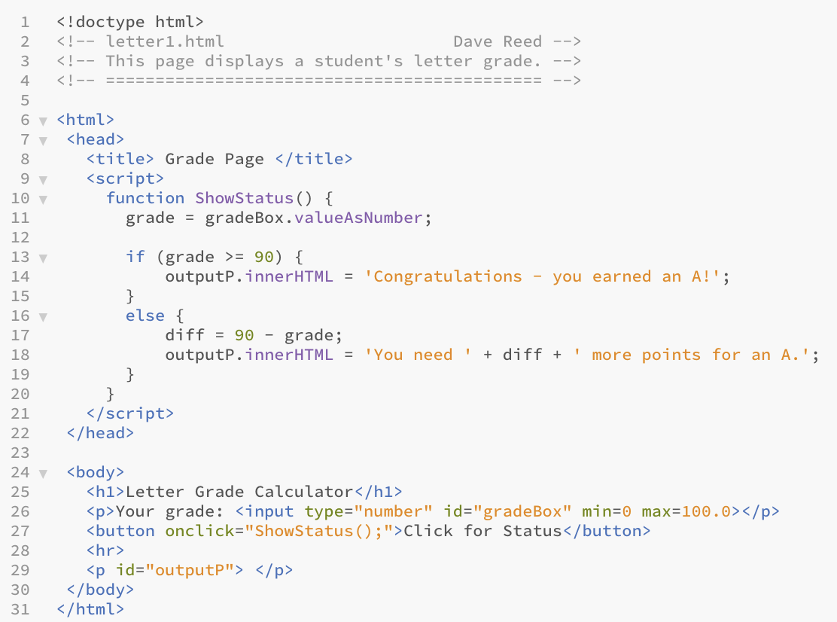

Letter Grade Page
since else case is present, it will display one message or the other

Slide 7
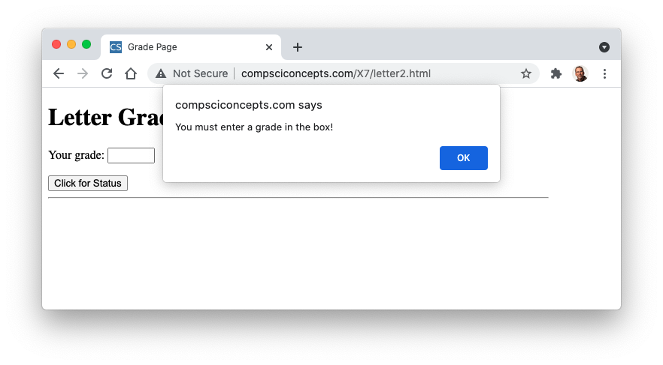
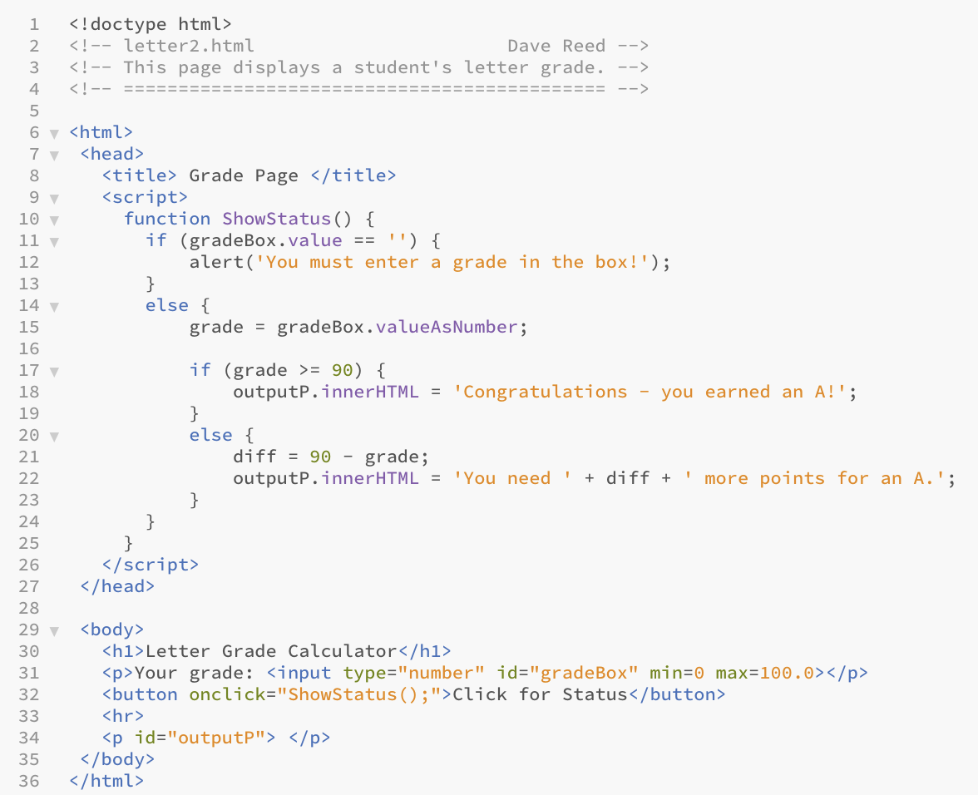
Input Verification
common use of if statement:
verify that user input has been entered
warn the user if not
here, an if statement checks to see if number box is empty (i.e., its value attribute is '')
if empty, displays an alert warning
if not, calculates & displays letter grade as before
note: an if statement can be nested inside another if statement

Slide 8
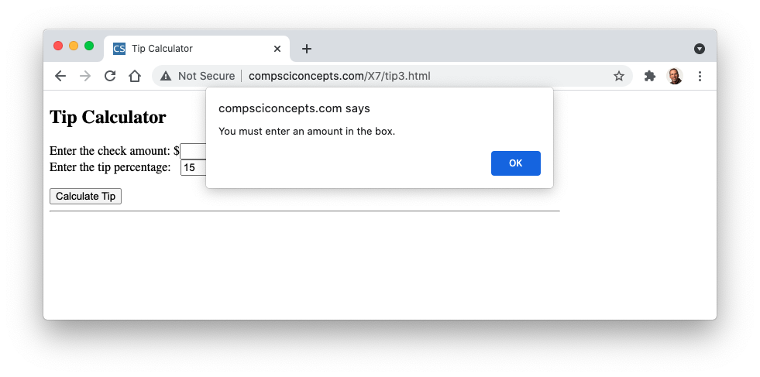
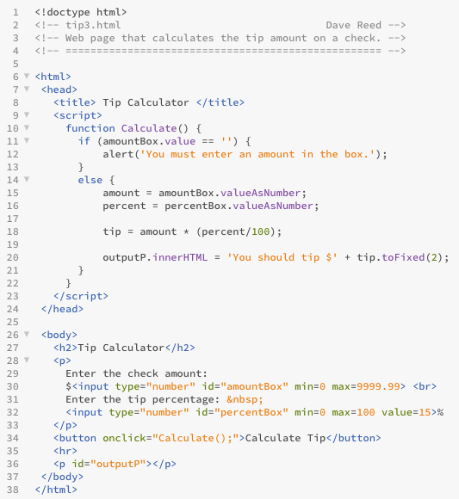
Input Verification
similarly, could add an if statement to the tip calculator to make sure the user entered a check amount
what about the tip percent?

Slide 9
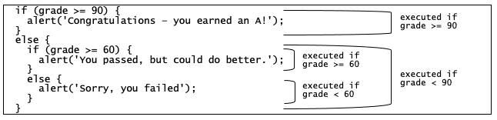
Cascading If-Else
programming tasks often require code that responds to more than one condition
this can be accomplished by nesting one if statement inside of another
example: three different grade levels
A-level (grade ≥ 90), passing (60 ≤ grade < 90), failing (grade < 60)
the outer if-else distinguishes A from non-A grades
the nested if-else further separates non-A grades into passing and failing

Slide 10
Cascading If-else Structure
nested if-else statements are known as cascading if-else structures because control cascades down the branches
the topmost level is evaluated first
if the test succeeds, then the corresponding statements are executed and control moves to the next statement following the cascading if-else structure
if the test fails, then control cascades down to the next if test
in general, control cascades down the structure from one test to another until one succeeds or the end of the statement is reached

Slide 11
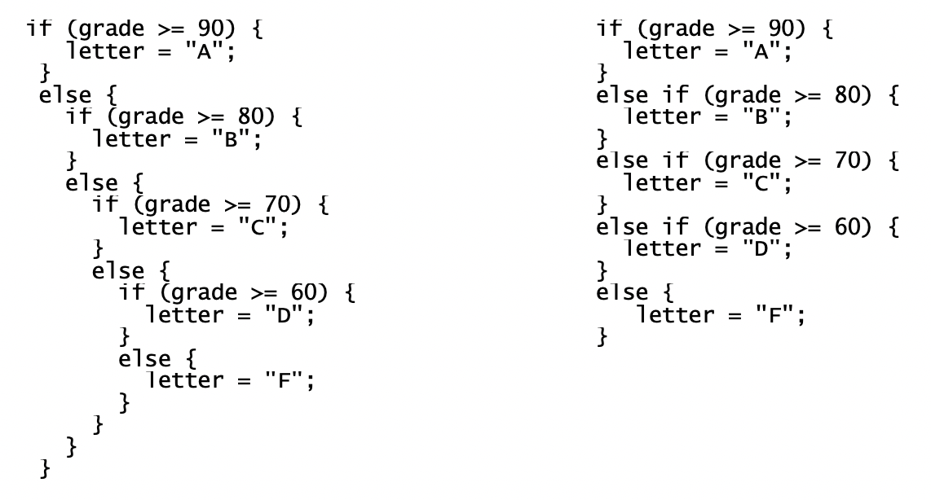
A Cleaner Notation
when it is necessary to handle a large number of alternatives, nested if-else structures can become unwieldy
multiple levels of indentation and curly braces cause the code to look cluttered make it harder to read/understand
can simplify by removing some unnecessary curly braces & aligning each case to the left
nested if statements vs. more readable if-else

Slide 12
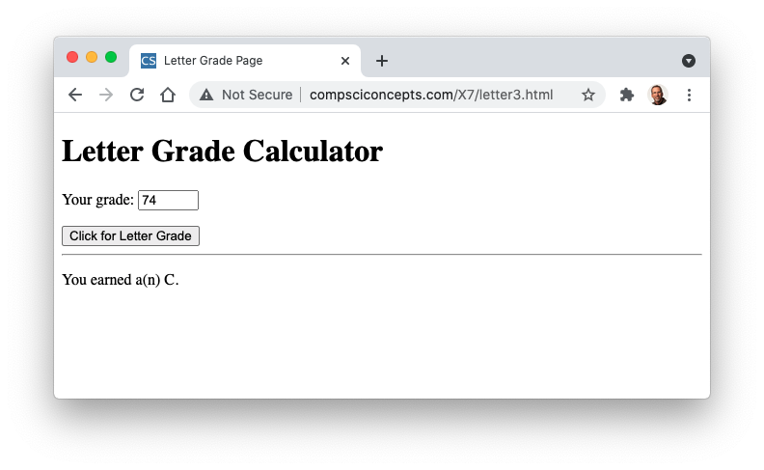
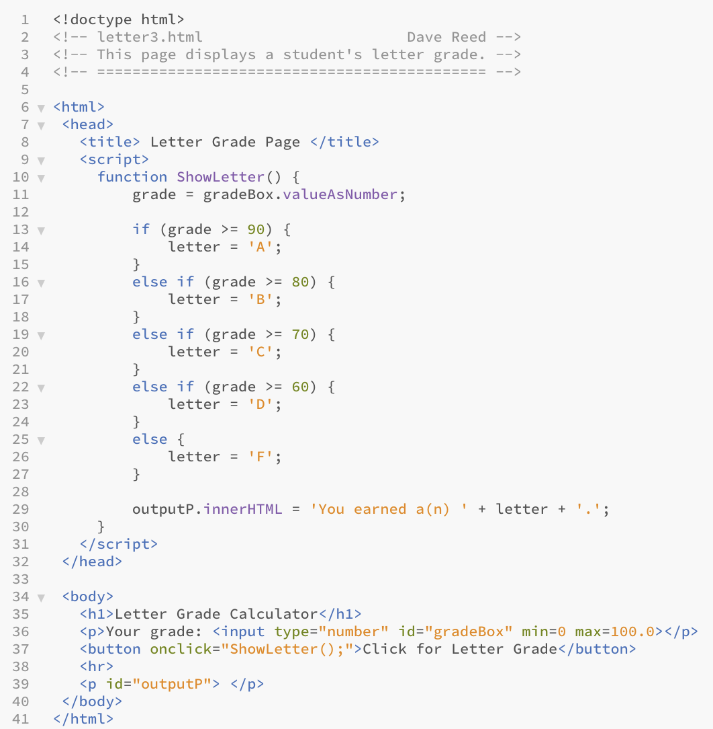
Letter Grade (cont.)
as before, the student's average is entered in a number box
the cascading if-else structure determines the corresponding letter grade

Slide 13
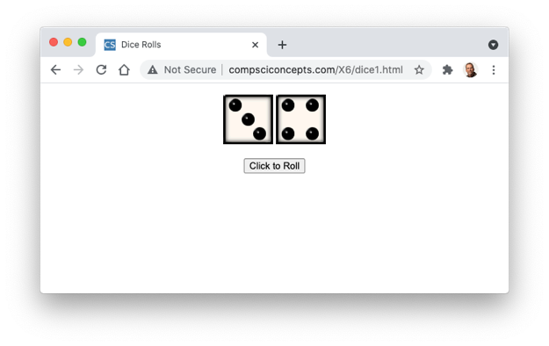
Embedded Counters
recall the dice pages from Chapter X6
suppose we wanted to keep a count of the number of rolls
we could use a span element to store the count (initially 0)
Number of rolls: <span id="rollSpan">0</span>.
for each roll, access the count, add 1, and reassign
rollSpan.innerHTML = rollSpan.innerHTML + 1; // DOES NOT WORK
problem: innerHTML always evaluates to a string
rollSpan.innerHTML + 1 = '0' + 1 = '0' + '1' = '01' (see Ch. X5)
we avoided this problem with number boxes using valueAsNumber
unfortunately, there is no equivalent attribute for a span
fortunately, there is a function that will convert a string into its equivalent number value
rollSpan.innerHTML = Number(rollSpan.innerHTML) + 1; // THIS WORKS!

Slide 14
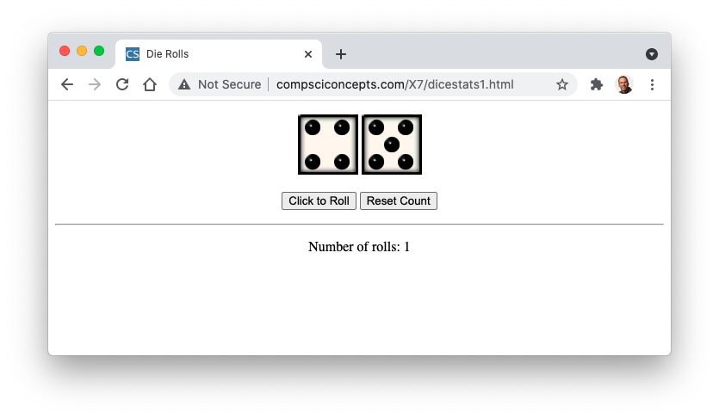
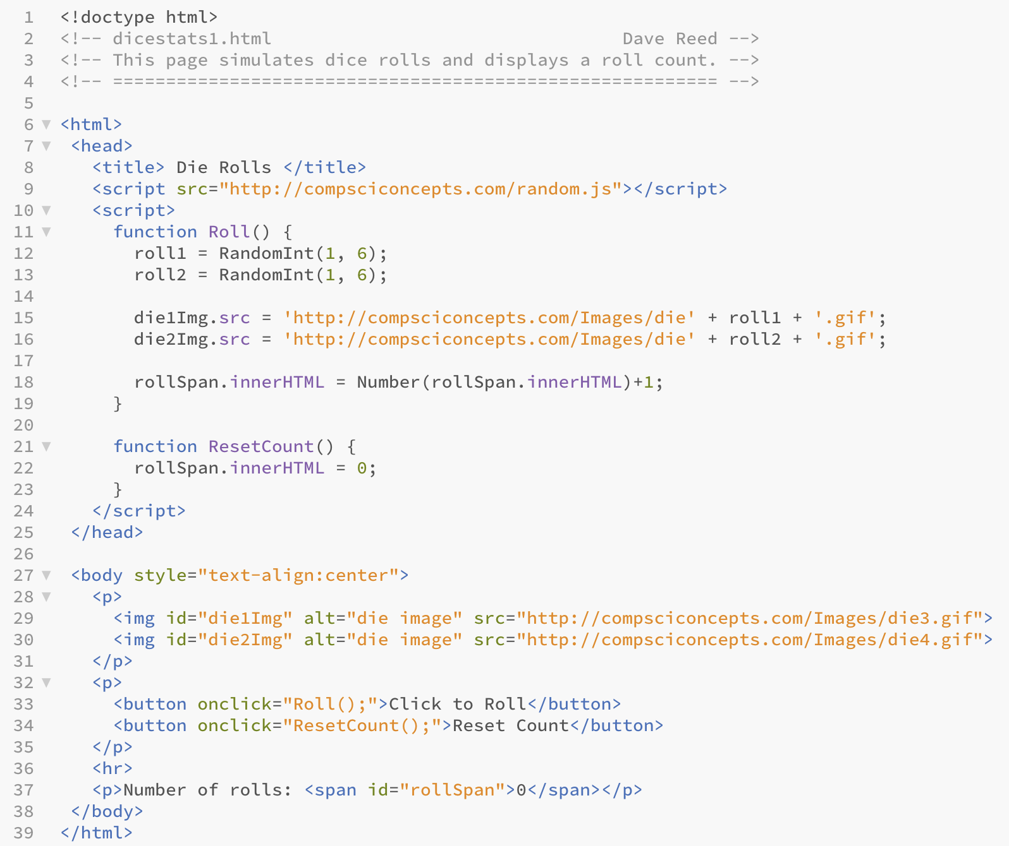
Dice Stats (v.1)
recall the pages from Ch X6 that simulated dice rolls
add an embedded counter
initially, the span contains 0
its contents are incremented each time function is called
also add a function to reset the counter

Slide 15
Conditional Counters
counters can be combined with if statements to count conditional events
e.g., to count doubles
if (roll1 == roll2) {
doubleSpan.innerHTML = Number(doubleSpan.innerHTML) + 1;
}
e.g., to count sevens
if (roll1+roll2 == 7) {
sevenSpan.innerHTML = Number(sevenSpan.innerHTML) + 1;
}
since doubles and sevens are mutually exclusive, could even combine
if (roll1 == roll2) {
doubleSpan.innerHTML = Number(doubleSpan.innerHTML) + 1;
}
else if (roll1+roll2 == 7) {
sevenSpan.innerHTML = Number(sevenSpan.innerHTML) + 1;
}

Slide 16
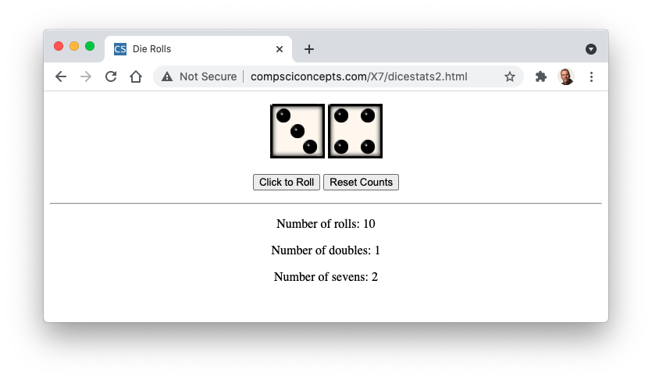
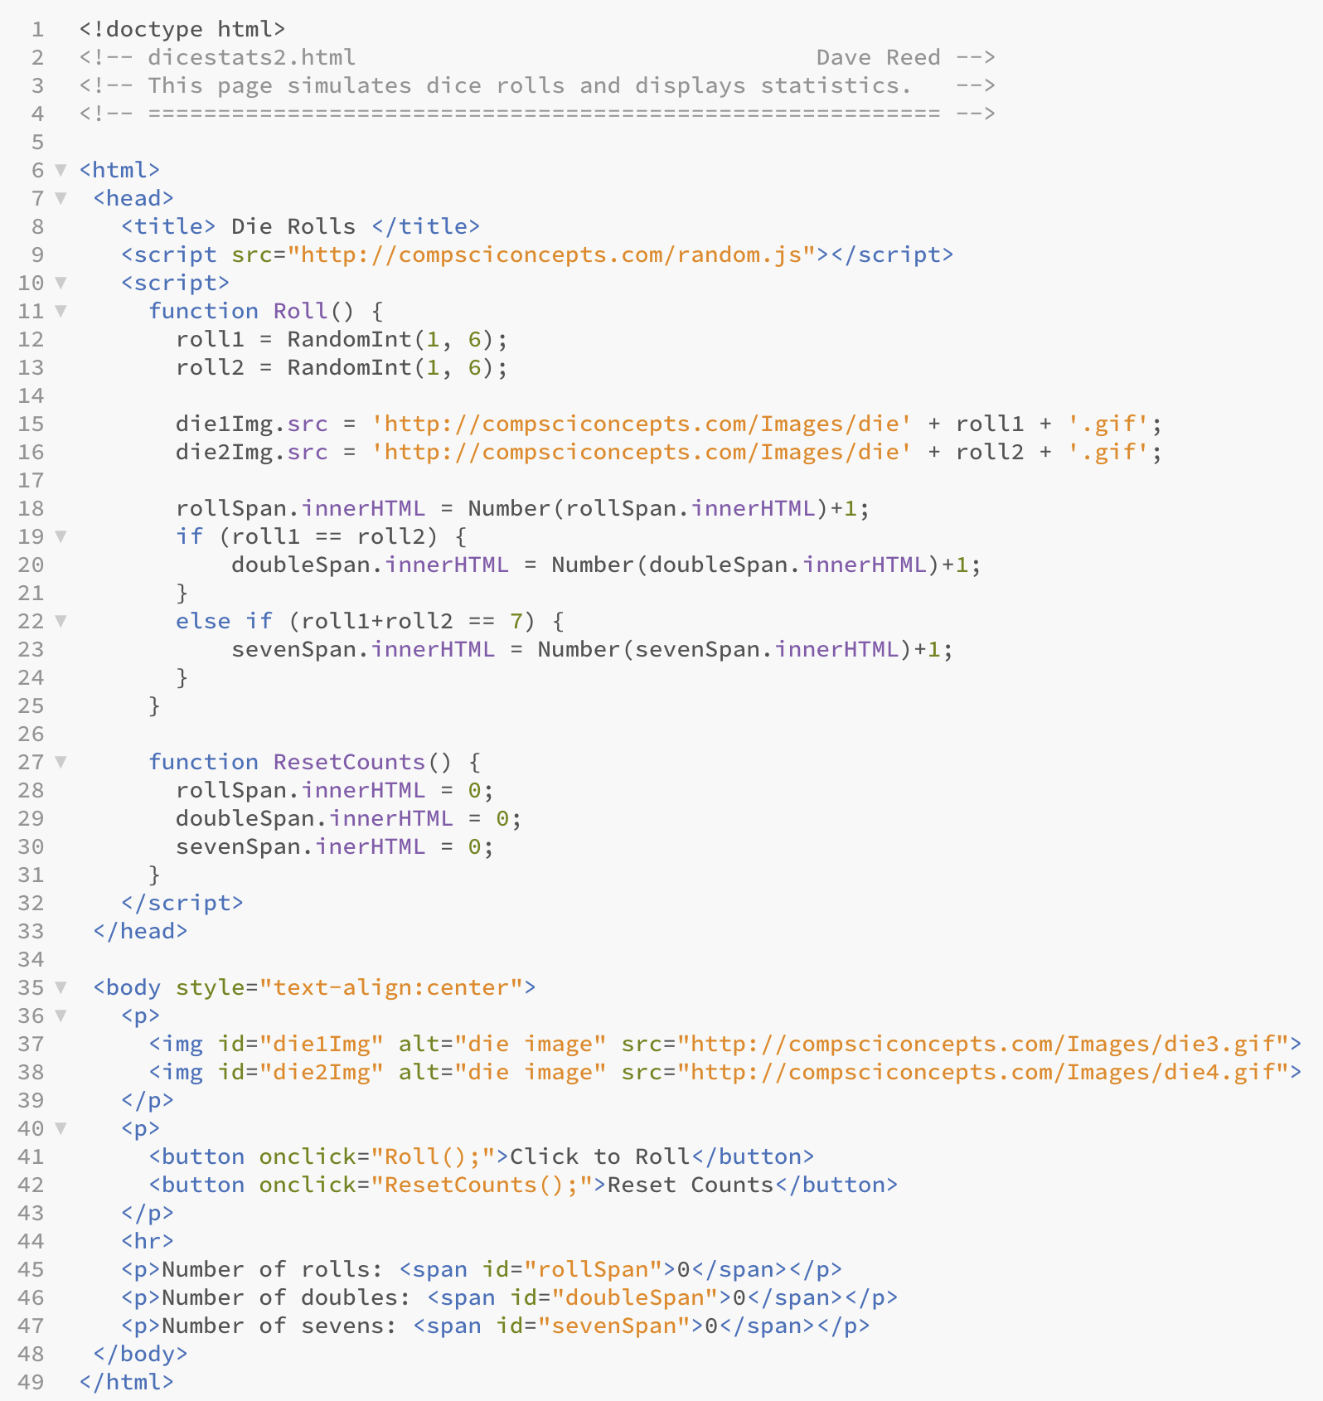
Dice Stats (v.2)
to keep stats on doubles and 7s
add spans to the page to keep track of the # of doubles and # of sevens
add if-else to conditionally increment the counters
also update ResetCounts to that all counters are reset

Slide 17
Boolean Expressions
sometimes, simple comparisons between two values may not be adequate to express the conditions under which code should execute
complex Boolean expressions can be built using logical connectives
TEST1 && TEST2 evaluates to true if TEST1 AND TEST2 are true
TEST1 || TEST2 evaluates to true if TEST1 OR TEST2 arise true
! TEST evaluates to true if TEST is NOT true
if (roll1 == 4 && roll2 == 4) {
CODE_TO_BE_EXECUTED_IF_4-4_COMBINATION_IS_ROLLED
}
if (roll1 == 4 || roll2 == 4) {
CODE_TO_BE_EXECUTED_IF_EITHER_ROLL_IS_4
}
if (!(roll1 == 4 && roll2 == 4)) {
CODE_TO_BE_EXECUTED_ IF_4-4_COMBINATION_IS_NOT_ROLLED
}

Slide 18
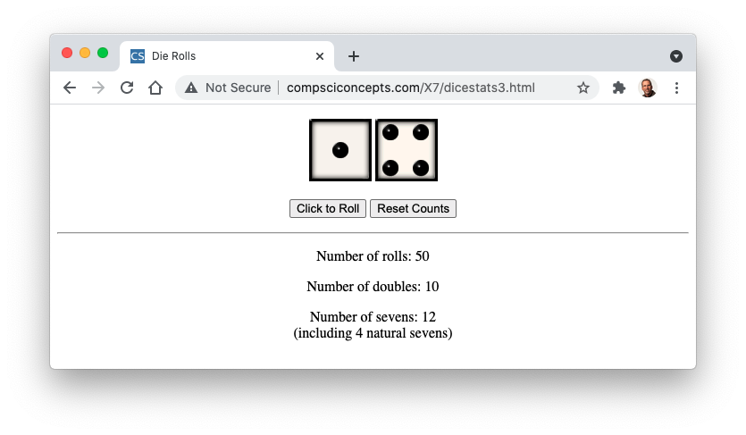
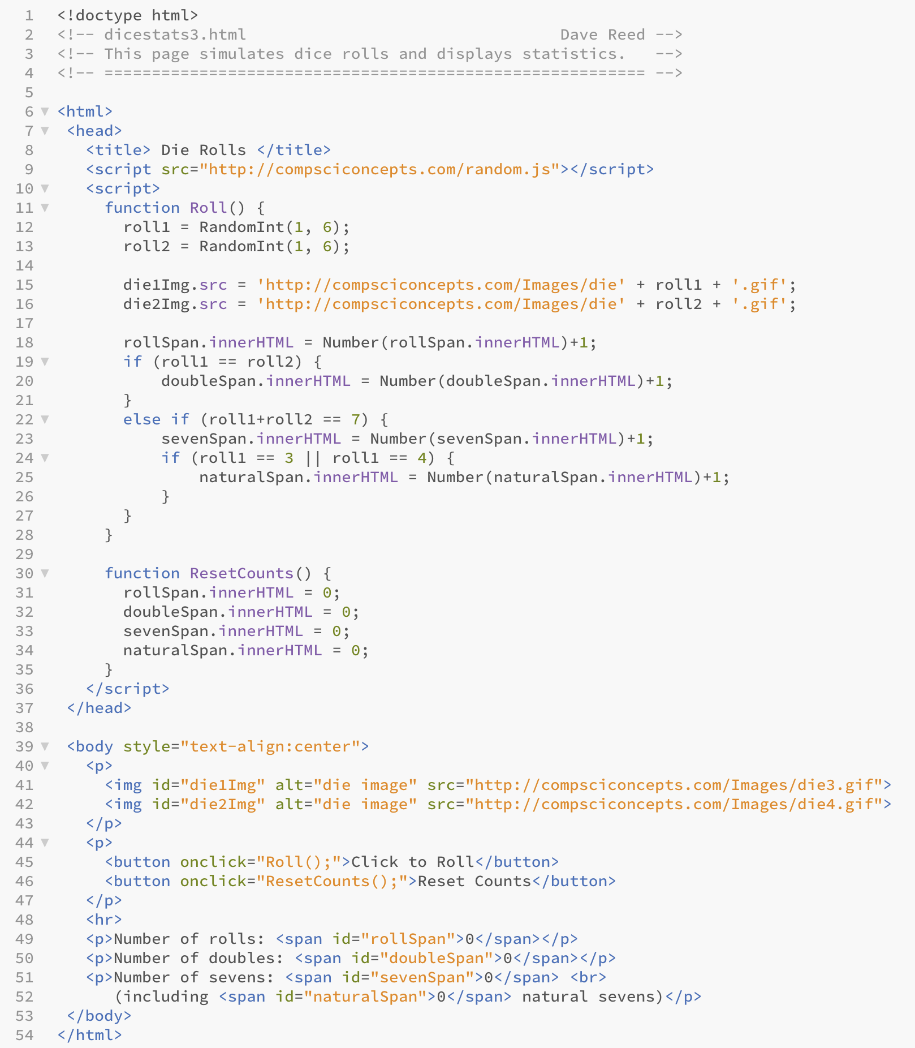
Dice Stats (v.3)
to also keep stats on natural 7s
add a test for 3-4 or 4-3 combinations
since the test is inside the sevens case, will only be executed if the roll is a seven
then, if roll1 is a 3 or a 4, increment naturalSpan

