Slide 1
Computer Science: Concepts & Explorations 2nd edition David Reed, Creighton University
Functions & Libraries

Slide 2
Abstraction
abstraction is the process of ignoring minutiae and focusing on the big picture
in modern life, we are constantly confronted with complexity
we don't necessarily know how it works, but we know how to use it
e.g., how does a TV work? a car? a computer?
we survive in the face of complexity by abstracting away details
to use a TV/car/computer, it's not important to understand the inner workings
we ignore unimportant details and focus on those features relevant to using it
e.g., TV has power switch, volume control, channel changer, …
JavaScript functions (like Math.sqrt) provide computational abstraction
a function encapsulates some computation & hides the details
the user only needs to know how to call the function, not how it works
simple user-defined functions similarly provide abstractions that simplify the page

Slide 3
User-defined Functions
functions simplify the programmer's task
minimize the amount of detail the developer must remember
e.g., to calculate a square root, only need to remember the name Math.sqrt
minimize the size and complexity of code
e.g., simple user-defined functions in the head simplify buttons in the body
the general form of user-defined functions:
function FUNCTION_NAME(PARAMETER1, PARAMETER2, …) {
STATEMENTS_TO_PERFORM_THE_DESIRED_COMPUTATION
return OUTPUT_VALUE;
}
parameters are variables that correspond to the inputs when the function is called
will have as many parameters as there are inputs to the function (could be 0)
a return statement specifies the output value for that function
optional, as some functions don't return a value (e.g., write a message in page)

Slide 4
Simple example
consider the following function for converting distances:
function InchesToCentimeters(inches) {
cm = inches * 2.54;
return cm;
}
the function has one parameter, named inches
when the function is called, an input value must be specified in the parentheses
InchesToCentimeters(10)
the input value from the call is assigned to the parameter variable
that variable can then be used in calculations (here, cm = 2.54*10 = 25.4)
when a return statement is reached, the expression is evaluated and returned
a function call can appear in any expression
the return value is substituted for the call when evaluating
outputP.innerHTML = InchesToCentimeters(10); displays 25.4 in outputP

Slide 5
Simple example (cont.)
as with any variable, parameter names should convey their purpose:
inches, distanceInInches, lengthInInches, …
convention used throughout the book:
variable/parameter names start with a lowercase letter
function names start with an uppercase letter
if a variable name consists of multiple words, use internal capitalization
since a return statement can specify an expression, we could equivalently define the function as:
function InchesToCentimeters(distanceInInches) {
return distanceInInches * 2.54;
}

Slide 6
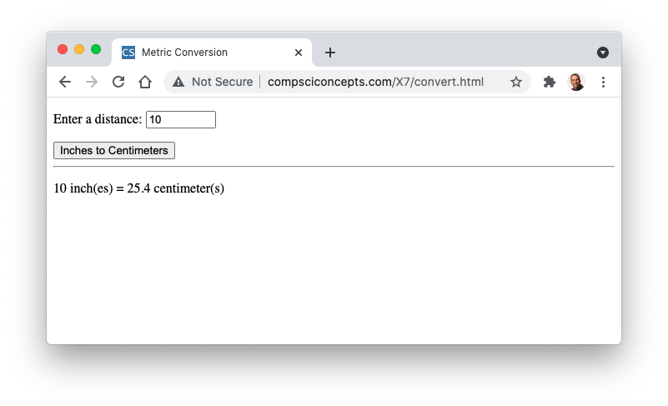
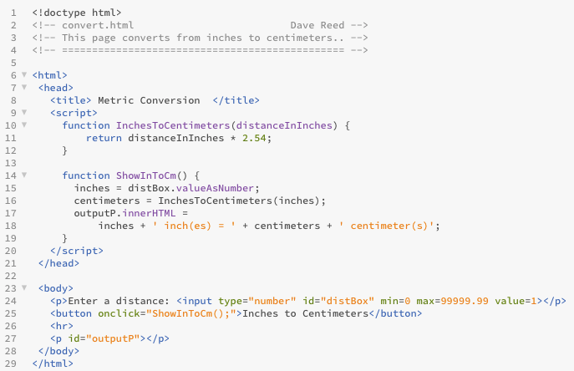
Conversion Page
this shows that a function can contain a call to another function
note 2 function definitions in head
still need parameterless function connected to the button

Slide 7
Pick-4 Revisited
InchesToCentimeters is easy to understand, but not very motivational
for a better example, consider the Pick-4 page from Chapter X5
used Math.random to generate random lottery balls in the range 1..numBalls
pick1 = Math.floor(numBalls*Math.random() + 1);
pick2 = Math.floor(numBalls*Math.random() + 1);
pick3 = Math.floor(numBalls*Math.random() + 1);
pick4 = Math.floor(numBalls*Math.random() + 1);
tricky, messy, difficult to modify (e.g., suppose we learned balls started at 0)
better solution: capture the tricky expression in a function
function RandomInt(low, high) {
return Math.floor(Math.random()*(high-low+1)) + low;
}
once defined & tested, can be used anywhere a random integer is needed

Slide 8
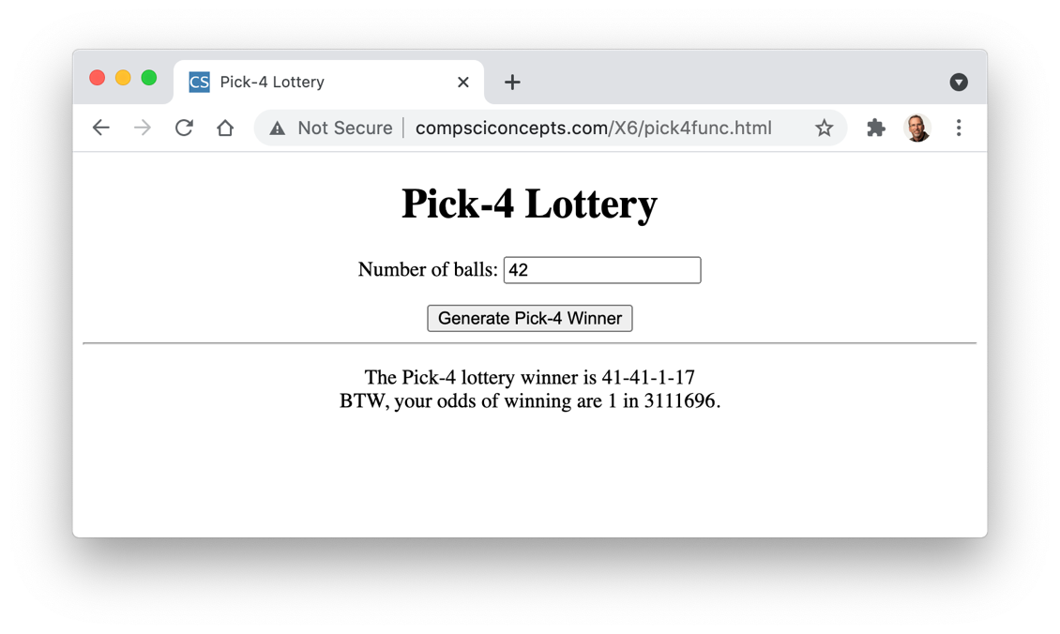
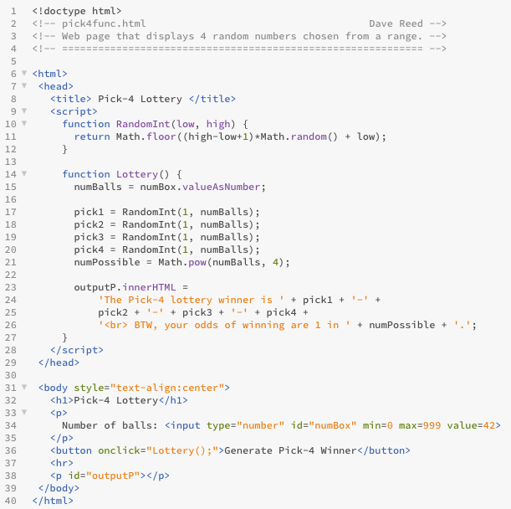
Pick-4 with Function
RandomInt function makes the code much easier to understand & modify
e.g., for balls starting at 0:
pick1 = RandomInt(0, numBalls-1);
pick2 = RandomInt(0, numBalls-1);
pick3 = RandomInt(0, numBalls-1);
pick4 = RandomInt(0, numBalls-1);

Slide 9
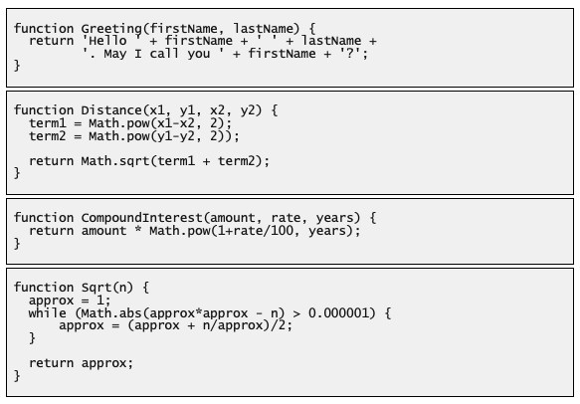
More Examples
parameters & return values can be strings
function for calculating point distance (Ch. X5)
function for calculating compound interest (Ch. X5)
function for calculating square root (using Newton's algorithm from Ch. C6)

Slide 10
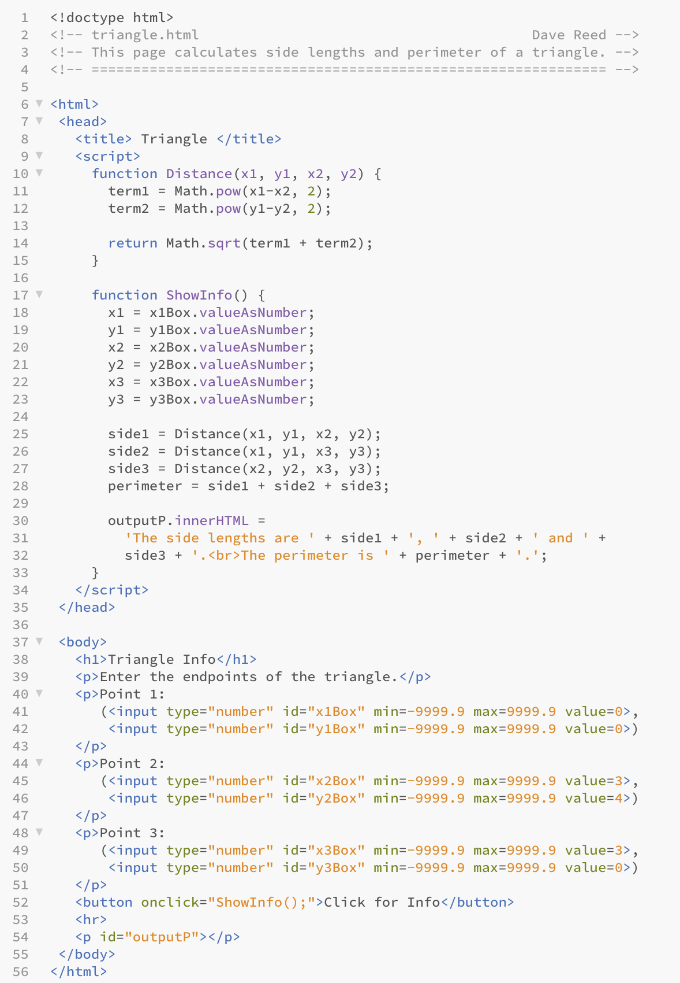
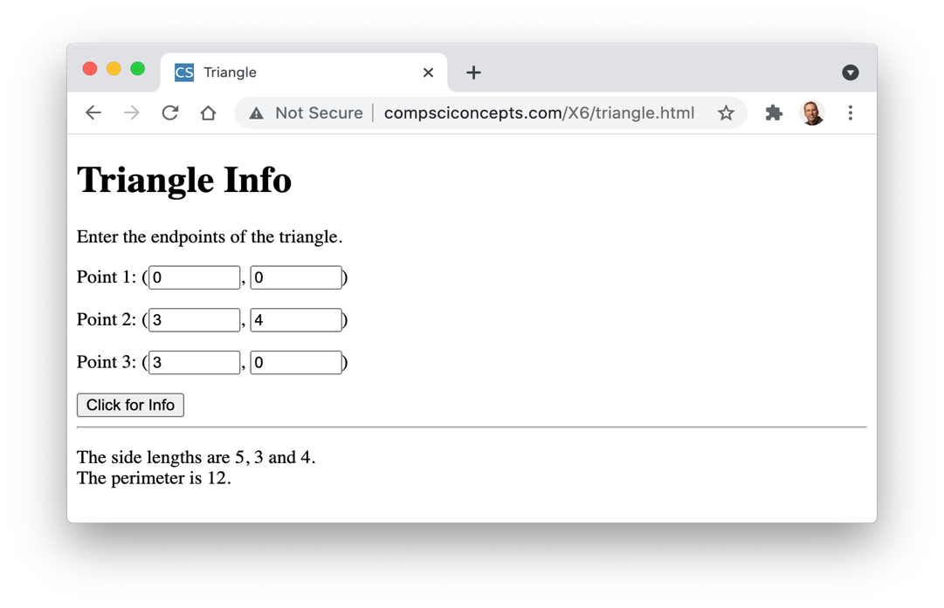
Triangle Page
recall distance.html page from Ch. X5
can simplify by adding Distance function
functions are especially useful if the calculation is performed multiple times
here, need to calculate the lengths of three triangle sides
define the complex distance calculation once in the function
can then call the function repeatedly

Slide 11
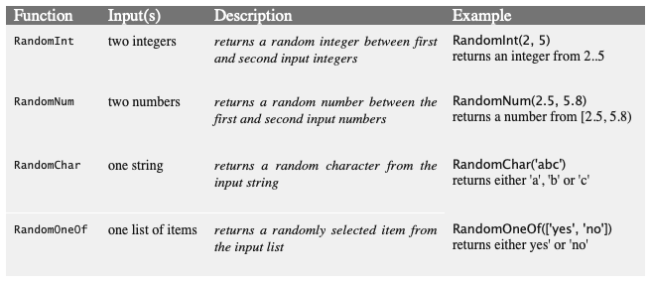
Function libraries
functions such as RandomInt can be added to head of a page
tedious if functions are to be used in many pages
involves creating lots of copies that all must be maintained for consistency
the alternative for general purpose functions is to place them in a library file
a library file is a separate text file that contains the definitions of one or more JavaScript functions
by convention, function library files end in .js since they contain JavaScript code
e.g., http://compsciconcepts.com/random.js

Slide 12
Function libraries
once a function library file has been created, it can be loaded into any page by adding a script element whose src is that file
<script src="LIBRARY FILENAME"><script>
this new script elements is added to the head of the page
note that no actual code appears in between the script tags
the code from the library is inserted the script element when the page loads
advantages of library files:
avoid duplication (only one copy of the function definition)
easier to reuse functions (simply load the library file into any page)
easier to modify functions (a single change to the library file automatically affects all pages that load the library

Slide 13
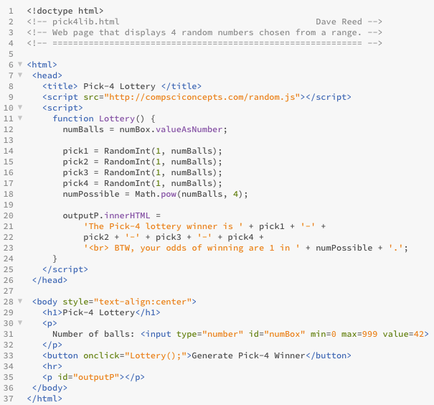
Pick-4 Yet Again
note: there is one script element for loading the library
this makes the RandomInt function accessible within the page
there is separate script element for defining the page-specific function
this function can call the library function that has been loaded

Slide 14
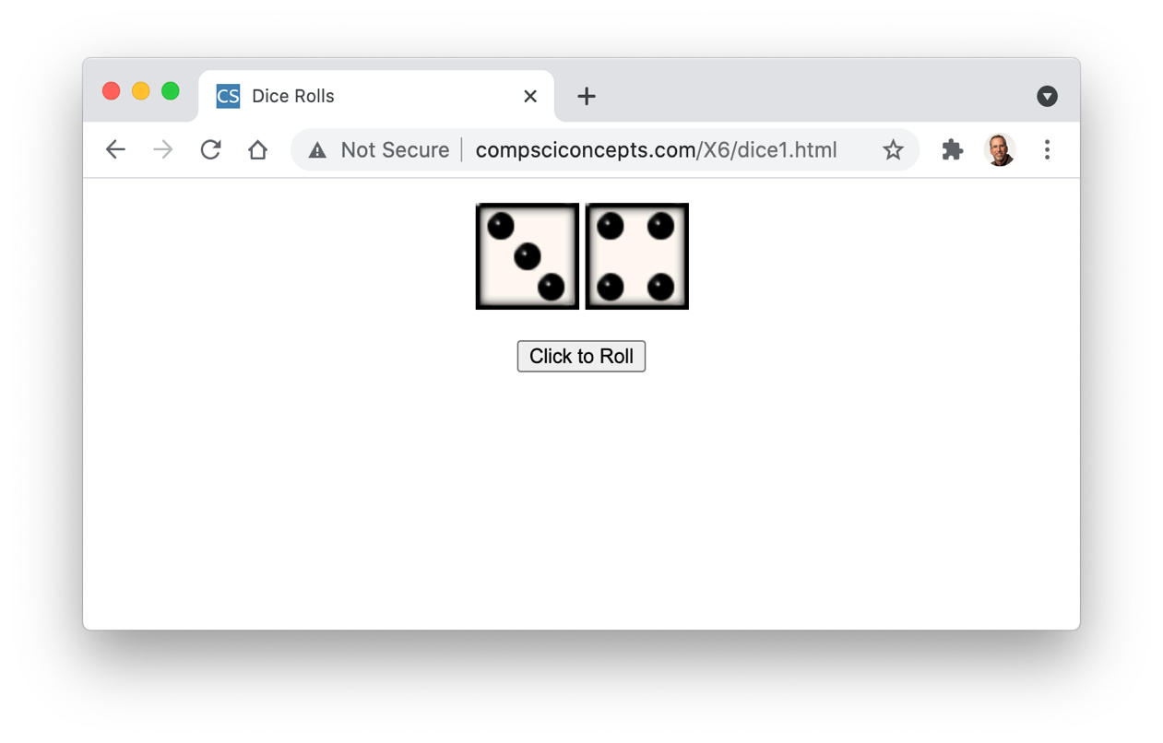
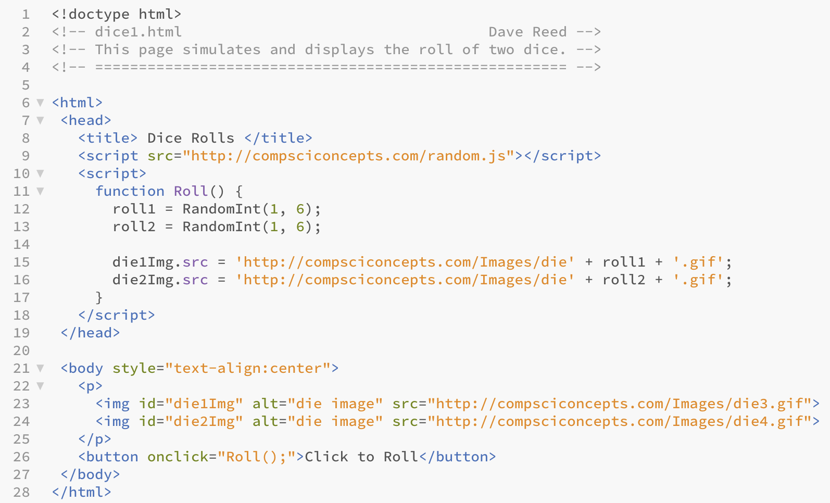
Dice Example (v. 1)
this page uses the RandomInt function from random.js to pick the random die images
note: die images are named die1.gif, die2.gif, …, die6.gif

Slide 15
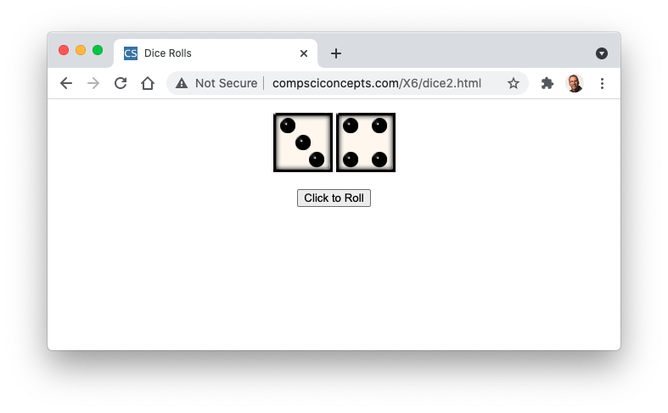
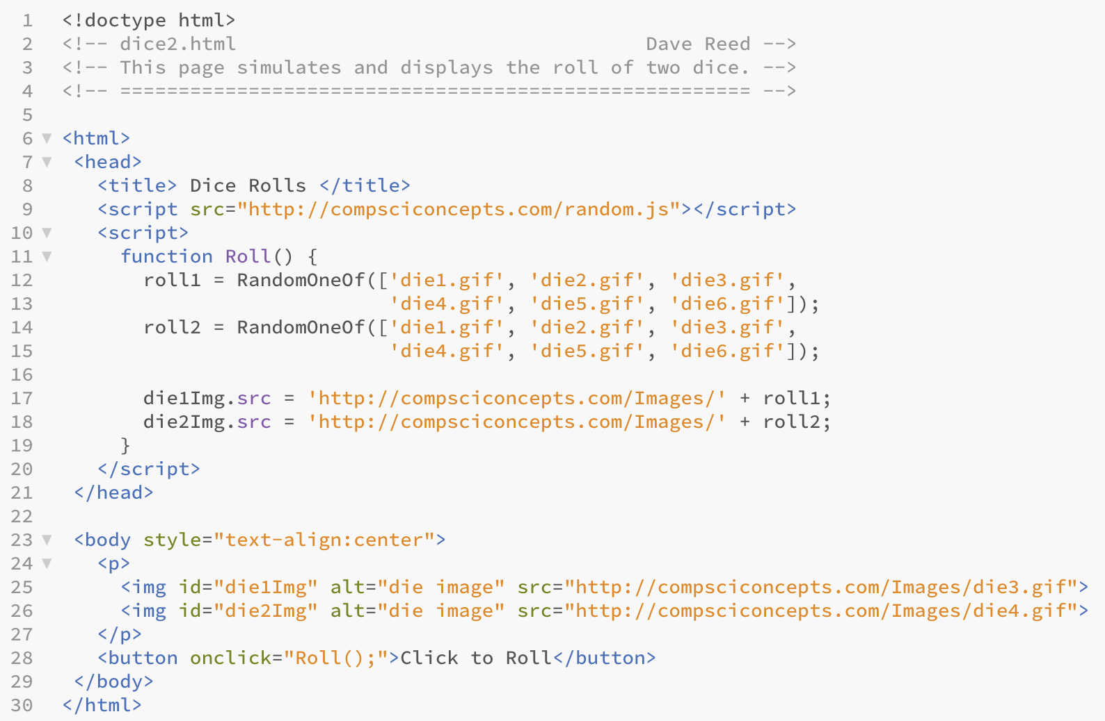
Dice Example (v. 2)
alternatively, could use the RandomOneOf function from the random.js library to pick the die images
note: function input must be a list of options, contained in [ ] and separated by commas

Slide 16
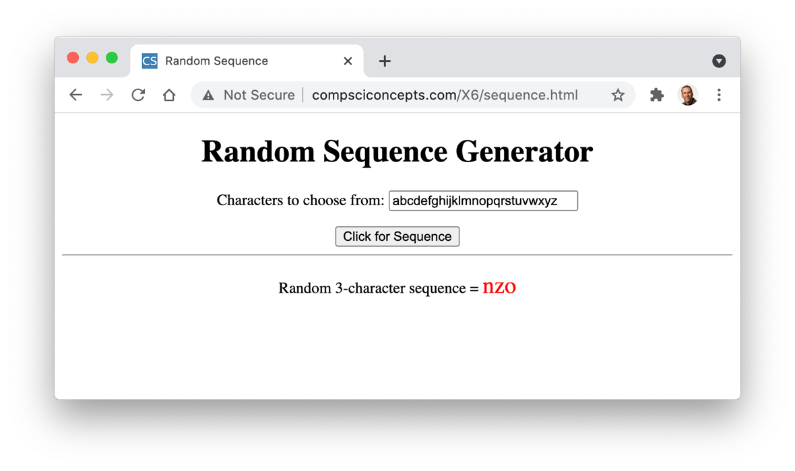
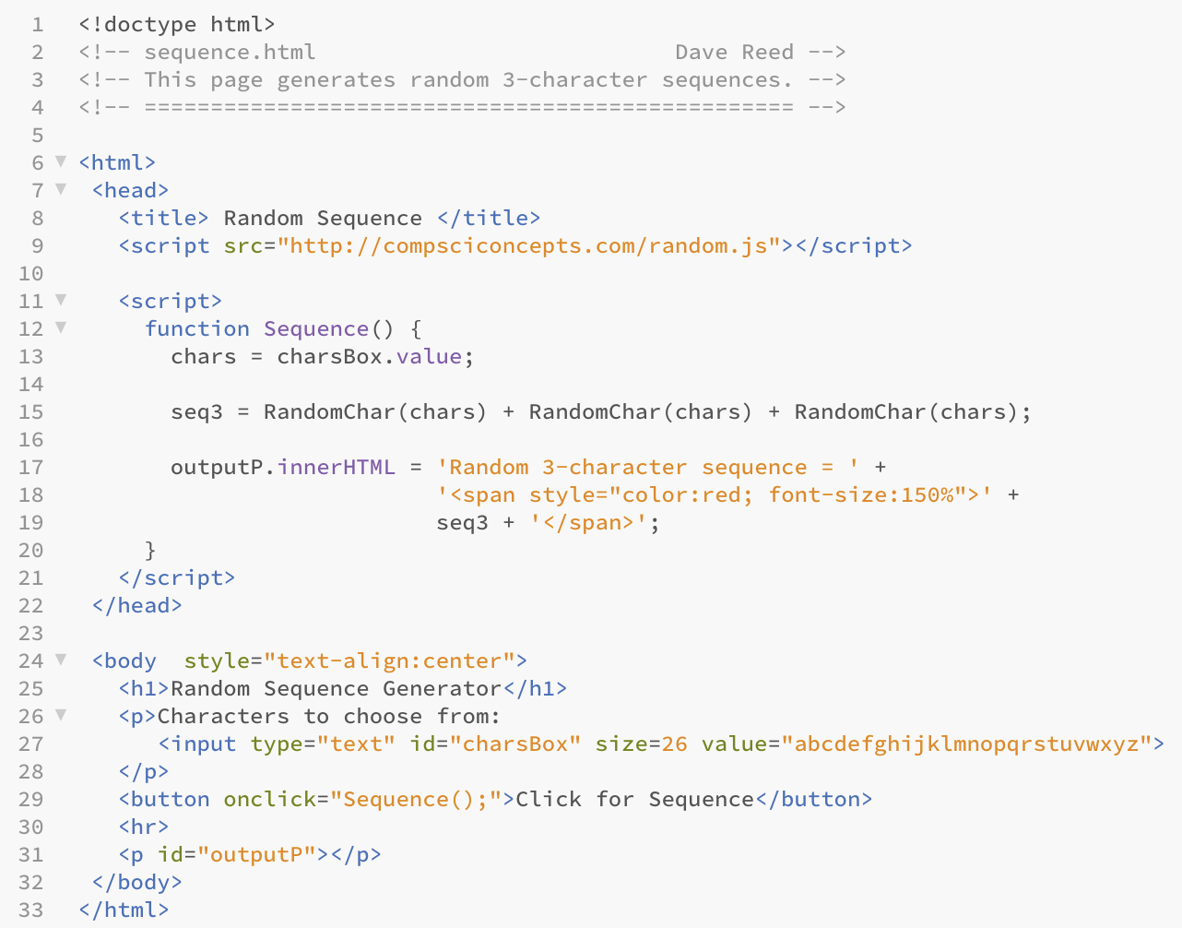
Sequences Example
consider the task of generating random character sequences
e.g., for creating secure passwords
the user can specify the characters to choose from in the text box
uses the RandomChar function from random.js to pick 3 random characters & concatenate them

Slide 17
Designing Functions
functions do not add any computational power to the language
a function definition simply encapsulates other statements
still, the capacity to define and use functions is key to solving complex problems, as well as to developing reusable code
encapsulating repetitive tasks can shorten and simplify code
provide units of computational abstraction – user can ignore details
when you write a general-purpose function that could be used in many pages
create a library file and package that function with related functions
these can then be loaded into pages that need those functions
when you define a function that is page-specific:
define it in the head of that page (within a script element)
can have more than one function defined in the same script element

