Slide 1
Computer Science: Concepts & Explorations 2nd edition David Reed, Creighton University
Numbers & Computation

Slide 2
Data Types
each unit of information processed by a computer belongs to a general category or data type
JavaScript has three predefined data types
string for representing text values (e.g., 'abcd', 'two words')
number for representing numeric values (e.g. 12, 3.99)
Boolean for representing logical values (true or false) LATER
each data type is associated with a specific set of predefined operators that may be used by programmers to manipulate values of that type
e.g., we have seen string concatenation via +
similarly, standard operators are predefined for numbers
addition (+), subtraction (-), multiplication (*), division (/)
text boxes allow the user to enter strings and access those entries
there is an equivalent element for numbers: number box

Slide 3
Number Box
a number box is an input element (similar to text box)
type attribute is assigned "number" (instead of "text")
optional value attribute is same as for text box – specifies default value that appears in the box
instead of size attribute, number boxes specify min and max values – the size is adjusted to fit that range
<input type="number" id="numBox" min=0 max=100 value=50>
to access the number in a number box, use valueAsNumber attribute
numBox.valueAsNumber

Slide 4
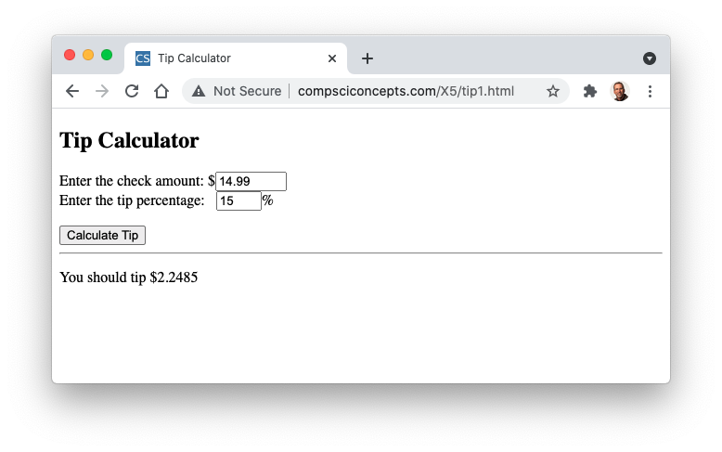
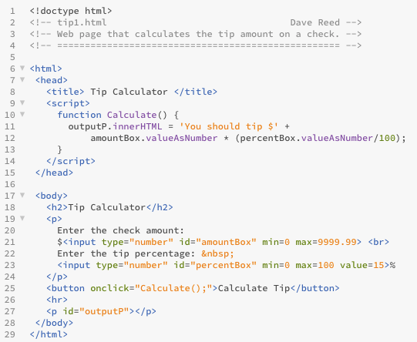
Tip Calculator
here, the user enters a check amount and tip percentage (default is 15%)
when button is clicked, accesses those numbers, calculates & displays tip

Slide 5
valueAsNumber vs. value
similar to text boxes, number boxes have a value attribute
the value attribute always returns the contents of the box as a string
this is NOT what you normally want when accessing a number box
e.g., suppose the user enters 12 in a number box named numBox
numBox.value evaluates to '12'
(numBox.value + 1) evaluates to '121' ???
recall, when + is applied to 2 numbers, addition: 1 + 2 = 3
when + is applied to 2 strings, concatenation: 'a' + 'b' = 'ab'
when + is applied to a string and a number, it converts the number to a
string and concatenates: '12' + 1 = '12' + '1' = '121'
BE CAREFUL TO ALWAYS USE valueAsNumber TO ACCESS NUMBER BOX CONTENTS

Slide 6
Variables
a variable is a name used to symbolize a dynamic (changeable) value
as before, assign a value using '=':
VARIABLE = VALUE;
variables are commonly used to simplify code by:
storing number values from boxes
amount = amountBox.valueAsNumber;
percent = percentBox.valueAsNumber;
or, storing the results of computations
tip = amount * (percent/100);

Slide 7

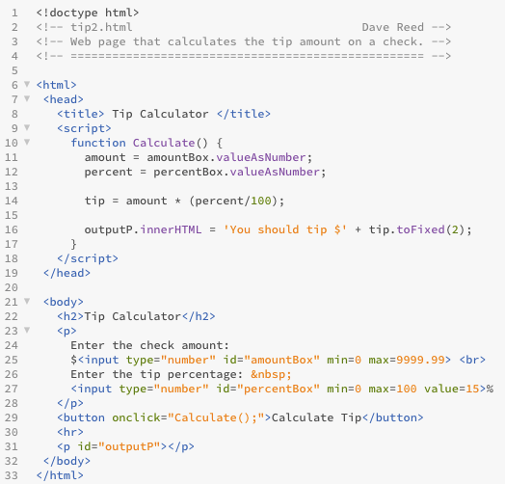
Tip Calculator
code is simplified by use of variables
tip.toFixed(2) rounds the tip to 2 decimal places

Slide 8
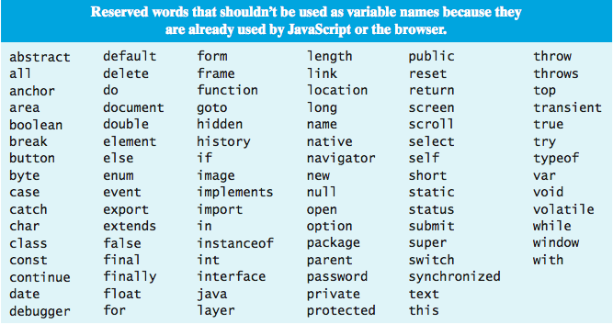
Variable Names
a variable name should start with a lowercase letter, consist of letters & digits
a variable name should be chosen to be descriptive of its purpose
e.g., mysteryImg, outputSpan

Slide 9
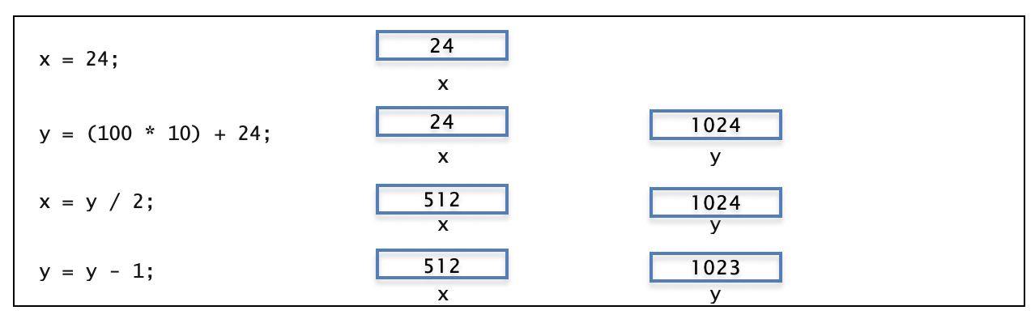
Variables & Assignments
variables can be assigned various types of values, including numbers and mathematical expressions
each variable has a memory cell associated with it, where a value can be stored
when an expression appears on the right-hand side, it is evaluated and the result is assigned to the variable (i.e., stored in its memory cell)
when a variable appears in an expression, its value (i.e., the value stored in its memory cell) is accessed and substituted into the expression
reminder: '=' is not the equality operator
to avoid confusion: read '=' as 'gets', as in 'y gets y-1'

Slide 10
Number Representation
useful facts about JavaScript numbers
to improve readability, very large or very small number are displayed in scientific notation: XeY represents the value X  10^{Y}
e.g., 1e24 → 1  10²⁴ → 1000000000000000000000000
JavaScript stores all numbers in memory cells of a fixed size (64 bits)
as a result, only a finite number of values can be represented
e.g., 1e308 can be represented, but 1e309 is treated as Infinity
1e-323 can be represented, but 1e-324 is treated as 0
even within the range 1e-323 . . . 1e309, not all numbers can be represented
note that between any two numbers lie infinitely more numbers!
JavaScript can represent approximately 17 significant digits
e.g.., 0.9999999999999999 can be represented exactly
0.99999999999999999 is rounded up to 1

Slide 11
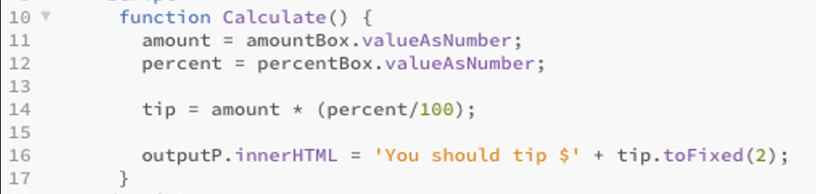
Patterns & Spacing
note the spacing in the Calculate function
blank lines are ignored by the browser, but are helpful to a developer
here, there are three main tasks
get the (numeric) contents of the text boxes
perform a computation on those numbers
display the result of the computation in the page
inserting blank lines to separate these tasks makes the code easier to understand
similar to dividing an essay into paragraphs
be aware: this same pattern will reappear in many pages

Slide 12
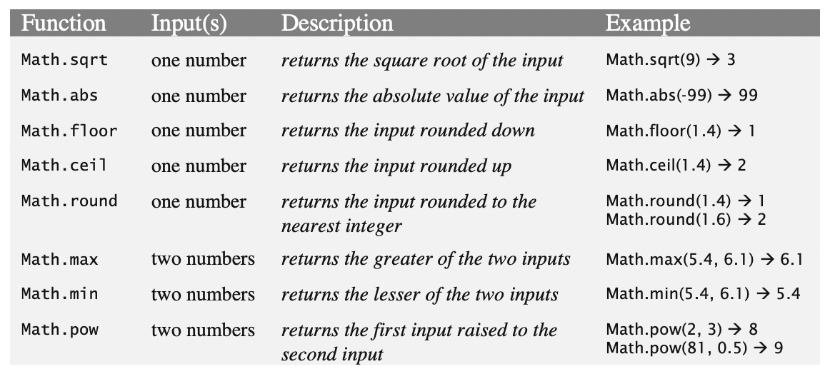
Predefined Functions
in JavaScript, a function is applied to inputs via a function call
num = Math.sqrt(25);
here, Math.sqrt is being called with input 25; it returns the output 5

Slide 13
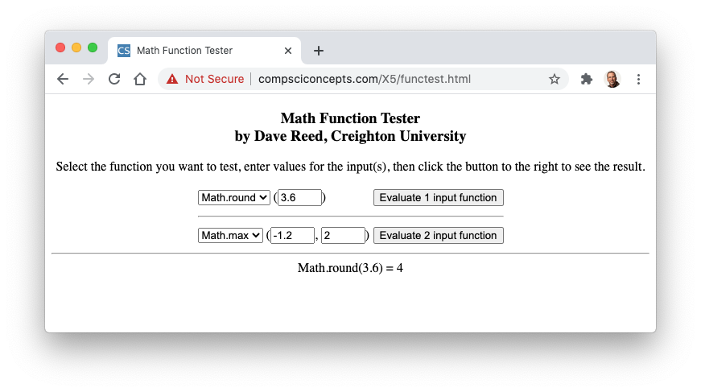
functest
the functest.html page is provided for you to explore the different math functions
select the function from a pull-down menu & inter the input(s) in text box(es)
click the button to see the function call and its output

Slide 14
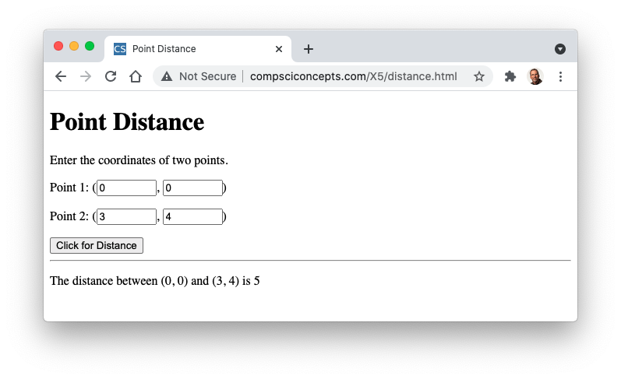
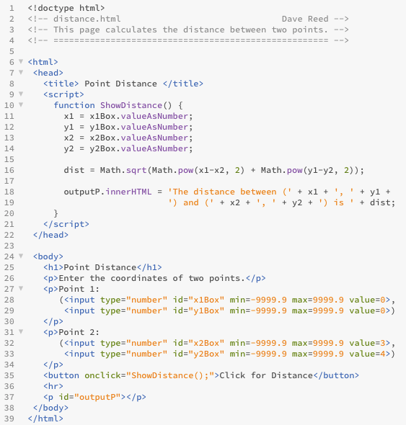

Point Distance
user enters two points (x1, y1) and (x2, y2) in text boxes
when button is clicked, the distance between those two points is calculated and displayed

Slide 15
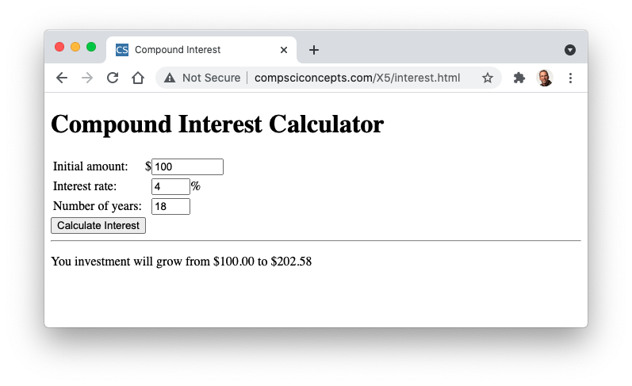
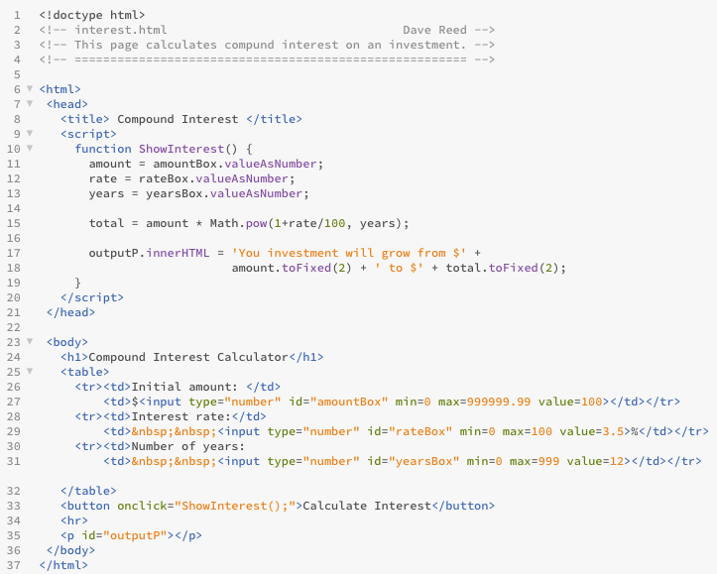
Compound Interest
calculates compound interest on an investment
user enters initial amount, interest rate & number of years
total =
amount*( +rate/100)^{years}

Slide 16
Math.random
in addition to the above math functions, JavaScript provides a function for generating a random number
Math.random has no inputs, returns a random real number from the range [0, 1)
note: smallest possible value = 0.0; largest possible value = 0.99999…
Math.random() → 0.3428794638
Math.random() → 0.8776243657
technically, it returns a pseudo-random number, since it uses a complex algorithm to generate numbers that appear random (using hidden inputs like the current time in milliseconds)
by itself, Math.random is not very useful
but, can use in expressions to expand or shift the range
2*Math.random() → 2*(number from [0, 1) → number from [0, 2)
Math.random()+10 → (number from [0, 1)) + 10 → number from [10, 11)
X*Math.random()+Y → number from [Y, X+Y)

Slide 17
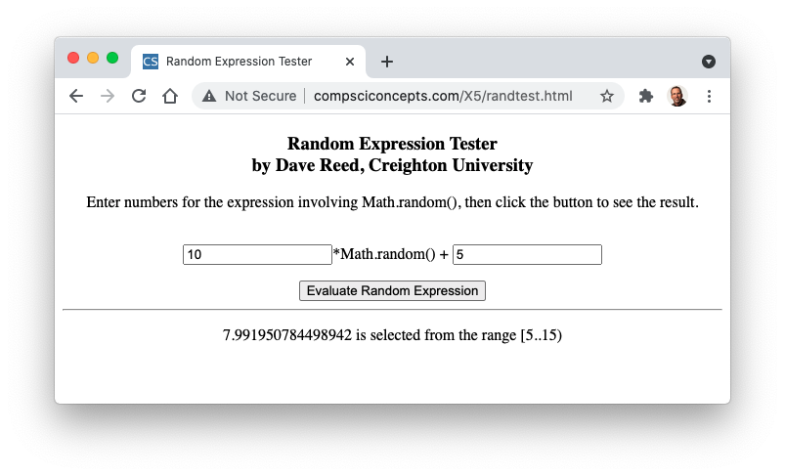
randtest

Slide 18
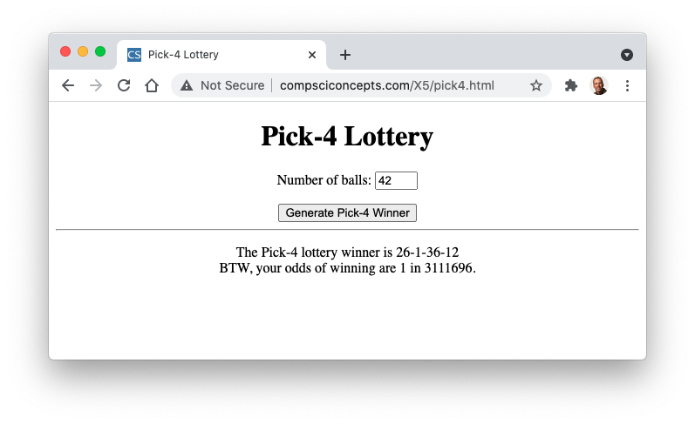
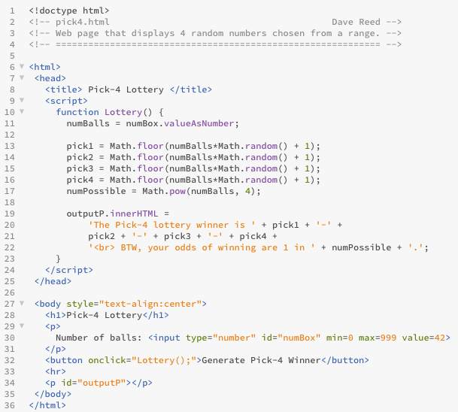
Pick-4 Example
this page simulates picking 4 numbered balls from lottery bins
to pick a random integer from 1 to numBalls
pick a # from the range [1, numBalls+1)
then round down

