Slide 1
Computer Science: Concepts & Explorations 2nd edition David Reed, Creighton University
Interaction & Design

Slide 2
Text Boxes
HTML event handlers enable the user to interact with the page
e.g., move the mouse over an image to change it
e.g., click on a button to display a text message in a page division
for greater control, the user must be able to enter information into the page
e.g., enter words to complete a fill-in-the-blank story
e.g., enter grades to calculate a course average
a text box is an HTML element that is embedded in the page
<input type="text" id="BOX_ID" size=NUM_CHARS value="INITIAL_CONTENTS">
the user can enter text directly in the box
a JavaScript statement can then access the contents of the text box by accessing its VALUE attribute
BOX_ID.value

Slide 3
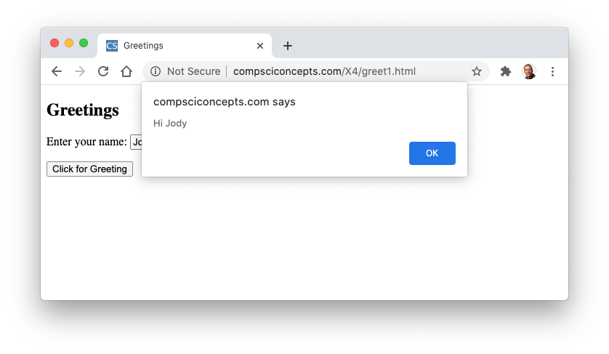
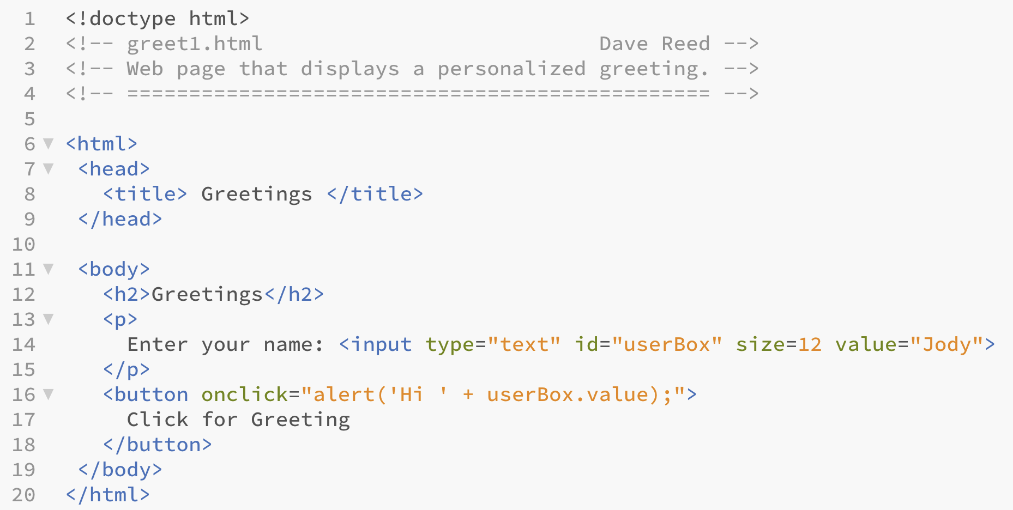
Greetings Page (v.1)
note: userBox.value does not have quotes around it
what would happen if it did?
"Jody" is the default value
when button is clicked, an alert window displays 'Hi Jody'
the user can enter his/her name in the text box

Slide 4
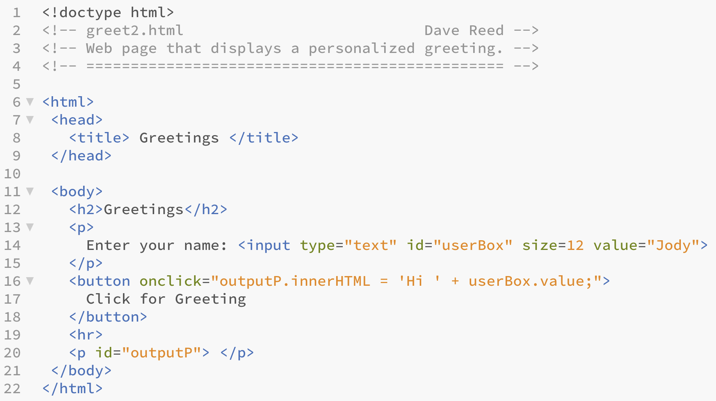
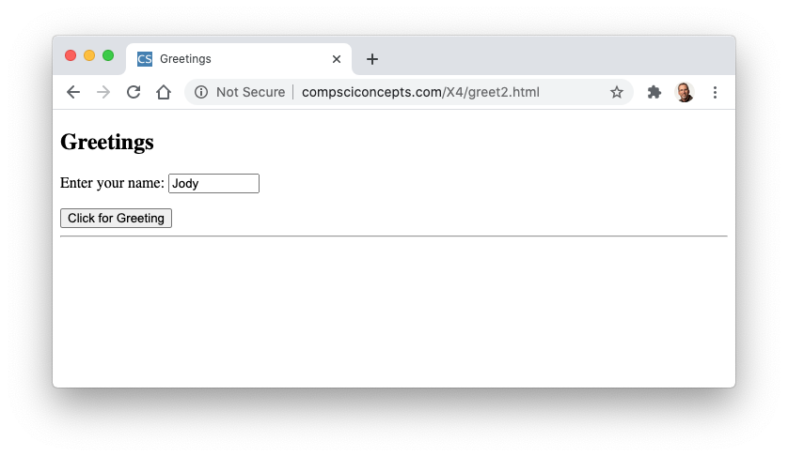

Greetings Page (v.2)
alternatively, could display the greeting in a dynamic paragraph
initially, outputP is empty
when button is clicked, the greeting is assigned to its INNERHTML attribute

Slide 5
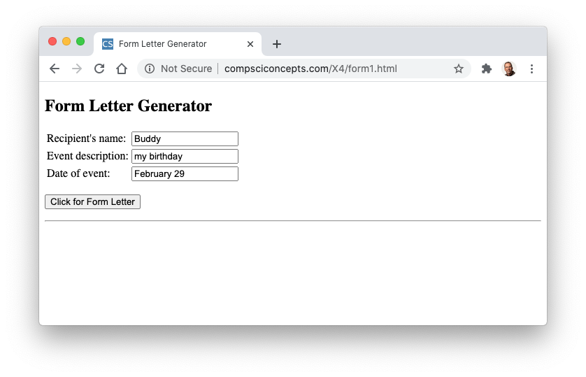
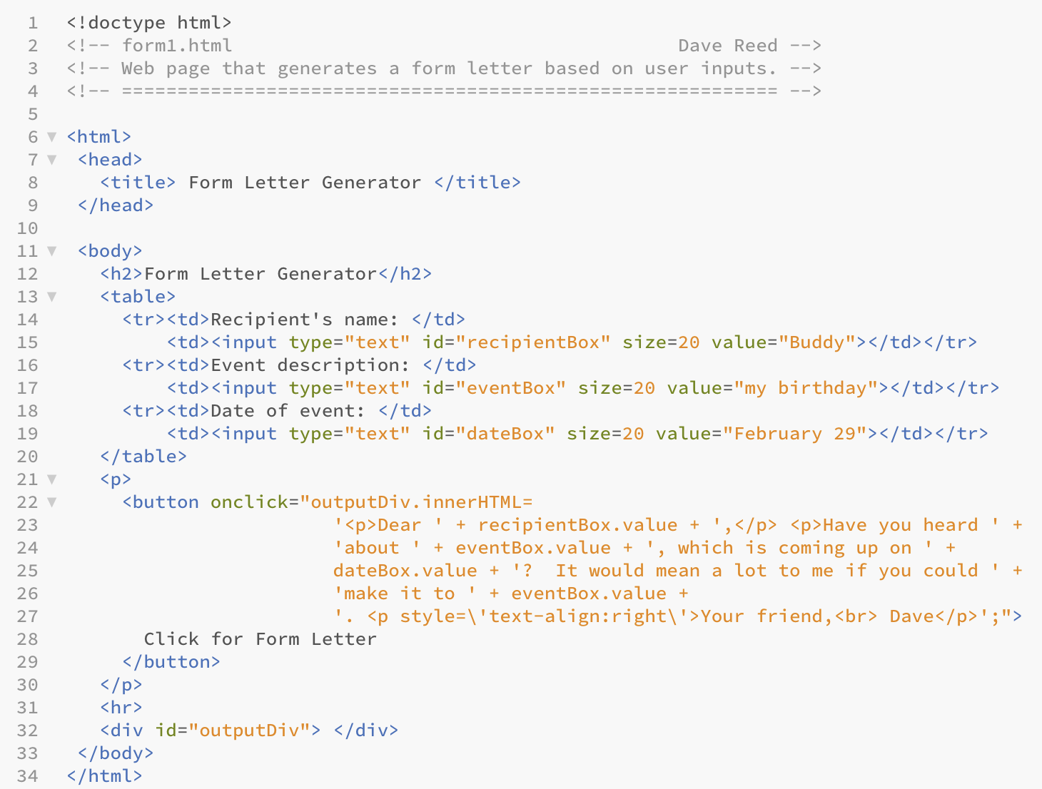
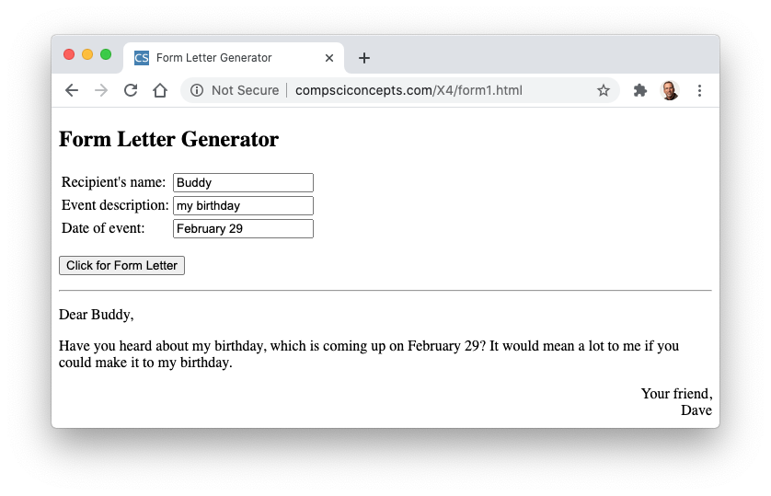
Form Letter Example
this page has 3 text boxes, uses contents to generate a custom form letter
note: each box must have a unique ID

Slide 6
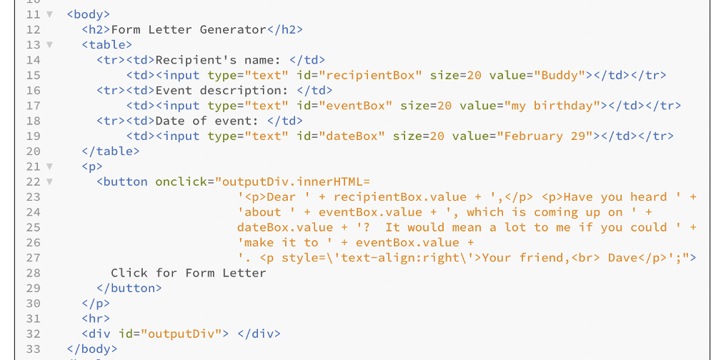
Simplifying Pages
we should be able to glance at the body of a page and visualize its contents
consider the body of the form generator page
the onclick code has nothing to do with the look of the page but its size and complexity clutter the body

Slide 7
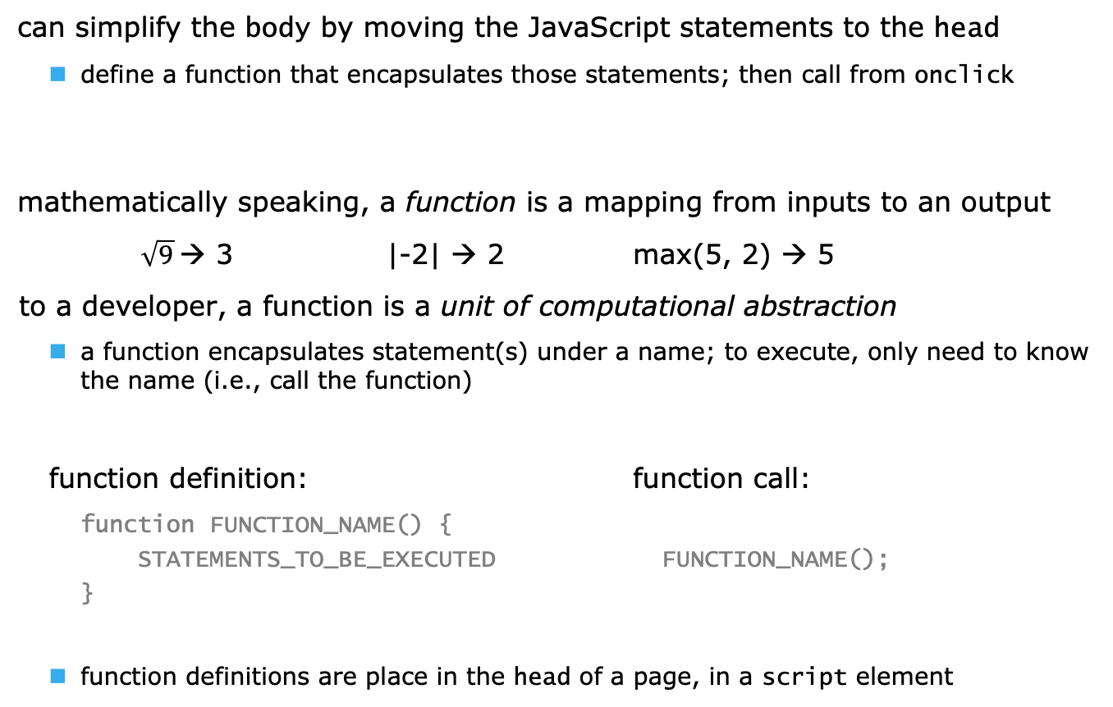
User-defined Functions
can simplify the body by moving the JavaScript statements to the head
define a function that encapsulates those statements; then call from onclick
mathematically speaking, a function is a mapping from inputs to an output
$\sqrt{9}$→ 3 |-2| → 2 max(5, 2) → 5
to a developer, a function is a unit of computational abstraction
a function encapsulates statement(s) under a name; to execute, only need to know the name (i.e., call the function)
function definition: function call:
function FUNCTION_NAME() {
STATEMENTS_TO_BE_EXECUTED FUNCTION_NAME();
}
function definitions are place in the head of a page, in a script element

Slide 8
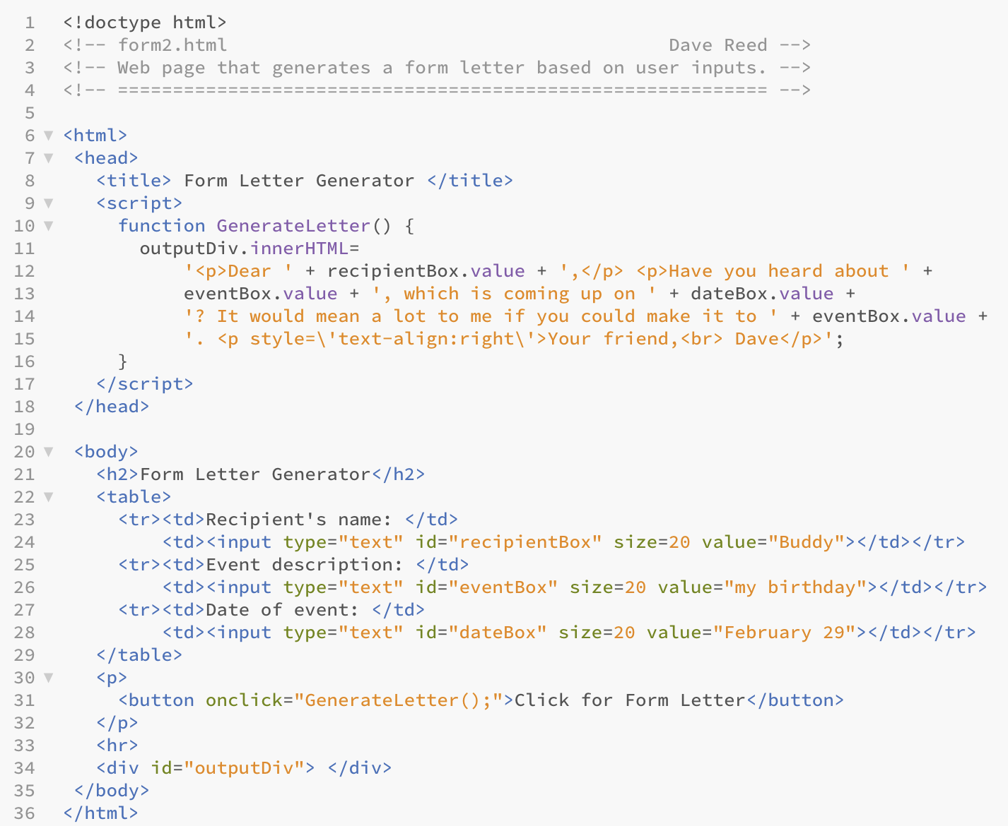
Function Example
this page behaves the same as form1.html
the action of the button is encapsulated in the GenerateLetter function in the HEAD (in SCRIPT tags)
the BODY is simplified, since the ONCLICK just contains a call to the function

Slide 9
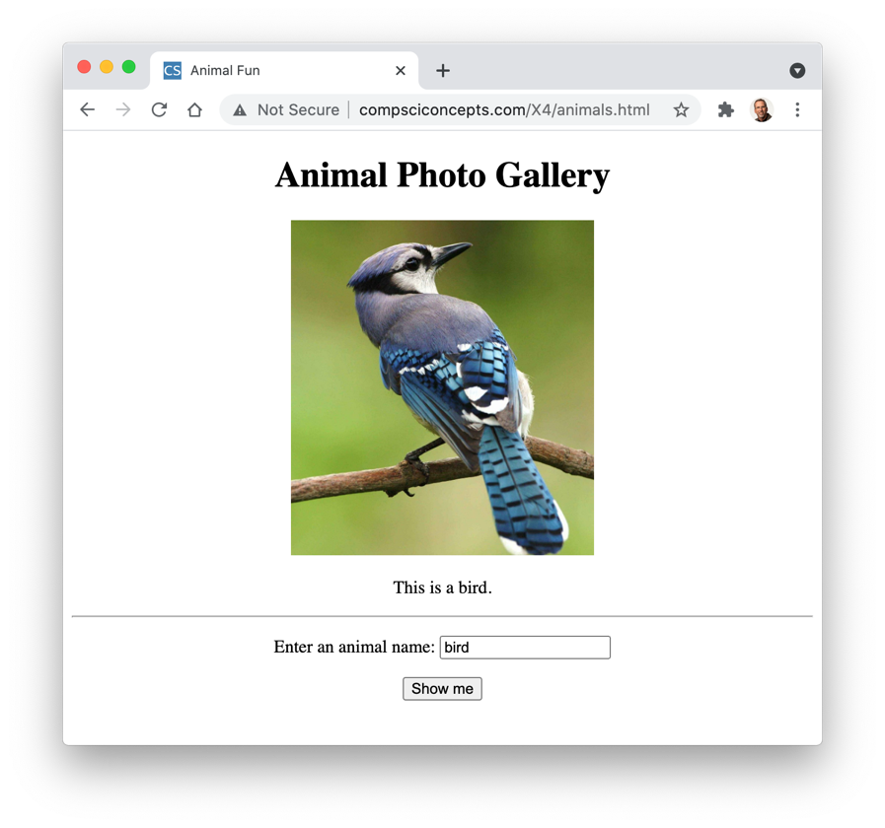
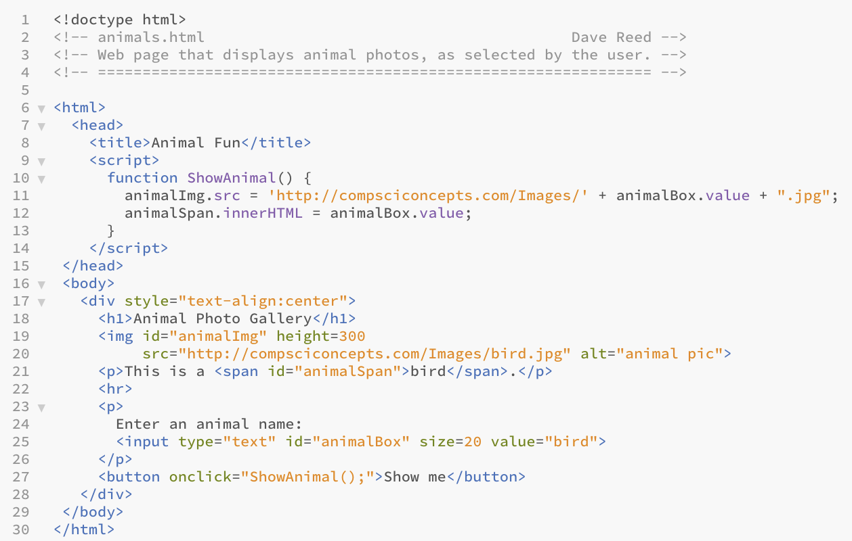
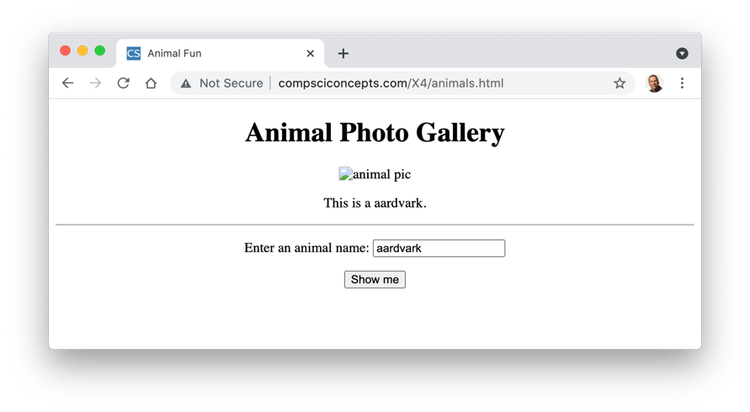
Another Example
Animal Gallery: contains
image of an animal
a text box where the user can enter an animal name
a button for changing the image
note how simple the BODY is

Slide 10
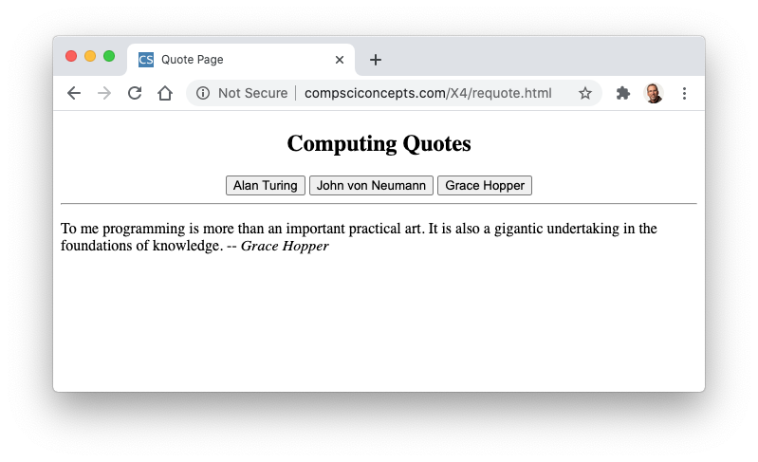
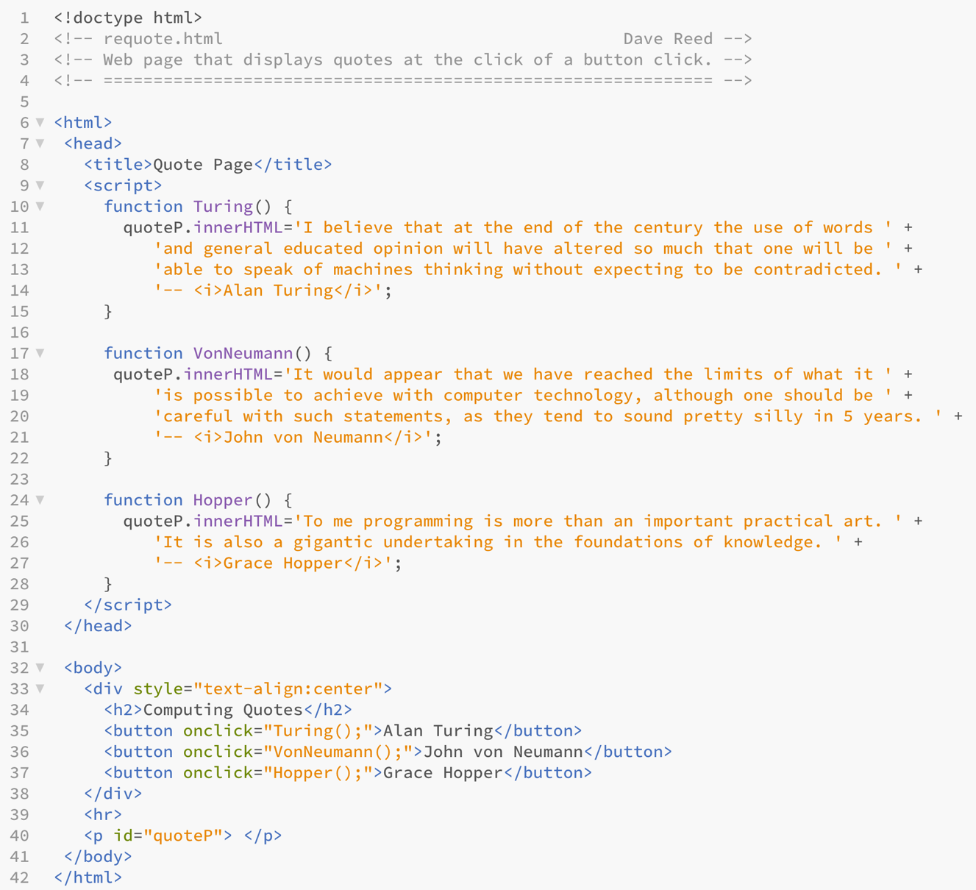
Another Example
each button has its own corresponding function
when clicked, the function is called to display a quotation in the page
note how simple the BODY is

Slide 11
Design Guidelines
be conservative in your use of color
be consistent in your use of formatting
avoid overriding the browser defaults unless it is necessary
don't center paragraphs
label interactive elements (buttons, text boxes) clearly
document the source code in case anyone views it
include a comment block at top with your name, file name, and brief description
use descriptive id names
convention: descriptor + elementType, e.g., vacationImg, outputP
when defining a complex action, place in function definition in the head and call the function from the event handler

Slide 12
Errors and Debugging
in computer jargon, the term bug refers to an error in a program
the process of systematically locating and fixing errors is debugging
three types of errors can occur
syntax errors: typographic errors
e.g., omitting a quote or misspelling a function name
since the browser catches these, they are usually "easy" to identify and fix
CHECK THE JAVASCRIPT CONSOLE FOR ERROR MESSAGES!
run-time errors: occur when operations are applied to illegal values
e.g., attempting to multiply a string or divide by zero
also caught by the browser, which either produces an error message or else returns a special value (string multiplication produces NaN, division by zero produces Infinity)
AGAIN, CHECK THE JAVASCRIPT CONSOLE!
logic errors: flaws in the design or implementation of a program
whenever your program produces the wrong result
since they are not caught by the browser (the program is legal, just not what you wanted), logic errors are hardest to identify
useful technique for identifying logic errors: diagnostic alert statements
at various intervals in the code, display the values of key variables using alert
you can then isolate at what point the program is going wrong

