Slide 1
Computer Science: Concepts & Explorations 2nd edition David Reed, Creighton University
Dynamic Web Pages

Slide 2
Static vs. Dynamic Pages
recall: a Web page uses HTML tags to identify page content and formatting information
HTML can produce only static pages
static pages look the same and behave in the same manner each time they are loaded into a browser
in 1995, researchers at Netscape developed JavaScript, a language for creating dynamic pages
Web pages with JavaScript can change their appearance:
over time (e.g., a different image each time that a page is loaded), or
in response to a user’s actions (e.g., typing, mouse clicks, and other input methods)

Slide 3
Programming Languages
JavaScript is a programming language
a programming language is a language for specifying instructions that a computer can execute
each statement in a programming language specifies a particular action that the computer is to carry out
(e.g., changing an image or opening a window when a button is clicked)
some programming languages are general-purpose
popular languages include C++, Java, J#
JavaScript was defined for a specific purpose: adding dynamic content to Web pages
can associate JavaScript statements with certain HTML elements so that they react to actions taken by the user (e.g., a button click)

Slide 4
ID Attributes
in order for an element to behave dynamically, it must have an ID attribute
ID is assigned a unique identifier by which that element can be accessed and changed
<img id="familyImg" src="Images/beach.jpg" alt="My Family">
an identifier should start with a lowercase letter, consist of letters and digits
e.g., familyImg mysteryImg outputSpan num1Box
once an element has an ID, it can be accessed and altered using dynamic attributes known as event handlers
the ONMOUSEOVER attribute specifies the action(s) to take place when the mouse is moved over the element
the ONMOUSEOUT attribute specifies specifies the action(s) to take place when the mouse is moved off the element
the actions are encoded as statements in the JavaScript language

Slide 5
Event Handler Attributes
for example, can have an image that reacts to mouse movements:
<img src="ADDRESS_OF_IMAGE" alt="DESCRIPTIVE_TEXT"
onmouseover="CODE_TO_EXECUTE_WHEN_MOUSE_GOES_OVER_IMAGE"
onmouseout="CODE_TO_EXECUTE_WHEN_MOUSE_LEAVES_IMAGE">
the simplest type of action is changing the value of an element's attribute
this is accomplished via a JavaScript assignment statement
ELEMENT_ID.ATTRIBUTE_NAME = NEW_ATTRIBUTE_VALUE;
for example, the following JavaScript assignment will change the SRC attribute of the element with ID mysteryImg
mysteryImg.src='http://compsciconcepts.com/Images/happy.gif';

Slide 6
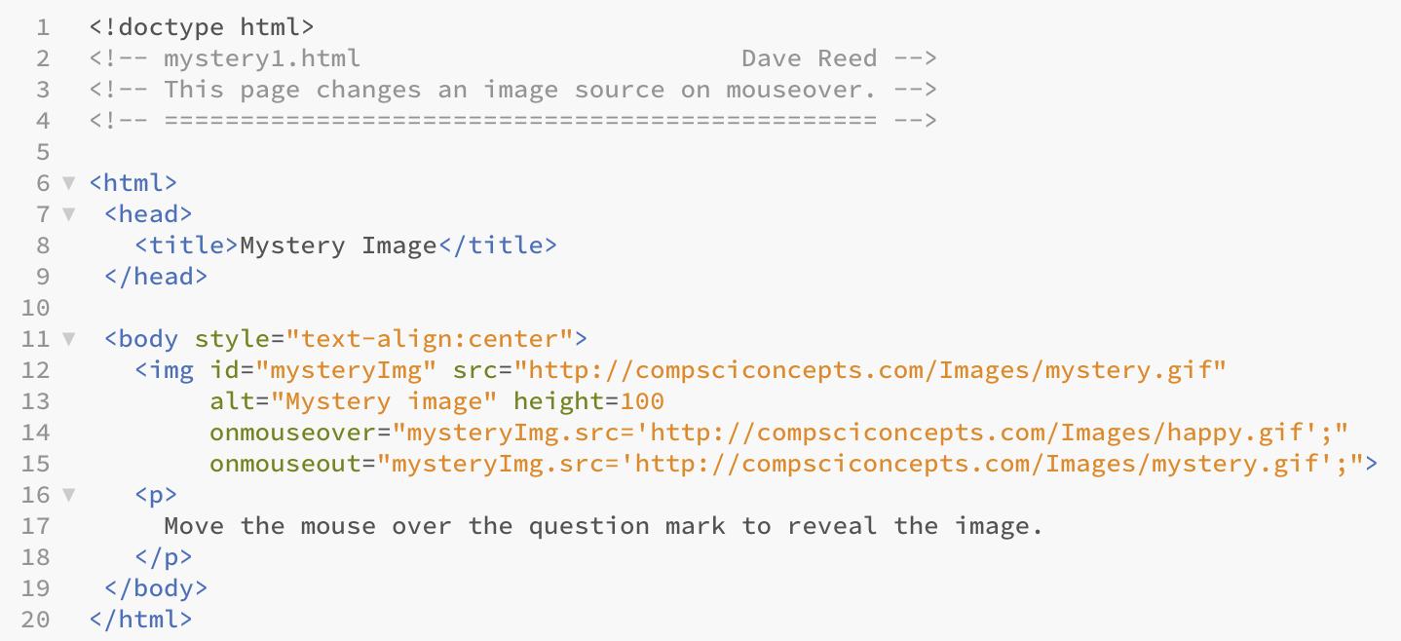
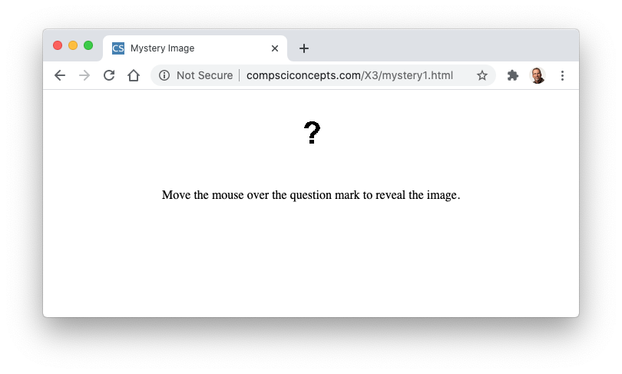
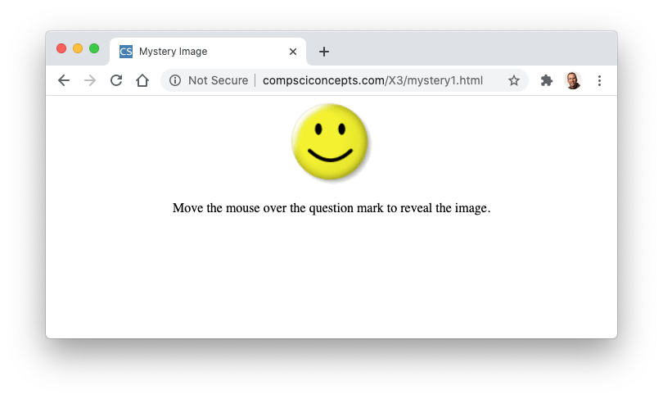
Mystery Image Page
initially, the image displays a '?'
when mouse moves over, SRC attribute is assigned to happy face
when mouse leaves, SRC attribute is assigned back to '?'

Slide 7
Strings & Syntax Errors
a string literal (or just string) is a sequence of characters enclosed in quotes
to avoid confusion, we will always use double quotes for HTML strings; single quotes for JavaScript strings
<img id="mysteryImg" src="mystery.gif" alt="Mystery image"
onmouseover="mysteryImg.src='happy.gif';"
onmouseout="mysteryImg.src='mystery.gif';">
syntax errors are errors in the format of HTML or JavaScript statements
for example, misspelling an element ID in a JavaScript assignment:
mysteryimg.src='http://compsciconcepts.com/Images/happy.gif';
unlike HTML syntax errors (which are largely ignored by the browser, JavaScript syntax errors often just fail
browsers produce error messages that help to identify JavaScript errors
in Google Chrome, error messages appear in the JavaScript Console:
View menu → Developer → JavaScript Console
when a page fails to behave as expected, CHECK THE ERROR MESSAGES!

Slide 8
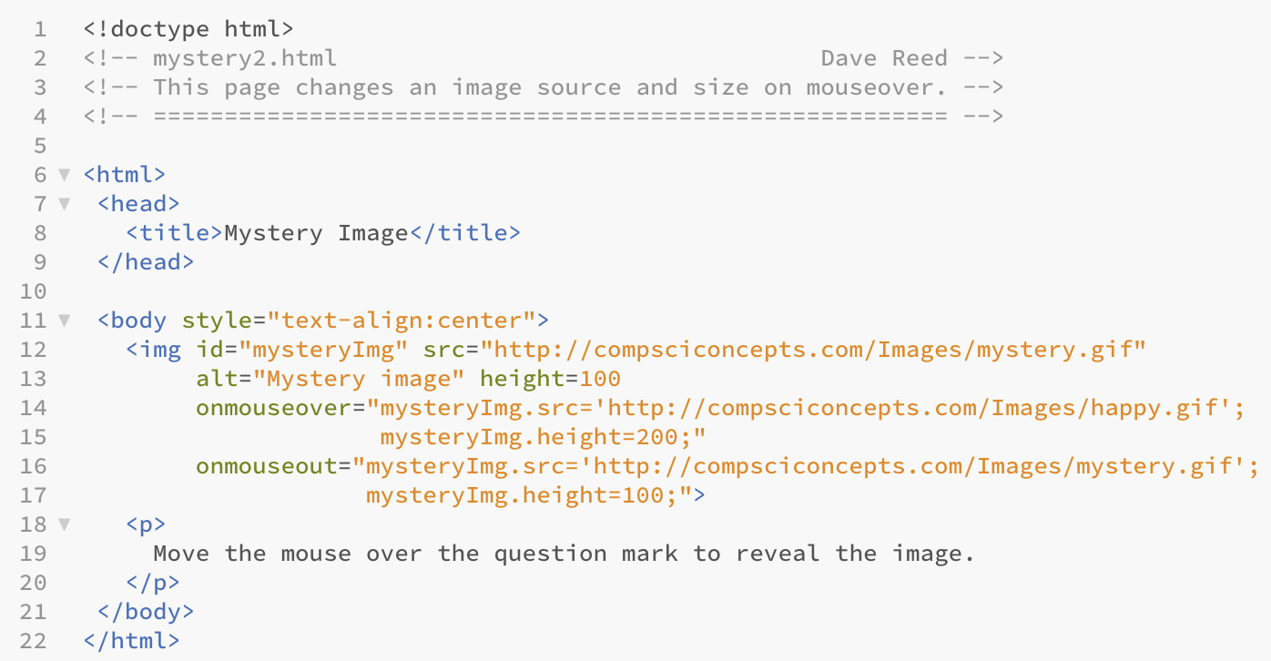
Multiple Actions
JavaScript assignments can similarly change other element attributes
e.g., can change an images height: mysteryImg.height = 200;
if desired, an event handler can perform multiple actions (separated by ;)
in this example, both the SRC and HEIGHT change on mouse events

Slide 9

Interaction via Buttons
a button is an HTML element that appears as a labeled rectangle or oval
usually associated with the ONCLICK event handler attribute, which specifies the action to take place when the button is clicked
general form:
<button onclick="CODE_TO_BE_EXECUTED_WHEN_MOUSE_CLICKS_ON_BUTTON">
BUTTON_LABEL
</button>
typically, buttons are used to initiate actions on other elements
e.g., click on a button to change the src or height/width of an img
<button onclick="mysteryImg.height=200;">Expand the Image</button>

Slide 10
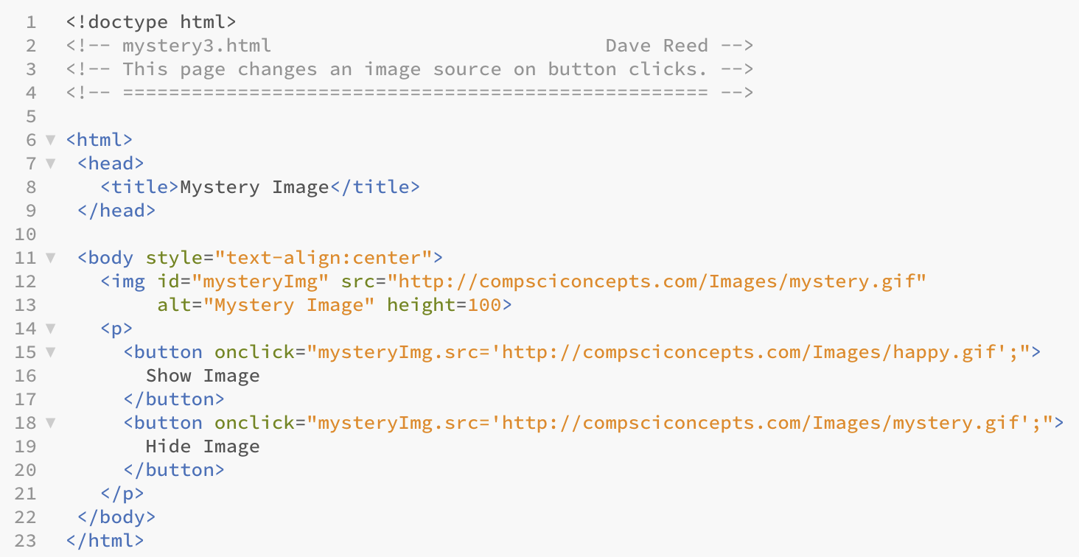

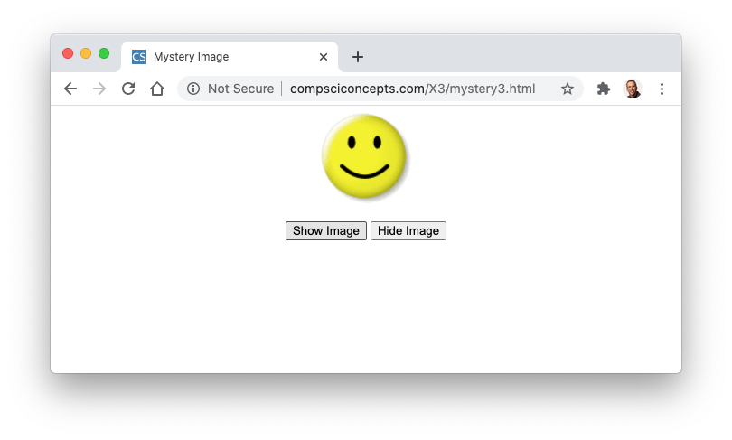
Button Example
image initially displays a question mark
when Show Image button is clicked, the image changes to 🙂
when Hide Image button is clicked, it changes back to ?

Slide 11
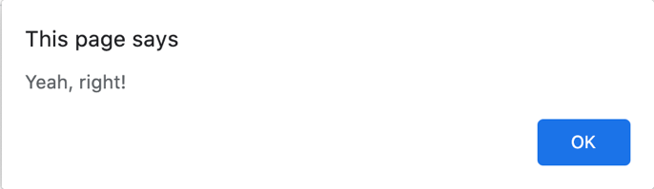
Dynamic Text
to display text within a page, there are 2 main options
alert statement: will display a simple text message in a separate alert window
innerHTML attribute: can display text directly in the page
general form of an alert statement: alert('MESSAGE');
when executed, it opens a separate window displaying that message
<button onclick="alert('Yeah, right.');">
Click for free money!
</button>
alert statements are useful when you want to display a short (1-line) message
the messages are limited, in that they can't include any HTML tags
can be annoying to the user since the pop-up window must be manually closed
note: if a message contains an apostrophe, must use backslash (escape character) to distinguish it from the ending quote: alert('I\'m happy you are here.');

Slide 12
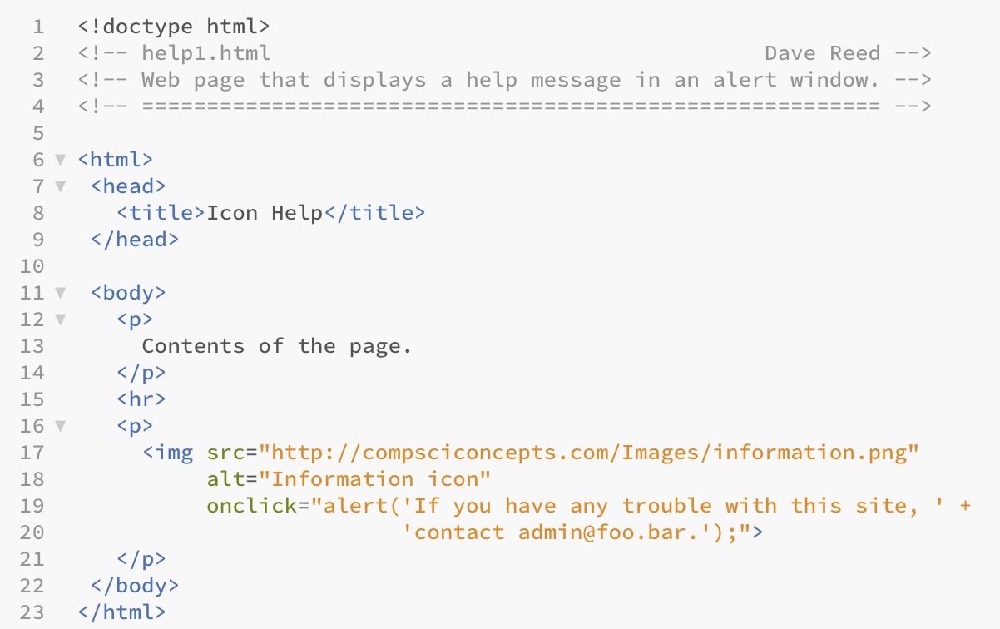
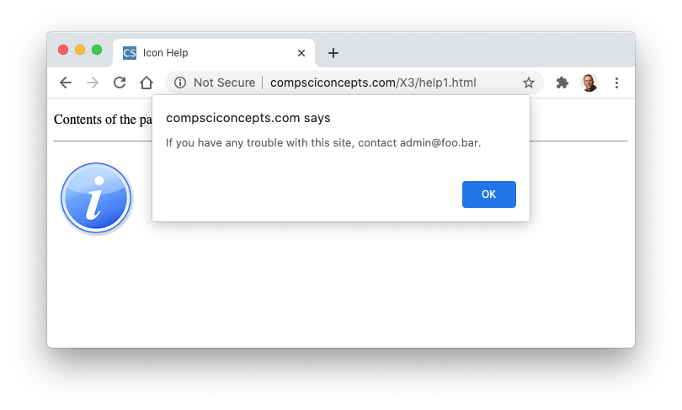
Help Page
when the mouse clicks on the image, an alert window is opened,
displaying the message
note: the user must click OK to close the window

Slide 13
innerHTML
better yet, embed the text directly in the page
text-based elements (p, span, div) have an innerHTML attribute
can be used to access or change the text within that element
be careful: the capitalization must be exact
outputSpan.innerHTML = 'Hello';
outputDiv.innerHTML =
'<p>You can write long messages that are embedded directly ' +
'in the page. You can even add <i>HTML formatting</i> to the ' +
'text. </p> <p>The contents of this dynamic DIV element is ' +
'being assigned multiple paragraphs.</p>';
outputP.innerHTML = outputP.innerHTML + '!';

Slide 14
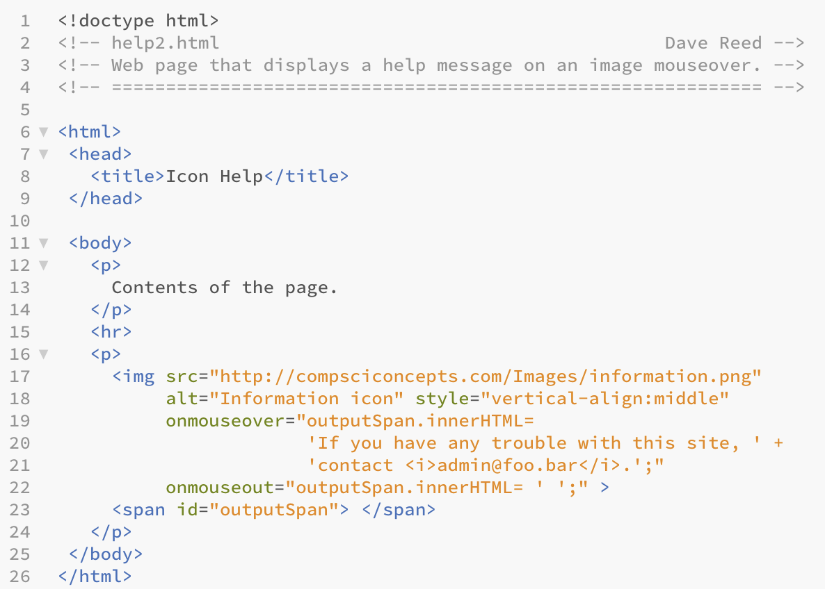
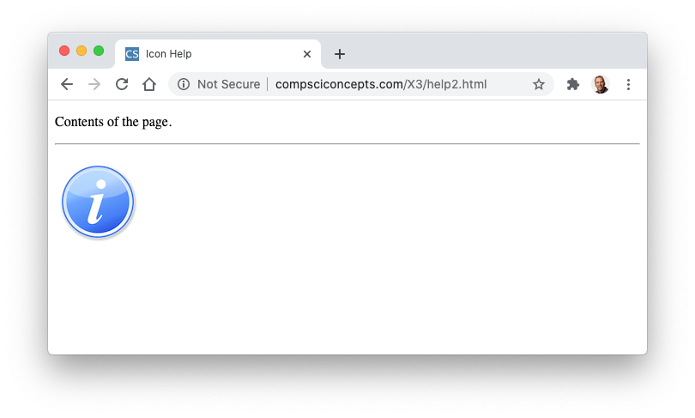

Help Page
initially, outputSpan is blank
when the mouse moves over the image, a text message is assigned to outputSpan.innerHTML (showing the message)
when the mouse moves off the image, an empty string is assigned back to outputSpan.innerHTML
(erasing the message)

Slide 15
Common Errors
two types of errors are common when displaying complex messages
BROKEN STRING: can't start a string on one line and continue on the next
alert('This example is illegal because the
string is broken across lines');
alert('This example is OK because the message ' +
'is broken into two distinct strings');
DISCONNECTED STRING: if message is broken into pieces, must have + between the pieces to connect them
alert('This example is illegal because '
'there is not a plus connecting the pieces');
alert('This example is OK because the ' +
'pieces are properly connected');
error messages in the JavaScript Console make identifying these types of mistakes much easier

Slide 16
Dynamic Style
it is also possible to change the style attribute of an element
must specify the property to be changed: style.PROPERTY
if the property contains a hyphen, instead use capitalization
e.g., background-color → backgroundColor
<p id="colorP"
onmouseover="colorP.style.color='red';"
onmouseout="colorP.style.color='black';">
This text will turn red when the mouse moves over it.
</p>
<p>This is a really
<span id="colorSpan
onmouseover="colorSpan.style.backgroundColor='yellow';"
onmouseout="colorSpan.style.backgroundColor='white';">
important</span> point to note.
</p>

