Slide 1
Computer Science:
Concepts & Explorations
2nd edition
David Reed, Creighton University
Hypertext & Multimedia

Slide 2
Hypertext
recall: HTML elements such as p, span, div, h1 organize text in a Web page
  br, &nbsp;, b, i, u, sup, sub give the designer some layout/formatting control
  the style attribute enables even greater control over the style of text
other HTML elements allow for pages to go beyond text: hypertext
  anchor (a) element embeds a hyperlink for navigation
  img element embeds an image
  video, audio elements embed media players
  ol and ul organize text into ordered and unordered lists
  table organizes text into rows and columns
with the addition of these elements, you will be prepared to design and create professional-looking Web pages

Slide 3
Hyperlinks
a hyperlink, or just link, is a connection to another Web page
  by default, a link appears as underlined text in the page
  when the user clicks on the link, the corresponding page is retrieved and displayed
a link is specified using anchor tags <a> and </a>
  text that appears within the tags is displayed as an underlined link
  must have an href attribute that specifies the associated Web address (also known as a Uniform Resource Locator, or URL)
    an absolute (or external) address begins with http:// or https:// and is stored on a Web server
    a relative (or internal) address is stored in the same folder as the referring page
  <a href="http://www.creighton.edu">Creighton University</a>
  <a href="personal.html">Local Page</a>

Slide 4
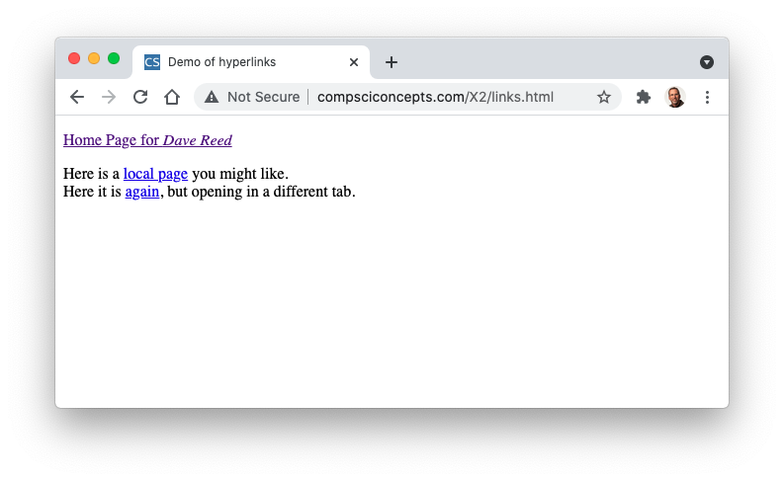
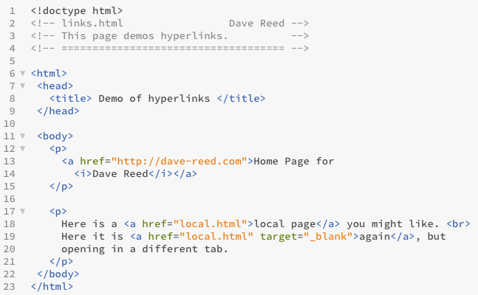
Hyperlinks Example
an unvisited link is shown in blue
a previously visited link is shown in purple
target="_blank" opens the page in a new tab

Slide 5
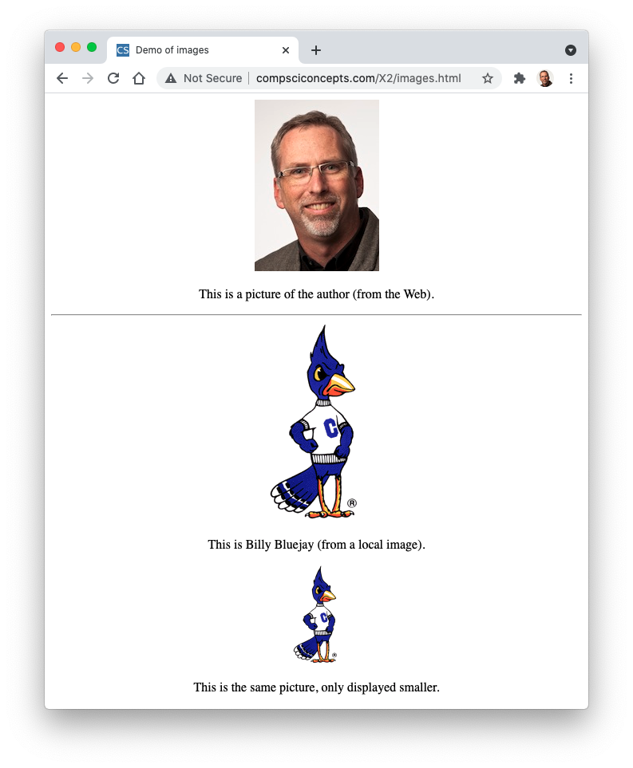
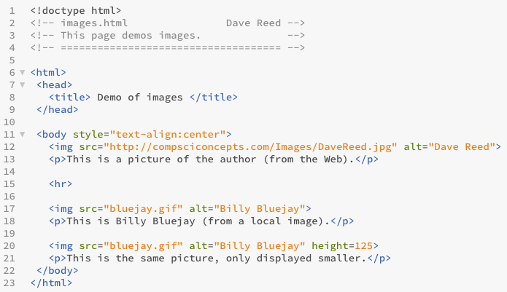
Images
images are embedded in a page using an img tag: <img>
  the src attribute specifies the address (URL) of the image file
    as before, the address can be absolute (external) or relative (internal)
  the alt attribute specifies alternate text to display if the image fails to load

Slide 6


Image sizing
you can change the size of an image in a page using the height or width attribute
<img src="bluejay.gif" alt="Billy Bluejay">
will display the image in its normal dimensions
<img src="bluejay.gif" alt="Billy Bluejay" height=200>
will display the image with a height of 200 pixels,
the width will automatically be adjusted to maintain
the current aspect ratio
<img src="bluejay.gif" alt="Billy Bluejay" width=100>
will display the image with a width of 100 pixels,
the height will automatically be adjusted to maintain
the current aspect ratio
advice: don't ever assign the height and width simultaneously
if the aspect ratio is changed, can flatten or stretch the image

Slide 7


Image alignment
can place an image and text side-by-side by placing in the same paragraph
<p><img src="bluejay.gif" alt="Billy Bluejay">
This is Billy Bluejay
</p>
by default, text will be aligned at the bottom, but you can set the vertical alignment of the image to change this
<p><img src="bluejay.gif" alt="Billy Bluejay"
style="vertical-align:middle">
This is Billy Bluejay
</p>

Slide 8
Video & Audio
while not as commonly used as images, you can embed video and audio players in a page using video and audio elements
  each element has a nested source element that specifies the video/audio file to be loaded
  the controls attribute displays user controls (e.g., play, pause) in the player
<video controls>
<source src="movie.mp4" type="video/mp4">
</video>
<audio controls>
<source src="sound.mp3" type="audio/mp3">
</audio>
online media repositories (e.g., YouTube) do not allow direct access to the file
  instead, you must use an inline frame element, which embeds a media player from the site
<iframe src="https://www.youtube.com/embed/MyDehO1IuG4" allowfullscreen></iframe>

Slide 9
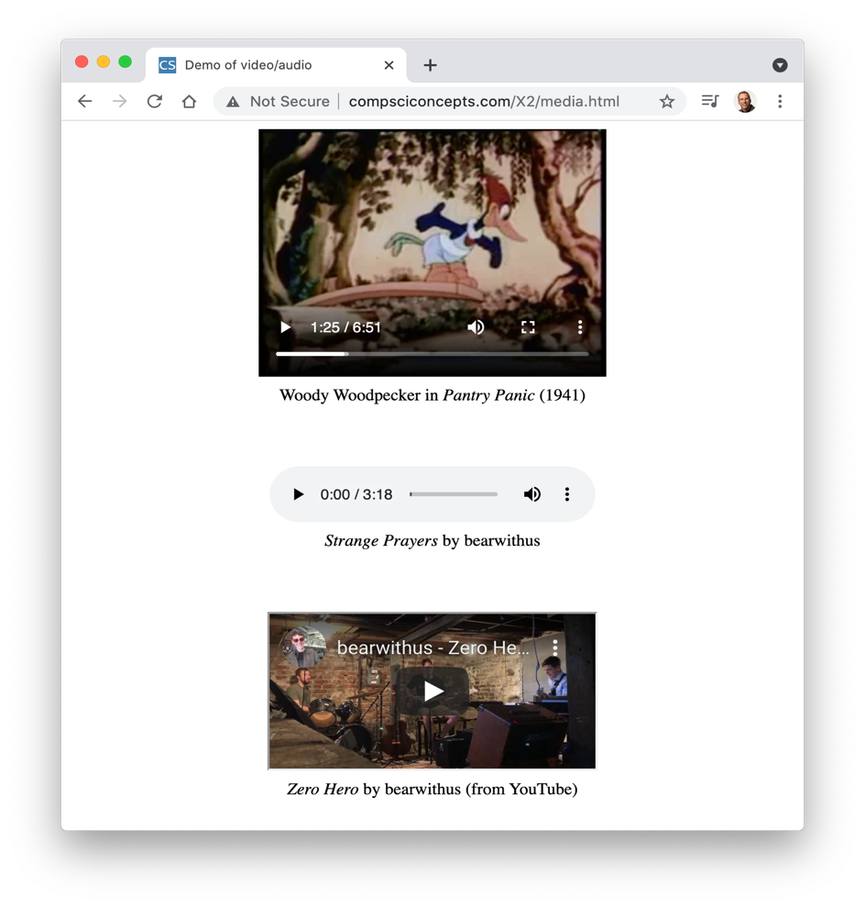
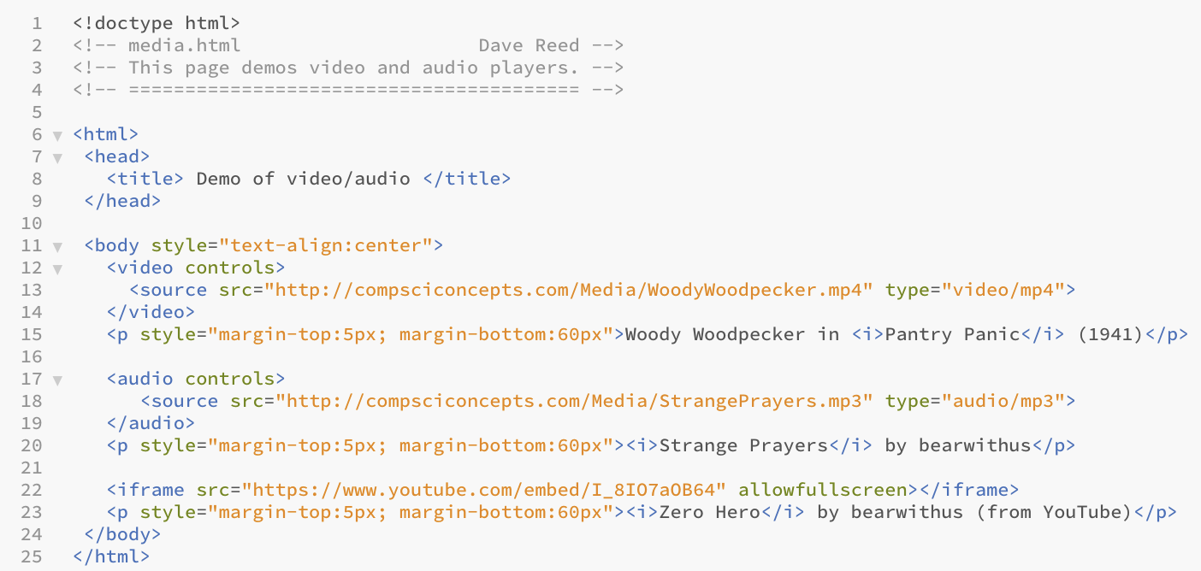
Media Example

Slide 10
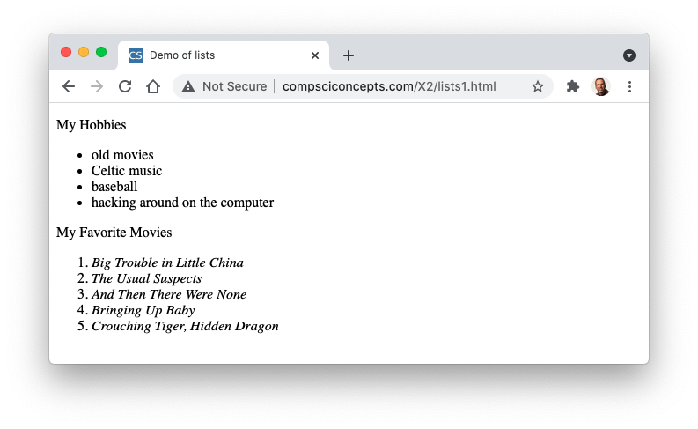
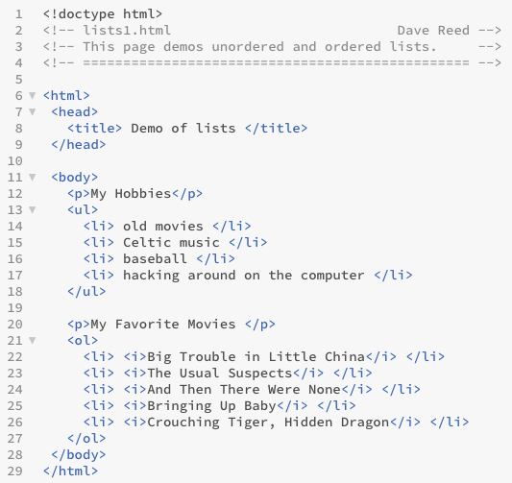
Lists
HTML lists organize items in sequence
  <ul>…</ul> enclose an unordered list; <ol>…</ol> enclose an ordered list
  <li>…</li> enclose a list item

Slide 11
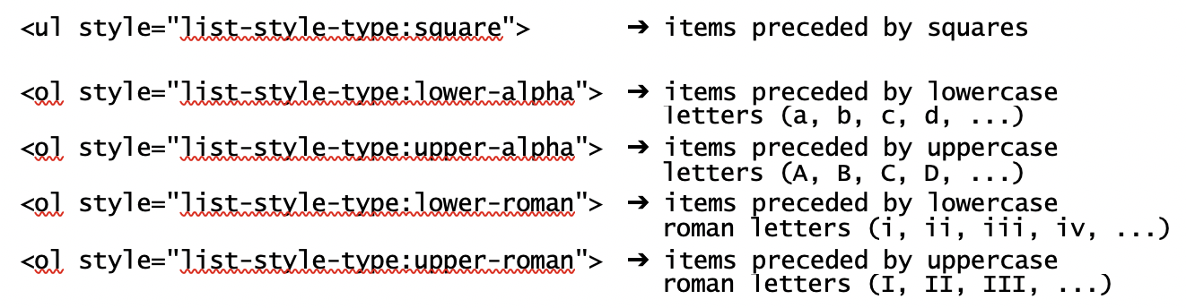
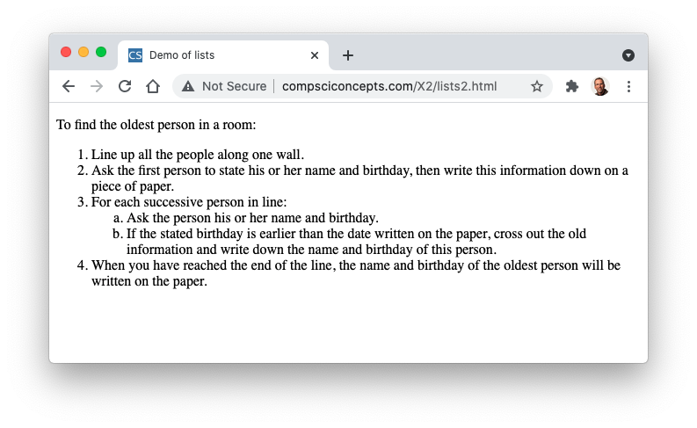
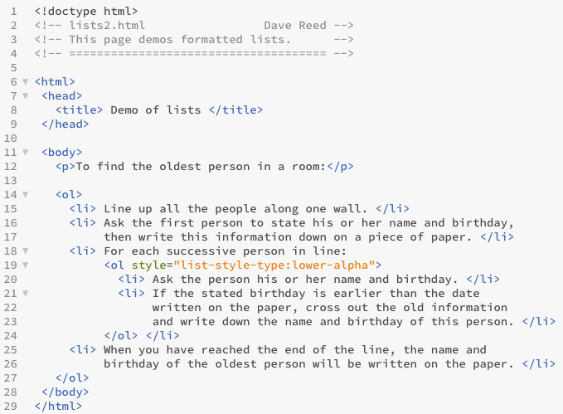
List Formatting
a style attribute can be used to format the list elements

Slide 12
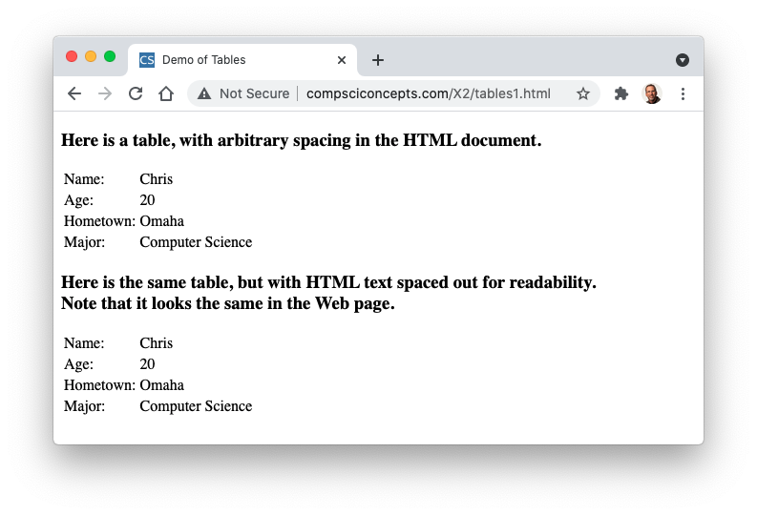
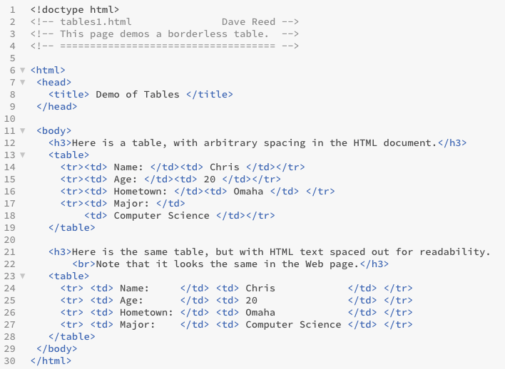
Tables
text can be aligned into rows and columns using a table element
  <table> and </table> encapsulate the table data
  <tr> and </tr> encapsulate a row within the table
  <td> and </td> encapsulate table data within a row (i.e., a column entry)

Slide 13
Table Formatting
style attributes can control how the table is displayed
<table style="border:5px solid; border-collapse:collapse">
. . .
</table>
the border will be 5 pixels wide & internal border lines will collapse into single lines
<table style="margin-left:auto; margin-right:auto">
. . .
</table>
will center the table (horizontally) in the page

Slide 14
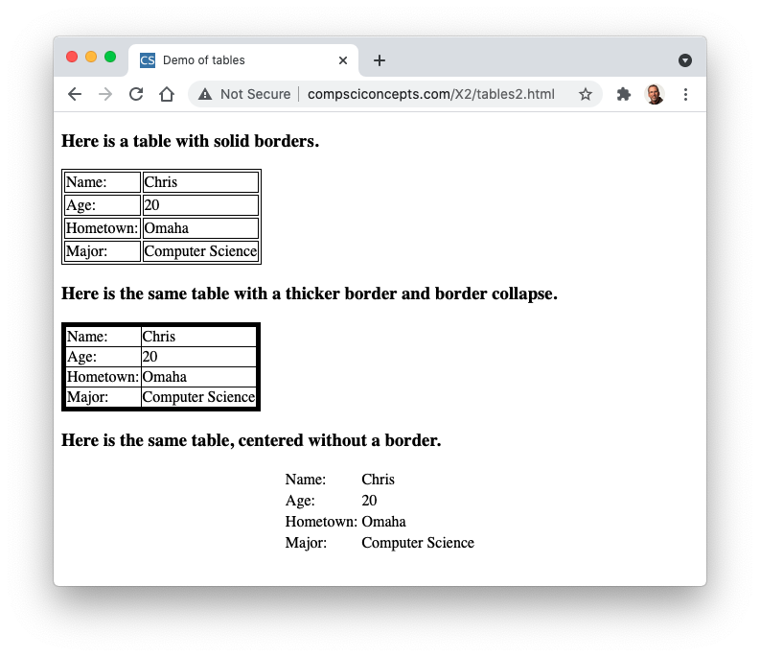
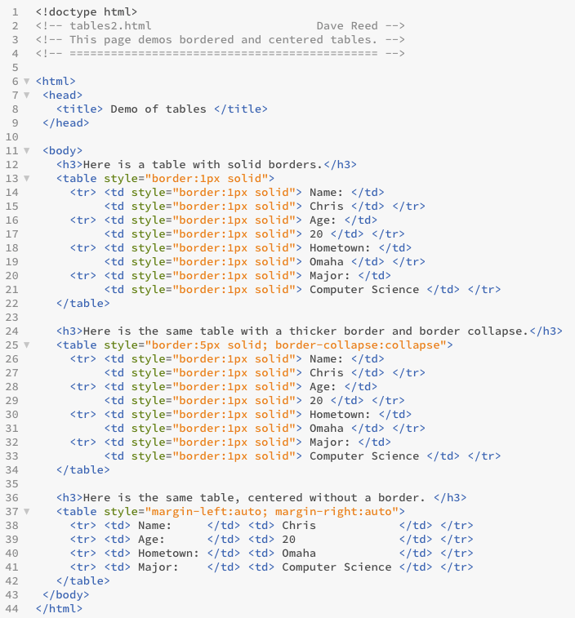
Table Formatting Example

