Slide 1
Computer Science: Concepts & Explorations 2nd edition David Reed, Creighton University
HTML and Web Pages

Slide 2
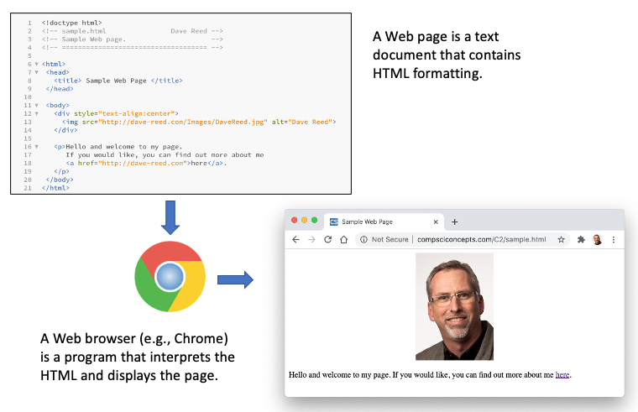
HTML & Web Pages
a Web page is a text document that contains additional formatting information in the HyperText Markup Language (HTML)
HTML specifies formatting within a page using tags
in its simplest form, a tag is a word or symbol surrounded by brackets (<>)

Slide 3
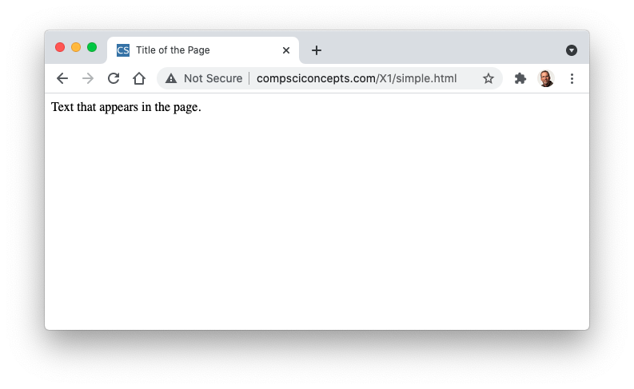
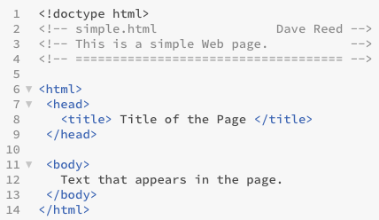
HTML Tags
required tags in a Web page:
<!doctype html> tells the browser this is a Web page
<html> and </html> enclose the entire HTML document
the head section (enclosed between <head> and </head>) contains information that the browser uses to control the look of the page
the head can contain a title for the browser window, enclosed between <title> and </title>
the body section (enclosed between <body> and </body>) contains the text that will appear in the page

Slide 4
HTML Elements
tags and the text they enclose form an HTML element
<title> Title of the Page </title> is a title element
<head>
<title> Title of the Page </title>
</head>
is a head element (which contains a nested title element)
most HTML elements have opening and closing tags, but not all
<!-- simple.html Dave Reed --> is a comment element
a comment is ignored by the browser (it does not appear in the rendered page)
comments are used by the page developer to document page features

Slide 5
Text Layout & Formatting
extra white space (spaces, tabs and blank lines) is ignored by the browser
this allows the browser to adjust the text to the window size
you can control some of the text layout using HTML elements
a paragraph element (<p>…</p>) specifies text surrounded by blank lines
a break element (<br>) causes text to be displayed on a new line
the &nbsp; special symbol forces a space to appear in the text
you can specify some text formatting using other HTML elements
a b element (<b>…</b>) specifies bold text
an i element (<i>…</i>) specifies italicized text
a u element (<u>…</u>) specifies underlined text
a sup element (<sup>…</sup>) specifies ^{superscripted text}
a sub element ( <sub>…</sub> ) specifies _{superscripted text}

Slide 6
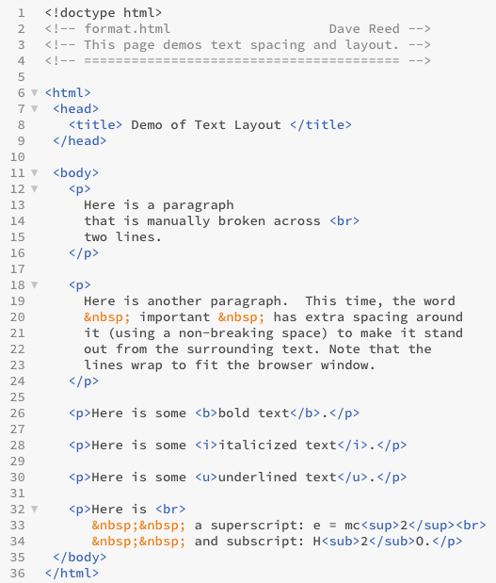
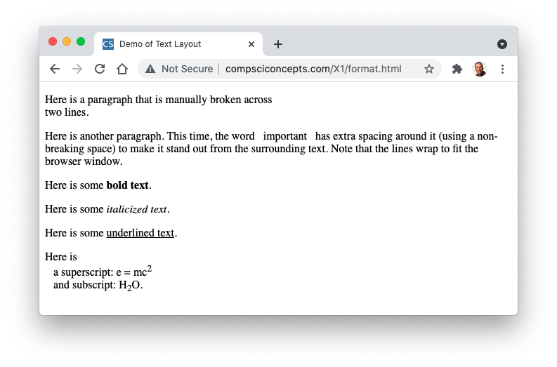
Layout & Formatting Example

Slide 7
Sections
in a large document, it is useful to divide the text into sections and then provide each with a heading describing the content that follows
<h1> … </h1> enclose a Top-level Heading
<h2> … </h2> enclose a Sub-heading
.
.
.
<h6> … </h6> enclose a Sub-sub-sub-sub-sub-heading
the horizontal-rule element <hr> draws a dividing line in the page

Slide 8
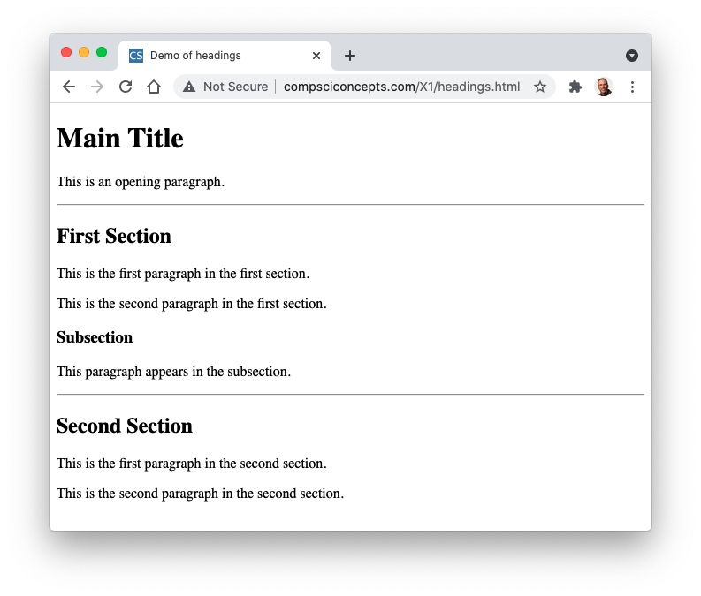
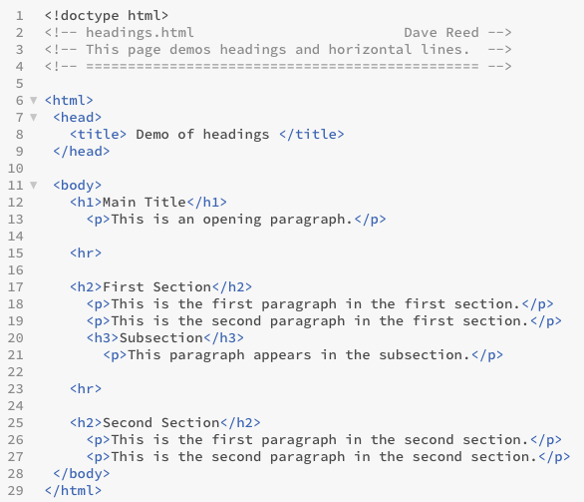
Section Example

Slide 9
Styling Elements
Web browsers rely on user preferences when displaying a page
each browser has a set of default (language, font, text size, color scheme), which can be reset by the user
can override some of these defaults by adding STYLE attributes
an attribute is qualifier that can be added to an element in its opening tag
the style attribute can be used to set style properties for an element
style="PROPERTY:VALUE"
e.g., can change the text color for an element by setting the color property
<p style="color:red"> Here is some red text. </p>

Slide 10
BODY Styling
when a style property is assigned to the body element, it applies to all elements embedded in the page
<body style="color:darkblue">
ENTIRE PAGE APPEARS IN DARK BLUE TEXT
</body>
the background-color property can also be set for the entire page
<body style="background-color:lightgray">
ENTIRE PAGE APPEARS WITH LIGHT GRAY BACKGROUND
</body>
can set multiple properties in the same style attribute
<body style="background-color:gray; color:white">
ENTIRE PAGE APPEARS WITH GRAY BACKGROUND, WHITE TEXT
</body>

Slide 11
SPAN & DIV
in addition to p, the span and div elements are useful for grouping text
span specifies a short span of text embedded in a paragraph
div specifies a page division which groups multiple elements together
span can be used to embedded colored words or phrases
<p>Isn't this page <span style="color:red">colorful</span>?</p>
div can be used to group paragraphs and color them as one
<div style="color:white">
<p>
You can format multiple paragraphs at once by placing them
inside a DIV and setting the STYLE attribute of the DIV.
</p>
<p>Both of these paragraphs will have white text.</p>
</div>

Slide 12
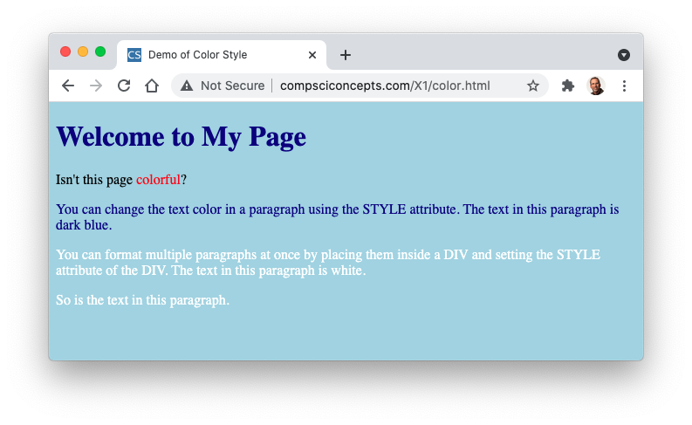
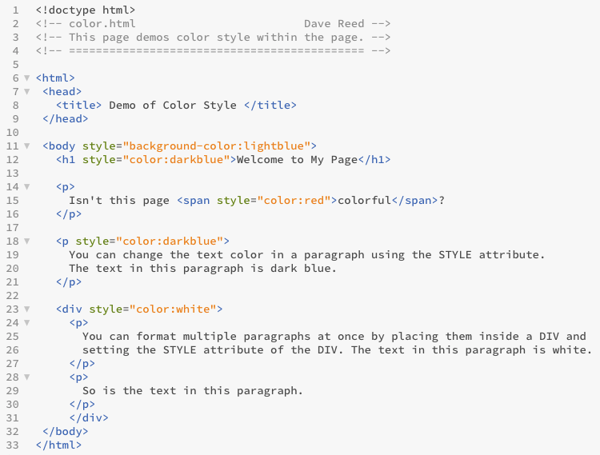
Color Styling Example

Slide 13
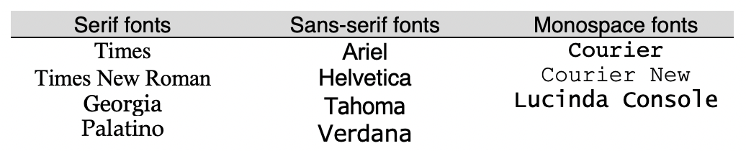
Font Styling
the font-family property can override the default font typeface
must specify the font name and its family (as a backup)
<p style="font-family:Helvetica, sans-serif">
This text appears in Helvetica.
</p>
<p style="font-family:Times, serif">This text appears in Times.</p>
the font-size property can override the default size of the font
can be absolute (in pixels) or relative to the current size (as percentage)
<span style="font-size:20px">This text appears 20 pixels tall.</span>
<p style="font-size:150%">This text is 50% larger than normal.</p>

Slide 14
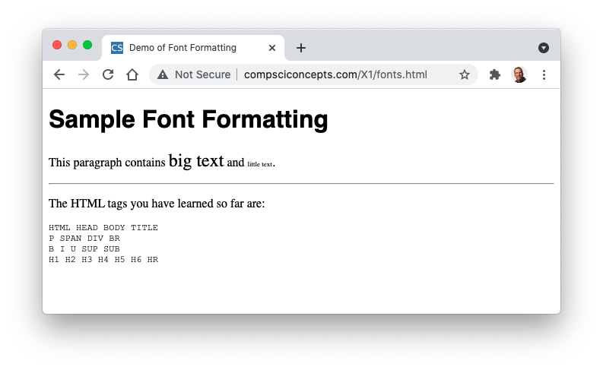
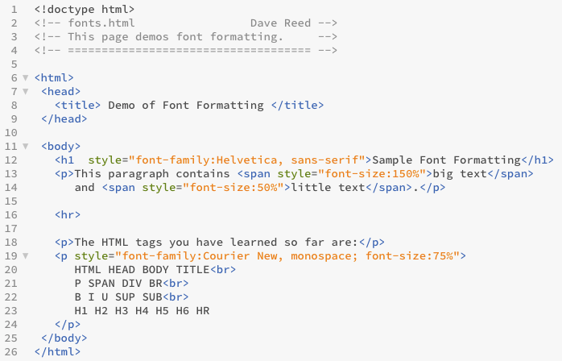
Font Styling Example

Slide 15
Alignment Styling
the text-align property can set the alignment of text elements
<h2 style="text-align:center">Centered Heading</h2>
<h2 style="text-align:right">Right-Justified Heading</h2>
<h2 style="text-align:justify">Left- and Right-Justified Heading</h2>
the text-indent property indents the first line of a paragraph
<p style="text-indent:10px">A paragraph with the 1st line indented...</p>
the margin-left and margin-right properties indent the entire paragraph
<p style="margin-left:10px">A paragraph with all lines indented...</p>

Slide 16
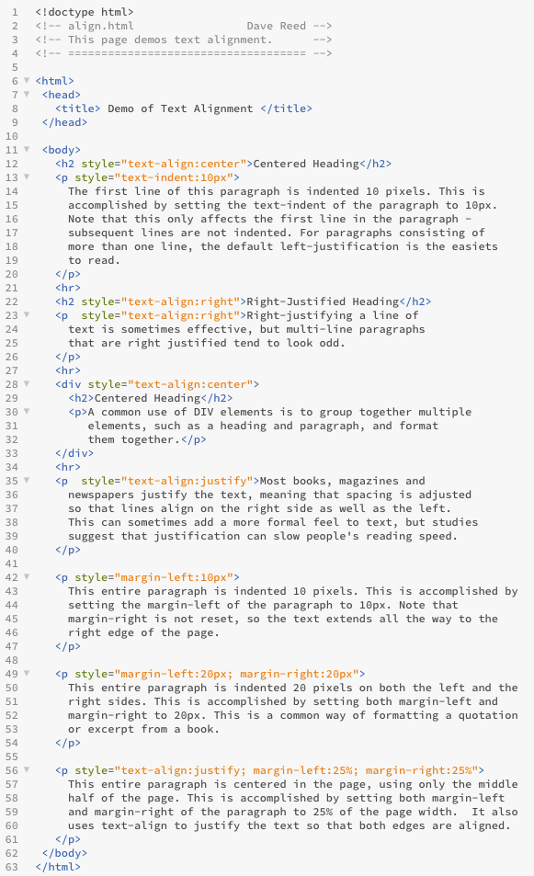
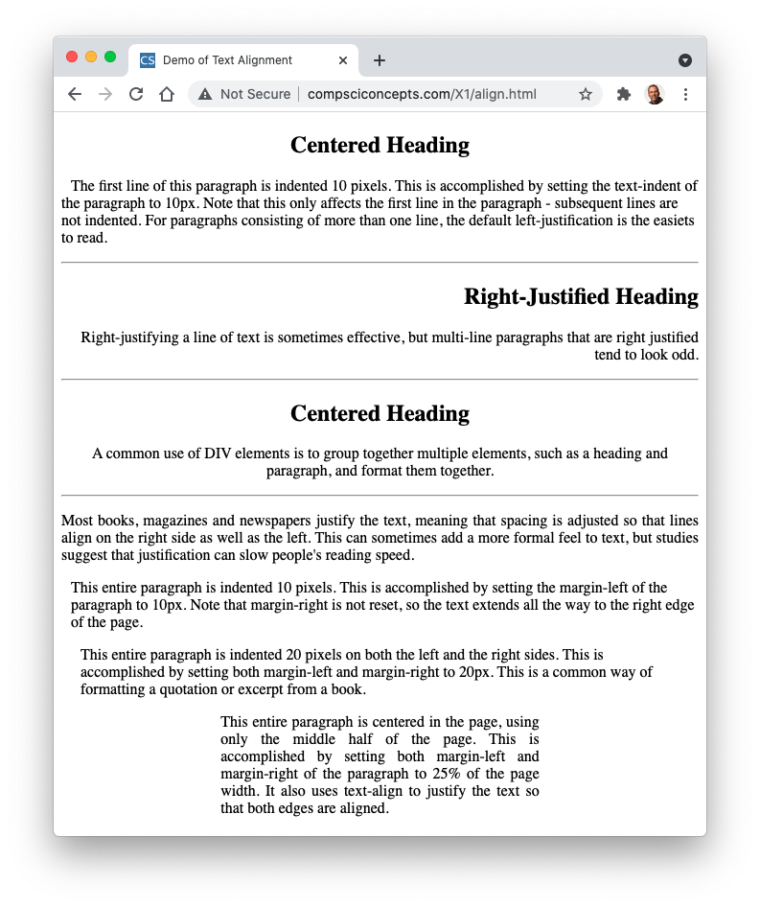
Alignment Styling Example

