Slide 1
Computer Science: Concepts & Explorations 2nd edition David Reed, Creighton University
Inside Multimedia

Slide 2
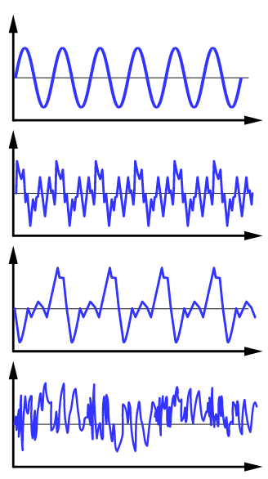
Representing Sounds
computers are capable of representing much more than numbers and text
complex data requires additional techniques and algorithms
EXAMPLE: representing sounds
sounds are inherently analog values with a specific amplitudes and frequencies
when sound waves reach your ear, they cause
your eardrum to vibrate, and your brain
interprets the vibration as sound
e.g. telephones translate a waveform into
electrical signals, which are then sent over
a wire and converted back to sound
e.g. phonographs interpret waveforms stored on
on grooves of a disk (similar to audio cassettes)
analog values cannot be reproduced exactly,
but this is not usually a problem since the
human ear is unlikely to notice small
inconsistencies
tuning fork
violin
piano
waterfall

Slide 3
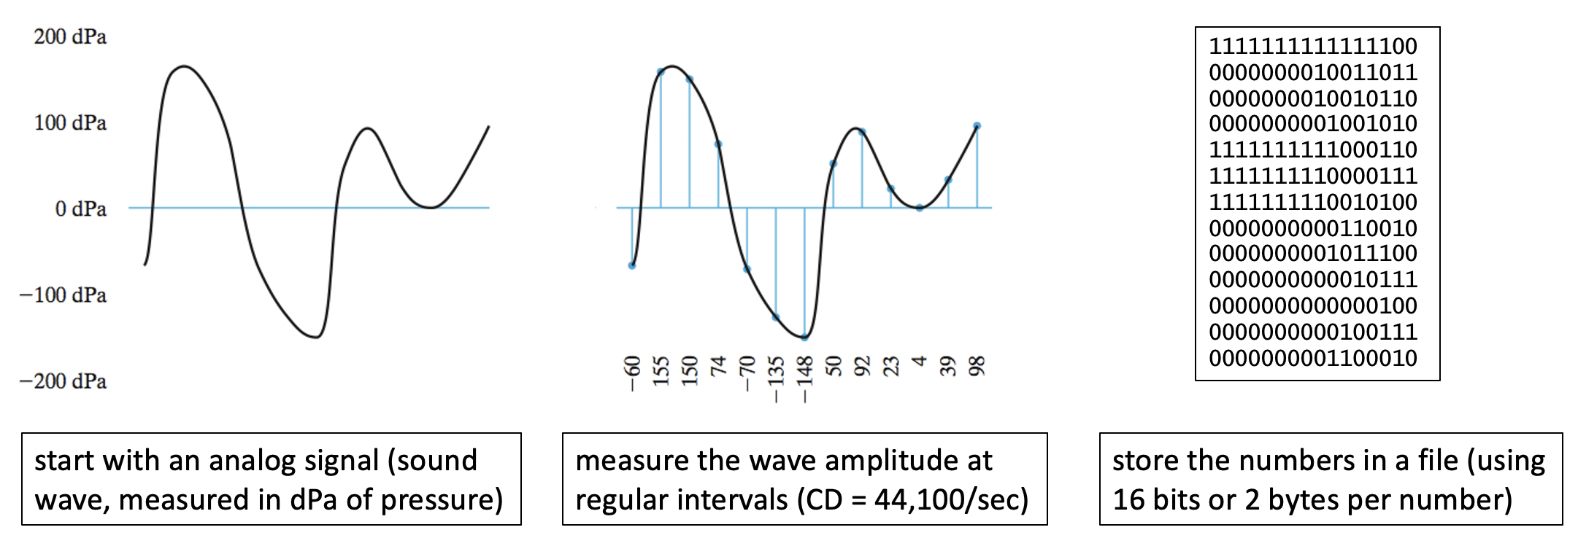
Representing Sounds (cont.)
when analog recordings are repeatedly duplicated, small errors that were originally unnoticed begin to propagate
digital recordings can be reproduced exactly without any deterioration
in sound quality
analog waveforms must be converted to a sequence of discrete values
digital sampling is the process in which the amplitude of a wave is measured at regular intervals, and stored as discrete measurements

Slide 4
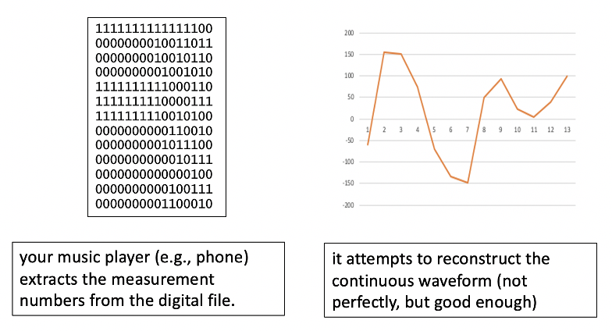
Representing Sounds (cont.)
to play a digital recording, a music player must extract the numbers and reconstruct the analog waveform
since there are gaps between measurements, the reconstruction will not be an exact reproduction of the original
CD takes 44,100 measurements/second, so gaps are small and the resulting sound is high-quality

Slide 5
Sound compression
CD-quality sound requires significant storage
consider a 3-minute, stereo recording (meaning two separate tracks)
assume each measurement is stored using 2 bytes
3 min x 60 sec/min x 2 tracks x 44,100 nums/sec x 2 bytes/num = 31.752 MB
since the typical music album contains 10-20 songs, CD storage requires: 317-634 MB of space
this will fit on a 700 MB disk, but would quickly overwhelm smartphones and portable music players
also, file size makes downloading or streaming music problematic
4G wireless connection can typically download up to 1.5 MB/second
to download 3 min song: 31.752 MB / 1.5 MB/sec = 21 seconds
to download 20 song album: 634 MB / 1.5 MB/sec = 7 minutes

Slide 6
Sound compression (cont.)
fortunately, techniques have been developed to reduce file size
e.g., filter out sounds beyond the range of human hearing
e.g., recognize when one track masks another
e.g., possibly even simplify the waveform
the MP3 format (introduced in 1993) uses techniques such as these to reduce file size by 75-95%
3 minute song: 31.752 x 0.05 = 1.6 MB = 1 second using G4
20 song album = 634 MB x 0.05 = 31 MB = 20 seconds using G4
MP3 is a lossy format
to achieve that level of compression, it makes simplifications and loses some of the information in the waveform
this results in lower sound quality when played

Slide 7
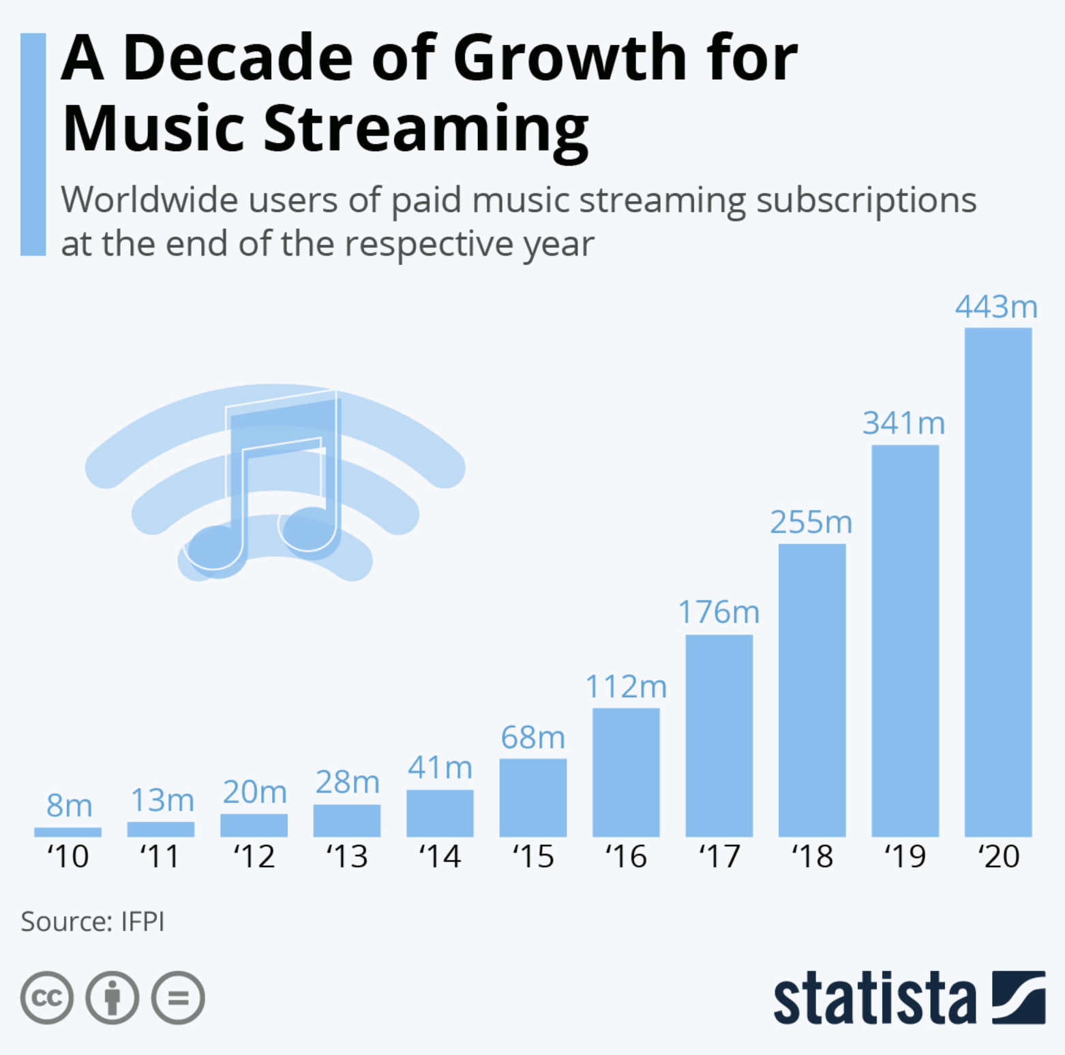
Impact on the music industry
before the CD in 1982, music piracy was almost non-existent
few people had the technology to copy a phonograph record
recording a cassette was easy, but the sound quality was bad
CDs changed the game
cheap devices for making perfect, digital copies were readily available
this panicked the music industry, led to MANY piracy prosecutions
before the MP3 format in 1993, streaming music was not feasible
now, phones & portable players are the primary music source for many
other digital audio formats have followed, e.g., WAV, AIFF, M4P.

Slide 8
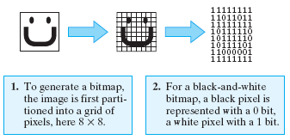
Representing Images
like sound, images are inherently analog
real-world colors come in an infinite variety of shades
film photography creates an analog representation using light-sensitive chemicals
like sound, techniques exist for digitizing images
the simplest involves partitioning the image into a grid of picture elements (pixels) and then converting each pixel into a bit pattern
the digital representation is known as a bitmap

Slide 9
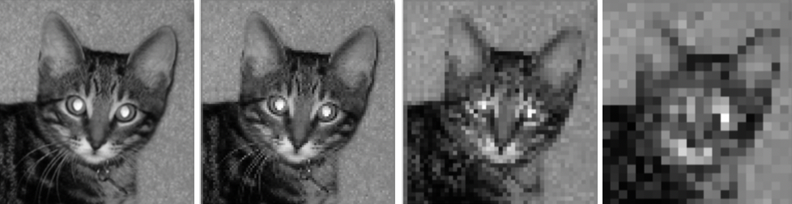
Image resolution
resolution refers to the sharpness or clarity of an image
bitmaps that are divided into smaller pixels will yield higher resolution images
the left image is stored using 72 pixels per square inch, each subsequent image has half the resolution
this is a grayscale image
each pixel is a shade of gray, somewhere between black and white
most image formats use 8 bits for a grayscale pixel → 256 shades of gray
as a result, grayscale requires 8x storage of black-and-white

Slide 10
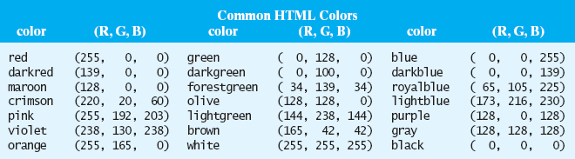
Color images
for color images, can break each color into its red, green & blue components
RGB value is a triple, listing the intensities of red, green & blue on a 0-255 scale
256³ = 16,777.216 different color combinations can be represented
each component requires 8 bits, so a total of 24 bits per pixel
→ color images require 3x storage of grayscale, 24x the storage of black-and-white
experiment with http://compsciconcepts.com/C9/rgb.html

Slide 11
Image compression
color bitmaps can be extremely large
12 megapixel image → 12 million pixels → 36 MB of storage
common image formats implement various compression techniques to reduce storage size
GIF (Graphics Interchange Format)
a lossless format, meaning no information is lost in the compression
commonly used for precise pictures, such as line drawings
25-50% reduction possible
PNG(Portable Network Graphics)
more modern, lossless alternative to GIF - more colors
10-50% smaller than GIF (so 33-75% reduction from bitmap)
JPEG (Joint Photographic Experts Group)
a lossy format, so the compression is not fully reversible (but more efficient)
commonly used for photographs
90-95% reduction possible
image formats also embed metadata (date, location, source, …) in images
can be useful for tasks such as organizing a photo gallery by data or geography

Slide 12
Steganography
an interesting side topic related to images is steganography
the practice of hiding a secret message in plain sight (e.g., within another message or object)
Take your secret message an encode it as bits (using ASCII/Unicode codes): b₁ b₂ b₃ b₄ b₅ b₆ b₇ b₈ b₉ ...
Take an image and break it into its RGB pixels: (R₁,G₁,B₁) (R₂,G₂,B₂) (R₃,G₃,B₃) …
For each bit b_{i} in the message, possibly change the B_{i} component of the corresponding pixel so that:
if b_{i} is even, then B_{i} is also even (add 1 to B_{i} if necessary)
if b_{i} is odd, then B_{i} is also odd (add 1 to B_{i} if necessary)
the resulting image will look the same to the human eye
e.g., most people can't distinguish between (20, 50, 100) and (20, 50, 101)
but, if you know to look, you can extract the message bits from the pixels

Slide 13
Example:
suppose the message starts with 'M' (whose ASCII value is 01001101)
and the image starts with pixels:
(100,200,50) (100,200,50) (100,202,52) (98,203,53) (88,190,48) (88,188,47) (86,180,40) (80,160,43)
then, embed the message bits in the B components of the pixels:
(100,200,50) (100,200,51) (100,202,52) (98,203,54) (88,190,49) (88,188,47) (86,180,40) (80,160,43)
to an unsuspecting viewer, the image will look normal
to a person who knows to look, the message bits can easily be extracted
(100,200,50) (100,200,51) (100,202,52) (98,203,54) (88,190,49) (88,188,47) (86,180,40) (80,160,43)
⇓ ⇓ ⇓ ⇓ ⇓ ⇓ ⇓ ⇓
0 1 0 0 1 1 0 1

Slide 14
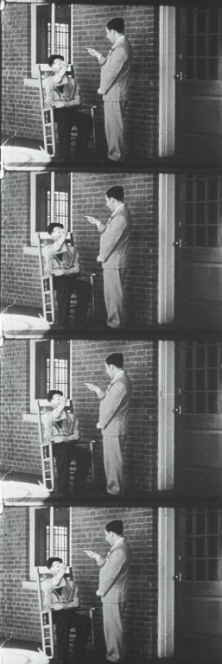
Representing movies
in principle, a movie is a sequence of images (frames) that are displayed in sequence to produce the effect of motion
typically, 24 frames/sec
MPEG or MP4 format uses a variety of techniques to compress video
individual frames use techniques similar to JPEG
since much of successive frames are same, need only store changes from frame to frame
elements of MPEG are included in the ATSC (Advanced Television Systems Committee) standard for digital TV
individual frames use techniques similar to JPEG
other related formats are DVD & Blu-Ray

Slide 15
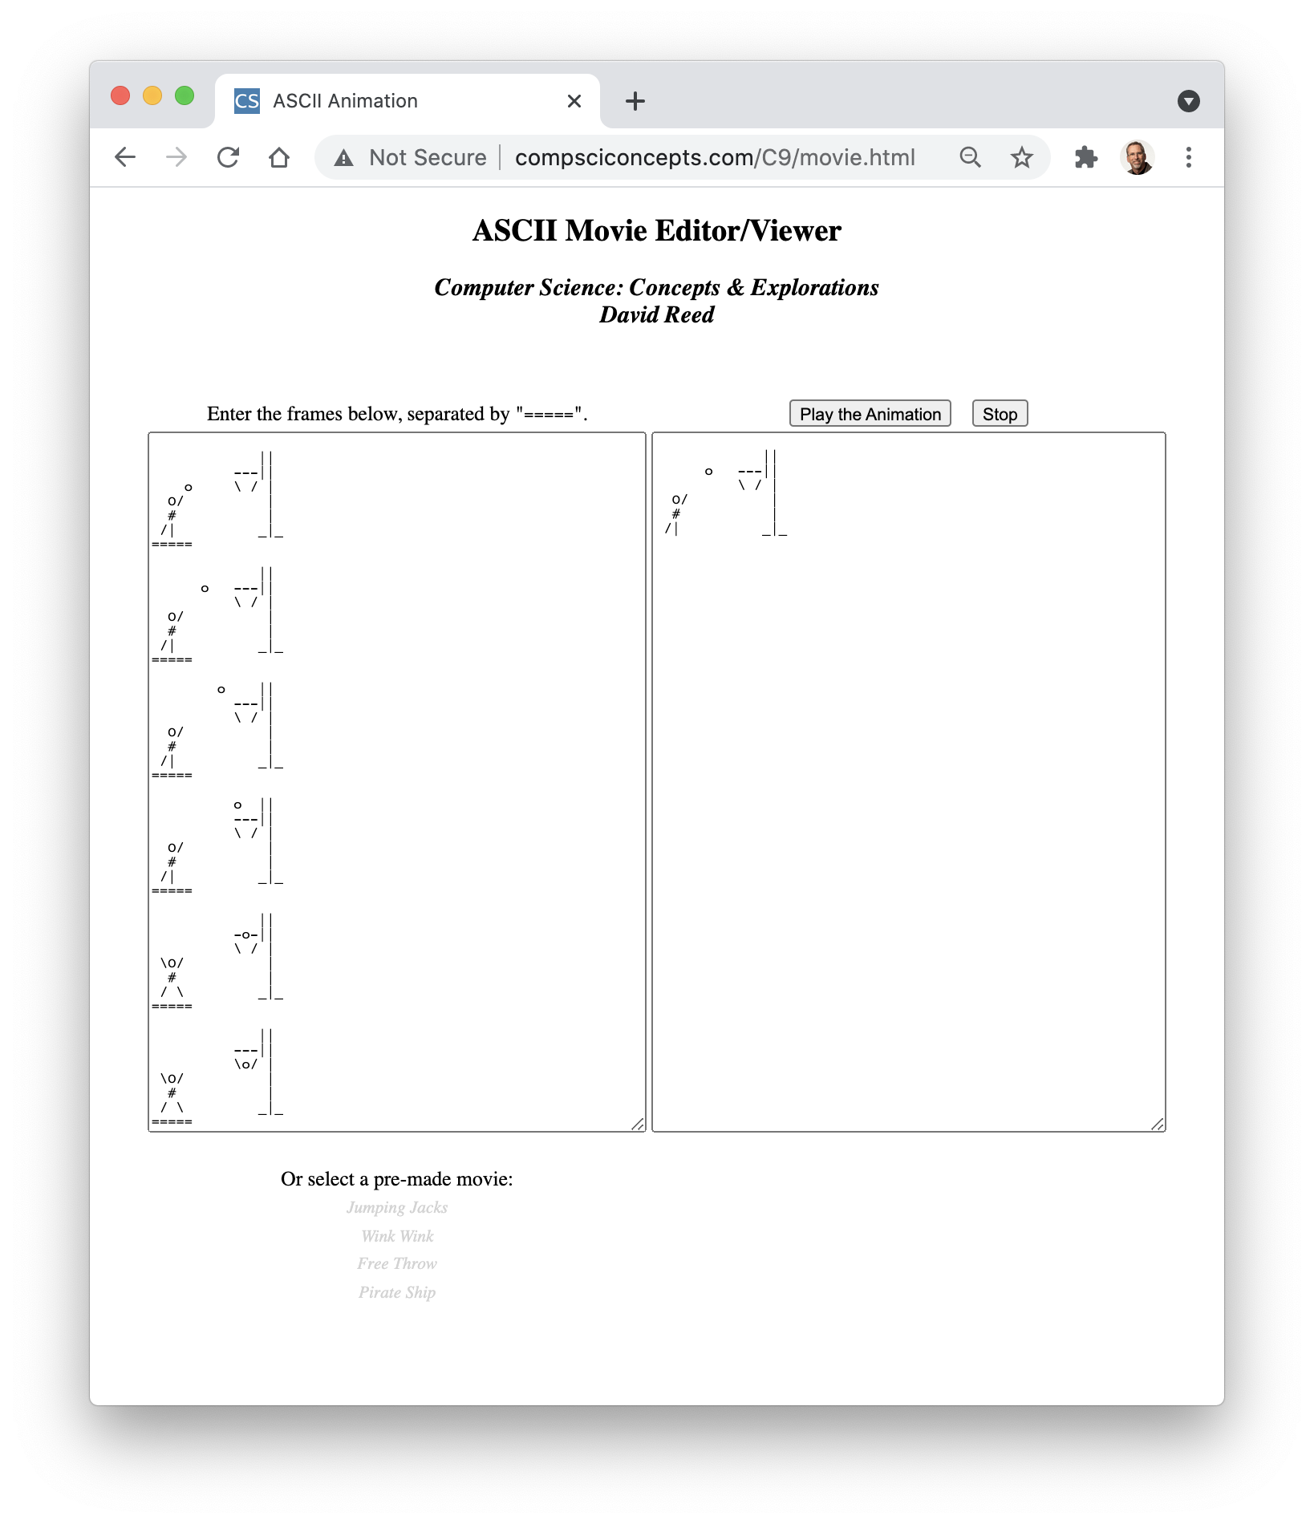
ASCII movies
for a fun and creative exercise, make your own movies
each frame is "drawn" using characters from the keyboard
frames are separated using =====
the button will "play" the movie, 5 frames/second

