Slide 1
Computer Science:
Concepts & Explorations
2nd edition
David Reed, Creighton University
Inside the Data

Slide 2

Analog vs. Digital
there are two ways data can be stored electronically
  analog values represent data in a way that is analogous to real life
    signals can vary continuously across an infinite range of values
  digital values utilize only a finite set of values

Slide 3
Analog/Digital Tradeoffs
the major tradeoff between analog and digital is variability vs. reproducibility
  analog allows for a (potentially) infinite number of unique signals, but they are harder to reproduce
    good for storing data that is highly variable but does not need to be reproduced exactly
  digital signals limit the number of representable signals, but they are easily remembered and reproduced
    good for storing data when reproducibility is paramount
when storing data on a computer, reproducibility is paramount
  changing a single bit in a file can drastically change the data
modern computers save and manipulate data as discrete (digital) values
  the most effective systems use two distinct (binary) states for representing data
  in essence, all data is stored as binary numbers

Slide 4
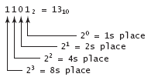
Binary Numbers
in the binary number system, all values are represented using only the two binary digits 0 and 1, which are called bits
we can also refer to bits by index
rightmost bit is index 0 (representing 2⁰ = 1s place)
next from right is index 1 (representing 2¹ = 2s place
next over is index 2 (representing 2² = 4s place
. . .
i^{th} index (from right) represents 2^{i} s place
note:
all even numbers end with a 0 bit; odd numbers with 1 bit WHY?
adding a 0 bit at the end it doubles its value WHY?

Slide 5
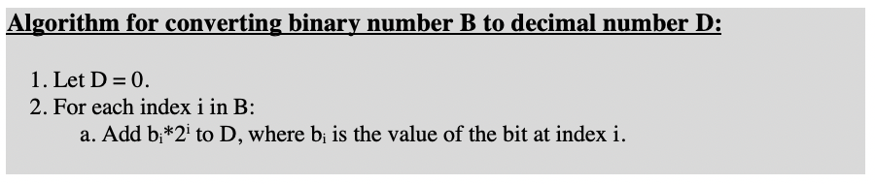
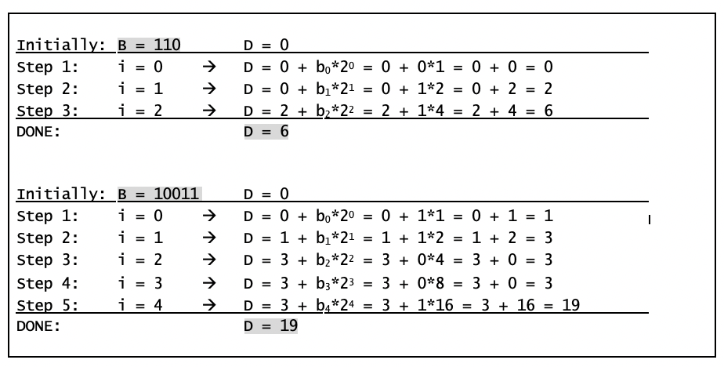
Binary → Decimal

Slide 6
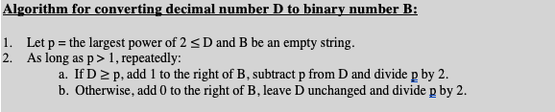
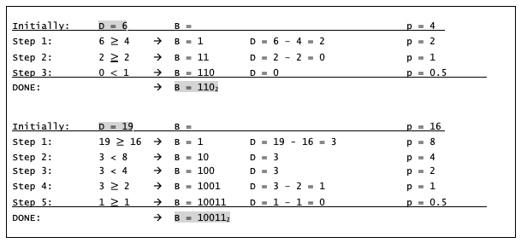
Decimal → Binary

Slide 7
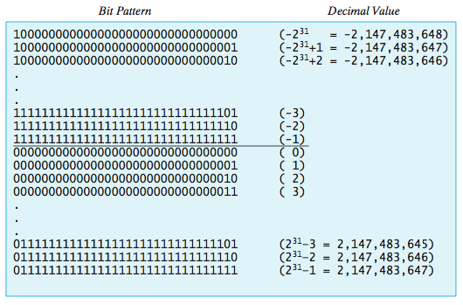
Representing Integers
when an integer value must be saved on a computer, its binary equivalent can be encoded as a bit pattern and stored digitally
usually, a fixed size (e.g., 32 bits) is used for each integer so that the computer knows where one integer ends and another begins
  the initial bit in each pattern acts as the sign bit (0=positive, 1=negative)
  negative numbers are represented in two’s complement notation
    the "largest" bit pattern corresponds to the smallest absolute value (-1)

Slide 8
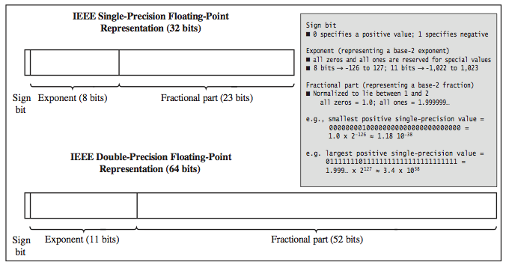
Representing Real Numbers
a real number can be uniquely identified by the two components of its scientific notation (fractional part and the exponent)
  123.456 = 0.123456 x 10³ 0.0099 = 0.99 x 10⁻²
thus, any real number can be stored as a pair of integers
  real numbers stored in this format are known as floating point numbers, since the decimal point moves (floats) to normalize the fraction
  standard formats exist for storing real numbers, using either 32 or 64bits
most programming languages represent integers and reals differently
JavaScript simplifies things by using IEEE double-precision floating point for all numbers

Slide 9
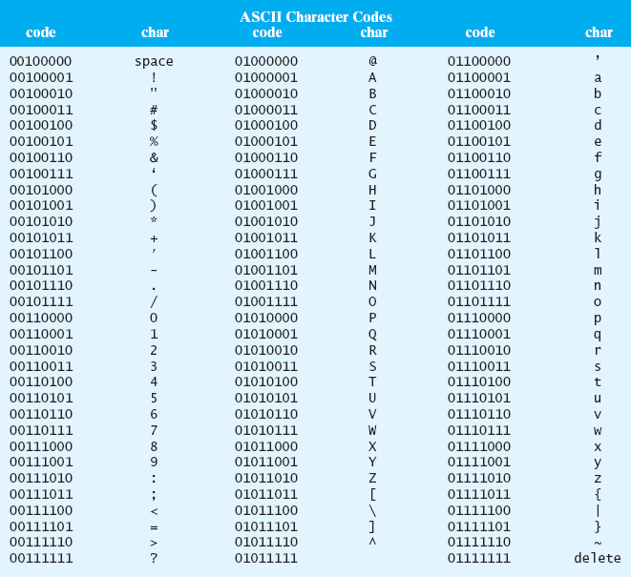
Representing Characters
characters have no natural correspondence to binary numbers
  computer scientists devised an arbitrary system for representing characters as bit patterns
  ASCII (American Standard Code for Information Interchange)
    maps each character to a specific 8-bit pattern
    note that all digits are contiguous, as are lower- and upper-case letters
    '0' < '1' < … < '9'
    'A' < 'B' < … < 'Z'
    'a' < 'b' < … < 'z'
  Unicode is a 16-bit extension to ASCII that supports other languages

Slide 10

Representing Text
strings can be represented as sequences of ASCII/Unicode codes, one for each character in the string
specific programs may store additional information along with the ASCII codes
  e.g. programming languages will often store the number of characters along with the ASCII/Unicode codes
  e.g., word processing programs will insert special character symbols to denote formatting (analogous to HTML tags in a Web page)

Slide 11
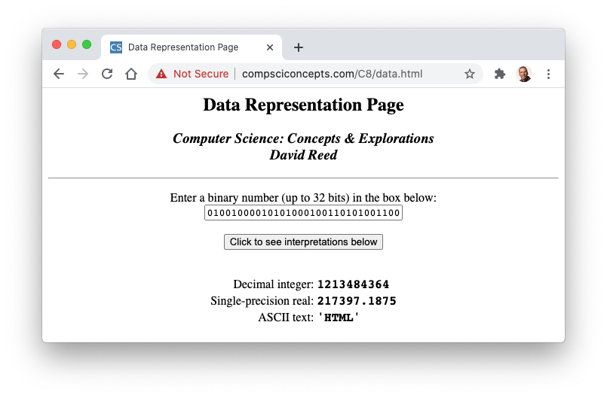
Distinguishing Data Types
how does a computer know what type of value is stored in a particular piece of memory?
  short answer: it doesn't
  when a program stores data in memory, it must store additional information as to what type of data the bit pattern represents
  thus, the same bit pattern might represent different values in different contexts

