Slide 1
Computer Science: Concepts & Explorations 2nd edition David Reed, Creighton University
Computer Science as a Discipline

Slide 2
Computer “Science”
some people argue that computer science is not a science in the same sense that biology and chemistry are
the interdisciplinary nature of computer science has made it hard to classify
computer science is the study of computation (more than just machinery)
it involves all aspects of problem solving, including
the design and analysis of algorithms
the formalization of algorithms as programs
the development of computational devices for executing programs
the theoretical study of the power and limitations of computing
whether this constitutes a "science" is a matter of interpretation
certainly, computer science represents a rigorous approach to understanding complex phenomena and problem solving

Slide 3
Artificial Science
many activities carried out by computer scientists utilize the scientific method
e.g., designing and implementing a large database system requires hypothesizing about its behavior under various conditioning, experimenting to test those hypotheses, analyzing the results, and possibly redesigning
e.g., debugging a complex program requires forming hypotheses about where an error might be occurring, experimenting to test those hypotheses, analyzing the results, and fixing the bugs
the distinction between computer science and natural sciences like biology, chemistry, and physics is the type of systems being studied
natural sciences study naturally occurring phenomena and attempt to extract underlying laws of nature
computer science study human-made constructs: programs, computers, and computational modes
Herbert Simon coined the phrase "artificial science" to distinguish computer science from the natural sciences
in Europe, computer science is commonly called "Informatics"

Slide 4
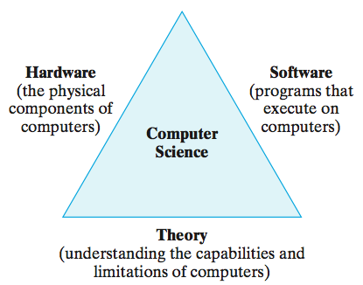
Computer Science Themes
since computation encompasses many different types of activities, computer science research is often difficult to classify
three recurring themes define the discipline

Slide 5
Hardware
hardware refers to the physical components of a computer and its supporting devices
most modern computers implement the von Neumann architecture
CPU + memory + input/output devices
ongoing research seeks to improve hardware design and organization
circuit designers create smaller, faster, more energy-efficient chips
microchip manufacturers seek to miniaturize and streamline production
systems architects research methods to increase throughput (the amount of work done in a given time period)
e.g., parallel processing – splitting the computation across multiple CPUs
e.g., networking – connecting computers to share information and work

Slide 6
Software
software refers to the programs that execute on computers
3 basic software categories
systems software: programs that directly control the execution of hardware components (e.g., operating systems)
development software: programs that are used as tools in the development of other programs (e.g. Microsoft.NET, Java SDK)
applications software: all other programs, which perform a wide variety of tasks (e.g., web browsers, word processors, games)
many careers in computer science are related to the design, development, testing, and maintenance of software
language designers develop and extend programming languages for easier and more efficient solutions
programmers design and code algorithms for execution on a computer
systems analysts analyze program designs and manage development

Slide 7
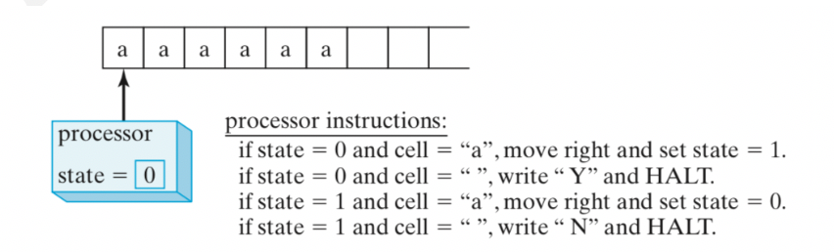
Theory
theoretical computer scientists strive to understand the capabilities of algorithms and computers (deeply rooted in math and formal logic)
example: the Turing machine is an abstract computational machine invented by computer pioneer Alan Turing
consists of: a tape on which characters can be written (I/O)
a processor that can read/write on the tape, move left or right (CPU)
space for storing the machine state - a number (memory)
significance of the Turing machine
it is programmable (example below is programmed to distinguish between an even or odd number of a's on the tape)
provably as powerful as any modern computer, but simpler so provides a manageable tool for studying computation
Turing used this simpler model to prove there are problems that cannot be solved by any computer!

Slide 8
Subfields of Computer Science
computer science can be divided into subfields
each subfield takes a unique approach to computation
however the common themes of computer science (hardware, software, and theory) influence every subfield
4 highly visible subfields
algorithms and data structures
architecture
software engineering
artificial intelligence and robotics

Slide 9
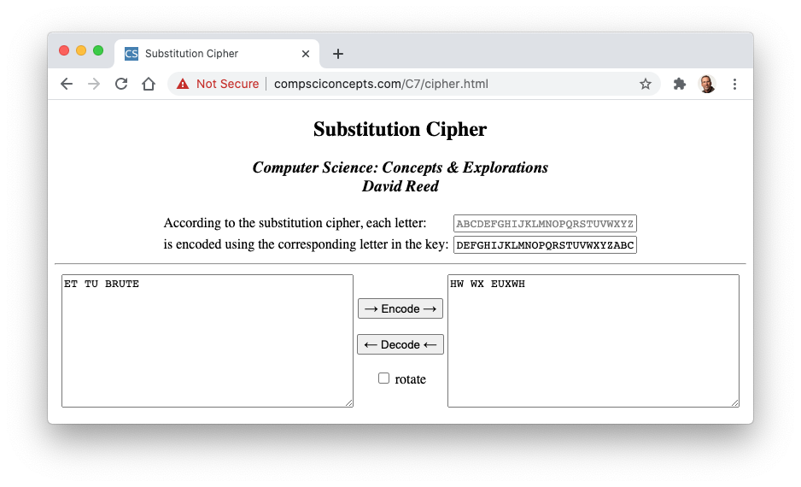
Algorithms and Data Structures
subfield that involves developing, analyzing, and implementing algorithms for solving problems
application: encryption
encryption is the process of encoding a message so that it is decipherable only by its intended recipient
Caesar cipher: shift each letter three down in the alphabet
e.g., ET TU BRUTE → HW WX EUXWH

Slide 10
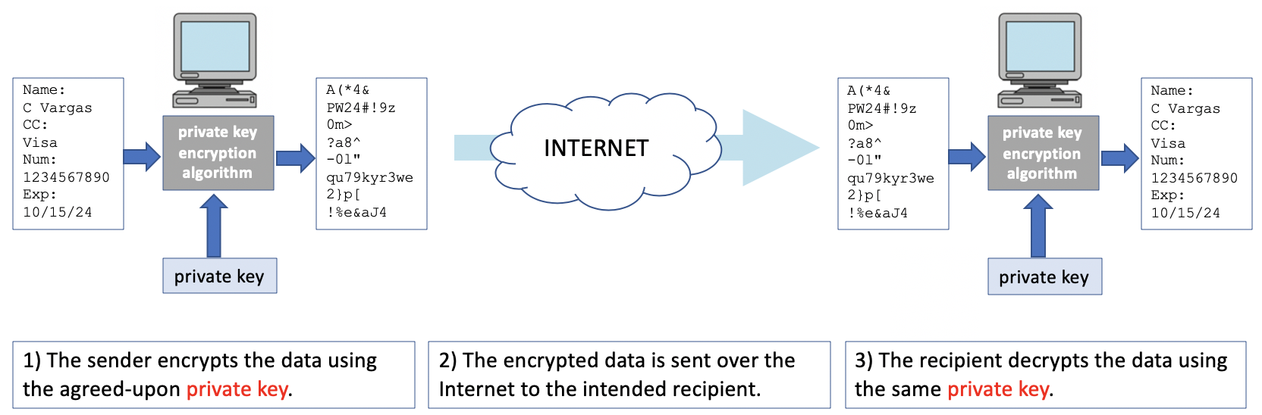
Private-key Encryption
Caesar cipher is an example of private-key encryption
relies on the sender and the recipient sharing a secret key
some modern encryption algorithms rely on private keys
e.g., Advanced Encryption Standard (AES) utilizes 256-bit keys (2²⁵⁶ ≈ 10⁷⁷ possibilities)
note: the private key must be shared securely
face-to-face meeting? guarded courier?
not feasible for online commerce

Slide 11
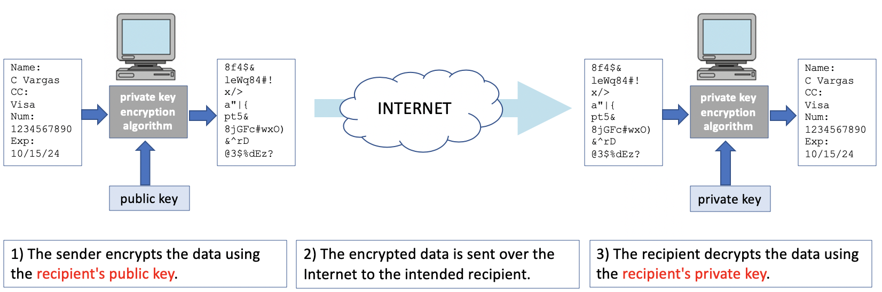
Public-Key Encryption
in 1976, Whitfield Diffie and Martin Hellman proposed a new approach
instead of a single, private key, public-key encryption utilizes a pair of keys
a public key is used to encrypt messages
a private key is required to decrypt the message
the only way to decrypt a message encrypted with a public key is using the corresponding private key
as long as the recipient keeps the private key secure, they are free to share the public key with anyone

Slide 12
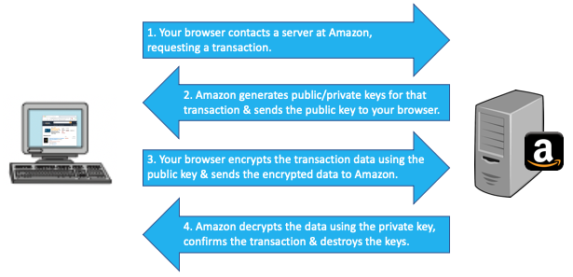
Encryption and e-commerce
public-key encryption is the basis of almost all secure communication over the Internet
without it, e-commerce would not be possible
consider what happens when you buy something online
public-key encryption is also used whenever you surf the Web with https:// or use a secure Wi-Fi connection

Slide 13
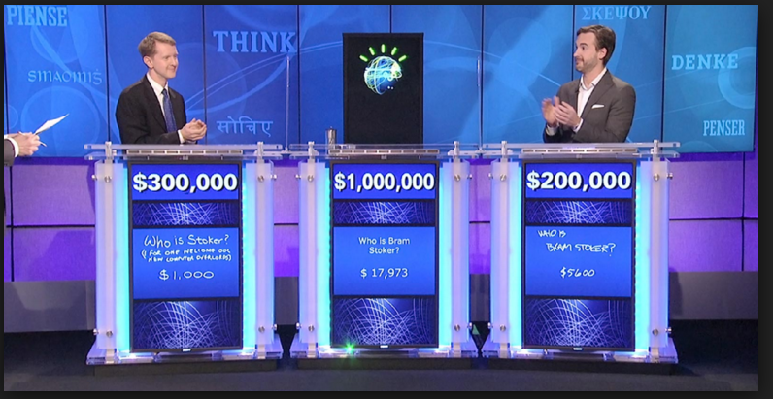
Architecture
subfield concerned with methods of organizing hardware components into efficient, reliable systems
application: parallel processing
multiple processors can sometimes be utilized to share the computational load
there are costs associated with coordinating the processors and dividing the work, so not well suited for all tasks
understanding when parallel processing can be used effectively is a common task for computer architects
e.g., Core 2 Duo and i3 processors are dual core - integrate the circuitry for 2 processors
can execute two different instructions simultaneously, potentially double execution speed
similarly, i5 and i7 have 4 cores, i9 has 8 cores
e.g., high-end Web Servers utilize multiple processors
can service multiple requests simultaneously by
distributing the load among the processors
IBM's Deep Blue contained 32 general-purpose processors and 512 special-purpose chess processors
worked in parallel to evaluate 200 million chess moves per second)
first computer to beat a world champ (1997)
its descendent, Watson, contains 2,880 processors
won Jeopardy challenge in 2011
used in many applications (weather modeling, medical diagnosis, satellite imagery analysis)

Slide 14
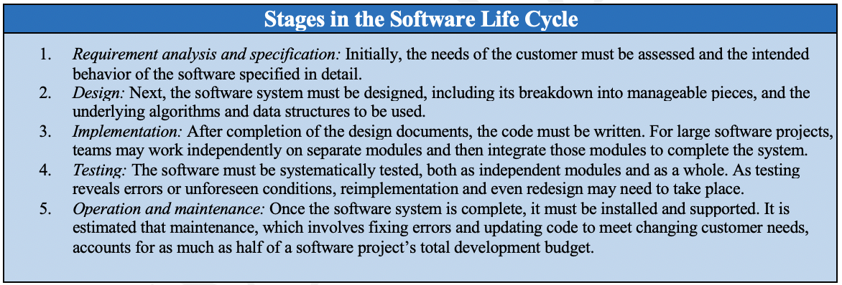
Software Engineering
subfield concerned with creating effective software systems
large projects can encompass millions of lines of code
teams of programmers work together to make an integrated whole
coordination and testing are key to successful projects
software demand continues to grow, placing pressure on programmers to produce at faster rates
clearly, there is a limit to personal productivity
simply adding more programmers does not solve the problem: increasing numbers means increased complexity, and coordination becomes an even bigger challenge
the adoption of the object-oriented programming methodology has made it easier to reuse code

Slide 15
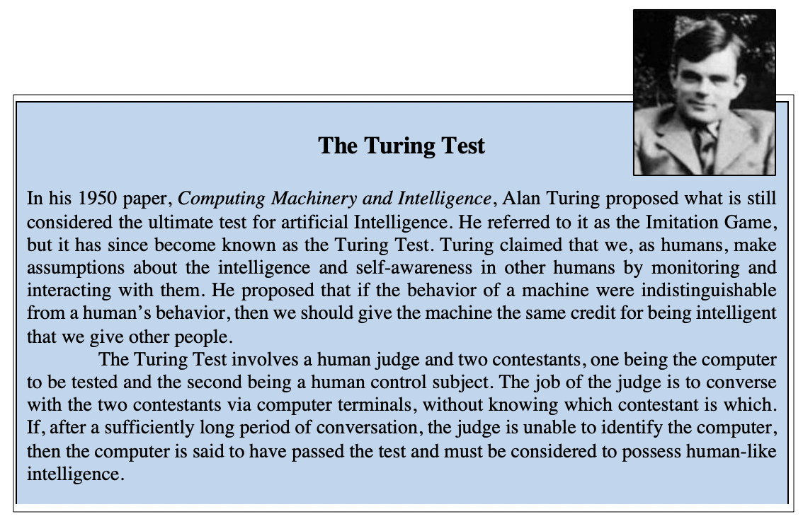
Artificial Intelligence
subfield that attempts to make computers exhibit human-like characteristics (e.g., the ability to reason and think)
in 1950, Turing predicted intelligent computers by 2000 (still not even close)
but, progress has been made in many A.I. realms
robots in manufacturing
expert systems – programs that encapsulate expert knowledge in a specific domain (e.g., for medical diagnosis, credit card fraud detection)
neural computing – design of architectures that mimic the brain
neural networks are used in handwriting analysis, self-driving cars, facial recognition, …

Slide 16
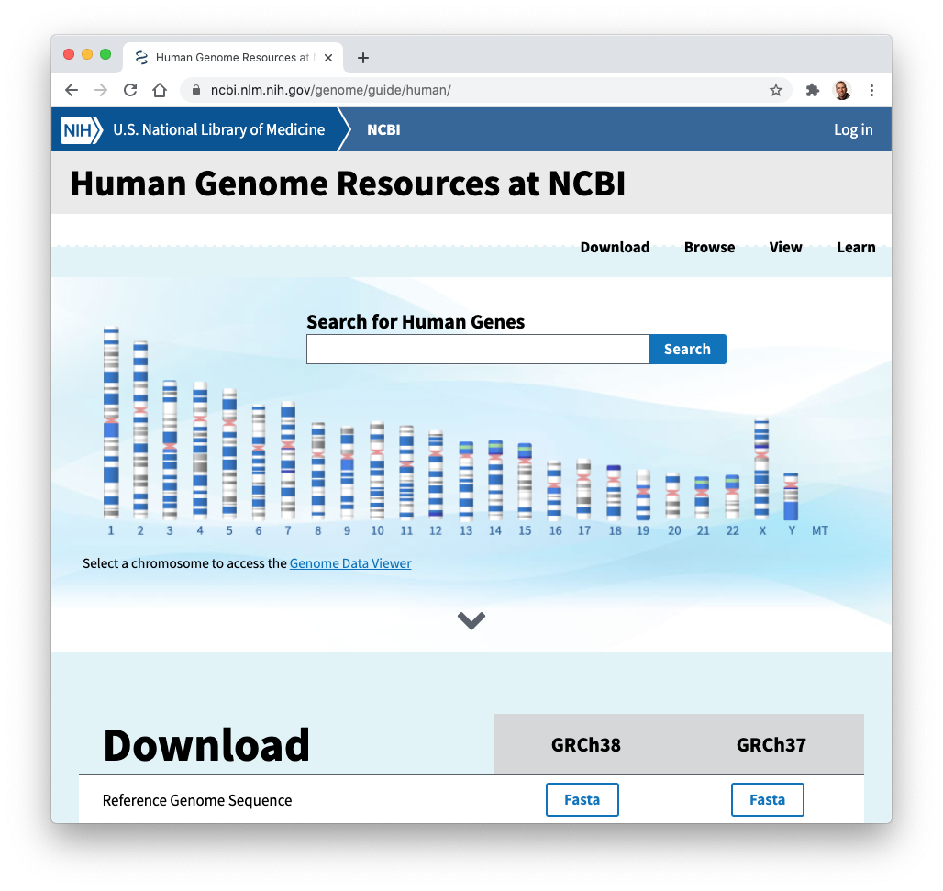
Bioinformatics
multi-disciplinary field that bridges the gap between biology and computer science
focuses on using computers and computer science techniques to solve biological problems
computers are integrated with various scientific tools
e.g., microscopes connected to computers and digital cameras
computer are used to model biological systems
e.g., pharmaceutical companies model drug interactions to save time and money
computers are used to store and process large amounts of biological data
e.g., Human Genome Project stores and provides tools for studying DNA

Slide 17
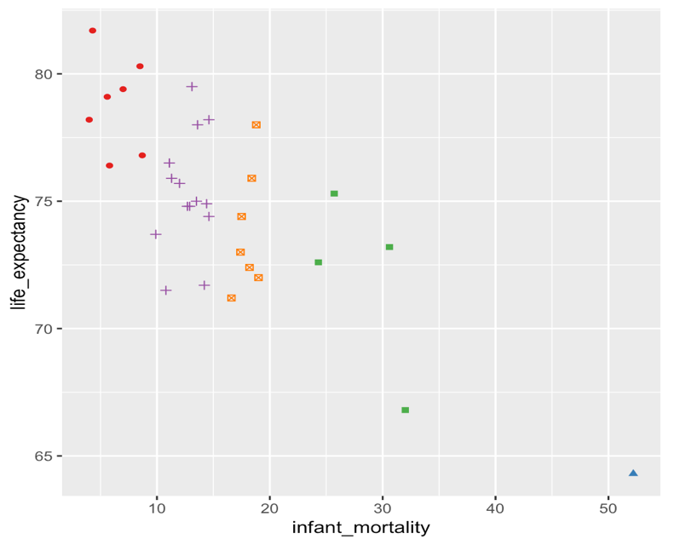
Data Science
data science utilizes concepts and methods from computer science, math and statistics to predict outcomes and extract insights from collections of data
supervised learning: learn to predict future outcomes based on past behavior
predicting the fluctuations in the stock market based on past performance
Amazon predicting which products you may want based on past purchases
Netflix predicting which shows you might like based on your viewing history
unsupervised learning: process data to discover patterns and extract insights
a baseball team discovering player tendencies or weaknesses
a government agency using data insights to set policy

Slide 18
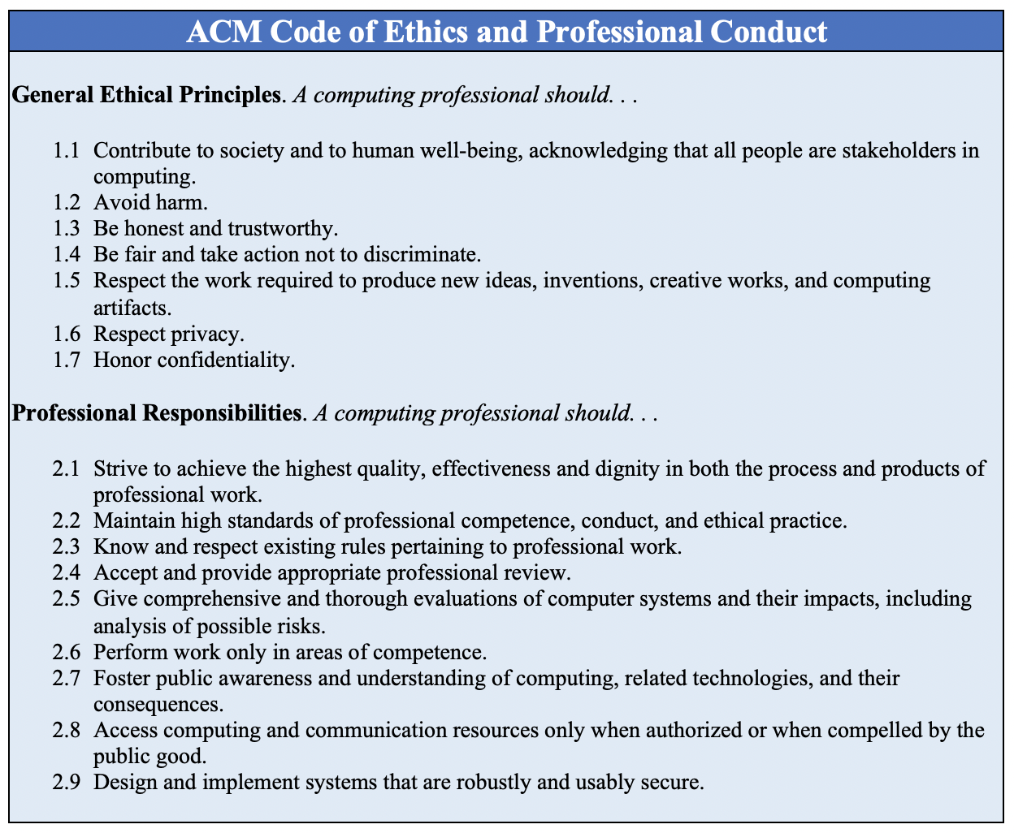
The Ethics of Computing
as technology becomes more prevalent in society, computing professionals must ensure that hardware and software are used safely, fairly, and effectively

