Slide 1
Computer Science: Concepts & Explorations 2nd edition David Reed, Creighton University
Algorithms & Programming

Slide 2
Algorithms
the central concept underlying all computation is that of the algorithm
an algorithm is a step-by-step sequence of instructions for carrying out some task
programming can be viewed as the process of designing and implementing algorithms that a computer can carry out
a programmer’s job is to:
create an algorithm for accomplishing a given objective, then
translate the individual steps of the algorithm into a programming language that the computer can understand
example: programming in JavaScript
we have written programs that instruct the browser to carry out a particular task
given the proper instructions, the browser is able to understand and produce the desired results

Slide 3
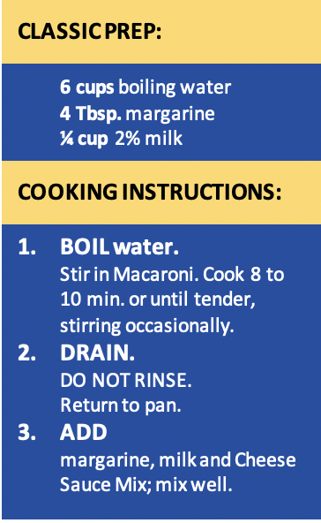
Algorithms in the Real World
the use of algorithms is not limited to the domain of computing
e.g., recipes for baking cookies
e.g., directions to your house
there are many unfamiliar tasks in life that we could not complete without the aid of instructions
in order for an algorithm to be effective, it must be stated in a manner that its intended executor can understand
a recipe written for a master chef will look different than a recipe written for a college student
as you have already experienced, computers are more demanding with regard to algorithm specifics than any human could be

Slide 4
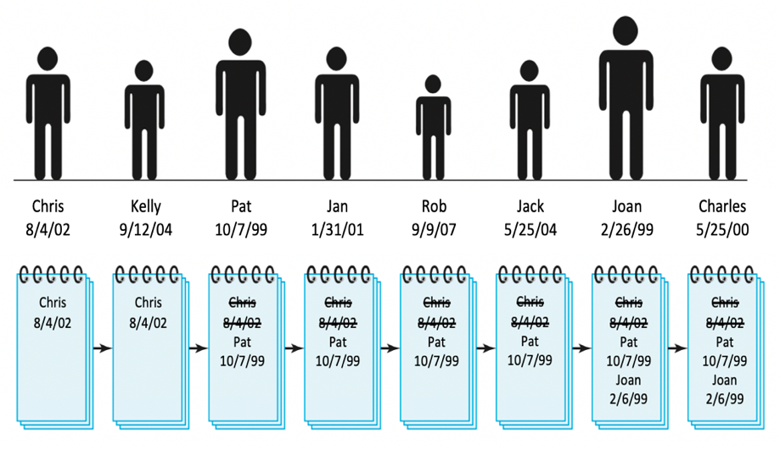
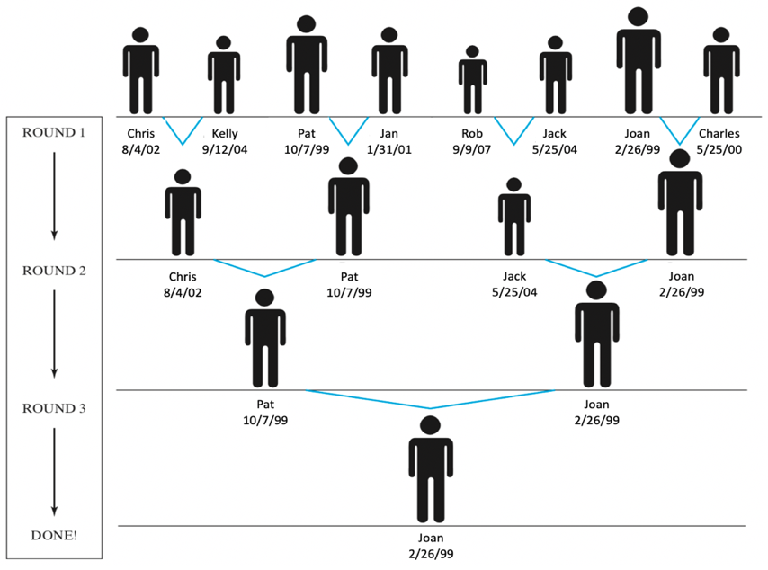
Algorithms & CT
recall the four characteristics of computations thinking: DECOMPOSITION, PATTERN RECOGNITION, ABSTRACTION and ALGORITHM
the final step in CT is formalizing the solution as an algorithm
a clearly stated algorithm is a blueprint for future problem solving
consider the 2 algorithms (from Ch. C5) for finding the oldest person in a room
Algorithm 1
Algorithm 2

Slide 5
Algorithm Analysis
determining which algorithm is "better" is not always clear cut
it depends upon what features are most important to you
if you want to be sure it works, choose the clearer algorithm
if you care about the time or effort required, need to analyze performance
algorithm 1 involves asking each person’s birthday and then comparing it to the birthday written on the page
the amount of time to find the oldest person is proportional to the number of people
if you double the amount of people, the time needed to find the oldest person will also double
algorithm 2 allows you to perform multiple comparisons simultaneously
the time needed to find the oldest person is proportional to the number of rounds it takes to shrink the line down to one person
which turns out to be the log₂ of the number of people
if you double the amount of people, the time needed to find the oldest person increases by the time required for one more round

Slide 6
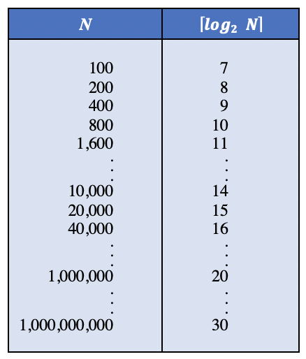
Algorithm Analysis (cont.)
when the problem size is large, performance differences
can be dramatic
for example, assume it takes 10 seconds to compare birthdays
for algorithm 1:
100 people → 10*100 = 1,000 seconds
200 people → 10*200 = 2,000 seconds
400 people → 10*400 = 4,000 seconds
. . .
1,000 people → 10*1,000 = 10,000 seconds
for algorithm 2:
100 people → 10*⎡ log₂ 100 ⎤ = 70 seconds
200 people → 10*⎡ log₂ 200 ⎤ = 80 seconds
400 people → 10*⎡ log₂ 400 ⎤ = 90 seconds
. . .
1,000 people → 10*⎡ log₂ 1,000,000 ⎤ = 100 seconds

Slide 7
Big-Oh Notation
to represent an algorithm’s performance in relation to the size of the
problem, computer scientists use what is known as Big-Oh notation
executing an O(N) algorithm requires time proportional to the size of problem
given an O(N) algorithm, doubling the problem size doubles the work
executing an O(log N) algorithm requires time proportional to the logarithm of the problem size
given an O(log N) algorithm, doubling the problem size adds a constant amount of work
based on our previous analysis:
algorithm 1 is classified as O(N)
algorithm 2 is O(log N)

Slide 8
Another Algorithm Example
SEARCHING: a common problem in computer science involves storing and
maintaining large amounts of data, and then searching the data for
particular values
data storage and retrieval are key to many industry applications
search algorithms are necessary to storing and retrieving data efficiently
e.g., consider searching a large payroll database for a particular record
if the computer selected entries at random, there is no assurance that the particular record will be found
even if the record is found, it is likely to take a large amount of time
a systematic approach assures that a given record will be found, and that it will be found more efficiently
there are two commonly used algorithms for searching a list of items
sequential search – general purpose, but relatively slow
binary search – restricted use, but fast

Slide 9
Sequential Search
sequential search is an algorithm that involves examining each list item in sequential order until the desired item is found
sequential search for finding an item in a list
start at the beginning of the list
for each item in the list
examine the item - if that item is the one you are seeking, then you are done
if it is not the item you are seeking, then go on to the next item in the list
if you reach the end of the list and have not found the item, then it was not in the list
sequential search guarantees that you will find the item if it is in the list
but it is not very practical for very large databases
worst case: you may have to look at every entry in the list

Slide 10
Binary Search
binary search involves continually cutting the desired search list in half until the item is found
the algorithm is only applicable if the list is ordered
e.g., a list of numbers in increasing order
e.g., a list of words in alphabetical order
binary search for finding an item in an ordered list
initially, the potential range in which the item could occur is the entire list
as long as items remain in the potential range and the desired item has not been found, repeatedly
examine at the middle entry in the potential range
if the middle entry is the item you are looking for, then you are done
if the middle entry is greater than the desired item, then reduce the potential range to those entries left of the middle
if the middle entry is less than the desired item, then reduce the potential range to those entries right of the middle
by repeatedly cutting the potential range in half, binary search can home in on the value very quickly

Slide 11
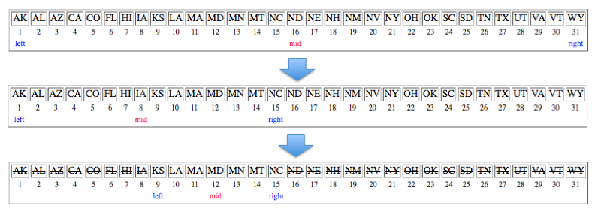
Binary Search Example
suppose you have a sorted list of state names, and want to find MD
start by examining the middle entry (ND)
since ND comes after MD alphabetically, can eliminate it and all entries that appear to the right
next, examine the middle of the remaining entries (IA)
since IA comes before MD alphabetically, can eliminate it and all entries that appear to the left
next, examine the middle of the remaining entries (MD)
the desired entry is found

Slide 12
Search Analysis
sequential search
in the worst case, the item you are looking for is in the last spot in the list (or not in the list at all)
as a result, you will have to inspect and compare every entry in the list
the amount of work required is proportional to the list size
→ sequential search is an O(N) algorithm
binary search
in the worst case, you will have to keep halving the list until it gets down to a single entry
each time you inspect/compare an entry, you rule out roughly half the remaining entries
the amount of work required is proportional to the logarithm of the list size
→ binary search is an O(log N) algorithm
imagine searching a phone book of the United States (330 million people)
sequential search requires at most 330 million inspections/comparisons
binary search requires at most ⎡log₂(330,000,000)⎤ = 29 inspections/comparisons

Slide 13
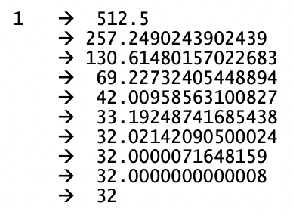
Another Algorithm Example
Newton’s Algorithm for finding the square root of N
start with an initial approximation of 1
as long as the approximation isn’t close enough, repeatedly
refine the approximation using the formula:
newApproximation = (oldApproximation + N/oldApproximation)/2
example: finding the square root of 1024
algorithm analysis:
Newton's Algorithm does converge on the square root because each successive approximation is closer than the previous one
however, since the square root might be a non-terminating fraction it is difficult to define the exact number of steps for convergence
in general, the difference between the given approximation and the actual square root is roughly cut in half by each successive refinement
→ demonstrates O(log N) behavior

Slide 14
Algorithms and Programming
programming is all about designing and coding algorithms for solving problems
the intended executor is the computer or a program executing on that computer
instructions are written in programming languages which are more constrained and exact than human languages
the level of precision necessary to write programs can be frustrating to beginners
but it is much easier than it was 50 years ago
early computers (ENIAC) needed to be wired to perform computations
with the advent of the von Neumann architecture, computers could be programmed instead of rewired
an algorithm could be coded as instructions, loaded into the memory of the computer, and executed

Slide 15
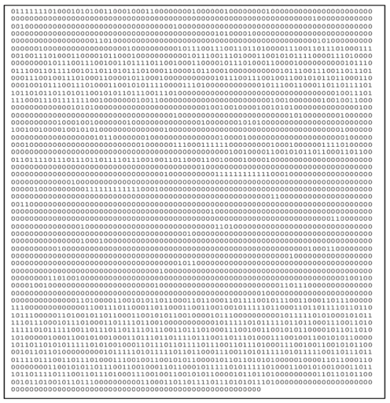
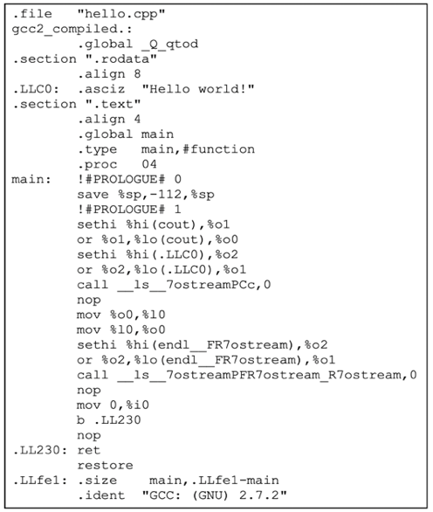
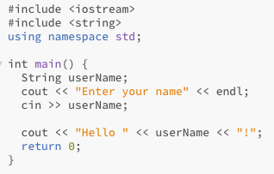
Evolution of Languages
the first programming languages were known as machine languages
consist of instructions that correspond directly to the hardware operations of a particular machine
i.e., instructions deal directly with the computer’s physical components including main memory and CPU registers
very low level of abstraction
machine language instructions are written in binary
programming in machine language is tedious and error prone
in early 1950s, assembly languages evolved from machine languages
replaced binary codes with words like ADD, MOVE
easier to remember & debug, but still machine-specific
a separate program called an assembler translated the assembly instructions into machine language
in the late 1950's, high-level languages were introduced
they allow the programmer to write code closer to the way humans think (as opposed to mimicking hardware operations)
more natural, plus machine-independent

Slide 16

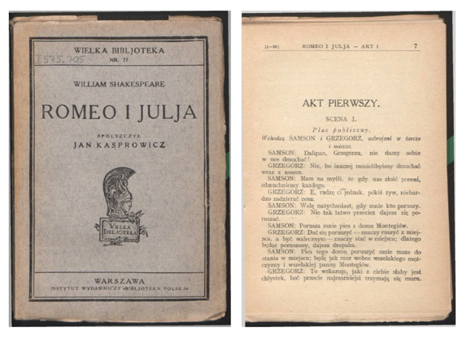
Program Translation
using a high-level language, the programmer is able to reason at a high-level of abstraction
but programs must still be translated into machine language that the computer hardware can understand/execute
real-world analogy: translating a speech from one language to another
an interpreter can be used provide a real-time translation
the interpreter hears a phrase, translates, and immediately speaks the translation
ADVANTAGE: the translation is immediate
DISADVANTAGE: if you want to hear the speech again, must interpret all over again
a translator (or compiler) translates the entire speech offline
the translator takes a copy of the speech, returns when the entire speech is translated
ADVANTAGE: once translated, it can be read over and over very quickly
DISADVANTAGE: must wait for the entire speech to be translated

Slide 17
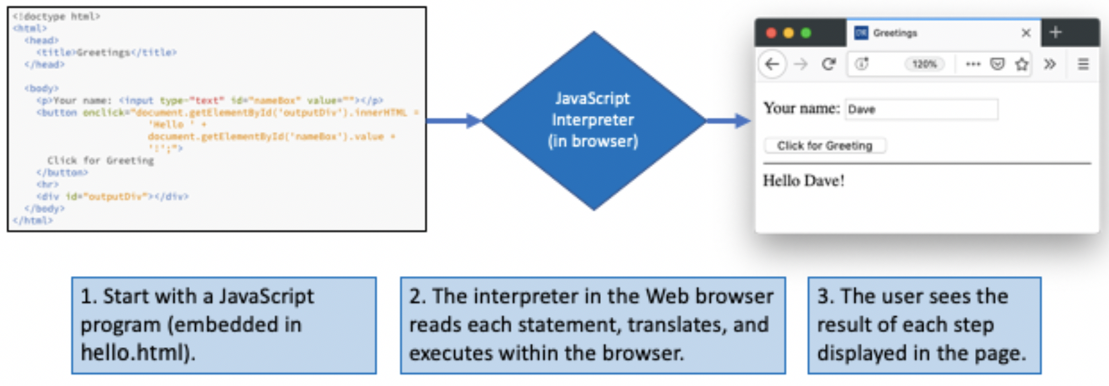
Interpreters
for program translation, the interpretation approach relies on a program known as an interpreter to translate and execute high-level statements
the interpreter reads one high-level statement at a time, immediately translating and executing the statement before processing the next one
particularly useful for dynamic, interactive applications (e.g., Web pages)
each execution requires translating again, can be slow
JavaScript is interpreted

Slide 18
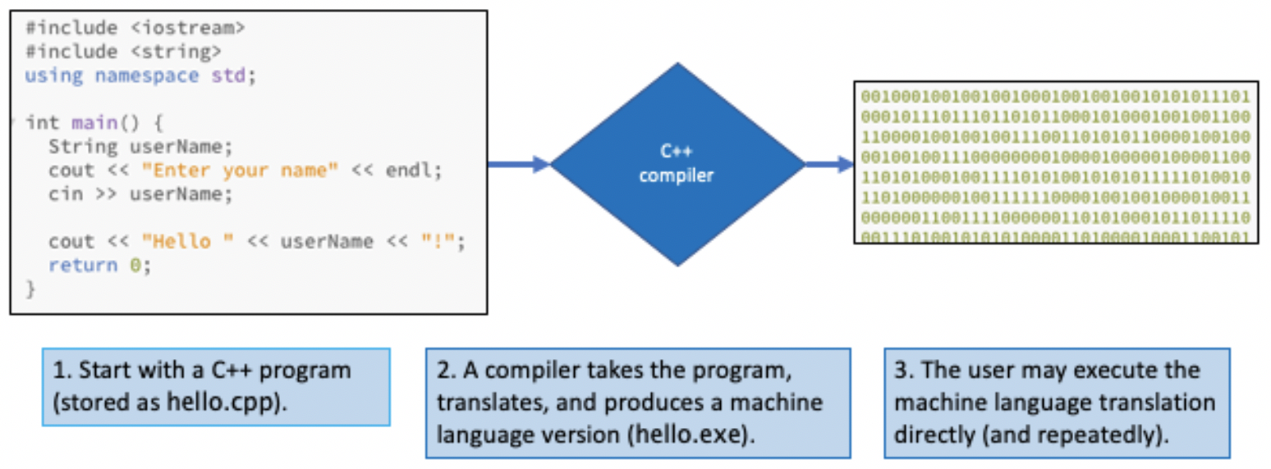
Compilers
the compilation approach relies on a program known as a compiler to translate the entire high-level language program into its equivalent machine-language instructions
the resulting machine-language program can be executed directly on the computer, very fast
used in large software applications when speed is of the utmost importance
but must compile the entire program before execution, so initial delay
C, C++, Java are compiled*

