Slide 1
Computer Science: Concepts & Explorations 2nd edition David Reed, Creighton University
Scientific & Computational Thinking

Slide 2
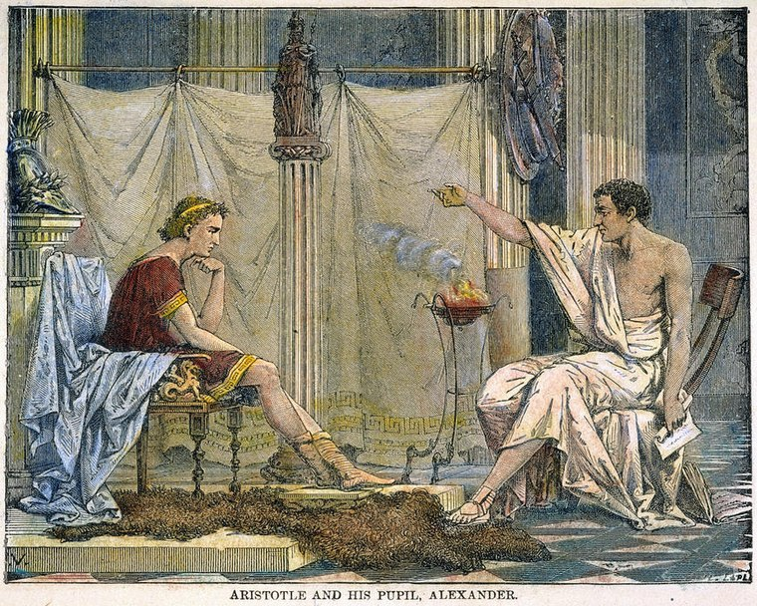
Early science
science: a system of knowledge covering general truths or the operation of general laws especially as obtained and tested through scientific method (Merriam-Webster dictionary)
science is important in our daily lives because:
it advances our understanding of the world and our place in it
scientific advances can lead to practical applications (e.g., technology, medicine, …)
modern science traces its roots back to the Greek natural philosophers
Thales (6 c B.C.) was first to break from mythology
observed and devised theories about nature
Plato (4 c B.C.) proposed a grand theory of cosmology
claimed heavenly bodies move uniformly in circles, because of their divine, geometric perfection
believed observation was confused and impure, truth was found through contemplation
Aristotle (4 c B.C.) proposed a common-sense vision of the natural world that stood for 2,000 years
studied and wrote on a cosmology, physics, biology, anatomy, logic, …
placed greater emphasis on observation than Plato, but still not experimental
Greek natural philosophy is "pre-scientific", since it relied on contemplation/observation, but not experimentation

Slide 3
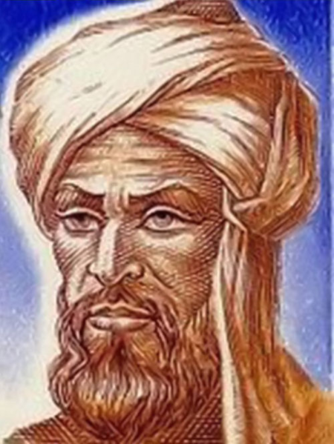
Roman times → Middle Ages
Roman civilization built upon the tradition of Greek natural philosophy
the Romans are better known for engineering than theoretical science
Pliny (1 c.) categorized plants, animals and minerals
Galen (2nd century) studied human anatomy and physiology
the fall of Rome (in 476) led to a discontinuity in western civilization
in western Europe, population dropped, literacy virtually disappeared, and Greek knowledge was lost
in eastern Europe, Greek knowledge was suppressed by orthodox Christianity in the Byzantine Empire (which finally fell in 1453)
during Europe's "Dark Age," medieval Islam became the principal heir to Greek science
in the 7th-14th centuries, the Islamic Empire covered parts of Europe, northern Africa, the Middle East, and western Asia
Greek writings were preserved and advanced by Arab scholars
the term "algorithm" is named after Persian scholar Muhammad ibn Musa al-Khwarismi

Slide 4
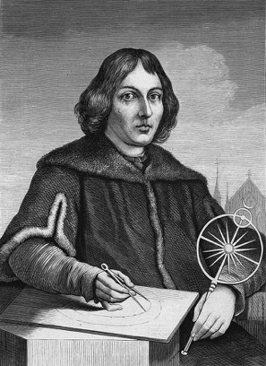
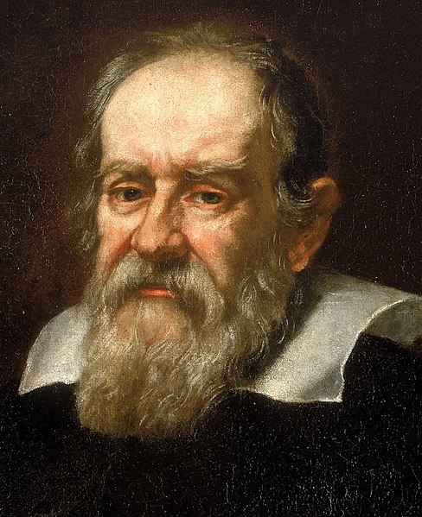
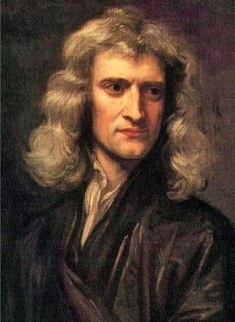
Scientific Revolution
the Renaissance (15th-16th centuries) was instigated by the rediscovery of Greek science
Greek knowledge was rediscovered by Crusaders to the Middle East; retrieved from medieval monasteries
Leonardo da Vinci (1452-1519) was artist, astronomer, geometer, engineer, …
Gutenberg's printing press made the broad dissemination of knowledge possible
the Scientific Revolution (16th-17th centuries) was brought about by a period of intellectual upheaval in Europe
the Protestant Reformation, new world exploration, …
the cultural environment allowed for questioning religious and scientific dogma – the universe was viewed as a complex machine that could be understood through observation and experimentation
Copernicus proposed a sun-centered cosmology (1543)
Kepler refined the heliocentric model, using elliptical orbits (1609)
Galileo pioneered the use of experimentation to validate observational theories
father of modern science (as well as modern physics and astronomy)
Newton described universal gravitation, laws of motion (1687)

Slide 5
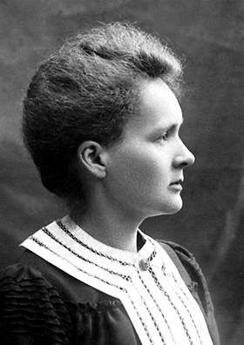
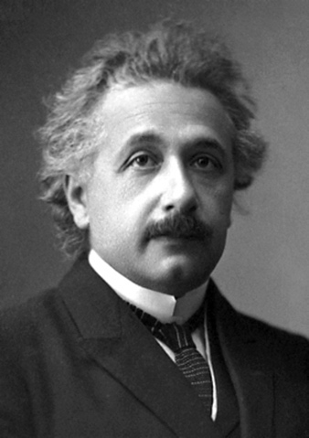
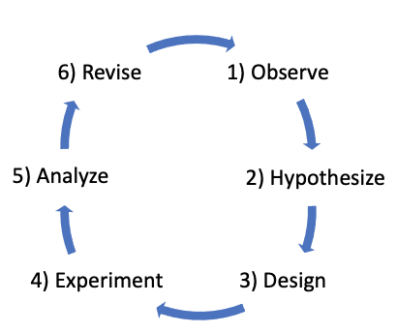
Modern Science
the Scientific Revolution established science as the preeminent source for the growth of knowledge
biology: Pasteur, Watson & Crick, …
chemistry: Dalton, Mendeleev, Curie, …
physics: Maxwell, Curie, Einstein, …
the scientific method provides the common process by which modern science is conducted
Observe a phenomenon
Hypothesize how it works
Design an experiment to test it
Experiment to confirm/deny
Analyze the results
Revise or refine the hypothesis
generally, the process repeats since the results may lead to revisions to the hypothesis or experiment

Slide 6
Scientific Method
EXAMPLE: understanding planetary motion
Observe that some lights in the night sky move different, faster than others.
Hypothesize that those lights (planets) are closer to the earth.
Develop a model of motion (say, Copernicus' circular orbits around the sun).
Conduct the experiment to see telescopic observations match the model.
Analyze the results and see that the observations are close but not exact – revise the model to use Kepler's elliptical orbits and repeat.
the scientific method can be applied to real-world situations as well
EXAMPLE: an auto mechanic observes a misfiring engine, hypothesizes that the cause is a bad spark plug and designs an experiment (replace it) to test
EXAMPLE: a programmer observes a program that doesn't work, hypothesizes the cause if a malformed statement and designs an experiment (bug fix) to test
reproducibility is essential to the scientific method
the same experiment, under the same conditions, should produce the same result
if a scientific discovery is not reproducible, it will not be accepted
consistency is a measure of how close the results are each time you conduct the experiment
accuracy is a measure of how close the results are to the correct (or expected) value

Slide 7
Computational Thinking
the scientific method is designed for understanding a phenomenon
may not be directly applicable to real-world problems solving
computational thinking is a problem-solving approach that involves expressing problems and their solutions in ways that a computer could execute
first coined by Papert in 1980, made popular by Jeannette Wing in 2006
computational thinking has been recognized by many as an essential 21st century skill (along with critical thinking, communication, collaboration, and creativity)
high-level characteristics of computational thinking
DECOMPOSITION – breaking a large, complex problem into smaller, more manageable problems
PATTERN MATCHING – recognizing how solutions to similar problems can be applied to new problems
ABSTRACTION – focusing on important details while ignoring irrelevant information
ALGORITHMS – designing and implementing the solution in the form of an algorithm
real-world example: assembling a bookcase

Slide 8
CT Example
consider the task of finding the oldest person in a room
there are a number of issues to consider, different approaches you could take
DECOMPOSITION
tasks that will need to be performed:
systematically process each person
be able to determine a person's age
record the names/ages so that will know the oldest at the end
PATTERN MATCHING
learn from past experiences that were similar
lining the people up will make it easier to cover everyone
pencil & paper are effective for simple tasks like these
ABSTRACTION
there are a lot of characteristics we don't care about (hair color, middle initial)
if born on the same day, we will consider the same age
if more than one "oldest" person, any one will do
ALGORITHMS
can now devise an algorithm, step-by-step sequence of instructions, to solve this

Slide 9
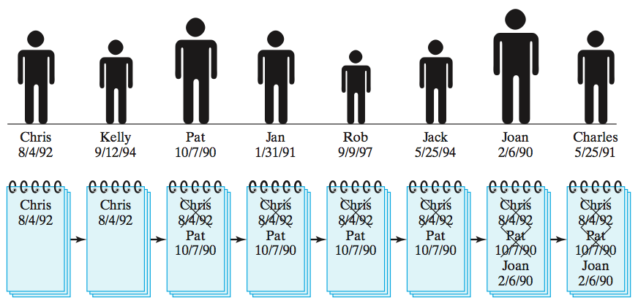
Algorithm 1
Finding the oldest person (algorithm 1)
line up all the people along one wall
ask the first person to state his or her name and birthday, then write this information down on a piece of paper
for each successive person in line:
ask the person for his or her name and birthday
if the stated birthday is earlier than the birthday on the paper, cross out old information and write down the name and birthday of this person
when you reach the end of the line, the name and birthday of the oldest person will be written on the paper

Slide 10
Algorithm 1 Analysis
algorithm 1 works, since the oldest person will eventually be found & recorded
the amount of time to find the oldest person is proportional to the number of people
if you double the amount of people, the time needed to find the oldest person will also double
for example, assume it takes 10 seconds to compare birthdays
8 people → 10*8 = 80 seconds (1.33 minutes)
16 people → 10*16 = 160 seconds (2.67 minutes)
32 people → 10*32 = 320 seconds (5.33 minutes)
. . .
100 people → 10*100 = 1,000 seconds (16.67 minutes)
. . .
400 people → 10*400 = 4,000 seconds (1 hour & 6.67 minutes)
this algorithm works, but it does not scale well if the number of people gets big
consider a more complex but also more efficient algorithm

Slide 11
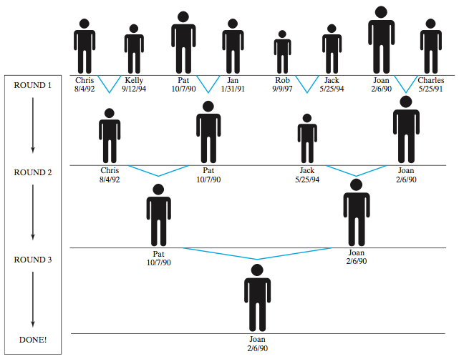
Algorithm 2
Finding the oldest person (algorithm 2)
line up all the people along one wall
as long as there is more than one person in the line, repeatedly
have the people pair up (1st with 2nd, 3rd with 4th, etc) – if there is an odd number of people, the last person will be without a partner
ask each pair of people to compare their birthdays
request that the younger of the two leave the line
when there is only one person left in line, that person is the oldest

Slide 12
Algorithm 2 Analysis
algorithm 2 works, since the oldest person in a pair never sits and the process eventually reduces down to that oldest person
the time needed to find the oldest person is proportional to the number of rounds it takes to shrink the line down to one person (since all pair comparisons in a round take place simultaneously)
the number of rounds is the number of times the people can repeatedly be divided in half (mathematically speaking, the log₂ of the number of people)
if you double the amount of people, the time needed to find the oldest person increases by the cost of one more comparison
for example, assume it takes 10 seconds to compare birthdays
8 people → 10* ⎡log₂ 8⎤ = 10*3 = 30 seconds (0.5 minutes)
16 people → 10* ⎡log₂ 16⎤ = 10*4 = 40 seconds (0.67 minutes)
32 people → 10 * ⎡log₂ 32⎤ = 10*5 = 50 seconds (0.83 minutes)
. . .
100 people → 10 * ⎡log₂ 100⎤ = 10*7 = 70 seconds (1.16 minutes)
. . .
400 people → 10 * ⎡log₂ 400⎤ = 10*9 = 90 seconds (1.5 minutes)

Slide 13
Multiple Solutions
# of people | time for Algorithm 1 | time for Algorithm 2
8 | 80 sec | 30 sec
16 | 160 sec | 40 sec
32 | 320 sec | 50 sec
…
100 | 1,000 sec | 70 sec
…
400 | 4,000 sec | 90 sec
many real-world problems can be solved in multiple ways
when presented with this problem, most people would devise a solution similar to Algorithm 1 (with many different variations possible)
it is simple to describe and understand
it is reasonably fast for small numbers of people
developing Algorithm 2 requires considerable experience solving similar problems
must be able to ABSRACT the relevant features of this problem, PATTERN MATCH with past solutions to similar problems, and DECOMPOSE the solution to fit this new problem.
like most endeavors, the more computational thinking you do, they better you become at it

