Slide 1
Computer Science: Concepts & Explorations 2nd edition David Reed, Creighton University
The History of Computers

Slide 2
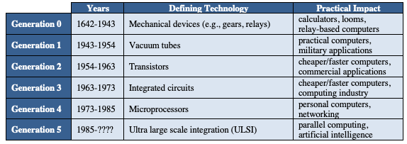
History of computing
calculating devices have been around for millennia (e.g., abacus ~3,000 B.C.)
modern "computing technology" traces its roots to the 16-17th centuries
as part of the "Scientific Revolution", people like Kepler, Galileo, and Newton viewed the natural world as mechanistic and understandable
this led to technological advances & innovation
from simple mechanical calculating devices to powerful modern computers, computing technology has evolved through technological breakthroughs

Slide 3
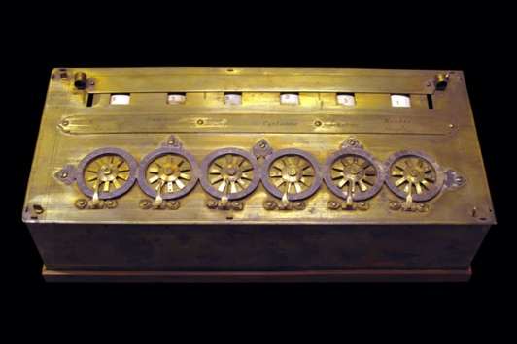
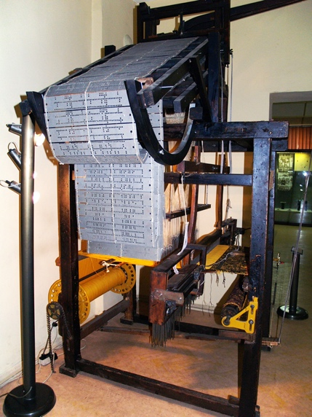
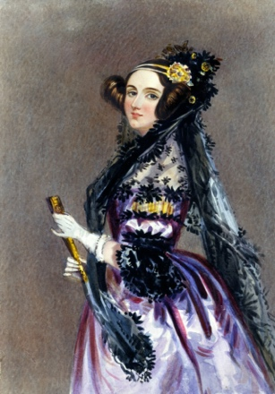
Generation 0: Mechanical Computers
1642 – Pascal built a mechanical calculating machine
used mechanical gears, a hand-crank, dials and knobs
other similar machines followed
1805 – the first programmable device was Jacquard's loom
the loom wove tapestries with elaborate, programmable patterns
a pattern was represented by metal punch-cards, fed into the loom
using the loom, it became possible to mass-produce tapestries, and even reprogram it to produce different patterns simply by changing the cards
mid 1800's – Babbage designed his "analytical engine"
its design expanded upon mechanical calculators, but was programmable via punch-cards (similar to Jacquard's loom)
Babbage's vision described the general layout of modern computers
Ada Lovelace developed instructions for the never-quite-finished Analytical Engine – is considered the world's first programmer

Slide 4
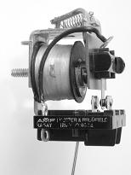
Generation 0 (cont.)
1930's – several engineers independently built "computers" using electromagnetic relays
an electromagnetic relay is physical switch, which can be opened/closed via electrical current
relays were used extensively in early telephone exchanges
Zuse (Nazi Germany) – his machines were destroyed in WWII
Atanasoff (Iowa State) – built a partially-working machine with his grad student
Stibitz (Bell Labs) – built the MARK I computer that followed the designs of Babbage
limited capabilities by modern standards: could store only 72 numbers, required 1/10 sec to add, 6 sec to multiply
still, 100 times faster than previous technology

Slide 5
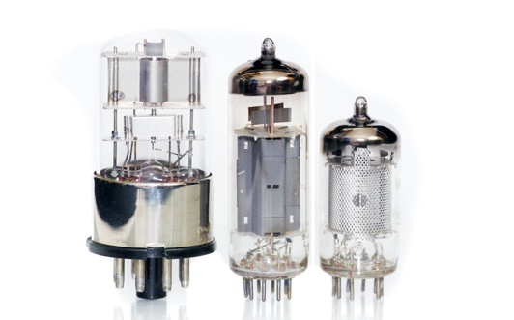
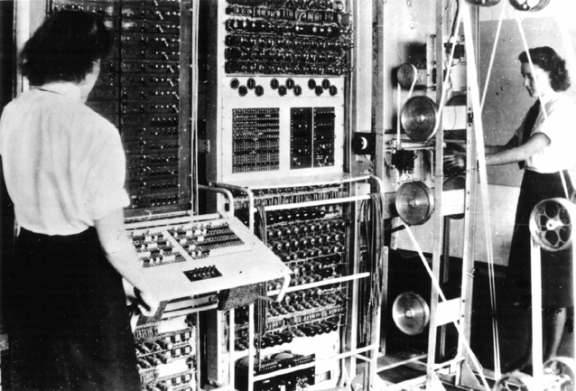
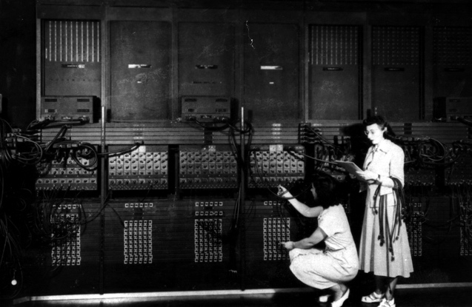
Generation 1: Vacuum Tubes
mid 1940's – vacuum tubes replaced relays
a vacuum tube is a light bulb containing a partial vacuum to speed electron flow
vacuum tubes could control the flow of electricity faster than relays since they had no moving parts
invented by Lee de Forest in 1906
1940's – hybrid computers using vacuum tubes and relays were built
COLOSSUS (1943)
first "electronic computer", built by the British govt. (based on designs by Alan Turing)
used to decode Nazi communications during the war
the computer was top-secret, so did not influence other researchers
ENIAC (1946)
first publicly-acknowledged "electronic computer", built by Eckert & Mauchly (UPenn)
18,000 vacuum tubes and 1,500 relays
weighed 30 tons, consumed 140 kwatts
"programmed" by women CS pioneers

Slide 6
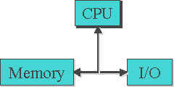
Generation 1 (cont.)
COLOSSUS and ENIAC were not general purpose computers
could enter input using dials & knobs, paper tape
but to perform a different computation, needed to reconfigure
von Neumann popularized the idea of a "stored program" computer
Memory stores both data and programs
Central Processing Unit (CPU) executes by loading program instructions from memory and executing them in sequence
Input/Output devices allow for interaction with the user
virtually all modern machines follow this
von Neumann Architecture
(note: same basic design as Babbage)
programming was still difficult and tedious
each machine had its own machine language, 0's & 1's corresponding to the settings of physical components
in 1950's, assembly languages replaced 0's & 1's with mnemonic names
e.g., ADD instead of 00101110

Slide 7
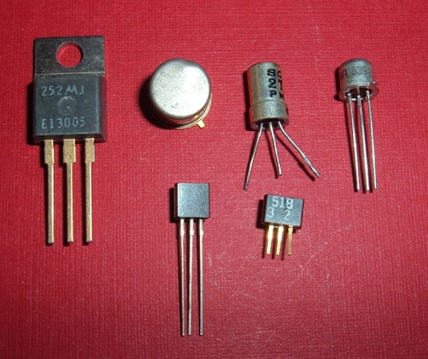
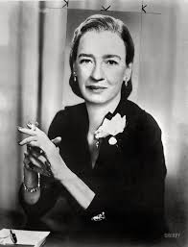
Generation 2: Transistors
mid 1950's – transistors began to replace tubes
a transistor is a piece of silicon whose conductivity can be turned on and off using an electric current
they performed the same switching function of vacuum tubes, but were smaller, faster, more reliable, and cheaper to mass produce
invented by Bardeen, Brattain, & Shockley in 1948 (earning them the 1956 Nobel Prize in physics)
some historians claim the transistor was the most important invention of the 20th century
as the cost of computers dropped, high-level languages were designed to make programming more natural (& efficient)
FORTRAN (1957, Backus at IBM)
PROGRAM add
READ *, a,b
s = a + b
PRINT *, ' The sum is ', s
STOP
END
LISP (1959, McCarthy at MIT)
COBOL (1960, Hopper at DOD)

Slide 8
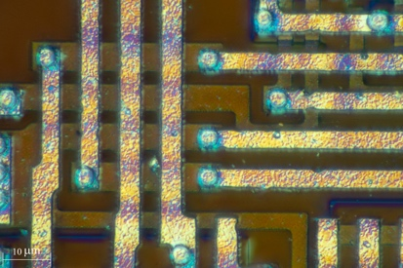
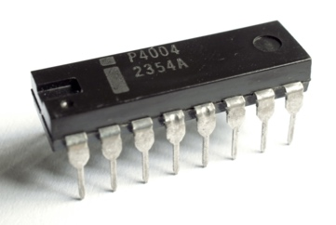
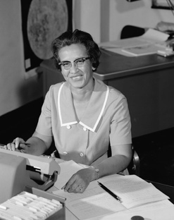
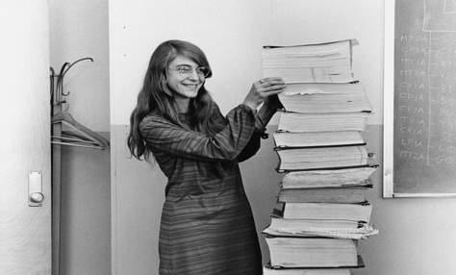
Generation 3: Integrated Circuits
mid 1960's - integrated circuits (IC) were produced
Noyce and Kilby independently developed techniques for packaging transistors and circuitry on a silicon chip (Kilby won the 2000 Nobel Prize in physics)
was made possible by miniaturization & improved manufacturing
allowed for mass-producing useful circuitry
1960's saw the rise of computing for business
recall: an operating system is a collection of programs that manage peripheral devices and other resources
in the 60's, operating systems enabled time-sharing, where users share a computer by swapping jobs in and out
specialized programming languages were developed, e.g., Pascal (1971, Wirth), C (1972, Ritchie)
U.S. space program was a driving force behind innovation
computers began to replace humans for complex calculations (e.g., Katherine Johnson)
Margaret Hamilton at MIT led team that developed Apollo Guidance system

Slide 9
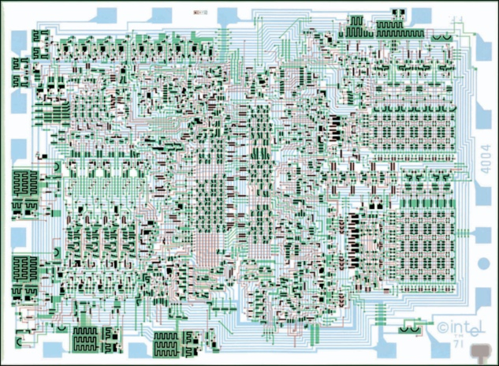
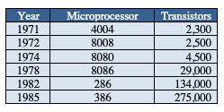
Generation 4: Microprocessors
1971 – Intel marketed the first microprocessor, the 4004, a chip with all the circuitry for a calculator
by the late 1970's, manufacturing advances allowed for the very large scale integration (VLSI) of hundreds of thousands of transistors w/ circuitry on a chip
this "very large scale integration" resulted in mass-produced microprocessors and other useful IC's
since computers could be constructed by simply connecting powerful IC's and peripheral devices, they were easier to make and more affordable
Moore's Law (more of an observation, really)–
the number of transistors that could fit on a chip doubled every 1-2 years

Slide 10
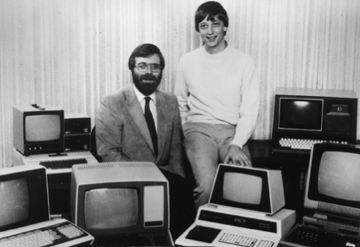
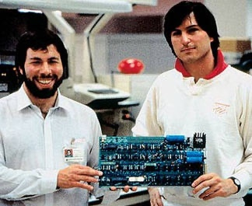
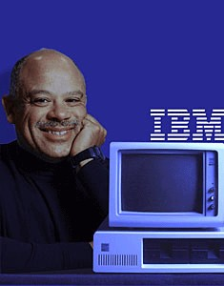
Generation 4: Microprocessors
with microprocessors came personal computing
1975 - Bill Gates & Paul Allen founded Microsoft
Gates wrote a BASIC interpreter for the first PC (Altair)
1977 - Steve Wozniak & Steve Jobs founded Apple
went from Jobs' garage to $120 million in sales by 1980
1980 - IBM introduced PC
Microsoft licensed the DOS operating system to IBM
1984 - Apple countered with Macintosh
introduced the modern GUI-based OS (which was mostly developed at Xerox)
1985 - Microsoft countered with Windows
in the 1980's
demand grew for networking computers together
1982: 235 computers connected to ARPANet
1989: 300,000 computers connected to Internet
object-oriented programming represented a new approach to program design which views a program as a collection of interacting software objects that model real-world entities

Slide 11
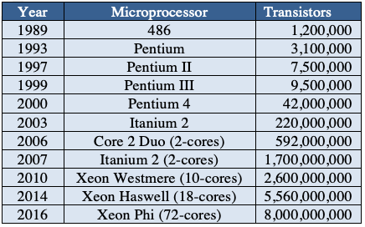
Generation 5: ULSI
the latest generation of computers is still hotly debated
no new switching technologies, ultra large scale integration (ULSI) has changed how computers are used
1n 1989, the Intel 486 contained 1.2 million transistors
manufacturing improvements are more difficult to achieve as components get smaller and smaller (Moore's Law in jeopardy?)
workarounds
multi-core processors increase the chip size by adding duplicate circuitry so that it can execute operations simultaneously
parallel processing computers have multiple independent processors that can share the load (e.g., a Web server)

Slide 12
Generation 5: ULSI (cont.)
Wi-fi and wireless broadband have made computing mobile and pervasive
wi-fi utilizes radio waves over short distances to connect computers and devices
typical speed & range: 100-200 Mbits/sec, 150-300 feet
user enters commands on computer/device
command is translated into radio signal, broadcast to wi-fi router
router carries out the command via Internet connection
response is translated into radio signal, broadcast back to computer/device
a longer range alternative to wi-fi is cellular networking
4G (15-25 Mbits/sec) & now 5G (50 Mbits/sec – 1 Gbits/sec), nationwide coverage
Artificial Intelligence (AI) applications dominate the news
Apple's Siri (2011) and Amazon's Alexa (2014) can recognize voice commands and control smart home devices
facial recognition software is used by law enforcement and businesses
credit card companies model purchasing patterns to identify fraud
retailers like Amazon use your history to predict future purchases
Self-driving cars from Uber and Tesla use video processing and AI techniques to control vehicles on open roads

Slide 13
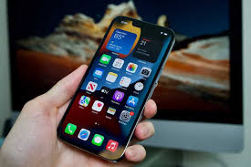
Speed matters
ENIAC (1946)
could perform 385 operations per second
75 years later…
iPhone 13 (2021)
can perform 15.8 trillion operations per second
41 billion times faster!
it would take the ENIAC 1,301 years to do what your iPhone can do in 1 second

Slide 14
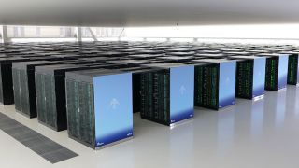
Speed REALLY matters
ENIAC (1946)
could perform 385 operations per second
Fugaku supercomputer (2021)
can perform 442 quadrillion operations per second
1.1 quadrillion times faster!!!
it would take the ENIAC 36.4 million years to do what the Fugaku can do in 1 second

Slide 15
Computing entrepreneurs
Richest People in the World (Forbes, 3/5/21)
1. Jeff Bezos $177.0 billion Age: 57
2. Elon Musk $151.0 billion Age: 50
3. Bernard Arnault $150.0 billion Age: 72
4. Bill Gates $124.0 billion Age: 65
5. Mark Zuckerberg $97.0 billion Age: 36
6. Warren Buffet $96.0 billion Age: 90
7. Larry Ellison $93.0 billion Age: 76
8. Larry Page $91.5 billion Age: 47
9. Sergey Brin $89.0 billion Age: 47
10. Mukesh Ambani $84.5 billion Age: 63
…
14. Steve Ballmer $68.7 billion Age: 64
15. Ma Huatang $65.8 billion Age: 49

