Slide 1
Computer Science: Concepts & Explorations 2nd edition David Reed, Creighton University
The Internet

Slide 2
History of Internet
recall: the Internet is a vast, international network of computers
the Internet traces its roots back to the early 1960s
MIT professor J.C.R. Licklider published a series of articles describing a “Galactic Network” of communicating computers
in 1962, Licklider became head of computer research at the U.S. Department of Defense’s Advanced Research Project Agency (ARPA)
in 1967, Licklider hired Larry Roberts to design and implement his vision of a Galactic Network
the ARPANET (precursor to the Internet) became a reality in 1969
it connected computers at four universities: UCLA, UCSB, SRI, and Utah
it employed dedicated cables, buried underground
the data transfer rate was 56K bits/sec, roughly the same as dial-up services today
the ARPANET demonstrated that researchers at different sites could communicate, share data, and run software remotely

Slide 3
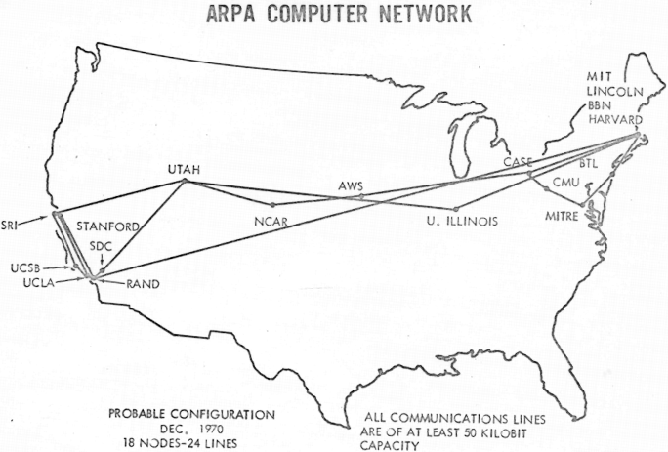
ARPANET
the ARPANET was intended to connect only military installations and universities participating in government projects
by 1970, 18 sites were connected
most had capability of 4 terminals per site

Slide 4
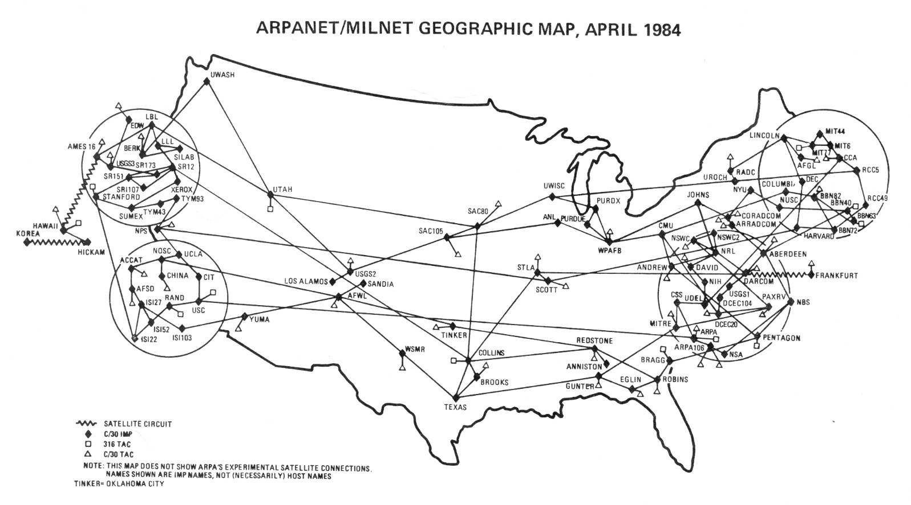
ARPANET Growth
the ARPANET grew slowly and steadily through the 1970s
in 1980s, it exploded due to interest in email, newsgroups, remote login, …
by 1984, more than 1,000 sites were connected to the ARPANET

Slide 5
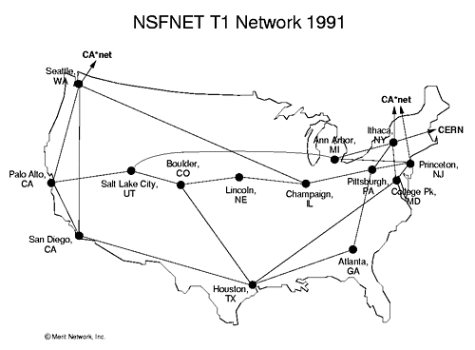
NSFNET
to accommodate further growth, the National Science Foundation (NSF) became involved with the ARPANET in 1984
NSF funded the construction of high-speed transmission lines that would form the backbone of the expanding network

Slide 6
"Internet"
the term “Internet” was coined in recognition of the similarities between the NSFNET and the interstate highway system
backbone connections provided fast communications between principal destinations, analogous to interstate highways
connected to the backbone were slower transmission lines that linked secondary destinations, analogous to state highways
local connections were required to reach individual computers, analogous to city and neighborhood roads
recognizing that continued growth would require significant funding and research, the government decided in the mid 90s to privatize the Internet
control of the network’s hardware was turned over to telecommunications companies and research organizations (e.g., AT&T, Verizon, T-Mobile)
research and design are administered by the Internet Society

Slide 7
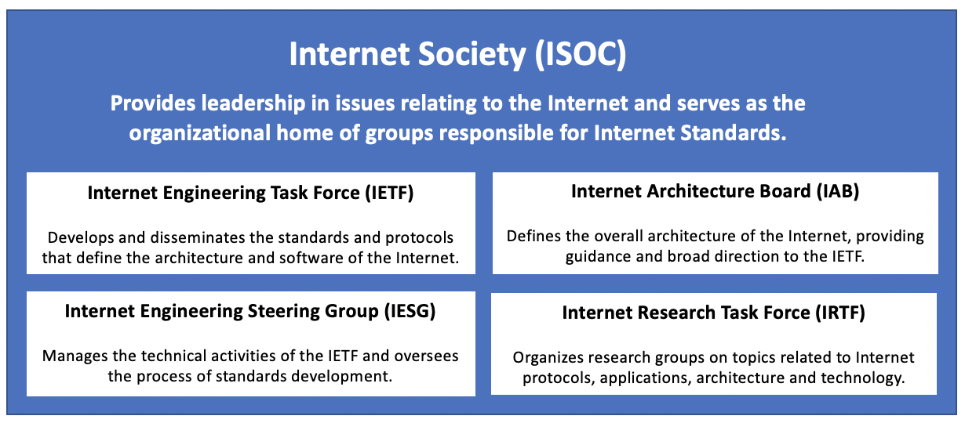
Internet Society
Internet Society is an international not-for-profit organization (founded in 1992)
it maintains and enforces standards, ensuring that all computers on the Internet are able to communicate with each other
it also organizes committees that propose and approve new Internet-related technologies and software

Slide 8
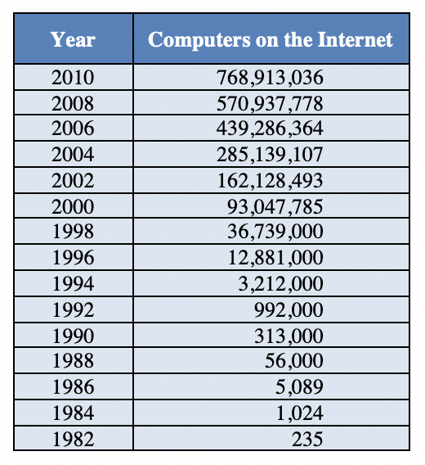
Internet Growth
until recently, the Internet more than doubled in size every 1 or 2 years
why has this trend slowed? will it continue?
(Internet Software Consortium)

Slide 9
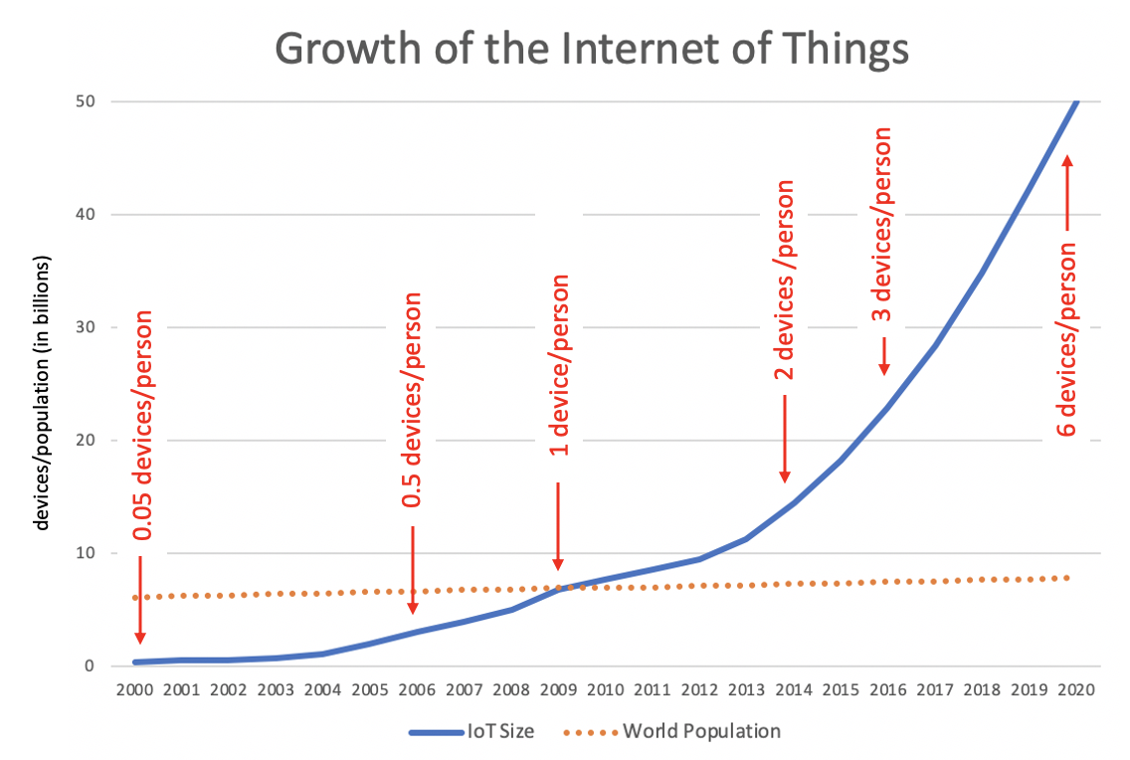
Internet of Things (IoT)
the growth of the Internet has slowed if you only count traditional computers
since 2010, massive growth has occurred with non-traditional devices
e.g. mobile devices (phones, tablets, watches, Bluetooth accessories)
e.g., embedded devices (smart home appliances, automobile control systems)

Slide 10
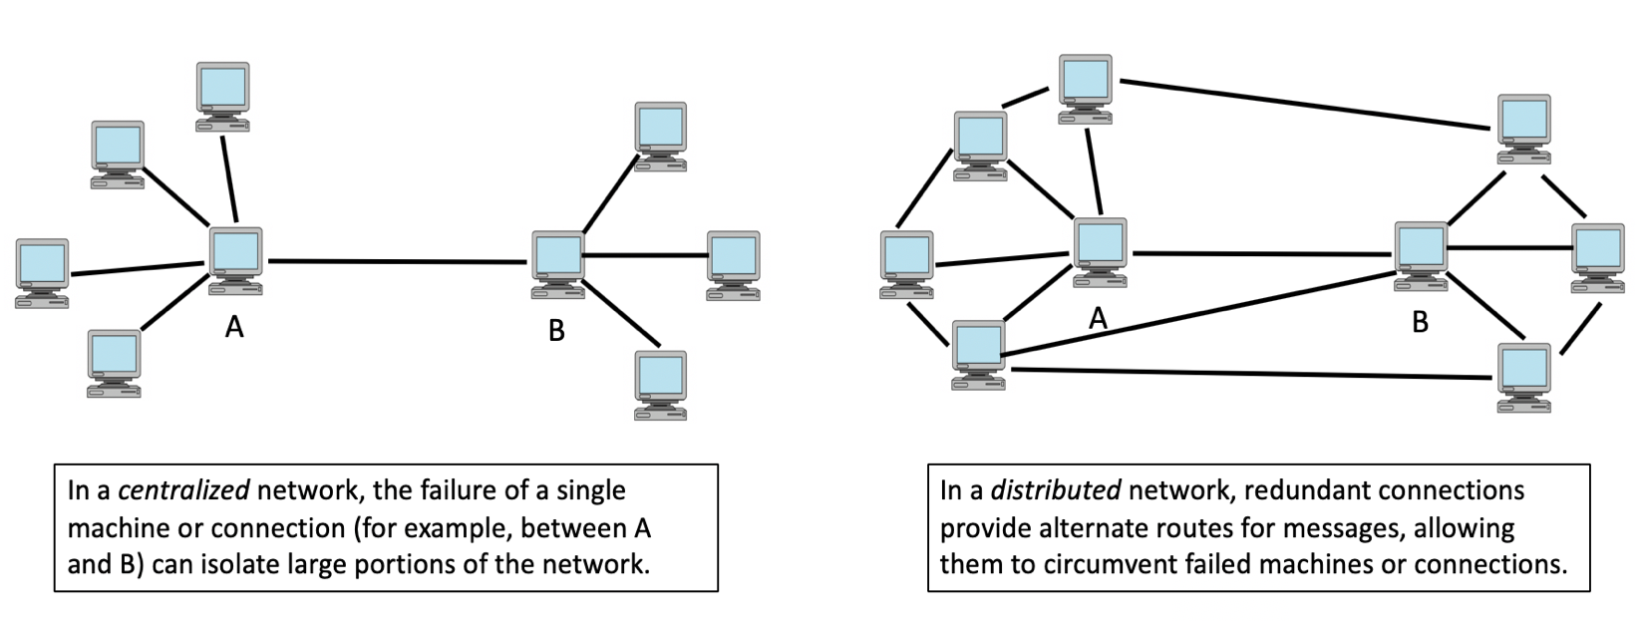
Distributed Networks
the design of the ARPANET was influenced by the ideas of Paul Baran, a researcher at the RAND Institute
Baran proposed 2 key ideas: distributed network and packet-switching
recall: the ARPANET was funded by the Dept of Defense for communications
as such, it needed to be resistant to attack or mechanical failure

Slide 11
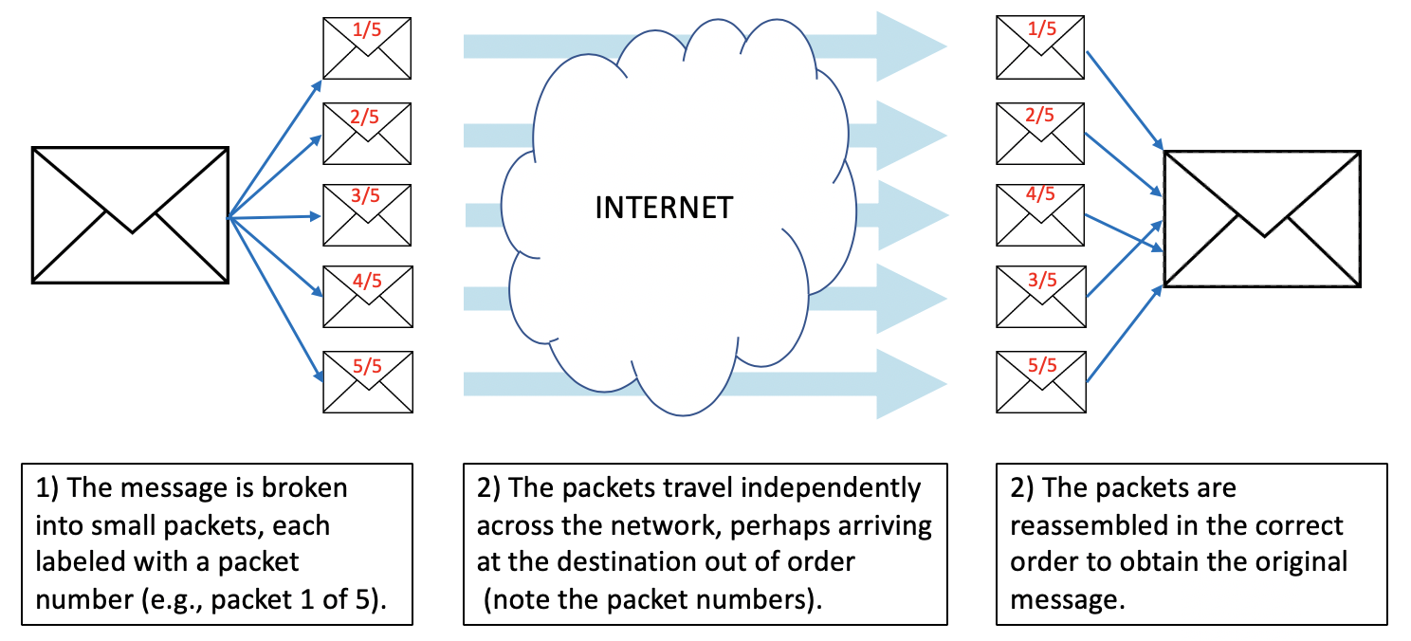
Packet Switching
in a packet-switching network, messages to be sent over the network are first broken into small pieces known as packets
these packets are sent independently to their final destination

Slide 12
Advantages of Packets
sending information in smaller units increases the efficient use of connections
large messages can't monopolize the connection
analogy: express line at grocery store to limit waiting
transmitting packets independently allows the network to react to failures or network congestion
routers (special-purpose computers that direct the flow of messages) can recognize failures or congestion and reroute the packet around trouble areas
analogy: changing route if Google Maps reports traffic congestion
breaking the message into packets can improve reliability
since the packets are transmitted independently, it is likely that at least part of the message will arrive (even if some failures occur within the network)
software at the destination can recognize which packets are missing and request retransmission

Slide 13
Protocols and Addresses
the Internet allows different types of computers from around the world to communicate
this is possible because the computing community agreed upon common protocols (sets of rules that describe how communication takes place)
the two central protocols that control Internet communication are:
Transmission Control Protocol (TCP)
Internet Protocol (IP)
these protocols rely on each computer having a unique identifier (known as an IP address)
analogy: street address + zip code provide unique address for your house/dorm
using this address, anyone in the world can send you a letter
an IP address is a number, written as a dotted sequence such as 147.134.2.84
each computer is assigned an IP address by its Internet Service Provider (ISP)
some ISPs (e.g., Cox, most colleges) maintain a pool of IP addresses and assign them dynamically to computers each time they connect

Slide 14
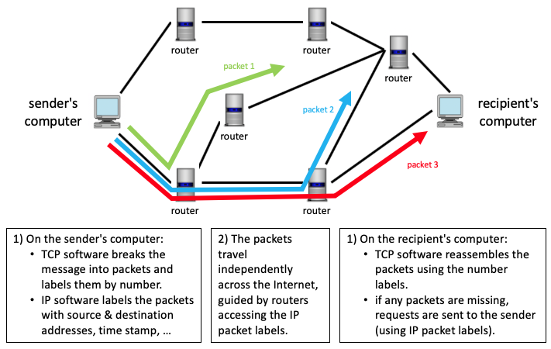
TCP/IP
Transmission Control Protocol (TCP)
controls the method by which messages are broken down into packets and then reassembled when they reach their final destination
Internet Protocol (IP)
concerned with labeling the packets for delivery and controlling the packets’ paths from sender to recipient (using the IP address)

Slide 15
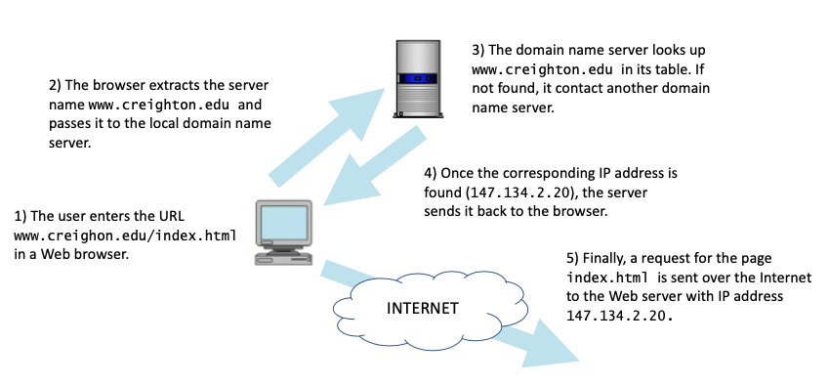
Routers and DNS
the Internet relies on special purpose computers in the network
routers are computers that receive packets, access the routing information, and pass the packets on toward their destination
domain name servers are computers that store mappings between domain names and IP addresses
domain names are hierarchical names for computers (e.g., bluejay.creighton.edu)
they are much easier to remember and type than IP addresses
domain name servers translate the names into their corresponding IP addresses

