Slide 1
Computer Science:
Concepts & Explorations
2nd edition
David Reed, Creighton University
The World Wide Web

Slide 2
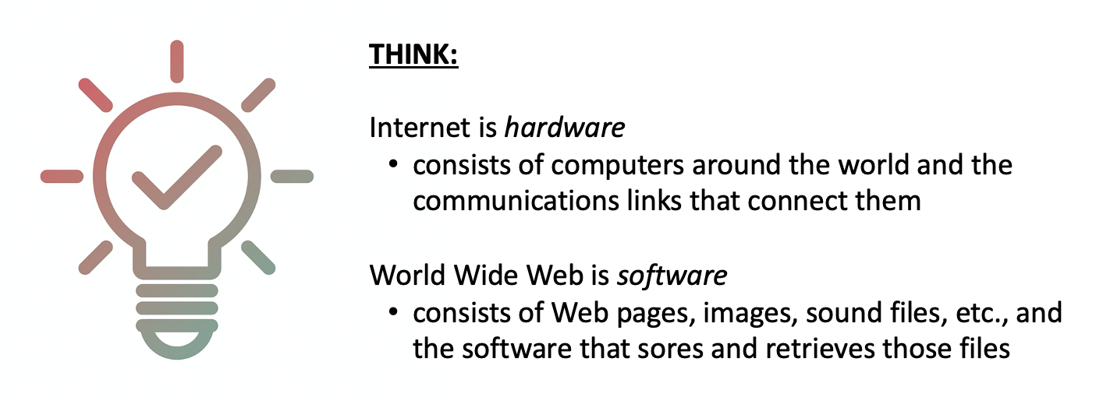
Web ≠ Internet
people often confuse the Web and the Internet – they are not the same!
  Internet was created in 1969; World Wide Web was created in 1990
the Internet could exist without the Web
  and did, in fact, for many years (applications included email and news groups)
the Web couldn't exist without the Internet
  the Internet is the hardware that stores and executes the Web software

Slide 3
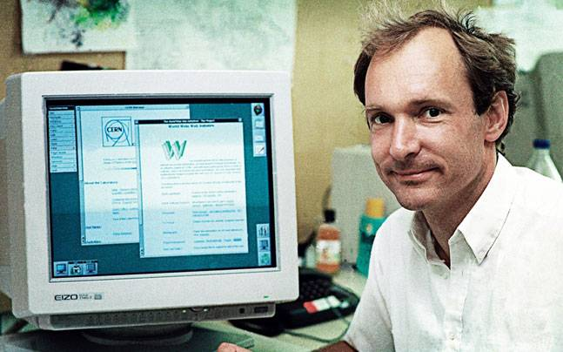
History of the Web
World Wide Web was invented by Tim Berners-Lee
  researcher from 1984-1994 at the European Laboratory for Particle Physics (CERN)
  founded and serves as director of the World Wide Web Consortium (W3C)
  knighted by Queen Elizabeth in 2004
CERN researchers were spread across Europe, but needed to collaborate
  in 1989, Berners-Lee devised a system that would allow them to freely exchange data, regardless of location or computer type
his design integrated two key ideas
  hypertext (documents with interlinked text and media)
    Web pages can contain images and links to other pages
  the distributed nature of the Internet
    pages can be stored on machines all across the Internet
    logical connections between pages are independent of physical locations

Slide 4
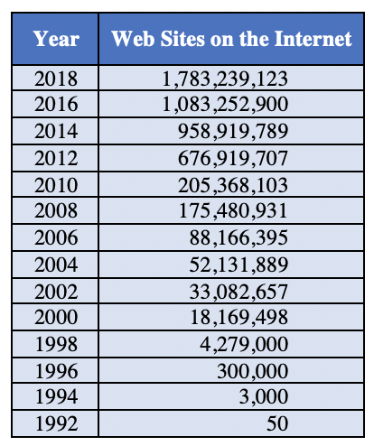
Web Timeline
1990: Berners-Lee produced working prototypes of a Web server and browser
1991: Berners-Lee made his software available for free over the Internet
1993: Marc Andreesen and Eric Bina at NCSA wrote the first graphical browser: Mosaic
  Mosaic integrated text, image & links, made browsing more intuitive
1994: Andreesen founded Netscape, which marketed the Netscape Navigator
1995: Microsoft released Internet Explorer → the browser wars begin!
1999: Internet Explorer becomes the most popular browser (~90% of market in 2002)
2021: Google Chrome has ~63% of market, then Safari at 19%, Mozilla Firefox at 4%
in 2019, Google claimed to have indexed more than 130 trillion pages
others estimate the number of Web pages could be in the hundreds of quadrillions

Slide 5
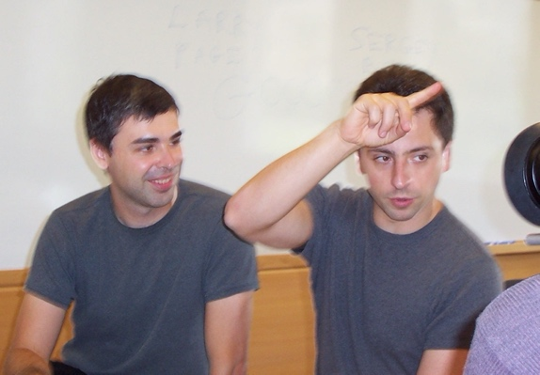
Search Engines
as the Web grew, it became difficult to find resources
  in general, you needed to somehow know the address of a page to access it
manually generated index sites appeared in the early 1990s
  provided lists of popular Web sites, organized by topic or alphabetically
  these were not scalable as the Web exploded in size
the first Web search engines appeared in the mid 1990s
  used software called Web crawlers, or spiders, to surf the Web, indexing pages
  enabled users to search those indexed pages via search words or phrases
unfortunately, the quality of early searches was not very good
  the search for a word/phrase might return unrelated or unreliable pages
the Google search engine began in 1996 as a research project by Stanford grad students Larry Page and Sergey Brin
  their goal was to create an easy-to-use search engine that produced high-quality results
  founded Google Inc. in 1998

Slide 6
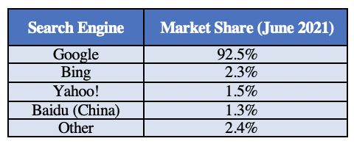
Google
at the heart of Google's performance is the PageRank algorithm
  ranks pages based on their perceived value and trustworthiness
  if a page is linked to by many other pages, that suggests that many people find its contents valuable and trustworthy
  moreover, the more valued/trusted those linking pages are, the more impact their links will have
Brin & Page also revolutionized how browsers made money
  they sold targeted adds and charged based on clickthrough
  e.g., a shoe store could purchase adds for when a user entered "shoe" or "footwear" as search terms, and would be charged based on how often users clicked on the ads
Brin & Page donated the patent for the PageRank algorithm to Stanford
  licensed its use back for $336 million in stock
Google dominates the search market
performed 5.6 billion searches in 2020
that's 63,000 searches per second!

Slide 7
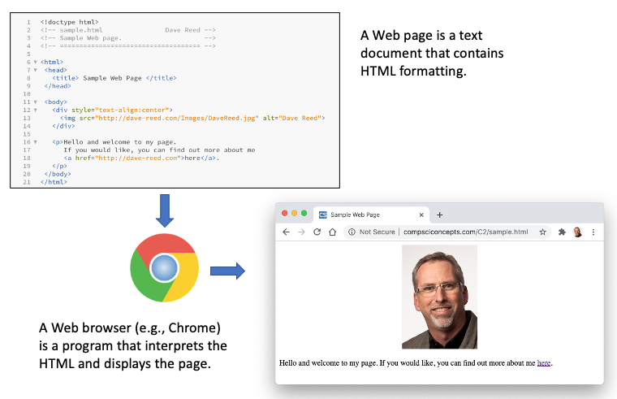
Viewing a Web Page
a Web page is a text document that contains additional formatting information in a language called HTML (HyperText Markup Language)
a Web browser is a program that accesses a Web page, interprets its content, and displays the page

Slide 8
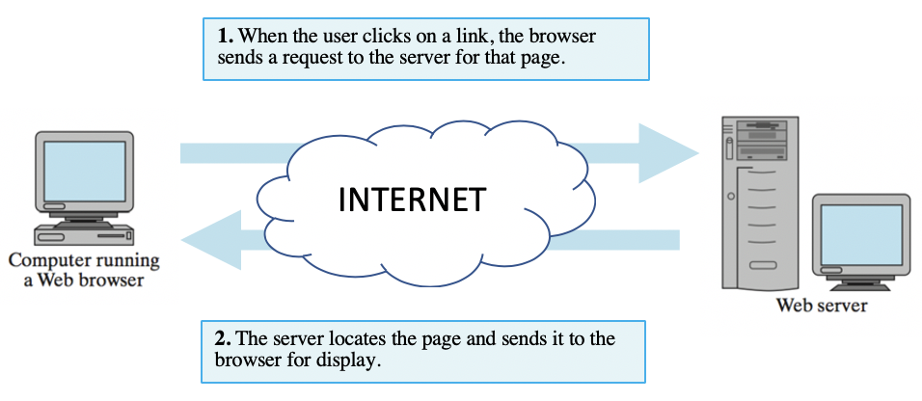
Web Server
a Web server is an Internet-enabled computer that executes software for providing access to certain Web document
  it stores Web pages and files (images, videos, …) and sends them to browsers who request them

Slide 9
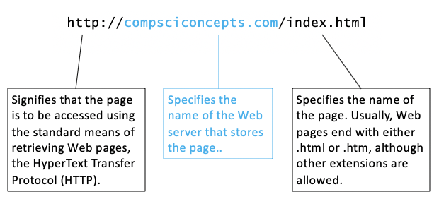
Web Addresses
Web pages require uniform names to locate and identify them uniquely
  each page is assigned a Uniform Resource Locator (URL)
  URL's are commonly referred to as Web addresses
  the different parts of the Web address provide information for locating the page

Slide 10
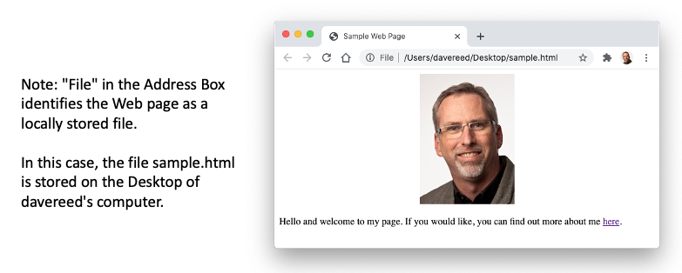
Viewing Local Web Pages
a Web browser can be used to view pages stored on the same computer
  can go through the File menu to select the local page, or
  can enter the File location in the address box (without the http prefix)
this feature is handy when developing Web pages
  can create a Web page and view it in the browser before uploading to a server

Slide 11
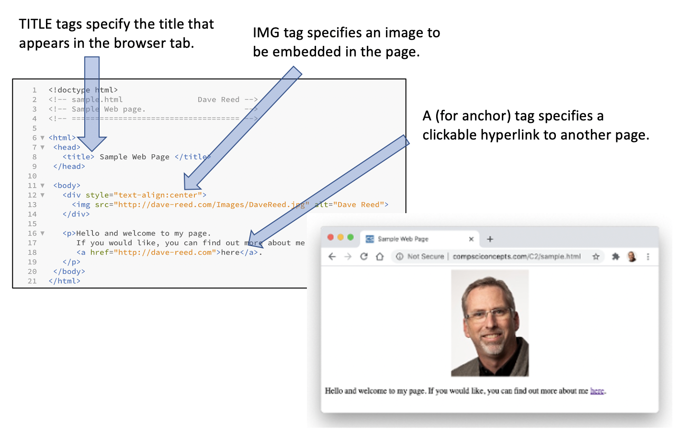
Web Protocols: HTML
HyperText Markup Language (HTML) utilizes tags to markup page contents
  these tags tell the browser how to display the contents
  HTML5 is the current standard, supported by all browsers

Slide 12
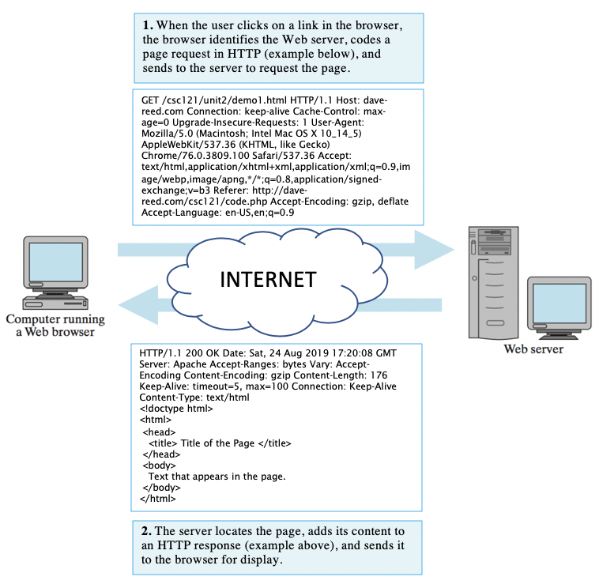
Web Protocols: HTTP
HyperText Transfer Protocol (HTTP) defines how messages between browsers and servers are formatted
  the prefix http:// in a URL specifies that the HTTP protocol is to be used in communicating with the server
  the prefix https:// is similarly used for secure (encrypted) HTTP communications

Slide 13
Browser caching
for efficiency reasons, browsers will sometimes cache pages/images
  the browser reserves space (a cache folder) on the user's computer
  to avoid redundant downloads, the browser will store a copy of a page/image in that reserved space (along with a timestamp)
  the next time the page/image is requested, browser will send a timestamp of the cached copy
    the server compares that timestamp with one of the stored document
      if cached copy is newer, then response says to use it
      if server copy is newer, then response includes the new version
in general, browsers are not allowed to access/modify user files
  this is for safety – you don't want to visit a Web site and risk having your files copied or damaged
  caching is a loophole (can only access/modify files in cache folder)
NOTE: caching still requires the browser to contact the server
  but only have to download the page if it has changed since last cached

Slide 14
Cookies
another loophole is cookies
a cookie is a small file that can be stored and accessed by a Web server
  similar to caching, browsers reserve space (a cookie folder) on the user's computer
  when the user visits a site, the Web server is allowed to store a small amount of data in a cookie file (e.g., date & time of visit, items purchased)
  when the user returns to that site, the Web server can retrieve any cookies it previously stored
  NOTE: only the site that stored the cookie is able to retrieve it
cookies can improve the user's experience, but can also be intrusive
  most browsers enable the user to control the use of cookies

