Slide 1
Computer Science:
Concepts & Explorations
2nd edition
David Reed, Creighton University
  Bridging the Divide

Slide 2
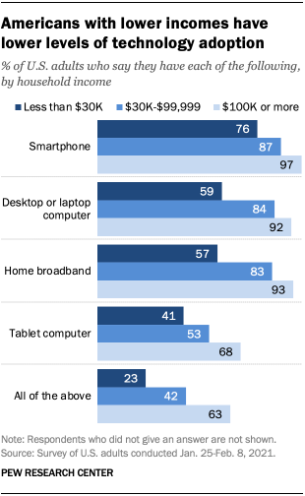
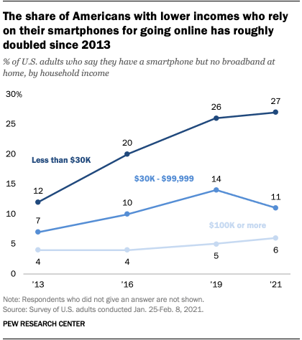
The Digital Divide
access to computers & Internet/Web offers numerous advantages
education, citizenship, employment, …
a troubling aspect of recent technological developments is that the benefits associated with computers are not shared equally by all
lower income Americans are far less likely to be online
many rely on smartphones for access

Slide 3
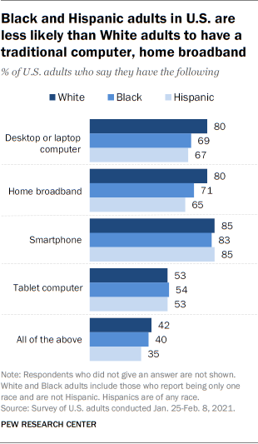
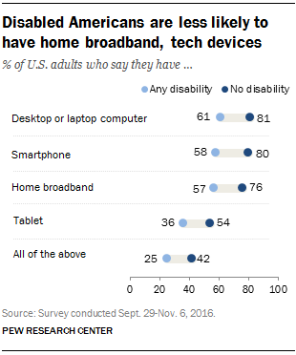
The Digital Divide (cont.)
similarly, inequities occur for those with minority ancestry or disabilities

Slide 4
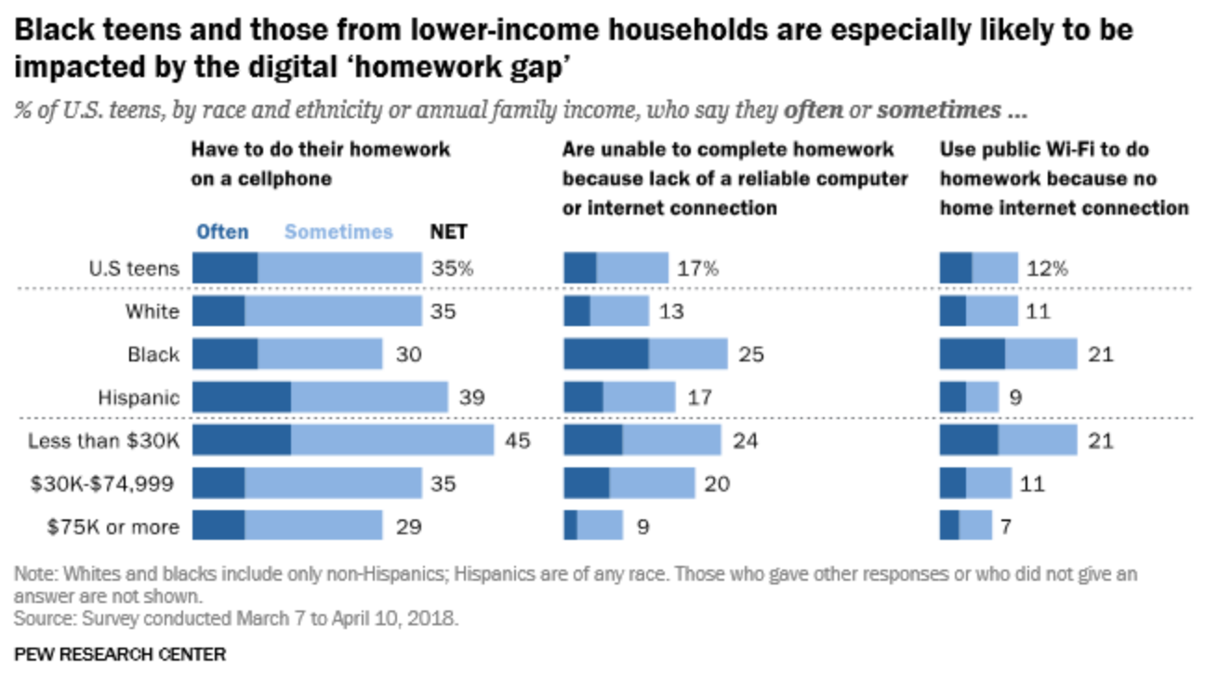
Homework Gap
the Digital Divide was highlighted during the 2020 COVID-19 pandemic
  many schools closed and students were transitioned to online classes
  those with home computers and reliable Internet were able to interact via videoconferencing software & complete online assignments
  those without were severely disadvantaged

Slide 5
Addressing Inequities
in late 1990s, U.S. government prioritized Internet connectivity
by 2003, nearly all public schools were connected (vs. 35% in 1994)
most public libraries provide free access to Internet-enabled computers
programs (e.g., Lifeline, Emergency Broadband Benefit) subsidize cellular and Internet bills for low-income families
numerous not-for-profit organizations address the Digital Divide
National Digital Inclusion Alliance coordinates hundreds of organizations
EveryoneOn connects low-income families with affordable Internet plans and devices
Computers for Kids takes old computers, refurbishes them, and donates them to schools and needy kids
Boys and Girls Club of America offers educational programs

Slide 6
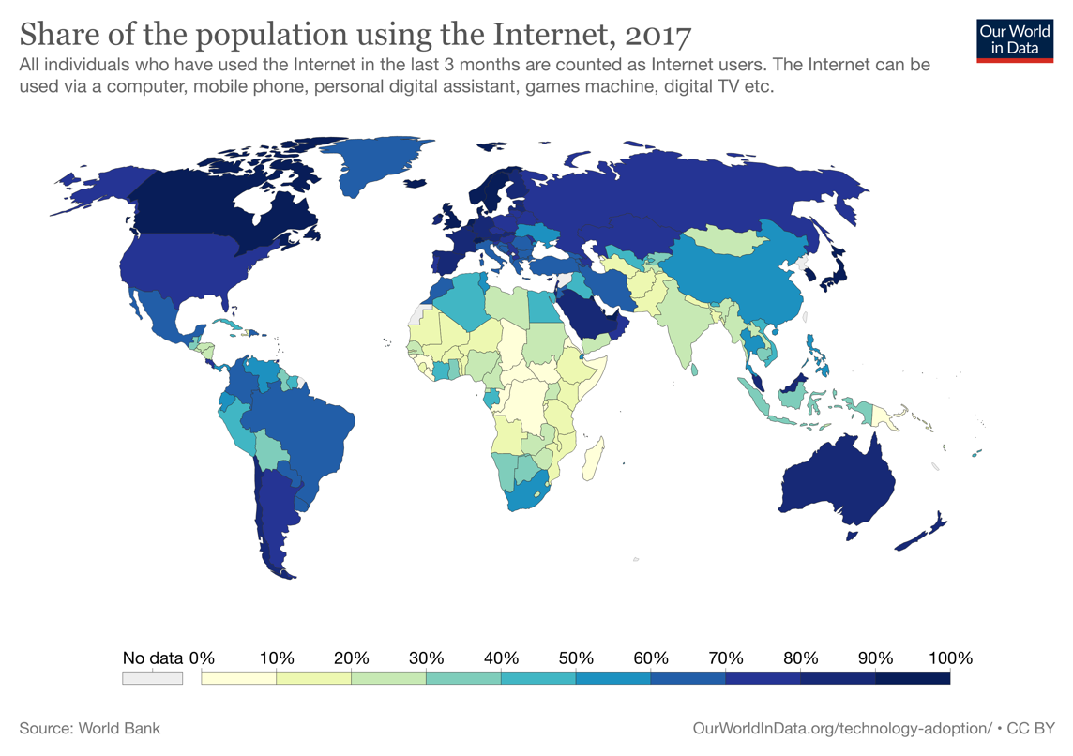
The Global Divide
globally, wealthier countries are more likely to have computers/Internet
the U.N. and World Economic Forum lead numerous initiatives
  2021 Generation Equality Forum raised $40 billion in new investments
many private sector initiatives as well
  One Laptop Per Child has donated more than 3 million low-power laptops
in 2014, 3 countries accounted for half of all Internet traffic
China (29%)
U.S. (13%)
Japan(8%)

Slide 7
Diversity in the Tech Sector
tech industry is one of the most dynamic & exciting sectors of the economy
  no other industry has the same potential for rapidly taking ideas and turning them into devices/applications that change the world
  e.g., cell phones & smartphones widely adopted within 10 years
many applications were the brainchild of a single person or small team
  Word Wide Web Tim Berners-Lee, 1990
  Mosaic browser Mark Andreesen & Eric Bina, 1994
  Google Larry Page & Sergey Brin, 1998
  Facebook Mark Zuckerberg, 2004
  Twitter Jack Dorsey, 2006
  Instagram Kevin Systrom & Mike Krieger, 2010
all these pioneers/innovators/entrepreneurs are white males
women and people of color have been and continue to be underrepresented in the tech industry (especially in leadership)

Slide 8
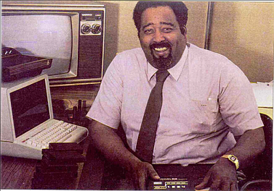

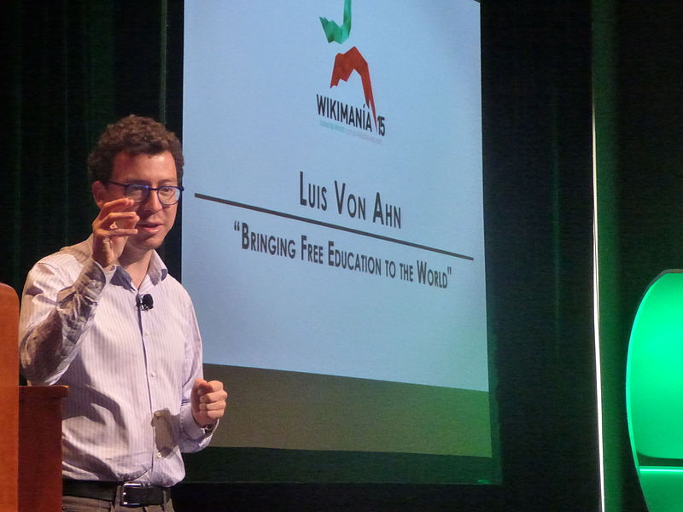
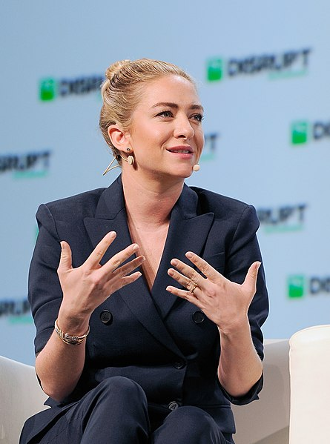
Success Stories
certainly, there have been successful leaders and innovators
  Jerry Lawson (1940-2011): led development of first cartridge-based video game, founded VideoSoft in 1980.
  Marissa Mayer (1975-): first female engineer at Google, led in development of Google Maps, Google Earth & Street Maps. CEO of Yahoo! from 2012-2017.
  Luis von Ahn (1979-): founded digital security company reCAPTCHA. Also founder and CEO of DuoLingo.
  Whitney Wolfe Herd (1989-): founded Bumble, youngest woman to take her company public on NYSE & youngest female self-made billionaire.

Slide 9
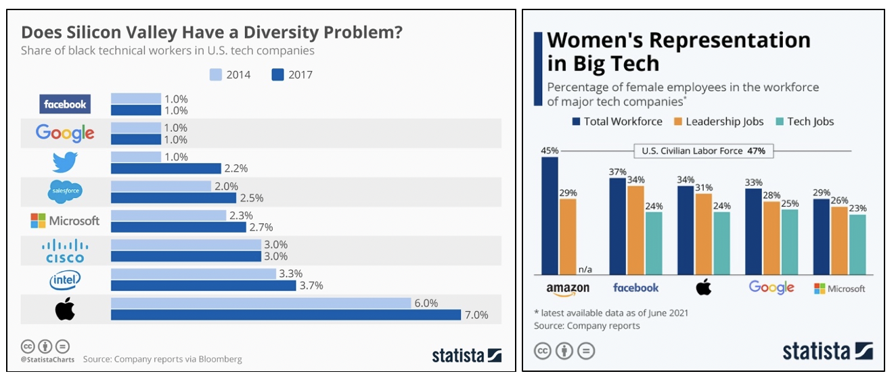
Underrepresentation
in 2020, women were > 50% of U.S. workforce, but only 26% of tech jobs
  only 7% of Fortune 500 CEOs were women
even greater underrepresentation for minority groups
  Hispanic/Latinx Americans: 18% of workforce, 8% of tech jobs
  African Americans: 13% of workforce, 5% of tech jobs

Slide 10
Increasing Diversity
tech companies are addressing equity/diversity, but change has been slow
  changing company culture to be more inclusive
  changing hiring practices to bring in more diversity
  creating mentoring programs for women & minority employees
one problem is that stereotypes & misinformation influence people when they are young
  TV & movies perpetuate white/Asian male sterotypes
  access to computers in schools is not equitable
  among 2020 college graduates with major in computer science:
    18% were women, 10% were Hispanic/Latinx, 9% were African American
many initiatives are focused on providing access/mentoring for young people
  e.g., National Center for Women & Information Technology (NCWIT), AnitaB.org, Code.org, Black Girls Code, and Hispanics in Computing
  AP CS Principles course launched in 2017, specifically designed to increase participation by women and minorities

Slide 11
Benefits of Diversity
studies have shown numerous benefits of diversity in the workplace
companies are more productive when teams are diverse in background/perspective
different viewpoints & experiences produce a diversity of ideas, which can encourage innovation
an openness to workers who look and think differently means outstanding candidates who might have been overlooked are now hired
a diverse workforce is better at understanding and responding to a diverse client base
the products designed and built by a diverse team tend to be higher quality and more equitable
    e.g., cell phone interfaces designed by men that are difficult to use by women with smaller hands
    e.g., 5-year gap between release of Apple emojis and emojis with different skin tones

Slide 12
Algorithmic bias
algorithmic bias occurs when faulty assumptions and poor design practices lead to software that discriminates
  in 2015, Amazon announced it was abandoning interview software that was proven to discriminate against women candidates
  in 2016, ProPublica published a report documenting how sentencing software used in courts discriminated against minority suspects
  in 2019, Science published a report documenting how hospital software for screening patients discriminated against minority and low-income patients
  Several studies have confirmed that facial recognition software misidentifies women and people of color disproportionally, leading to more arrests due to use by law enforcement.
in all these cases, algorithmic bias was not intentional
lack of diversity led to unquestioned assumptions & flawed development process

Slide 13
Bridging the Divide
when combating any form of discrimination and inequity, awareness is the first step
in the past decade, awareness of the Digital Divide has led to change
  governments and companies are leading equity efforts
  young women and people of color are being encouraged to consider future careers in computing
  recognition of toxic corporate cultures & unfair hiring practices are producing change (albeit slowly)
  recognition of the dangers of algorithmic bias is leading to new design and testing methodologies

