Slide 1
Computer Science: Concepts & Explorations 2nd edition David Reed, Creighton University
Impact of Computing

Slide 2
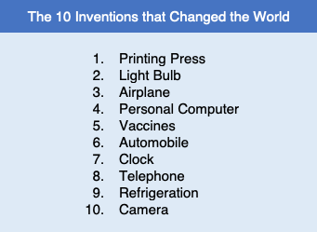
Most impactful inventions
science writer Daniel Stone ranked the 10 most important/impactful inventions
do you agree with his list?
(Daniel Stone. “The 10 Inventions that Changed the World.” National Geographic Magazine, June 2017.)
more than any other invention, computer technology is still evolving, which means that it continues to impact society in new ways

Slide 3

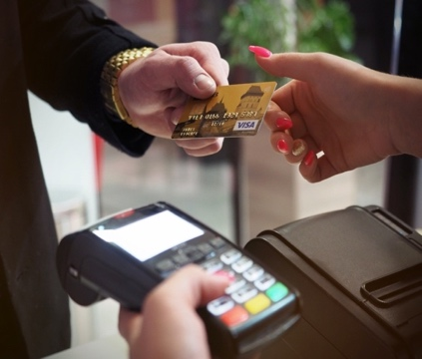
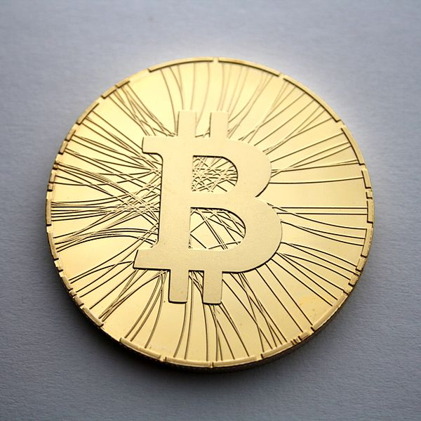
Impact on Money
40+ years ago, the U.S. was a cash-based society
2 tech developments changed that
cheap, portable devices for processing credit card transactions
expansion of the Internet
banks could treat money as numbers in a file
led to expansion of ATMs, debit cards, online banking
many Americans now live virtually cash-free
in 2019, 39 billion credit card transactions, 10 billion ATM transactions
in 2020, most individuals carried less than $40
cryptocurrencies like Bitcoin are growing in popularity
market-based, not backed by government or bank
offers complete anonymity, potentially tax free
very volatile, not clear if will be widely accepted

Slide 4
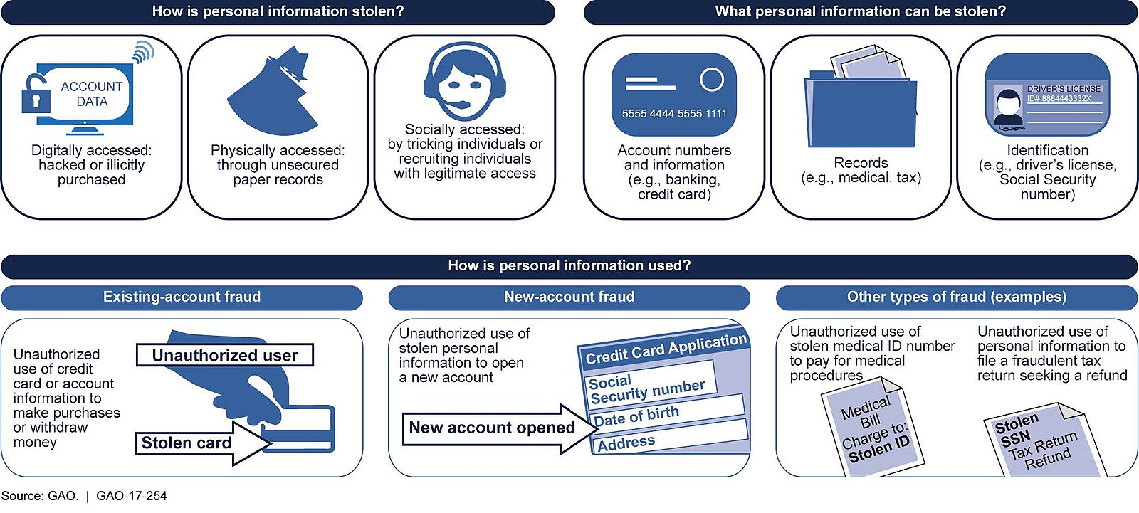
Negatives: debt & security
the convenience of ATMs, debit/credit cards has led to a debt crisis for many
avg. credit card interest rate: 16%
by comparison: 30-year mortgage (2.8%), 5-year CD (0.31%)
2021 credit card debt in U.S. totaled $807 billion
avg. household credit-card debt: $6,270
electronic money meant fewer muggings, but introduced identity theft & fraud
nearly half of Americans experienced in 2020, total loss of $712 billion

Slide 5
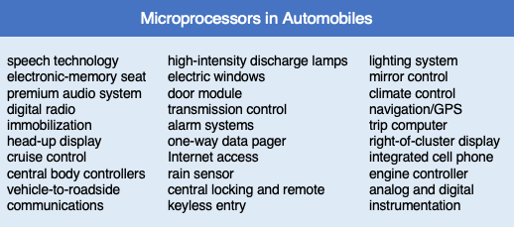
Computers in Everyday Tasks
modern life also depends on thousands of less obvious, hidden computer applications
embedded processors are computer chips that are built into appliances and machinery to control their workings
they account for more than 98% of all computer processors
modern homes contain hundreds of embedded processors
in ovens, television remote controls, cordless phones, automatic thermostats, …
automobiles employ embedded processors to control a wide variety of components

Slide 6
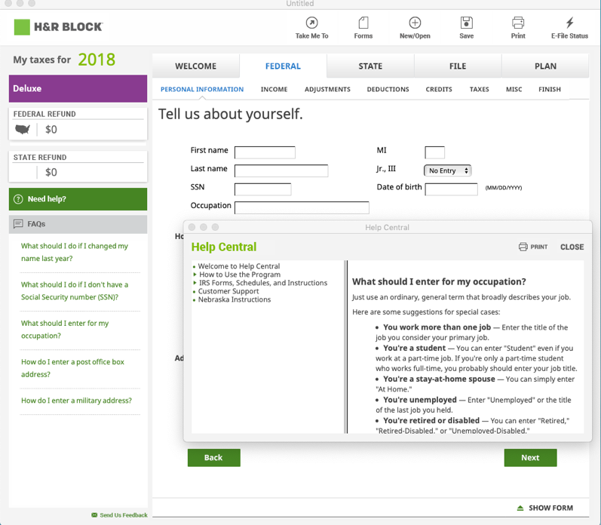
Computers in Everyday Tasks
society has also been affected by the availability of personal computers and easy-to-use software
software can enable people to accomplish tasks previously reserved for highly trained professionals, e.g.,
word processing and desktop publishing software
video editing software
tax preparation software
smart phones and hand-held computers have driven the development of mobile apps
in June 2021, Apple's App Store listed 2.2 million apps, Google's Play Store listed 3.4 million apps
Amazon's Kindle & Sony's Reader enable downloading and reading electronic books

Slide 7
Negatives: overreliance
as society becomes dependent on complex, computer-based products and services, the effects of errors or system failures become far-reaching
computer-system bugs can produce dire consequences
from 1985-1987, 4 cancer patients died from radiation overdoses due to a single coding error in medical equipment software
in 1991, 28 soldiers were killed by a Scud missile because a software error(involving number roundoff) caused the Patriot missile to miss its target
in 1999, NASA’s Mars Climate Orbiter went off course and was destroyed in the Martian atmosphere (the problem was due to software inconsistencies which used different measurement conversions, e.g., English vs. Metric)
in 2010, Toyota recalled more than 400,000 hybrid due to faulty anti-lock brake software (estimated cost exceeds $6 billion)
in 2012, Knight Capital group lost $461 million in 30 minutes due to a bug in their online trading software
from 2016-2019, self-driving cars have caused 6 fatalities
to avoid errors, various software design and testing methodologies are used
however, as the size and complexity of the software grows, design and testing become exponentially more difficult
Windows 2000 – 35 million lines of code, 63,000 known bugs

Slide 8
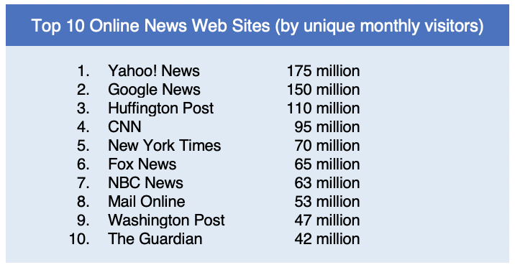
Internet/Web for Information
many users utilize the Internet/Web as an information source
online resources are quickly replacing (or complementing) traditional sources of information
Web sites can be updated 24 hours/day, can report on breaking stories
text can be integrated with other types of media
the immediacy of online delivery system is especially appealing
independent media organizations have utilized the Web to present stories and opinions that might not otherwise reach a mainstream audience
in order to compete, many newspapers/magazines now offer online services

Slide 9
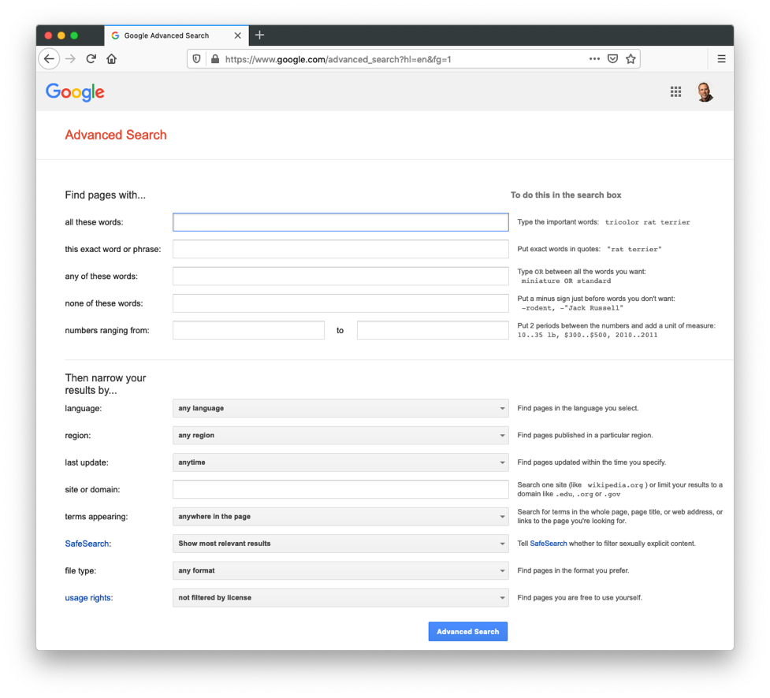
Internet/Web for Information
the majority of Web pages are unique resources created by individuals and private organizations
you can find Web content on virtually any topic
to help navigate the vast sea of information, search engines automatically catalog Web pages and allow users to search for data by topic or keywords

Slide 10
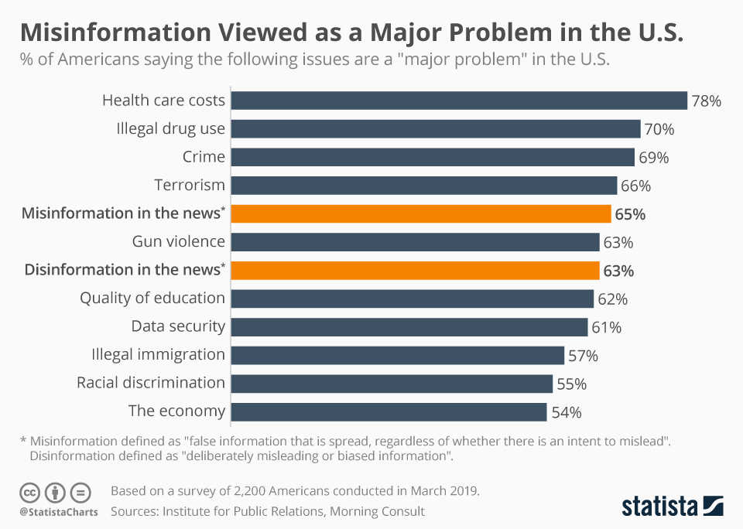
Negatives: fake news
the openness of the Web allows for a diversity of views to be presented
but, not all views are fact-based or unbiased
misinformation or disinformation (intentional misinformation) are widespread
Americans rated online misinformation a major problem (2019)
only 26% were very confident in their ability to recognize fake news

Slide 11
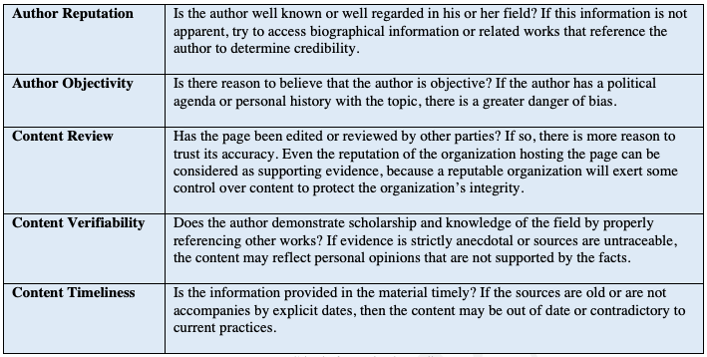
Negatives: info overload
the impressive range of information available online can be viewed as a strength, but it is also one of the greatest weaknesses
as of 2019, Web estimated in hundreds of billions of pages (maybe much more)
finding specific info can be hard, even with search engines
since most Internet/Web content lacks editorial review, it is up to the user to evaluate its credibility

Slide 12
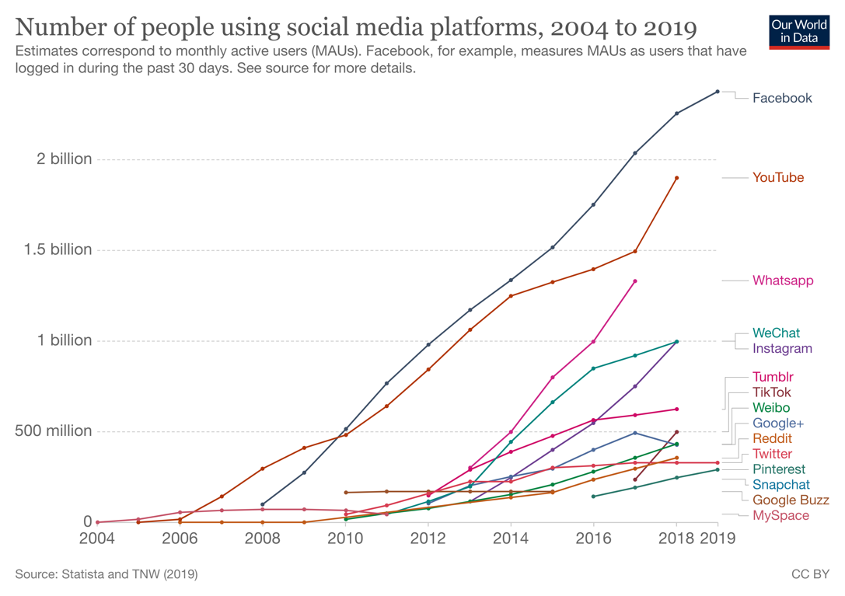
Internet/Web for Communication
many users were originally drawn to the Internet by the availability of electronic mail and newsgroups
in 2021, 4.1 billion active email users worldwide (1.8 billion used Gmail)
319.6 billion email messages were sent/received each day (~50% spam)
increasingly, the Internet is being used for social networking
in 2021, 97% of Americans own cell phone, 85% own smartphone
23 billion texts sent in 2020
social media sites have grown in popularity
Facebook
YouTube
Whatsapp
WeChat
Instagram

Slide 13
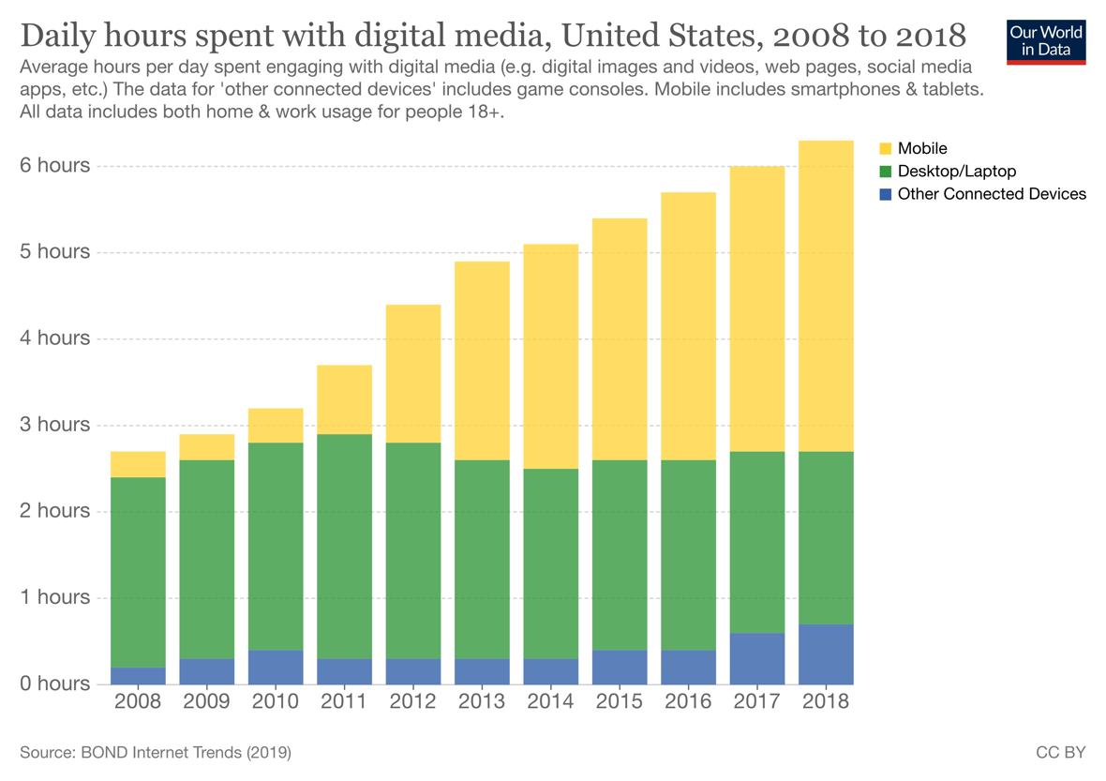
Negatives: addiction
studies have shown social media can be physically & emotionally addictive
in 2018, average adult spent 6 hours/day on connected devices
assuming 7 hours of sleep, that's 35% of waking day
nomophobia: fear of being detached from mobile phone connectivity

Slide 14
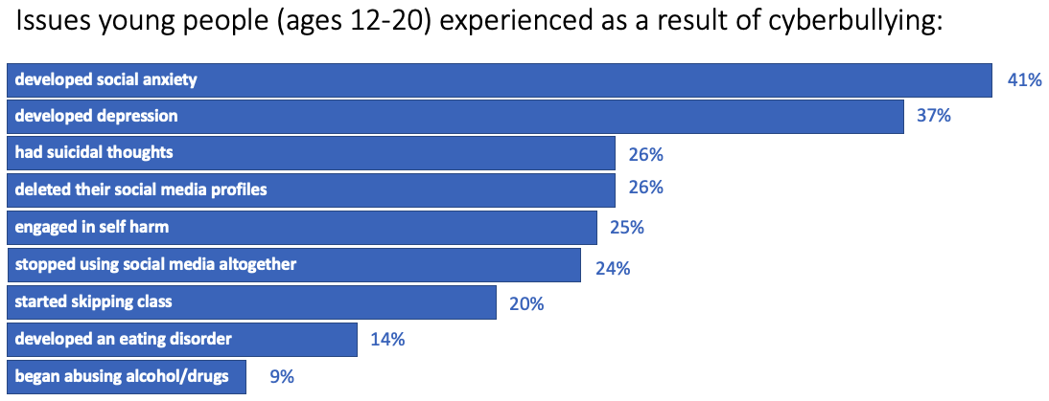
Negatives: cyberbullying
preteen & teen use of social media has led to bullying via text & social media
annual survey in U.K. identifies negative consequences
suicide rate for teen girls in U.S. increased 65% from 2010-2015, coinciding with rise in smartphone social media use
also, texting while driving is 6x more dangerous than drunk driving

Slide 15
Internet/Web for Commerce
another popular function of the Web is to facilitate electronic commerce, or e-commerce
businesses have recognized the Web’s potential as an advertising medium, and as a tool for reaching new customers
some business sites are information-based (providing background on the company or product descriptions)
other business sites are transaction-based (allowing customers to purchase products or services directly)
online shopping has numerous advantages for the consumer
you can make purchases from your home at any time
it is easy to comparison shop
many online retailers, such as Amazon.com, allow consumers to research products as well as purchase them

Slide 16
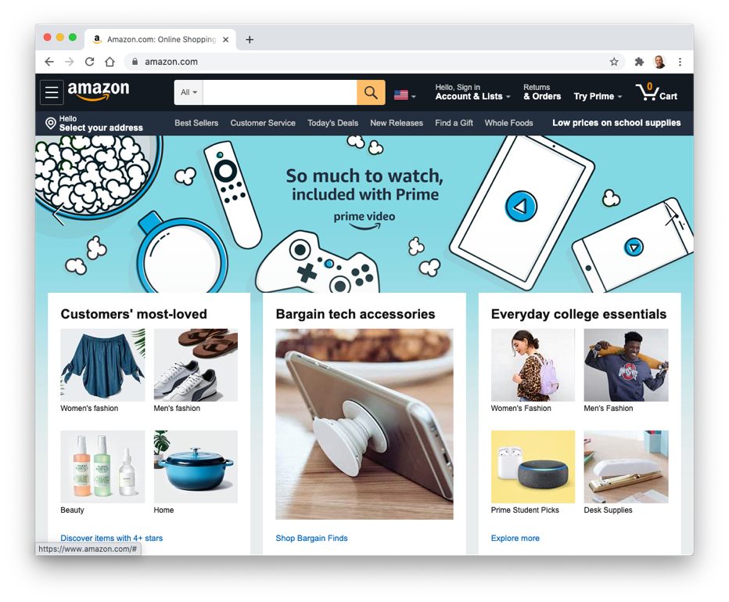
Internet/Web for Commerce
total online sales in 2020: $861 billion
some of the most successful sites are online offshoots of traditional retailers
Walmart, Best Buy, PetSmart
Amazon is by far the dominant force
more than 1/3 of ecommerce sector
the Web has provided a new advertising channel for businesses
e-commerce sites charge fees for hosting advertising banners on Web pages
banner ads are clickable images that promote a company’s product or service
users who click on the ad are directed to the company’s Web site
the Web’s structure allows for a direct connection between ads and related purchasing interfaces

Slide 17
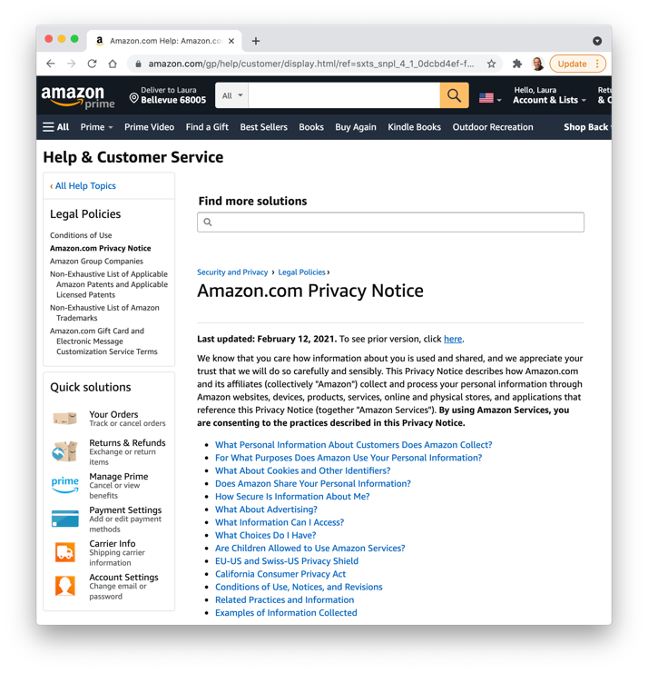
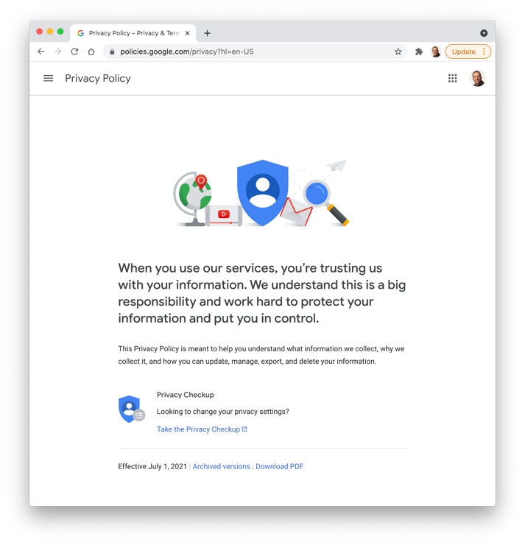
Negatives: privacy
when using credit cards or shopping online, consumers sacrifice privacy for the sake of convenience
companies maintain records of consumer purchases
private details can be inferred from shopping patterns
companies often sell customer profiles to marketing firms
Web users can limit exploitation by interacting only with reputable online businesses with privacy policies
such policies will explain what information is collected by the business and how that information is to be used (and shared)

Slide 18
Negatives: security
email also raises privacy concerns
email messages travel through numerous routers, and each router represents a security risk
when a message is received it is commonly stored in a file on the recipient’s computer – there is a danger that unauthorized users might get access
few laws apply directly to electronic privacy
courts overwhelmingly favor employers over employees in privacy suits
unless explicitly stated, it is generally accepted that employers may access any content on company-owned machines
increasing occurrences of phishing attacks, in which people are fooled into surrendering sensitive information via email
privacy is closely linked with security
with online transactions, credit card numbers or other personal information can be intercepted and subsequently result in identity theft
encryption methods are commonly used to secure information transmissions, but online fraud is still a continuing problem

Slide 19
In conclusion…
"Technology is, of course, a double edged sword. Fire can cook our food but also burn us." – Jason Silva
overall, changes brought about by computers have been extremely positive
there is no going back, computers are integrated into our lives
not all change is good, so you need to be informed and diligent about the choices you make
social media allows people to connect over distances, but also can lead to physical isolation and cyber-bullying
facial recognition can add security to banking, but can invade privacy and be discriminatory
hopefully, this book has helped you better understand computer technology and its applications
will enable you to make informed choices about how you adopt technology

