Slide 1
Computer Science: Concepts & Explorations 2nd edition David Reed, Creighton University
Inside the Computer

Slide 2
Electricity and Switches
modern computers are powered by electricity, using electrical signals to store and manipulate information
the components of a computer require electrical power to carry out their assigned task
electricity generates the light that shines through a computer screen, illuminating the individual pixels that make up images and letters
electricity runs the motor that spins the hard-drive disk, allowing information to be accessed
main memory and CPU employ electrical signals to store and manipulate data
bit patterns are represented by the presence or absence of electrical current along a wire

Slide 3
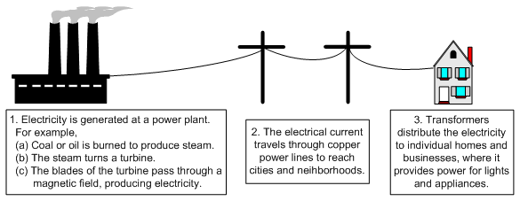
Electricity Basics
electricity is a flow of electrons, the negatively charged particles in atoms, through a medium
good conductors of electricity allow for the flow of electrons with little resistance (e.g., copper, silver, gold)
other elements, especially nonmetals, are poor conductors (e.g., carbon, oxygen)
electricity can be quantified in amperes or voltage
amperes gauge electron flow: 1 amp is equal to 6.24 quintillion electrons flowing past a given point each second
voltage measures the physical force produced by the flow of electrons: standard household in United States has 110 to 120 volt outlets

Slide 4
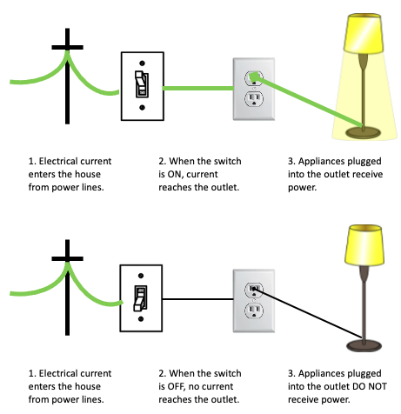
Switches
the most basic tool for controlling the flow of electricity is a switch
a switch can be flipped to connect or disconnect two wires, thus regulating the flow of electricity between them
example: a light switch on a wall serves as an intermediary between the power line entering your home and the outlet that operates a lighting fixture
if the switch is turned on, then the wires that link the outlet to the power line are connected, and the lighting fixture receives electricity
if the switch is turned off, then the connection is interrupted, and no power reaches the outlet

Slide 5
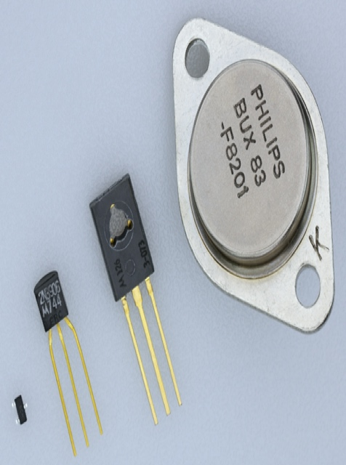
Transistors
as we saw in Chapter C4, advances in switching technology have defined the generations of computers
1930’s – electromagnetic relays served as physical switches, with on/off positions controlled by the voltage to a magnet
1940’s – vacuum tubes replaced relays, which were faster (since no moving parts) but tended to overheat and burn out frequently
1948 – the transistor was developed by Bardeen, Brattain, and Shockley
a transistor is a solid piece of metal attached to a wire that serves as a switch by alternatively conducting or resisting electricity
transistors allowed for the development of smaller, faster machines at a lower cost
semiconductors are metals that can be manipulated to be either good or bad conductors of electricity
the first transistors were made of germanium and gold, but modern transistors are constructed from silicon
through a process known as doping, impurities are added to a slab of silicon, causing the metal to act as an electrical switch

Slide 6
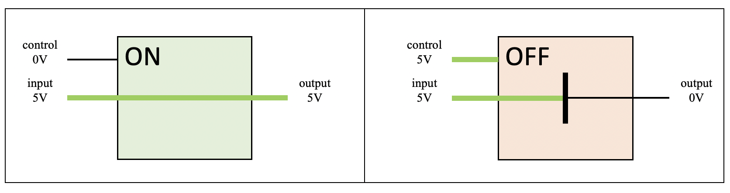
Transistors as Switches
a PMOS transistor is positively doped, so that the switch is ON (or closed) when there is no current on the control wire, but OFF (or open) when current is applied
transistors can be combined with other electronic components to form circuits, which control the flow of electricity in order to produce a particular behavior

Slide 7
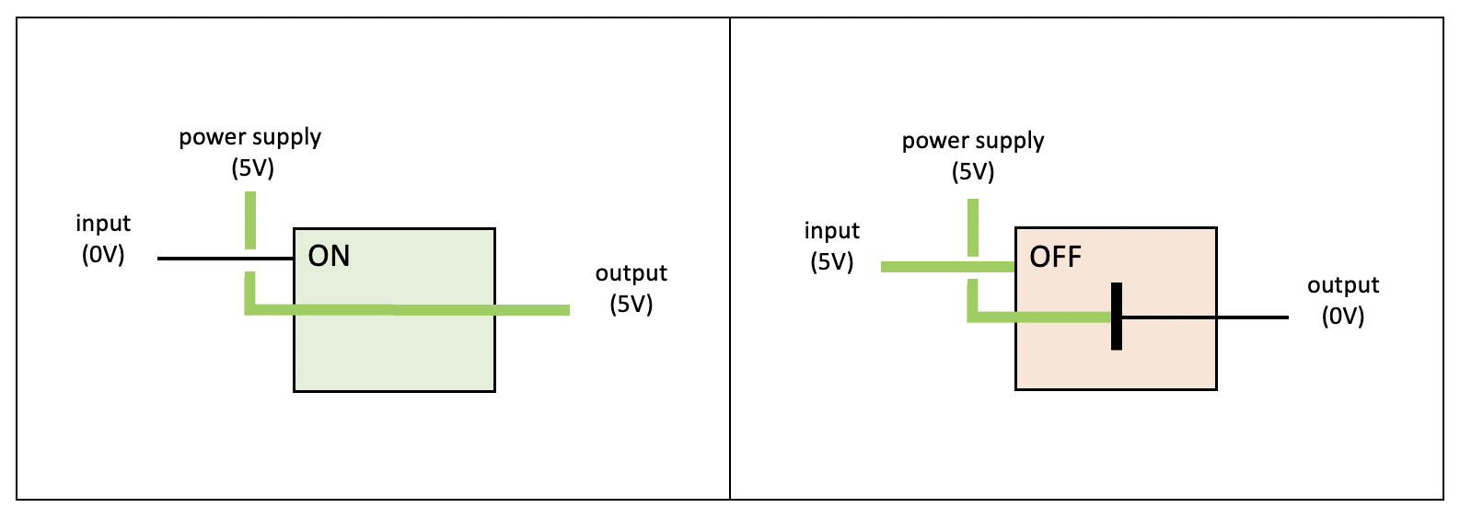
From Transistors to Gates
consider the following circuit combining a PMOS transistor with a power supply
note: the power supply is connected to the transistor input wire, the circuit input is connected to the control wire
if no current (0 volts) is applied to the circuit input wire, the transistor will be ON to allow current to travel on the output wire
if current (5 volts) is applied to the circuit input wire, the transistor will be OFF so no current reaches the output wire
the result is that the output is the opposite of the input
this circuit known as a NOT gate

Slide 8
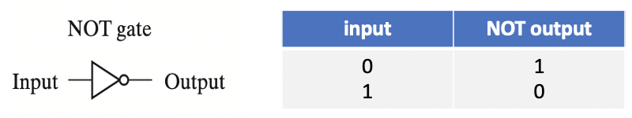
Gates and Binary Logic
the term “gate” suggests a simple circuit that controls the flow of electricity
in the case of a NOT gate, the flow of electricity is manipulated so that the output signal is always opposite of the input signal
we can think of a gate as computing a function of binary values
0 represents no current; 1 represents current
the symbol to the left (triangle w/ circle) is often used to denote a NOT gate
the truth table to the right describes the mapping of input to output
note: NOT gates invert voltages in the same way that the JavaScript NOT operator (!) inverts Boolean values
0 corresponds to false; 1 corresponds to true

Slide 9
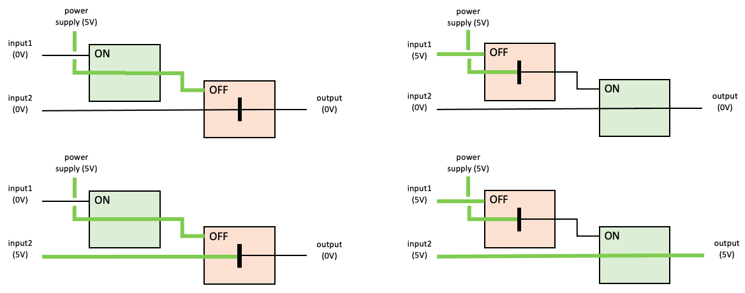
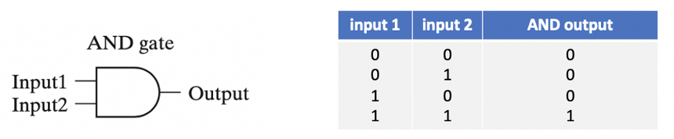
Gates and Binary Logic
many other simple circuits can be defined to perform useful tasks
AND gate – produces voltage on its output wire if both input wires carry voltage

Slide 10
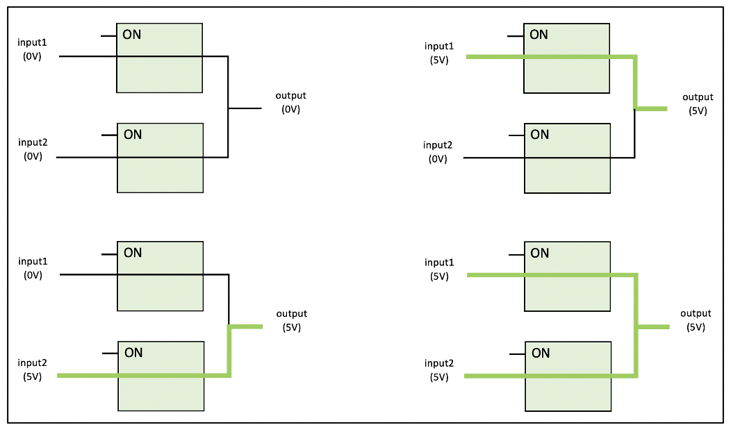
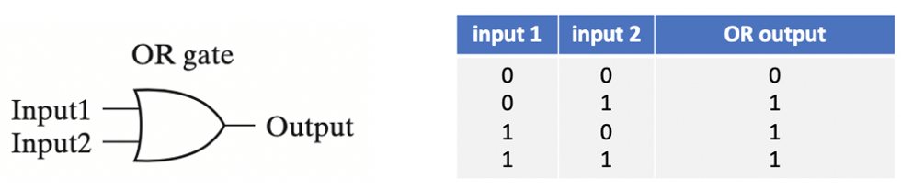
Gates and Binary Logic
OR gate – produces voltage on its output wire if either input wire carries voltage

Slide 11
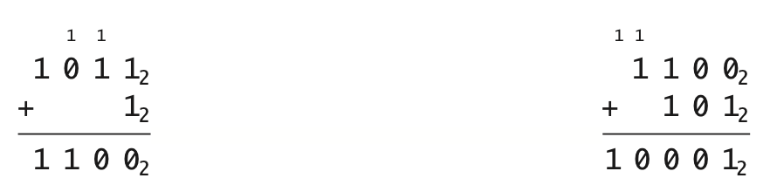
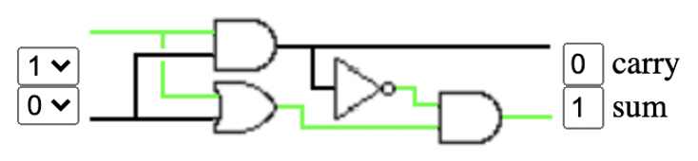
From Gates to Circuits
basic logic gates can be combined to build more advanced circuitry
example: adding two binary numbers
although binary addition is relatively straightforward, designing a circuit for adding binary numbers is quite complex
instead of starting at the transistor level, we can use AND, OR, and NOT gates
focus first on the addition of 2 bits
requires two input lines, two output lines (sum of inputs and possible carry)
the circuit consist of four gates (known as a half-adder)

Slide 12
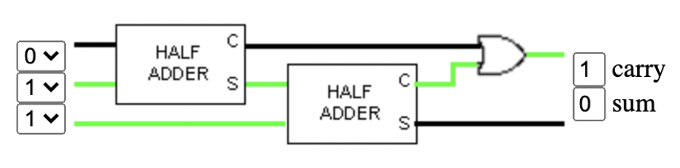
Full-adder Circuit
the term “half-adder” refers to the fact that when you add binary numbers containing more than one bit, summing the corresponding bit pairs by column is only half the job
you must also consider that a bit might be carried over from the previous addition
using half-adders and logical gates as building blocks, we can design a circuit that takes this into account (known as a full-adder)

Slide 13
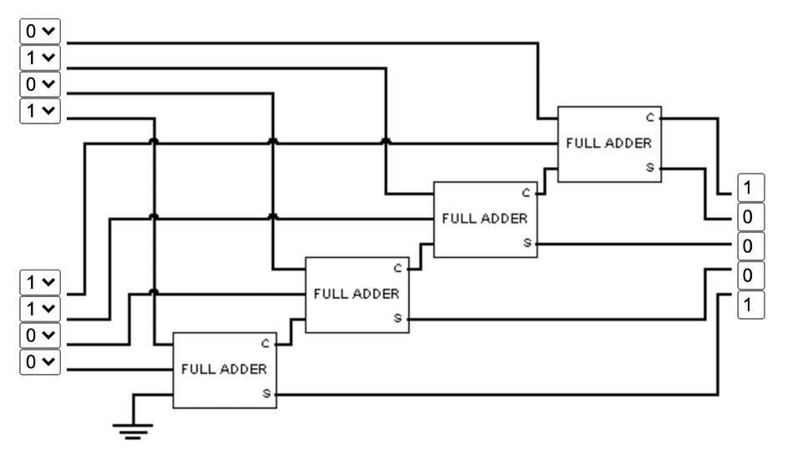
4-bit Adder Circuit
using full-adders as building blocks, we can design a more complex circuit that sums two 4-bit numbers
since a full-adder is required to add each corresponding bit pair together (along with possible carry), the circuit will need four full-adders wired together

Slide 14
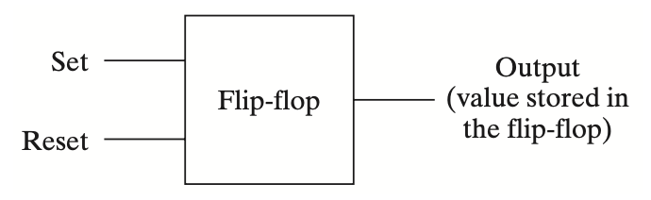
Designing Memory Circuitry
main memory and registers within the CPU are composed of circuitry
whereas adders manipulate inputs to produce outputs, memory circuits must maintain values over time
the simplest circuit for storing a value is known as a flip-flop
it can be set to store a 1 by applying current on an input wire
it can be reset to store a 0 by applying current on another input wire

Slide 15
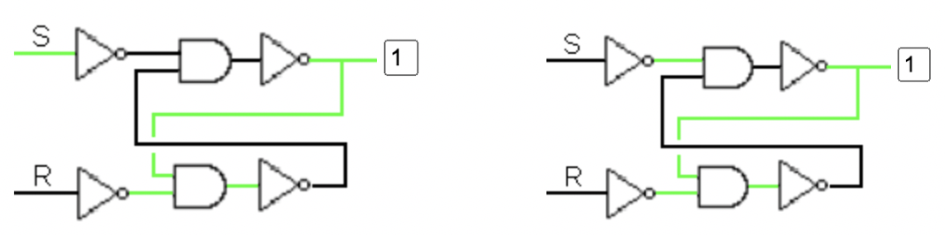
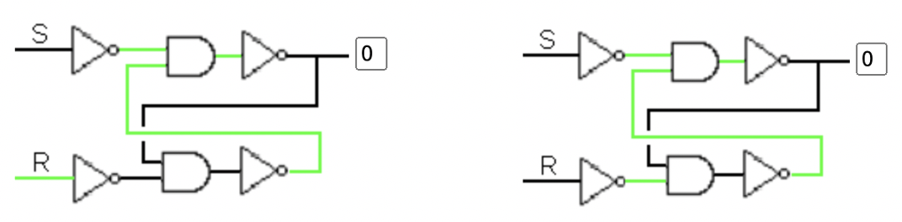
Flip-flop Circuit
a flip-flop stores a value by feeding the output currents back into the circuit
the value is maintained by current flowing around and around the circuit
a current burst on the Set wire produces output current, which then cycles
a current burst on the Reset wire produces no output current

Slide 16
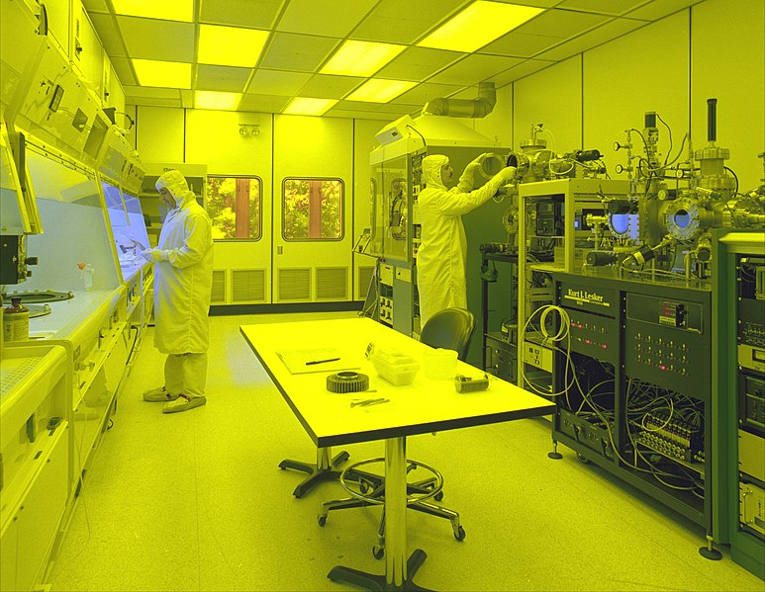
From Circuits to Microchips
initially, circuits were built by wiring together individual transistors
this did not lend itself to mass production
even simple circuits consisting of 10s or 100s of transistors were quite large
in 1958, two researchers (Jack Kilby and Robert Noyce) independently developed techniques that allowed for the mass-production of circuitry
circuitry (transistors + connections) is layered onto a single wafer of silicon, known as a microchip or chip
since every component is integrated onto the same microchip, these circuits became known as integrated circuits
the production of integrated circuits is one of the most complex engineering processes in the world
transistors can be as small as 5 nanometers (~ 1/16,000th the width of a human hair)
since a hair or dust can damage circuitry, chips are created in climate-controlled "clean rooms"

Slide 17
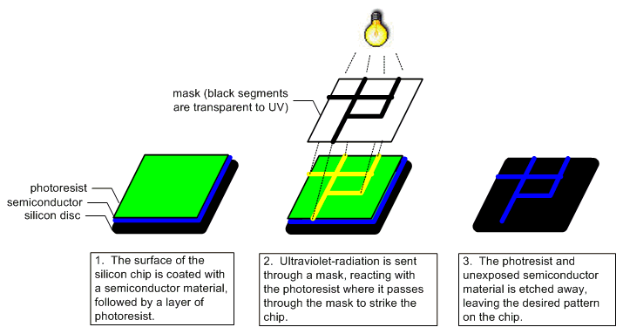
Manufacturing ICs
initially, the silicon chip is covered with a semiconductor material, then coated with a layer of photoresist (a chemical sensitive to UV light)
transistors are then printed onto a mask (transparent surface on which an opaque coating has been applied to form patterns)
UV light is filtered through the mask, passing through the transparent portions and striking the surface of the chip in the specified pattern
the photoresist exposed to UV light reacts, hardening the layer of the semiconductor below it
the photoresist that was not exposed and the soft layer of semiconductor below are etched away, leaving only the desired pattern of semiconductor material on the surface of the chip
the process can be repeated 40-60 times depositing multiple layers

Slide 18
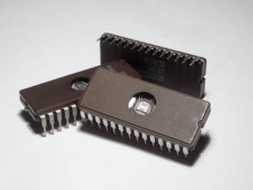
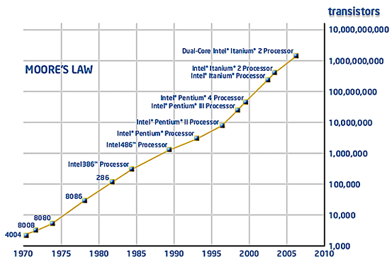
Packaging Microchips
since a silicon chip is fragile, the chip is encased in plastic for protection
metal pins are inserted on both sides of the packaging,
facilitating easy connections to other microchips
impact of the microchip
lower cost due to mass production
faster operation speed due to the close proximity of circuits on chips
simpler design/construction of computers using prepackaged components
Moore’s Law describes the remarkable evolution of manufacturing technology
Moore noted the # of transistors on a chip doubles every 1-2 years
has held true for 50 years
technology has slowed, but the pattern continues to hold due to multicore processors

