Slide 1
Computer Science:
Concepts & Explorations
2nd edition
David Reed, Creighton University
Computer Basics

Slide 2
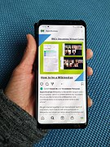
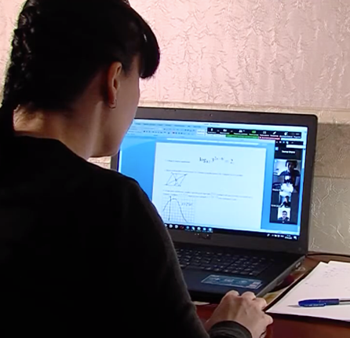
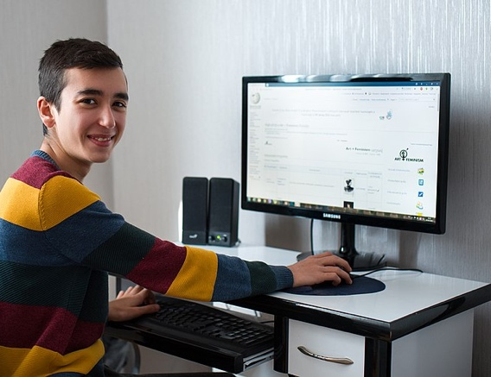
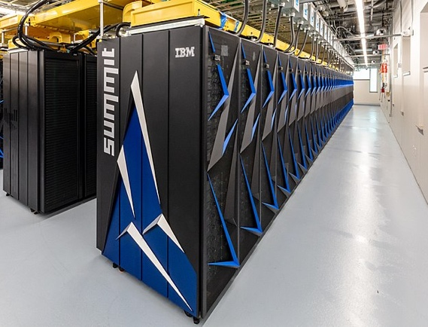
What is a Computer?
a computer is a device that receives, stores, and processes information
different types of computers have different characteristics
  supercomputers: powerful but expensive; used for complex computations (e.g., weather forecasting, engineering design and modeling)
  desktop computers: less powerful but affordable; used for a variety of user applications (e.g., email, Web browsing, document processing)
  laptop computers: similar functionality to desktops, but mobile
  palmtop computers: portable, but limited applications and screen size
  smartphones: portable, integrated with phone, camera

Slide 3
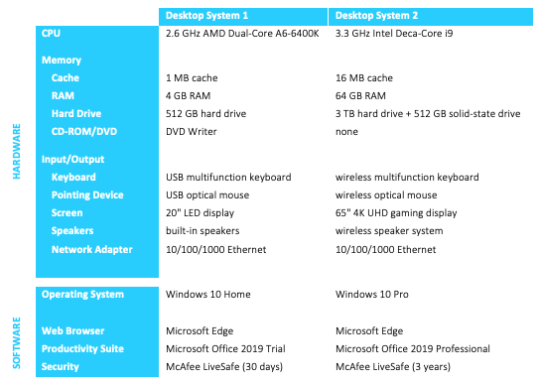
Desktop Specifications
purchasing a computer can be confusing
  sales materials contain highly technical information and computer jargon
the following specs describe two computer systems for sale in January 2020
  Desktop 1 is a low-end system, inexpensive but with limited features
  Desktop 2 is a high-end system, uses the latest technology so expensive

Slide 4
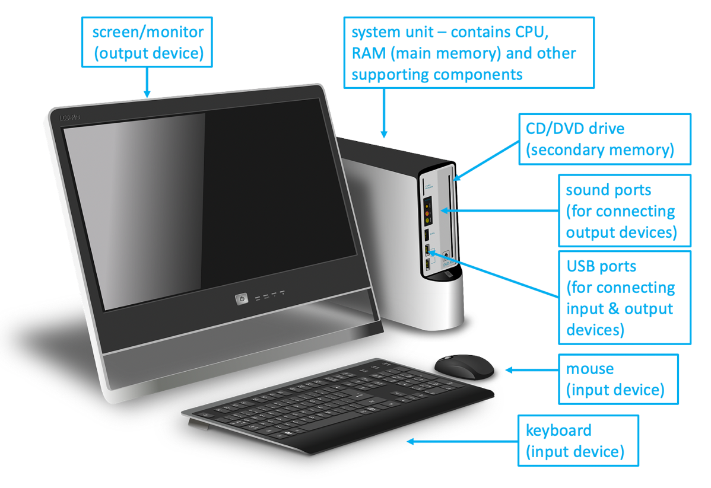
Hardware vs. Software
the term hardware refers to the physical components of a computer system
  e.g., monitor, keyboard, mouse, hard drive
the term software refers to the programs that execute on the computer
  e.g., word processing program, Web browser

Slide 5
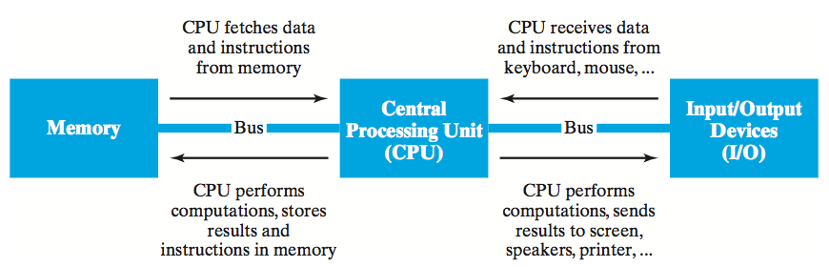
von Neumann Architecture
although specific components may vary, virtually all modern computers have the same underlying structure
  known as the von Neumann architecture
  named after computer pioneer, John von Neumann, who popularized the design in the early 1950's
the von Neumann architecture identifies 3 essential components
  Input/Output Devices (I/O) allow the user to interact with the computer
  Memory stores information to be processed as well as programs (instructions specifying the steps necessary to complete specific tasks)
  Central Processing Unit (CPU) carries out the instructions to process information

Slide 6
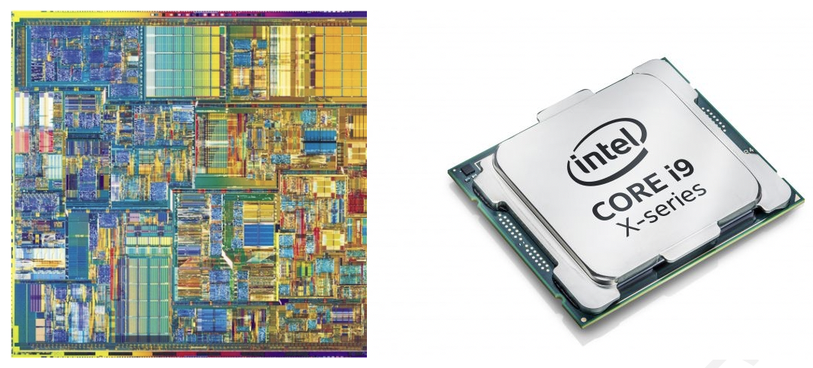
Central Processing Unit (CPU)
the CPU is the "brains" of the computer, responsible for controlling its inner workings
  made of circuitry – electronic components wired together to control the flow of electrical signals
  the circuitry is embedded in a small silicon chip, 1-2 inches square
  despite its small size, the CPU is the most complex part of a computer
    (CPU circuitry can have 100's of millions of individual components)
  commercial examples: AMD Ryzen 5, Intel Core i5, and Intel Core i7

Slide 7
CPU (cont.)
the CPU works by repeatedly fetching a program instruction from memory and executing that instruction
  individual instructions are very simple (e.g., add two numbers, or copy this data)
    but they vary across CPUs, higher end can do more in a single instruction
  complex behavior results from incredible speed
    a 2.6 GHz AMD A6 processor can execute 2.6 billion instructions per second
    a 3.3 GHz Intel i9 processor can execute 3.3 billion instructions per second
a dual-core processor contains the circuitry of 2 processors, packaged on a single chip
in theory, can execute 2 instructions simultaneously
a deca-core processor contains the circuitry of 10 processors, packaged on a single chip
in theory, can execute 10 instructions simultaneously

Slide 8
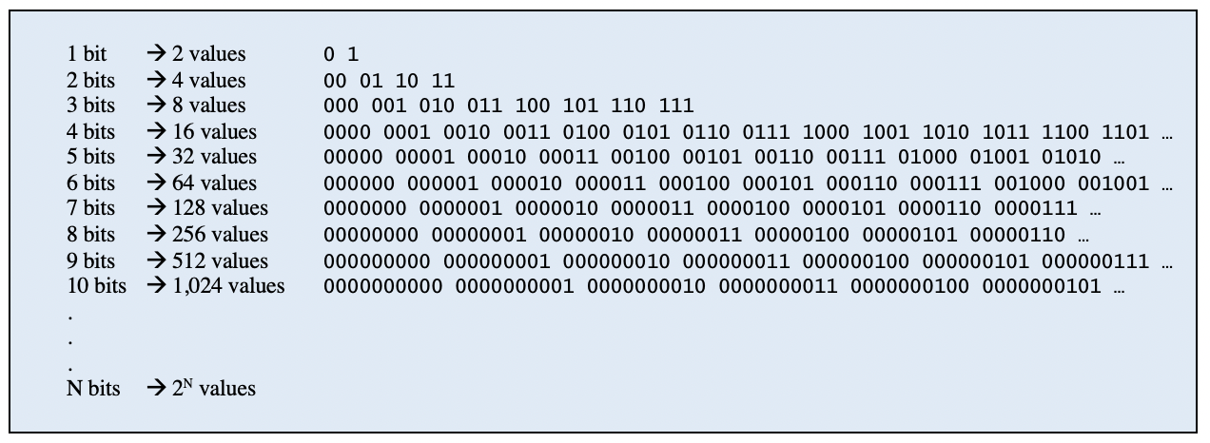
Memory
memory is the part of the computer that stores data and programs
modern computers are digital devices, meaning they store and process information as binary digits (bits)
  bits are commonly represented as either 0 or 1
  bits are the building block of digital memory
    by grouping bits together, large ranges of values can be represented

Slide 9
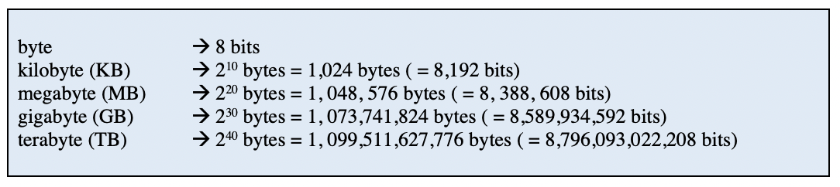
Memory (cont.)
memory capacity is usually specified in bytes
  a byte is a collection of 8 bits – so can represent a range of 2⁸ = 256 values
  large collections of bytes can be specified using prefixes
since a byte is sufficient to represent a single character, can think of memory in terms of text
  a kilobyte can store a few paragraphs (roughly 1 thousand characters)
  a megabyte can store a book (roughly 1 million characters)
  a gigabyte can store a small library (roughly 1 billion characters)
  a terabyte can store a book repository (roughly 1 trillion characters)

Slide 10
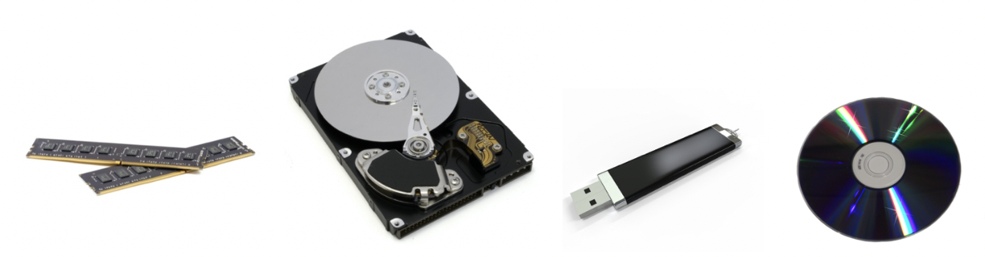
Memory (cont.)
modern computers use a combination of memory types, each with its own performance and cost characteristics
main memory (or primary memory) is fast and expensive
  data is stored as electric signals in circuitry, used to store active data
  memory is volatile – data is lost when the computer is turned off
  examples: Random Access Memory (RAM), cache
secondary memory is slower but cheaper
  use different technologies (magnetic signals on hard disk, reflective spots on CD)
  memory is permanent – useful for storing long-term data
  examples: hard disk, flash drive, compact disk (CD)
RAM chips hard drive flash drive CD/DVD

Slide 11
Memory (cont.)
higher-end computers tend to have
  more main memory to allow for quick access to more data and programs
  more secondary memory to allow for storing more long-term data

Slide 12
Input/Output (I/O)
input devices allow the computer to receive data and instructions from external sources
  examples: keyboard, mouse, track pad, touch screen, microphone, scanner
output devices allow the computer to display or broadcast its results
  examples: monitor, speaker, printer

Slide 13
Software
recall: hardware refers to the physical components of computers
software refers to the programs that execute on the hardware
a software program is a sequence of instructions for the computer (more specifically, for the CPU) to carry out in order to complete some task
  e.g., word processing (Microsoft Word, Corel WordPerfect)
  e.g., image processing (Adobe Photoshop, Flash)
  e.g., Web browsing (Microsoft Edge, Mozilla Firefox, Google Chrome, Safari)

Slide 14
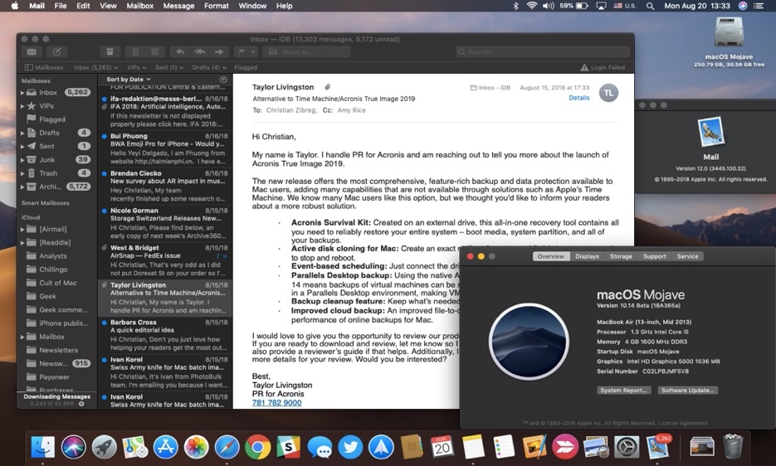
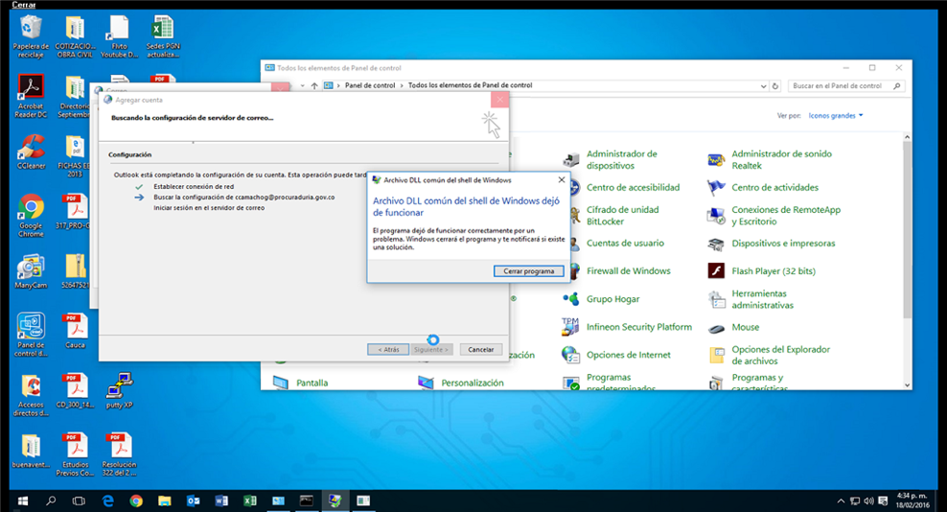
Operating Systems
the Operating System (OS) is a collection of programs that controls how the CPU, memory, and I/O devices work together
  kernel: manages the CPU's operations, controls how data and instructions are loaded and executed by the CPU, coordinates other hardware components
  file system: organizes and manages files and directories
  graphical user interface (GUI): provides intuitive, visual elements for interacting with the computer
    GUI's utilize windows, icons, menus, and pointers

